Slide 1
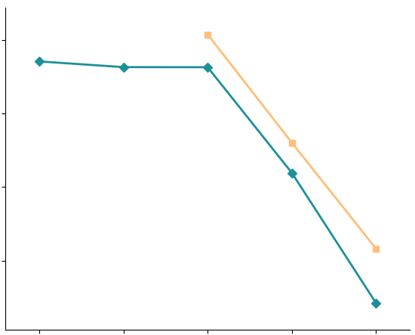
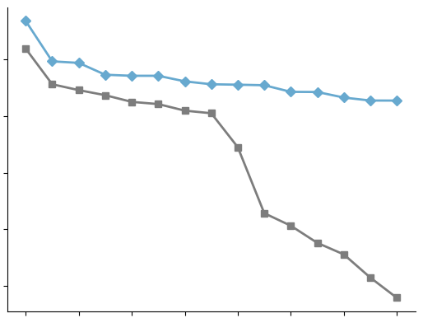




a
b
m/z value 720.4954
$${10}^{−1}$$
m/z value 279.2335
0.75
$${10}^{−3}$$
0.70
MSE LOSS
0.65
$${10}^{−5}$$
Correlation Coefficients
0.17
0.60
Atnal
$${10}^{−7}$$
Prostate Dataset
msiPL
Colorectal Dataset
0.55
0
4
8
12
Memory
Efficient
PCA
DWT+PCA
PCA
msiPL
Atnal
15 Top Correlated m/z Values

