Slide 1
Implementation of a heuristic technique

Slide 2
hello!
We are G8
IYou can find us at
abdelrahman.gelany@student.guc.edu.eg
& mohamed.abdelmaksod@student.guc.edu.eg
& mohamed.diyah@student.guc.edu.eg

Slide 3
Milestone 3 agenda
Introduction
Motivation
Problem Formulation
Algorithm used
Results & Comparison
Conclusion

Slide 4
1.
Introduction
What is a heuristic method for optimization problems?

Slide 5
A heuristic algorithm is a method for finding near-optimal solutions to a problem of optimization. This is accomplished, however, by sacrificing optimality, completeness, correctness, or precision in favour of speed.

Slide 6

The paper Title
Bi-SON: Big-Data Self Organizing Network for Energy Efficient Ultra-Dense Small Cells

Slide 7
2.
Motivation
What is paper’s importance?

Slide 8
Motivation
A) Although small cell can enhance the capacity of cellular mobile networks, ultra-dense small cells suffer from severe interference and poor energy efficiency.
B) Big-data self organizing network
(Bi-SON) framework with data-driven dynamic power
control scheme to improve energy efficiency of the outdoor
ultra-dense small cell network system.

Slide 9
3.
problem formulation
optimization type and objective function!

Slide 10


Decision variables
One
DECISION VARIABLE
$$α_{q}∈\left\{0 | 1\right\}$$
-if the small cell q is in the sleeping mode ,so $α$ = 0
-if the small cell q is in the active mode ,so $α$ = 1
Two
- OPTIMIZATION TYPE :
MAXIMIZATION
Three
DECISION VARIABLE$α_{q}$
-is the on;y variable parameter included in The downlink signal to interference plus noise power ratio from the small cell 𝑞to the user k (SINR_q,k)

Slide 11


Objective function
max the sum of utility of the data rate (throughput R)
>> $R=\sum_{q=0}^{Q}{\sum_{k}^{K}{r_{q,k}}}=\sum_{q=0}^{Q}{\sum_{k}^{K}{\frac{B}{M_{q}}\log_{2}{(1+{SINR}_{q,k})}}}$
; where
> ${SINR}_{q,k}$ $=\frac{P_{R,q,k}}{σ^{2}+\sum_{l≠q}^{Q}{P_{R,l,k}}}.α_{q}$ > $P_{R,q,k}$ $=$ $P_{T,q} ε d_{q,k}^{−α}$
Such that the parameters are Q,N,Mq,B; where Q small cell and K users besides Mq represent the number of served users in the samll cell q. B is the bandwidth of each small cell . The spectral efficiency of the user k which is served by the small cell q can be expressed $\log_{2}{(1+{SINR}_{q,k})}$

Slide 12
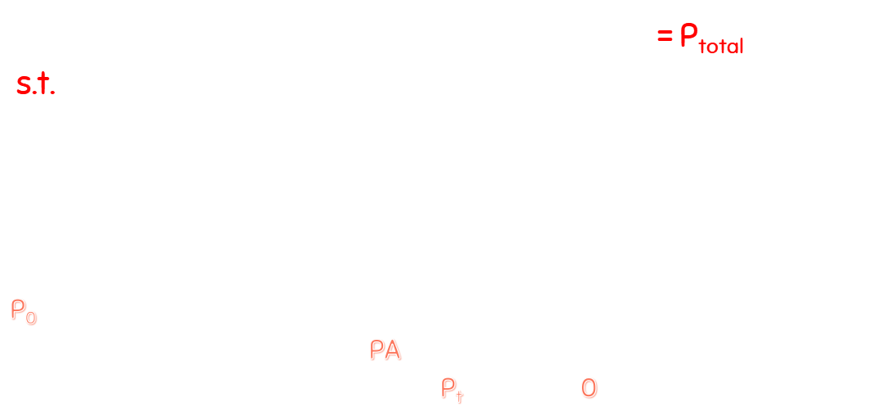
Constraints
The total energy consumption of the system = P_{total}
s.t. $P_{total}=\sum_{q=0}^{Q}{P_{q}=\sum_{q=0}^{Q}{[α_{q}P_{active,q}+ (1−α_{q})P_{sleep,q}]}}=\sum_{q}^{Q}{[α_{q}({P_{0}+\frac{1}{μ}P}_{T,q}+ (1−α_{q})P_{sleep,q}]}$
P₀ is the basic consumption of circuit depending on the small cell type, and 𝜂 is the power amplifier (PA) efficiency. The transmission power of the active and the sleeping mode is P_{t} watt and 0 watt, respectively.

Slide 13
4.
Algorithm used
Evolutionary Algorithms called Genetics Algorithm (GA).

Slide 14
What Are Genetics Algorithms?
The Genetic Algorithms promote the evolution process in the same way as natural systems do. According to Charles Darwin's theory of evolution, biological entities evolve according to the principle of "survival of the fittest" through natural evolution. The GA search is intended to promote the "survival of the fittest" principle. To tackle optimization difficulties, the GAs use a random search method. The GA use tactics that focus their search toward optimization in the new search arena by utilizing past historical data.

Slide 15
But why Genetic algorithm?
1) It has a wider solution space.
2) It is easier to discover the global optimum.
3) Parallelism: Multiple GAs can run together using the same CPU without interfering with each other. They run parallelly in isolation.

Slide 16
5.
results
What is paper’s outputs besides comparison to our model?

Slide 17
And input tables to compare data
Time (Hour) | 0 | 3 | 6 | 9 | 12 | 15 | 18 | 21 | 24
User Density ( user/km² ) | 1500 | 700 | 500 | 900 | 1100 | 1300 | 1700 | 1900 | 1500

Slide 18
Paper Results I
The total cell throughput is plotted versus time in Figure 4. The following observations can be drawn from the diagram:
1) The static analysis model has the same total cell throughput as the D3A model with a high active user density for the IA method. In a low user density, however, the static analysis model has poorer total cell throughput than the D3A model because it cannot dynamically change the decision function to optimise the system.
2) In this scenario, the IA method combined with the D3A model can boost total cell throughput by 50% compared to the no-energy-saving approach.

Slide 19
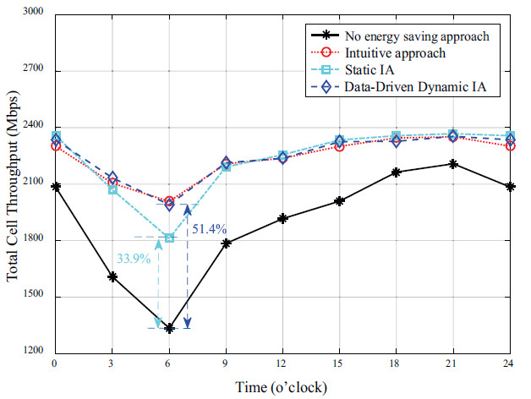
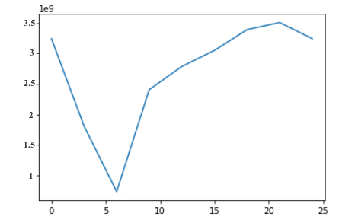
Paper Figure 4 Our Model Figure 4
Totally consistent with the paper's findings, but there exists some slightly differences.

Slide 20
Paper Results II
Figure 5 shows that the energy efficiency against the time.
From the figures, we have the following observations:
1) The IA algorithm has better energy efficiency than the
intuitive approach. This is because the IA algorithm can
significantly reduce co-channel interference and power
consumption in the high density region of active small
cells to improve the energy efficiency.
2) Compared with no energy saving approach, the IA
method with D3A model can provide the 135% energy
efficiency.

Slide 21
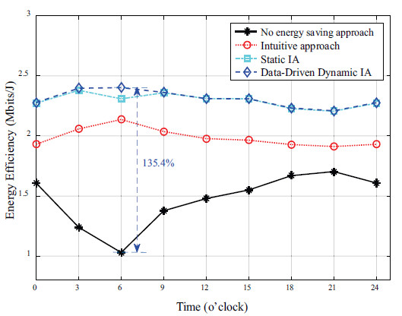
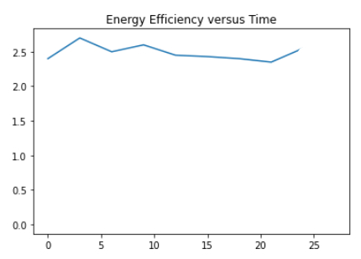
Paper Figure 5 Our Model Figure 5
Same behavior with slightly different values, yet fully follow the paper’s results.

Slide 22
Conclusion
Obviously we notice that our outputs from the model using the genetic algorithms is so much similar to the outputs from the paper’s model.
Although there exists some differences either on the shape of the curve itself or the values of the data rate and/or the energy.
This could be due to many different reasons, for instance we my used different assumptions rather than his assumption or the genetic algorithm it self is not the optimal and the algorithms which are used on the paper are more fitted to this paper especially.
The last reason in my opinion is that the paper authors might have many trials and errors until they come up with these results and as we are tight in time and not dedicated to this research field we did not reach the best results.
We may resume our work in future in order to reach the optimal results.

Slide 23
thanks!
For any abiguities??
You can find us at
abdelrahman.gelany@student.guc.edu.eg
& mohamed.abdelmaksod@student.guc.edu.eg
& mohamed.diyah@student.guc.edu.eg

