Slide 1




Nice To Meet You
Group 7
Ambient Intelligence Course
A.Y. 2017-18
https://ami-2018.github.io/NTMY/

Slide 2
Introduction
NTMY team

Slide 3
What is NTMY
NTMY is an Ambient Intelligence system that aims to help students in university residences to meet new friends by letting the users organize thematic events.
The goal of the project is to build a system that can be used in university residences to smartly organize events in order to let people meet others with the same interests. For this purpose, it makes use of different kinds of electronic devices such as PCs, mini computers, smartphones and wearables, all of which contribute to solve different problems that can be experienced during the organization of an event.
- Taken from Vision and Goal

Slide 4
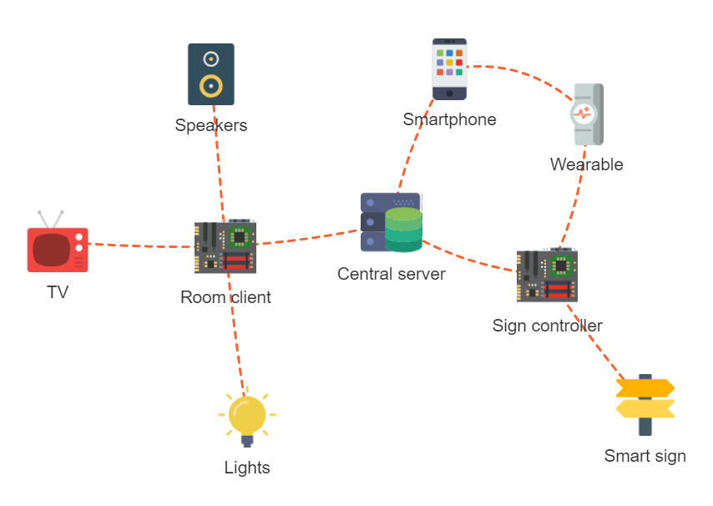
System architecture

Slide 5
NTMY Team
Alessio Ciarcià
SW developer
Matteo Corain
SW developer
Andrea Cossio
HW developer
Raffaele Tuzzo
SW developer
Wear app
Panel app
Server app
Client app
Smartphone app
Panel design
Panel app

Slide 6
Server architecture
Matteo Corain

Slide 7
Server main functions
Data storage
The server stores all the data regarging the users, the events and the rooms
Events allocation
The server is capable of the smart allocation of the rooms based on the events’ characteristics
API interface
The server presents an HTTP REST API-based interface to communicate with the other components of the system

Slide 8
Data storage
Uses SQLite as the database backend
Uses the Python SQLAlchemy support library
Manages data about users, rooms, events and their relationships

Slide 9
Events allocation
Generates the daily schedule matching rooms and events
Uses a brute force optimization method
It is capable of optimizing different target functions
Makes sure that events fit the rooms and don’t overlap
Run asynchronously in a separated thread

Slide 10
API interface
Uses Flask as the HTTP server
Exposes APIs to access data about users, rooms, events, media contents, graph nodes
Access to data is restricted only to registered users

Slide 11
NTMY Android app
Andrea Cossio

Slide 12
NTMY Wear app
Alessio Ciarcià

Slide 13
Panels architecture
Raffaele Tuzzo

Slide 14
Demo time!
NTMY team

Slide 15
What you’ll see today
Event creation and joining
Room preparation
Directional panels
NTMY action

