Slide 1
Intelligent Decision Support Systems
Introduction part3

Slide 2
Review Questions
1- True or False
Newell distinguished 5 levels in the context of knowledge representation. ( )
Brachman defines 3 levels for different types of representations. ( )
Problem Solving Methods (PSM) abstract from details of the implementation of the reasoning process. ( )
Generic inference pattern “Heuristic Classification” describes the problem-solving behaviour of these systems on the Knowledge Level in a generic way. ( )
The propose & revise method is an efficient method for solving the task of parametric design. ( )
An expert system is a software application that stores knowledge about multi domains. It is able to draw conclusions from that knowledge and offers concrete solutions for problems in that domains. ( )
An expert system simulates human experts and thus the knowledge base typically consists of highly specialized expert knowledge. ( )
ELIZA simulated a psychotherapist by reformulating questions posed by the machine. ( )
The HAL9000 communicates by voice and can control auxiliary devices on a spaceship. ( )

Slide 3
Review Questions
2-MCQ
I) Which term describes the common-sense of the judgmental part of problem-solving?
a)Values-based b)Critical c)Analytical d)Heuristic
II) The main function of problem-solving agent is to________.
a)Solve the given problem and reach the goal b)Find out which sequence of action will get it to the goal state c)Both a & b d)None of the above
III) The best AI agent is one which____________
a)Needs user inputs for solving any problem b)Can solve a problem on its own without any human intervention c)Need a similar exemplary problem in its knowledge base d)All of the above
IV) Which of the following, is a component of an expert system?
a)inference engine b)knowledge base c)user interface d)all of the mentioned
V) Newell distinguished 3 levels in the context of knowledge representation as following:-
i-Knowledge Level ii-Logical Level iii-Implementation Level
iv- Conceptual Level
a)i ii iii b)i ii iv c)ii iii iv d)i iii iv

Slide 4
Review Questions
VI) Brachman defines 5 levels for different types of representations as following:-
i-Knowledge Level ii-Logical Level iii-Implementation Level
iv- Conceptual Level v- Epistemological Level vi- Linguistic Level
a)i ii iii iv v b)i ii iv v vi c)ii iii iv v vi d)i iii iv v vi
VII) The propose & revise method is an efficient method for solving the task of parametric design. It depends on the following inference(s):-
propose only b) C-test only c) revise only d) propose, C-test, and revise
VIII) Early computer program capable of natural language processing.
ELIZA b) SIRI c) HAL 9000 d) Deep Blue
IX) Personal assistant - mobile app for the iPhone
"Just like a real personal assistant, it understands what you say, fulfills tasks and adapts over time to the preferences. Today, it can help you find things and plan. “
a) ELIZA b) SIRI c) HAL 9000 d) Deep Blue
X) Chess-playing computer developed by IBM that won against world champion Garry Kasparov in 1997. It was fine-tuned by chess grand masters.
a) ELIZA b) SIRI c) HAL 9000 d) Deep Blue

Slide 5
T/F
1-F 2-F 3-T 4-T 5-T 6-F 7-T 8-F 9-T
MCQ
1-d 2-c 3-b 4-d 5-a 6-c 7-d 8-a 9-b
10-d

Slide 6
SUBDOMAINS OF AI

Slide 7
Subdomains of AI
Cognition معرفةas information processing
Artificial neuronal networks
Heuristic search methods
Knowledge representation and logic
Automatic theorem proving
Non-monotonic reasoning
Case-based reasoning
Planning
Machine Learning
Knowledge Engineering
Natural Language Processing
Image Understanding
Cognitive Robotics الانسان الالى المدرك
Software Agents

Slide 8
Cognition
Deals with complex software systems that directly interact and communicate with human users.
Characteristics of cognitive systems (CS):
  CS are directly integrated in their environment, act in it, and are able to communicate with it.
  CS are able to direct and adapt their actions based on the environment they are situated in.
  CS typically represent system-relevant aspects of the environment.
  Their information processing capabilities are characterized through learning aptitudeموهبة التعلم and anticipationالترقب
Examples of cognitive system:
  Organisms / biological cognitive systems
  Technical systems such as robots or agents
  Mixed human-machine systems

Slide 9
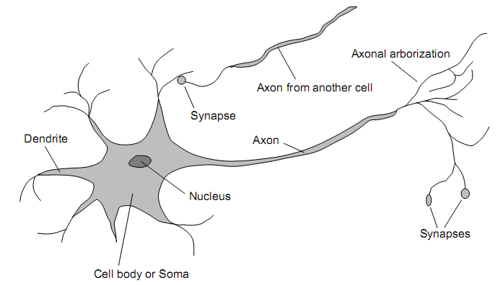
Neural networks
Neural networks are networks
of neurons as in the real
biological brain.
Neurons الخلايا العصبية are highly specialized
cells that transmit impulses within
animals to cause a change in a target
cell such as a muscle effector cell or glandular cellخلية غدية .
The axon المحور العصبى , is the primary conduit انبوبةthrough which the neuron transmits impulses to neurons downstream in the signal chain
Humans: 10¹¹ neurons of > 20 types, 10¹⁴ synapses المشابك , 1ms-10ms cycle time
Signals are noisy “spike trains” قطارات شوكيةof electrical potential

Slide 10
Neural networks (2)
What we refer to as Neural Networks in the course are mostly Artificial Neural Networks (ANN).
ANN are approximation of biological neural networks and are built of physical devices, or simulated on computers.
ANN are parallel computational entities that consist of multiple simple processing units that are connected in specific ways in order to perform the desired tasks.
Remember: ANN are computationally primitive approximations تقريب بدائى of the real biological brains.
Application examples: e.g., handwriting recognition, time series prediction, kernel machines (support vector machines, data compression, financial predication, speech recognition, computer vision, protein structures هياكل البروتين ).

Slide 11
Search Methods
Search Methods are typically helping humans to solve complex tasks by generating (optimal) plans (i.e. a set of operations / states) that includes sequences / actions to reach a goal state.
Example problem: Tower of Hanoi
  Initial status: ((123)()())
  Goal status: (()()(123))
Definition: A search method is defined by picking the order of node expansion.
Search strategies are evaluated according to completeness, time complexity, space complexity, optimality.
Time and space complexity are measured in terms of maximum branching, depth of the least-cost solution, maximum depth of the state space
Distinction between informed / uninformed search techniques
1
2
3
A
B
C

Slide 12
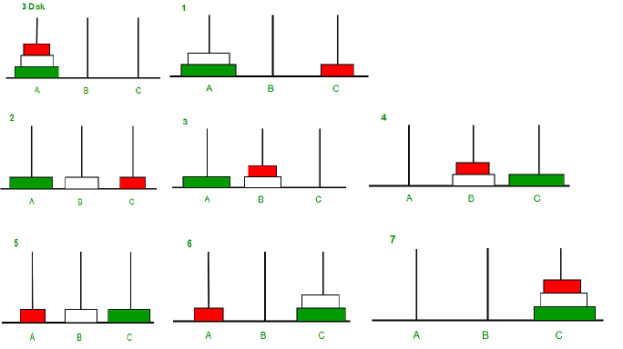
Tower of Hanoi

Slide 13
Search Algorithms in AI
Artificial Intelligence is the study of building agents that act rationally. Most of the time, these agents perform some kind of search algorithm in the background in order to achieve their tasks.
A search problem consists of:
  A State Space. Set of all possible states where you can be.
  A Start State. The state from where the search begins.
  A Goal Test. A function that looks at the current state returns whether or not it is the goal state.
The Solution to a search problem is a sequence of actions, called the plan that transforms the start state to the goal state.
This plan is achieved through search algorithms.

Slide 14
Uninformed Search Algorithms
The search algorithms in this section have no additional information on the goal node other than the one provided in the problem definition. The plans to reach the goal state from the start state differ only by the order and/or length of actions. Uninformed search is also called Blind search.
The following uninformed search algorithms are discussed in this section.
Depth First Search خوارزمية البحث في العمق أولا
Breath First Search خوارزمية البحث بالعرض أولا
Uniform Cost Search الخوارزمية الحدسية

Slide 15
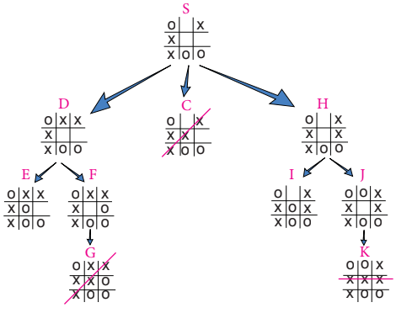

Slide 16
Informed Search Algorithms
Here, the algorithms have information on the goal state, which helps in more efficient searching. This information is obtained by something called a heuristic.
In this section, we will discuss the following search algorithms.
Greedy Search البحث الجشع
A* Tree Search
A* Graph Search
Search Heuristics: In an informed search, a heuristic is a function that estimates how close a state is to the goal state. For examples – Manhattan distance, Euclidean distance, etc. (Lesser the distance, closer the goal.)
Visit:- https://www.geeksforgeeks.org/search-algorithms-in-ai/

Slide 17
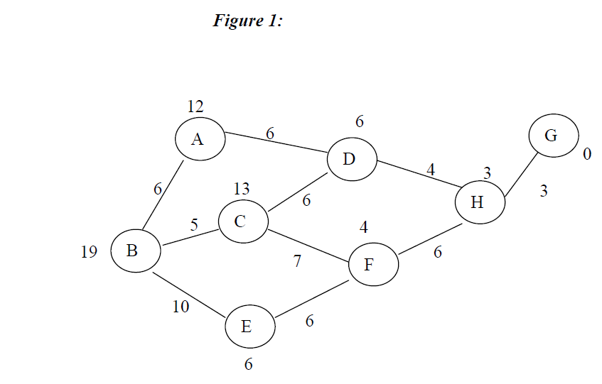

Slide 18
Knowledge Representation and Logic
The term knowledge representation describes the design and implementation of formalisms, to model a part of the reality (a domain).
A model represented using formalisms and implemented by an interpreter is often called a knowledge base.
A knowledge base is a collection of facts and beliefs.
Modelling of knowledge bases happens on a conceptual level.
Intentionالمقصد : To model a domain of discourse and to draw inferences about the objects in the domain (reasoning)
Logic studies the principles of reasoning and offers
  Formal languages for expressing knowledge
  Well understood formal semantics
  Reasoning methods to make implicit knowledge explicit

Slide 19
Automatic theorem proving
Automatic theorem proving deals with the design and implementation of computer programmes that are capable of making mathematical proofs.
Theorem provers deduce new formulas from given formulas via logical deduction rules until the target formula is found.
Theoretical foundation of automated theorem proving: mathematical logic; typically first-order-logic.
Formulas are mathematically precisely defined via interpretations (provide semantics for function and predicate symbols via mappings and relations respectively)

Slide 20
Non-monotonic reasoning التفكير غير الرتيب
Classical logic is monotonic in the following sense: whenever a sentence A is a logical consequence of a set of sentences T, then A is also a consequence of an arbitrary superset of T .
Non-monotonic reasoning:
  Additional information may invalidate conclusions.
  Non-monotonic reasoning is closer to (human) common-sense reasoning.
  Most rules in common-sense reasoning only hold with exceptions (i.e. university_professors_teach)
Important approaches to formalise non-monotonic reasoning:
  Default-Logics: Non-classical inference rules are use to represent defaults
  The modal approach: Modal operators are used to explicitly declare if something is believed in or is consistent.
  Circumscription: Validity can be restricted to specific models.
  Conditional approaches: A conditional junctor is used to represent defaults in a logical language.

Slide 21
Case-based reasoning
Definition: A “case” is an experience made during the solving of a problem.
A case is typically informally given and covers the problem and the solution.
Experiences (respiratory الجهاز التنفسىcases) are used to solve newly occurring problems.
Cases are collected in a so-called case-base (analogous to a knowledge base in KBS)
Case-based reasoning is inspired by human problem solving capabilities.
Application scenarios are characterized through:
  A considerable amount of cases has to be available
  Using the cases to solve the problem has to be easier than solving the problem directly.
  Available information is incomplete or unsecure and imprecise.
  The construction of a KBS and the modelling of cases is not easily possible.
Typical application scenarios can be found in the area of diagnostics التشخيص, electronic sales, configuration التكوين , or planning.

Slide 22
Planning
What is Planning?
  “Planning is the process of thinking about the activities required to create a desired goal on some scale” [Wikipedia]
We take a more pragmatic view – planning is a flexible approach for taking complex decisions:
  decide about the schedule of a production line;
  decide about the movements of an elevator;
  decide about the flow of paper through a copy machine;
  decide about robot actions.
By “flexible” we mean:
  the problem is described to the planning system in some generic languageلغة عامة ;
  a (good) solution is found fully automatically;
  if the problem changes, all that needs to be done is to change the description.
Planning looks at methods to solve any problem that can be described in the language chosen for the particular planning system.
Approaches for the generation of action sequences: action planning and situated activity planning.

Slide 23
Machine Learning
Machine Learning (ML) is a central research area in AI to acquire knowledge تستحوذ على المعرفة .
ML deals with the computer-aided design and realisation of learning problems.
Learning is defined as the process that enables a systems to perform better during solving of the same or similar tasks in the future (Simon, 1983)
Reduction of learning to mathematical theories اختزال تعلم النظريات الرياضية: Deduction الحسم , Induction الحث , Abductionالاختطاف .
Learning task is typically characterized through the description of inputs, expected outputs, and environmental conditions.
Typical machine learning applications: Data mining, Speech recognition, text analysis, control learning, hidden markov networks, etc.

Slide 24
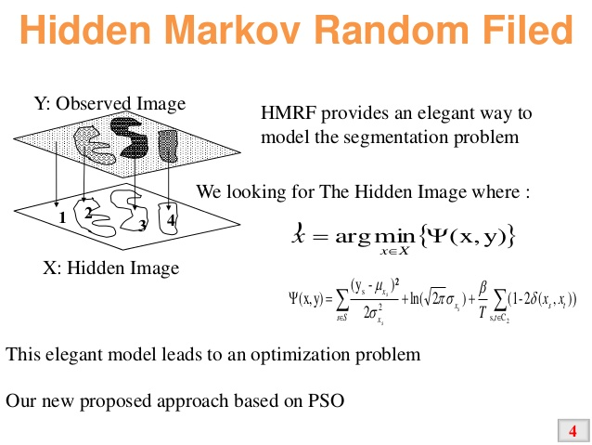
hidden markov networks

Slide 25
Knowledge Engineering
Knowledge engineering is concerned with the acquisition اكتساب , management, use and transformation of knowledge.
Goals are similar to software engineering, i.e. to systematically develop expert systems using existing methods and tools.
Core process in knowledge engineering: knowledge acquisition; During knowledge acquisition knowledge is formalised, i.e. transformed from a natural language representation to a formal representation.
Process models for knowledge acquisition: Model by Puppe; model by Buchanan; Harmon/Mauss/Morrissey; Waterman; or MIKE
Methodical approaches and tools: D3; CommonKADS; MIKE; Protégé-II; RASSI
Application cases include the development of expert systems, workflow systems or knowledge management

Slide 26
Natural Language Processing
Goal: Processing and understanding of speech or written language.
Early applications include question-answer systems, natural-language based access to databases or speech-based control of robots.
Challenges include information re-construction from spoken words or information selection and reduction during speech production.
Application areas: Tools for inter-human communication, tools for text generation or text correction (i.e. identification of grammatical errors based on language models), information classification or filtering, or human-machine communication.

Slide 27
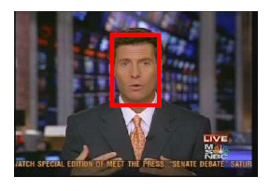
Image Understanding
Image Understanding (IU) deals with the analysis and interpretation of visual information. IU denotes the reconstruction and interpretation of scenes based on images.
Early approaches based on pattern recognition (still one of the most important foundations of this field)
Prominent applicationالتطبيق المميز : object recognition of still and moving objects
Application areas: symbol recognition, medical image analysis, vehicle navigation, image archiving, gesture recognitionالتعرف على الايمائات

Slide 28
Cognitive Robotics
AI deals with the development of robots as autonomous and intelligent systems.
Robotic covers many sub-areas of AI and involves interdisciplinary work عمل بينى including mechanic and electrical design and cognitive areas.
Types of robots: static robots, mobile robots, and humanoid بشرىrobots.
Application areas: construction, planning, or observation.

Slide 29
Software Agents
Core paradigm in AI النموذج الاساسى .
Definition: A software agent is a long-term operating program whose function can be described as autonomous execution تنفيذ مستقلof tasks or tracing of goals via interaction with his environment.
Agent (see earlier slide)
  has a memory and the capability to act in his world based on it.
  has sensors to perceive information from his environment.
  has actuators to influence the external world.
  has the capability to probe actions
  has internal memory for methods and the exploration of the world is guided by knowledge kept in it.
Applications: Data collection and filtering, event notification, planning and optimization in various application areas (commerce, production, military, education)

Slide 30
SUMMARY

Slide 31
Summary
Birth of AI in the 1950s
Broad spectrum of subdomains and combination of disciplines
Distinction between
  Weak and strong AI
  Symbolic and subsymbolic AI
Central role: symbols and knowledge representation
Knowledge-based systems and intelligent agents are core concepts in AI

