Slide 1





Team Details
Team Name:
gitcommitall
SR. NO
ROLE
NAME
ACADEMIC YEAR
1
Team Leader
Amrit Lahari
2
Member 1
Shubham Gangwar
3
Member 2
Saiswaroop Natarajan
4
Member 3
-
A team can have up to 4 members including the team leader. Add rows if necessary.
COLLEGE NAME
BITS Pilani
TEAM LEADER CONTACT NUMBER
TEAM LEADER EMAIL ADDRESS
{+91 XXXXX XXXXX}
f20230442@pilani.bits-pilani.ac.in

Slide 2


Problem Statement Addressed
AI-Based Restoration of Degraded Images for Semiconductor Inspection (KLA)
DESCRIPTION / DETAILS
Microscopic inspection images in semiconductor fabs are degraded by three simultaneous modes: speckle noise (pixel values overshoot the valid [0,1] range - we measured inputs spanning -0.21 to 1.87), additive Gaussian noise, and 2x loss of spatial resolution (256x256 -> 128x128). Degradation hides the fine structures and defects that inspection depends on. The task: a single AI model that jointly denoises and super-resolves each 128x128 input back to a clean 256x256 image, scored on SSIM, PSNR, LPIPS, inference speed (H100) and generalization to out-of-distribution structures.

Slide 3



Idea Description - Describe your Idea/Solution/Prototype
One network, one pass: joint denoising + 2x super-resolution, trained end-to-end on the 3,200 paired images provided by KLA. We benchmarked a CNN track and a transformer track under an identical training harness and ship the empirically better model.
KEY CONCEPT & APPROACH
Learn only the correction: the network output is added to a bicubic 2x upsample of the input (global residual), so capacity is spent on removing noise and restoring detail rather than rebuilding the image. Charbonnier loss, cosine LR, AMP, flip/rotation augmentation.
SOLUTION OVERVIEW
Restores fine defect-relevant structure without hallucination: a compact restoration network (NAFNet-SR 1.13M params / SwinIR 5.16M params) maps each degraded 128x128 frame to a clean 256x256 frame in a single forward pass, running in milliseconds per image.

Slide 4

Proposed Solution - Describe your Idea/Solution/Prototype
Two architectures trained and compared on a clean held-out validation split of 400 images; the better one (by PSNR / SSIM / LPIPS and latency) is submitted.
SOLUTION DETAILS
Track A - NAFNet-SR: nonlinear-activation-free blocks (LayerNorm, SimpleGate, simplified channel attention) at low resolution, PixelShuffle 2x head, bicubic global residual. Track B - SwinIR: windowed self-attention (window 8) that suits the repeating patterns of semiconductor structures. Both trained on random 64x64 crops, batch 32, ~2h on GCP (A100 40GB + L4). Validation every 5 epochs; best checkpoint kept. Optional LPIPS fine-tune and x8 self-ensemble (TTA) evaluated against the latency budget.

Slide 5
Innovation and Uniqueness
Engineering rigor over exotic architecture: measured model selection, leakage-free validation, and speed-aware design choices.
KEY INNOVATION
COMPETITIVE ADVANTAGE
Global bicubic-residual design: the network learns only the degradation correction, which stabilizes training and preserves true structure (no hallucinated geometry - critical for defect inspection). Range-aware handling keeps speckle overshoot information ([-0.2, 1.9]) instead of clipping the input.
CNN-vs-transformer bake-off under one harness, selected on measured PSNR / SSIM / LPIPS and per-image latency rather than paper claims. A strict 400-image held-out validation split (never trained on) keeps model selection honest, and the fully-provided degradation pairs mean no synthetic-degradation mismatch.

Slide 6



Impact and Benefits
Sharper inspection images directly improve defect detection reliability, reduce false rejects, and let fabs run faster or cheaper imaging while software recovers the quality.
Primary Impact
Quantifiable Outcomes
Restores inspection-grade image quality from noisy, low-resolution captures in a single millisecond-scale forward pass per frame - fits inline inspection throughput.
+4.8 dB PSNR over bicubic (23.00 -> 27.77 dB); SSIM 0.555 -> 0.757; LPIPS 0.146; 87 ms/image.

Slide 7
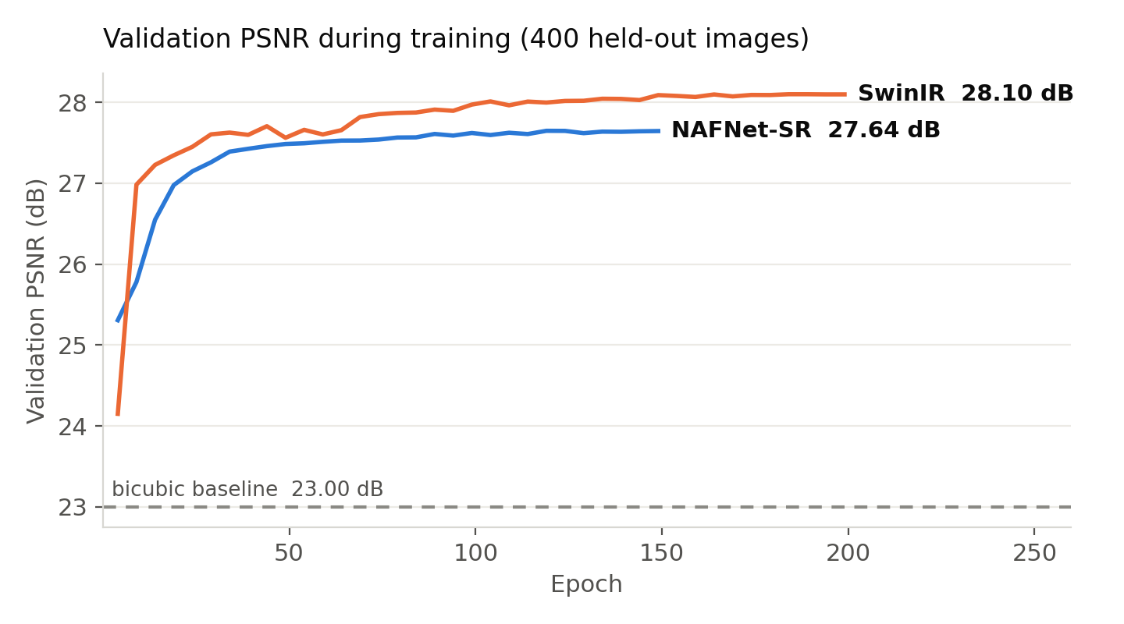
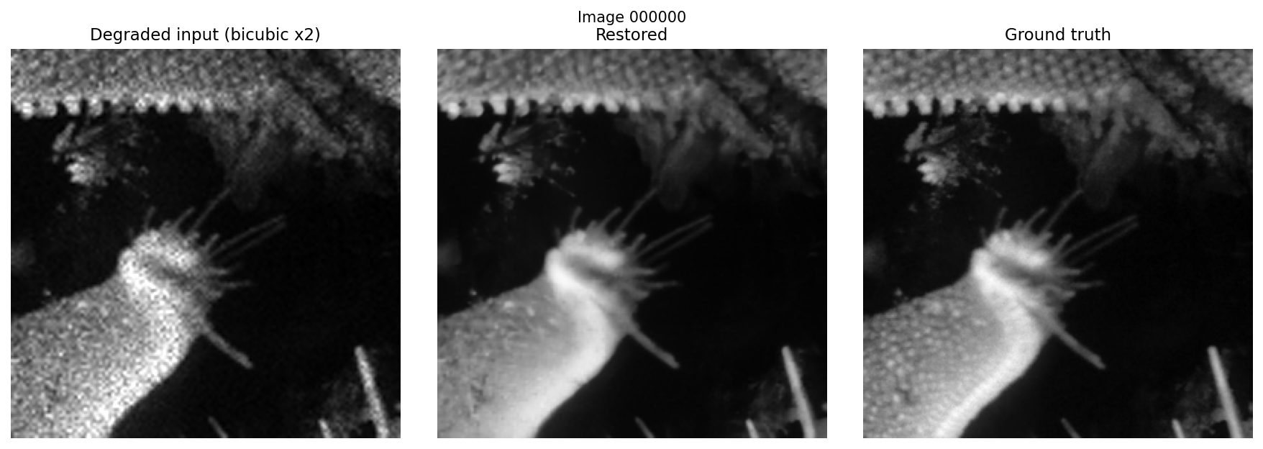
Results - Quantitative & Visual
Model | PSNR (dB) | SSIM | LPIPS | ms / image
Bicubic x2 (baseline) | 23.00 | 0.555 | 0.431 | -
NAFNet-SR (1.13M) | 27.65 | 0.755 | 0.293 | 42.5
NAFNet-SR + LPIPS fine-tune | 27.31 | 0.744 | 0.160 | 43.9
SwinIR (5.16M) | 28.10 | 0.767 | 0.272 | 84.3
SwinIR + LPIPS fine-tune (submitted) | 27.77 | 0.757 | 0.146 | 86.6
Validation: 400 held-out pairs. Latency measured on RTX 3060 Laptop; H100 inference is several times faster. Visual: degraded input vs restored vs ground truth.

Slide 8




Technology & Feasibility/Methodology Used
PyTorch 2.x (AMP, torch.compile), timm, scikit-image, LPIPS; trained on GCP (A100 40GB + L4) in under 2 hours per model - cheap to retrain as processes drift.
IMPLEMENTATION STRATEGY
Deliverable-first design: a standalone evaluate.py restores a directory of .npy images and reports PSNR / SSIM / LPIPS + mean per-image latency with zero manual editing (KLA benchmark-ready). Resumable training, pinned requirements.txt, and weights shipped in-repo make the full pipeline reproducible end to end.
Software Architecture
Hardware Components
Development Tools

Slide 9




GitHub & Video Link
GitHub Repository
https://github.com/AmRitJain0442/I4c-submission
Prototype / Simulation Video
{Paste your Video Link here showing simulation or working prototype}

Slide 10


Research and References
Research Background & Methodology
Briefly describe the research foundation or scientific principles supporting your idea.
Residual and attention-based image restoration; joint denoising + super-resolution on paired degraded/clean data; perceptual metrics (LPIPS) alongside PSNR/SSIM for inspection-relevant fidelity.
References & Citations
List key papers, articles, or data sources.
Chen et al., Simple Baselines for Image Restoration (NAFNet), ECCV 2022 - arXiv:2204.04676
Liang et al., SwinIR: Image Restoration Using Swin Transformer, ICCVW 2021 - arXiv:2108.10257
Zhang et al., The Unreasonable Effectiveness of Deep Features (LPIPS), CVPR 2018 - arXiv:1801.03924

