Slide 1
Senior Capstone
Software Issue & Change Management
Requirements Document
Donald Akujobi
Raymond Lemon
Amber Dawkins
Matthew King
Wayne State University

Slide 2
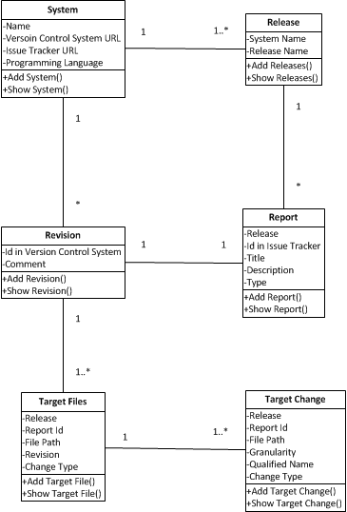
Class Diagram

Slide 3
Where we are at
Edited our previous page flow model to give a clearer view of how the website should work
Pulled all existing html and css from the legacy website to use as a starting template
Setup development environments (IntelliJ, Apache Tomcat)
Setup Github accounts
Did research for using the Spring framework for the login and functions for pages.

Slide 4
Things to do
Next Iteration 10/22-10/28:
Resolve development environment differences
Meet with client to obtain feedback and update requirements
Implement the remaining models and edit our current relationships for Revision, Target File, and Target Change
Create the MySQL Database with the table relationships defined in our revised domain model. Work on the persistence of model attributes to the database tables.

Slide 5
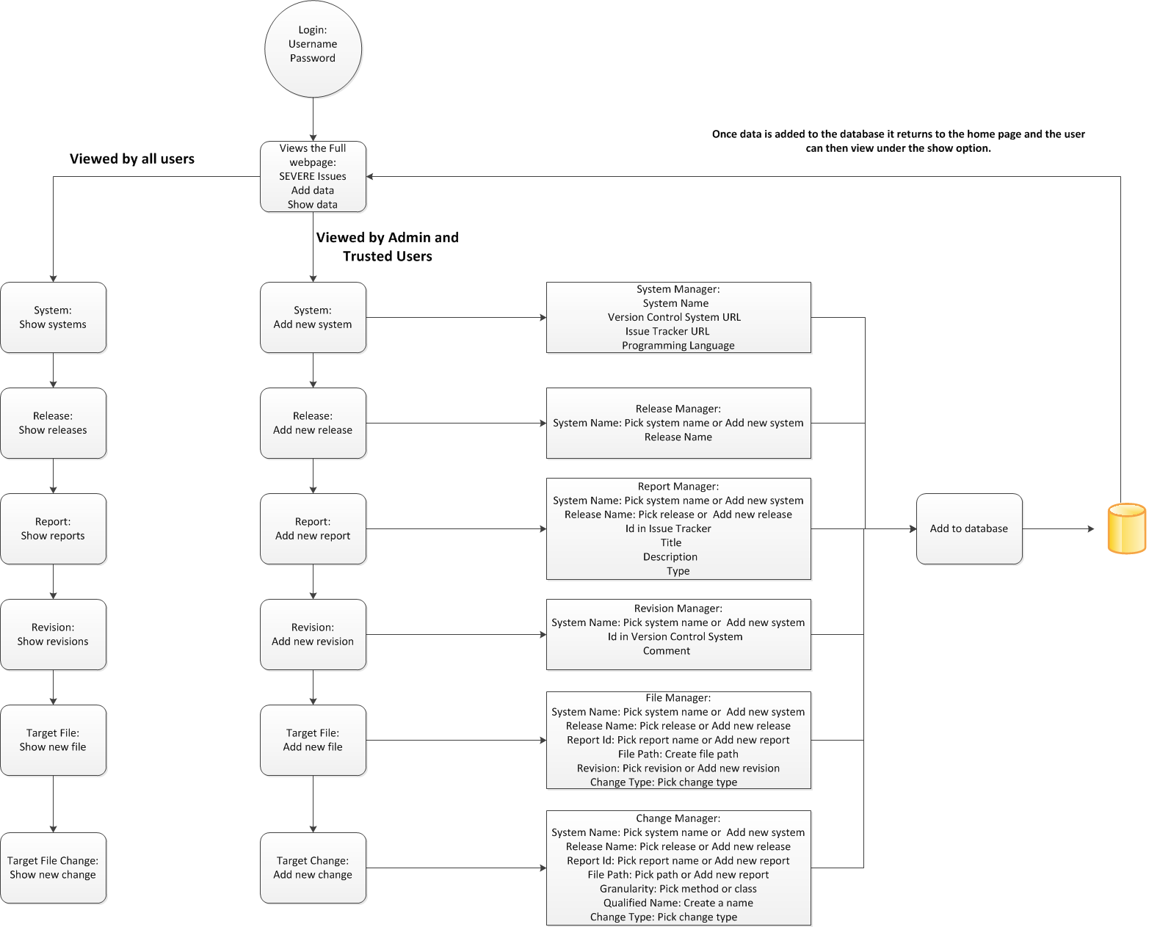
Data Flow Diagram

Slide 6
Resources:
Bootstrap
http://getbootstrap.com/
DesignDocuments/JavaTutorials:
http://www.youtube.com/user/derekbanas/videos?view=1&flow=grid
Spring, Hibernate, Spring MVC:
http://www.youtube.com/user/koushks/videos?view=1&flow=grid
HTML,CSS3,JavaScript:
http://thenewboston.org/tutorials.php

