Slide 1
Robust Singular Values based on L1-norm PCA
Team: Linear Men
Team members:
Makhin Artem
Kuznetsov Mikhail
Mumladze Maximelian
Zelentsov Aleksei

Slide 2
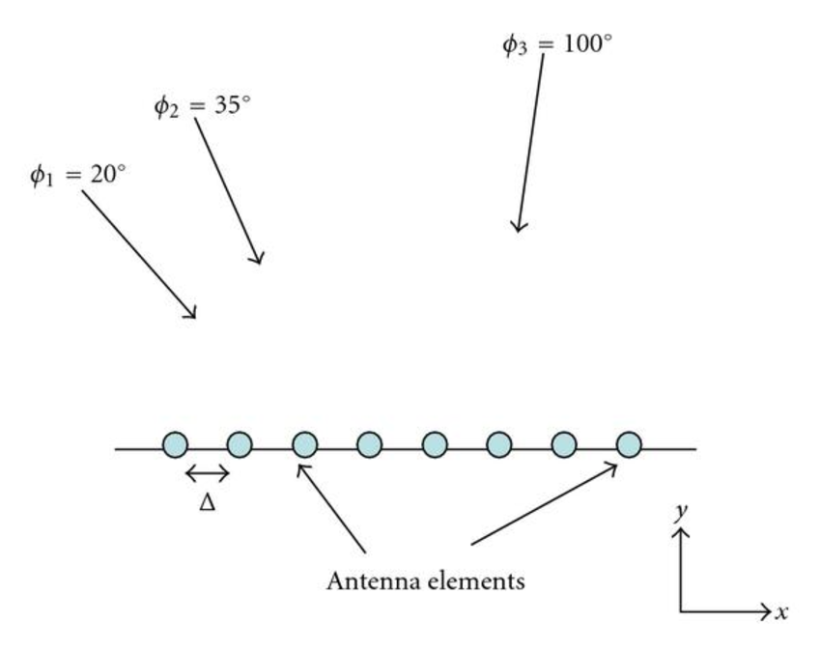
Problem
L2 for PCA is sensitive against outliers
SVD inherits this outlier sensitivity.
We need a robust solution.
We implemented SVD and Singular Value (SV) estimation using L1-cSVD.
Robust SV estimation is useful for many engineering problems:
Channel capacity estimation
DOA estimation
Restructuring of Deep NN Acoustic models

Slide 3
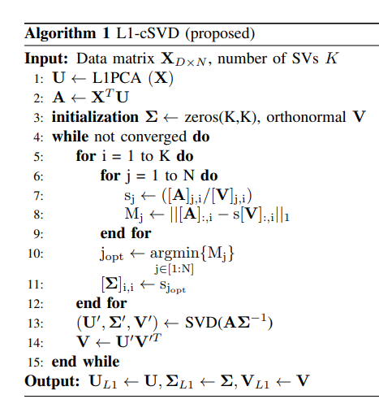


Solution
There were solutions for Robust PCA, using L1-PCs
But the results do not diagonalize the data matrix (No SVs)
In this paper, authors utilize previous algos to define a new method called L1-cSVD for finding SVs
Basically, we want to find
Where singular vectors are L1-PCs
For X to be diagonazible, the problem becomes
This is a non-convex opt. problem, so using different techniques, authors come up with the algorithm on the right
Done by Makhin Artem

Slide 4
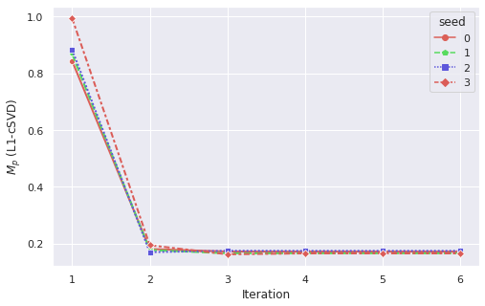

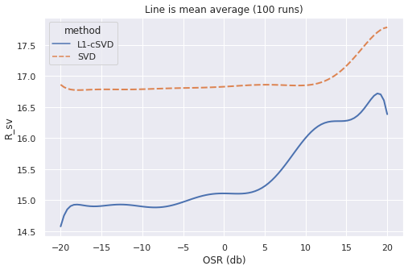

Experiments, pt.1-2
Convergence Analysis
Performance Analysis
We test algos on SV estimation using noisy data
L1-cSVD performs better than SVD
We see that for all 4 initializations, L1-cSVD converges
Done by Kuznetsov Mikhail

Slide 5
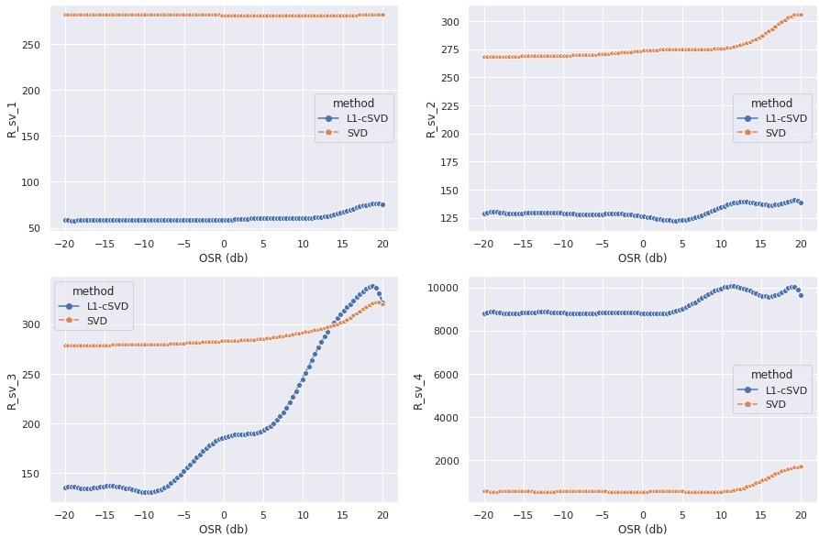
Experiments, pt.1-2

Slide 6
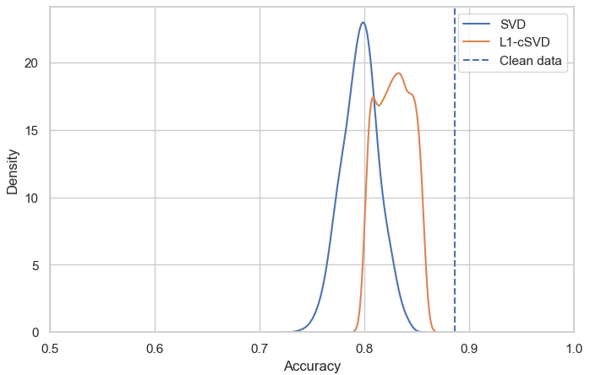
Experiments, pt. 3
Bayesian Classifier
We use Vowel dataset from PMLB, augmented with outliers
And then we train a classifier using standard SVD and L1-cSVD
Our algorithm performs better on corrupted data
Done by Zelentsov Aleksei

Slide 7
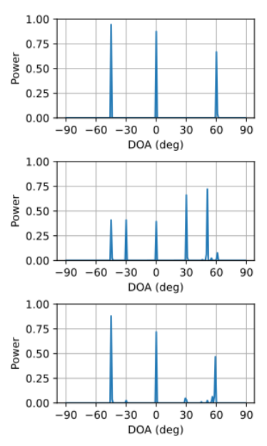
Experiments, pt. 4
Direction of Arrival Estimation
We create incoming signals and add outlier noise
We obtain a spatial spectrum through l1-SVD using standard SVD and L1-cSVD for dim. reduction
Once again, our algorithm performs better on corrupted data
Done by Mumladze Maximelian

Slide 8
Conclusion
Using several examples, we’ve shown that L1-cSVD performs better Singular Values Estimation on datasets with gross and sparse outliers than other solutions

