Slide 1
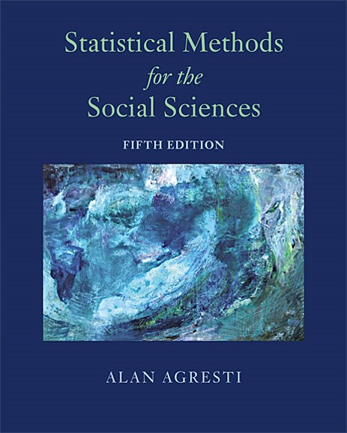
Statistical Methods for the Social Sciences
Fifth Edition
Chapter 1
Introduction
Copyright © 2018, 2009, 1997 Pearson Education, Inc. All Rights Reserved
Notes:
If this PowerPoint presentation contains mathematical equations, you may need to check that your computer has the following installed:
1) MathType Plugin
2) Math Player (free versions available)
3) NVDA Reader (free versions available)

Slide 2
1.1 Introduction to Statistical Methodology
This chapter introduces “statistics” as a science that deals with describing data and making predictions that have a much wider scope than merely summarizing the collected data.

Slide 3
Data
The observations gathered on the characteristics of interest are collectively called data.
Existing archived collections of data are called databases.
Many databases are now available on the Internet. An important database for social scientists contains results since 1972 of the General Social Survey.

Slide 4
What is Statistical Science?
Statistics consists of a body of methods for obtaining and analyzing data.

Slide 5
Statistical Science (1 of 2)
Statistical science provides methods for
Design: Planning how to gather data for a research study to investigate questions of interest to us.
Description: Summarizing the data obtained in the study.
Inference: Making predictions based on the data, to help us deal with uncertainty in an objective manner.

Slide 6
Statistical Science (2 of 2)
Graphs, tables, and numerical summaries such as averages and percentages are called descriptive statistics. We use descriptive statistics to reduce the data to a simpler and more understandable form without distorting or losing much information.
Predictions made using data are called statistical inferences.
Description and inference are the two types of ways of analyzing the data. Social scientists use descriptive and inferential statistics to answer questions about social phenomena.

Slide 7
1.2 Descriptive Statistics and Inferential Statistics
A statistical analysis is classified as descriptive or inferential, according to whether its main purpose is to describe the data or to make predictions.

Slide 8
Populations and Samples
The entities on which a study makes observations are called the sample subjects for the study.
The population is the total set of subjects of interest in a study. A sample is the subset of the population on which the study collects data.
Descriptive statistics summarize the information in a collection of data.
Inferential statistics provide predictions about a population, based on data from a sample of that population.

Slide 9
Parameters and Statistics
A descriptive statistic is a numerical summary of the sample data.
A parameter is a numerical summary of the population.

Slide 10
Defining Populations: Actual and Conceptual (1 of 3)
Usually the population to which inferences apply is an actual set of subjects, such as all adult residents of the United States. Sometimes, though, the generalizations refer to a conceptual population-one that does not actually exist but is hypothetical.

Slide 11
Example: Parameters / Statistics
In practice, our main interest is in the values of the parameters, not merely the values of the statistics for the particular sample selected.
For example, in viewing results of a poll before an election, we’re more interested in the population percentages favoring the various candidates than in the sample percentages for the people interviewed.

Slide 12
Defining Populations: Actual and Conceptual (2 of 3)
Suppose a medical research team investigates a newly proposed drug for treating lung cancer by conducting a study at several medical centers. Such a medical study is called a clinical trial. The conditions compared in a clinical trial or other experiment are called treatments.

Slide 13
Defining Populations: Actual and Conceptual (3 of 3)
Basic descriptive statistics compare lung cancer patients who are given the new treatment to other lung cancer patients who instead receive a standard treatment, using the percentages who respond positively to the two treatments. In applying inferential statistical methods, the researchers would ideally like inferences to refer to the conceptual population of all people suffering from lung cancer now or at some time in the future.

Slide 14
1.3 The Role of Computers and Software in Statistics
Statistical software packages include R, S P S S, S A S, and Stata. Appendix A explains how to use them, organized by chapter.
Software relieves us of computational drudgery and helps us focus on the proper application and interpretation of the statistical methods.

Slide 15
Data Files (1 of 2)
Statistical software analyzes data organized in the spreadsheet form of a data file:
Any one row contains the observations for a particular subject (e.g., person) in the sample.
Any one column contains the observations for a particular characteristic.

Slide 16
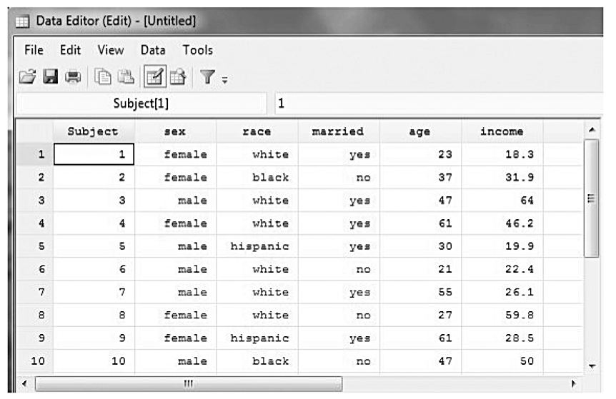
Data Files (2 of 2)
The figure shows an example of a data file, in the form of a window for editing data using Stata software. Some of the data are numerical, and some consist of labels.

Slide 17
Uses and Misuses of Statistical Software (1 of 2)
A note of caution: The easy access to statistical methods using software has dangers as well as benefits. It is simple to apply inappropriate methods. A computer performs the analysis requested whether or not the assumptions required for its proper use are satisfied.

Slide 18
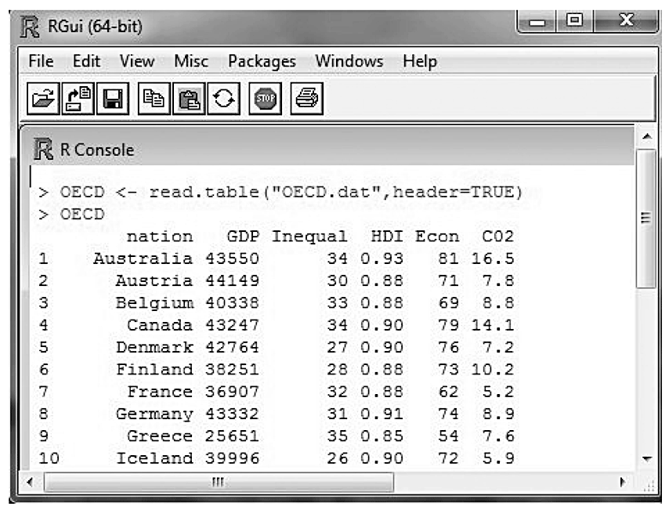
Uses and Misuses of Statistical Software (2 of 2)
Example of Part of an R Session for Loading and Displaying Data
It is vital to understand the method before using it. Just knowing how to use statistical software does not guarantee a proper analysis.

Slide 19
1.4 Chapter Summary (1 of 3)
The field of statistical science includes methods for
designing research studies,
describing the data (descriptive statistics), and
making predictions using the data (inferential statistics).

Slide 20
1.4 Chapter Summary (2 of 3)
Statistical methods apply to observations in a sample taken from a population. Statistics summarize sample data, while parameters summarize entire populations.
Descriptive statistics summarize sample or population data with numbers, tables, and graphs.
Inferential statistics use sample data to make predictions about population parameters.

Slide 21
1.4 Chapter Summary (3 of 3)
A data file has a separate row of data for each subject and a separate column for each characteristic. Software applies statistical methods to data files.

