Slide 1
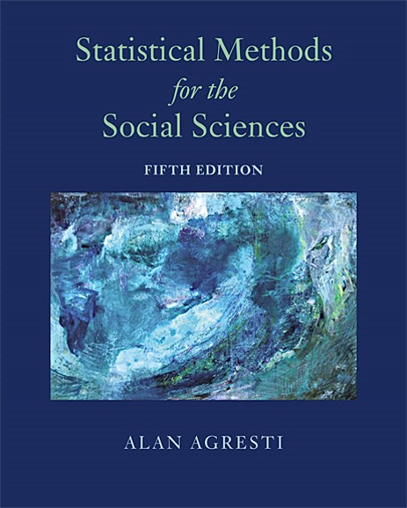
Statistical Methods for the Social Sciences
Fifth Edition
Chapter 2
Sampling and Measurement
Copyright © 2018, 2009, 1997 Pearson Education, Inc. All Rights Reserved
Notes:
If this PowerPoint presentation contains mathematical equations, you may need to check that your computer has the following installed:
1) MathType Plugin
2) Math Player (free versions available)
3) NVDA Reader (free versions available)

Slide 2
Sampling and Measurement
For a statistical analysis, descriptive methods summarize the data and inferential methods use sample data to make predictions about populations.
Decide what to measure and how to measure.
A measure should have validity and reliability.

Slide 3
2.1 Variables and Their Measurement
Statistical methods help us determine the factors that explain variability among subjects.

Slide 4
Variables
Variable - a characteristic that can vary in value among subjects in a sample or a population.
The values the variable can take form the measurement scale.

Slide 5
Quantitative and Categorical Variables
Types of variables
Quantitative
The measurement scale has numerical values that represent different magnitudes of the variable.
Categorical (also called qualitative)
The measurement scale is a set of categories.

Slide 6
Normal, Ordinal, and Interval Scales of Measurement (1 of 2)
For a quantitative variable, the possible numerical values are said to form an interval scale, because they have a numerical distance or interval between each pair of levels.

Slide 7
Normal, Ordinal, and Interval Scales of Measurement (2 of 2)
Categorical variables have two types of scales.
The categories are unordered. The scale does not have a “high” or “low” end. The categories are then said to form a nominal scale.
The categorical scale has a natural ordering of values. The categories form an ordinal scale.

Slide 8
Quantitative Aspects of Ordinal Data
Ordinal scales more closely resemble interval scales. They possess a quantitative feature: Each level has a greater or smaller magnitude than another level.
Analyze ordinal scales by assigning numerical scores to categories. By treating ordinal variables as interval scale, we can use methods available for quantitative variables.

Slide 9
Discrete and Continuous Variables (1 of 2)
Discrete and Continuous Variables - A variable is discrete if its possible values form a
set of separate numbers, such as
It is continuous if it can take an infinite continuum of possible real number values.

Slide 10
Discrete and Continuous Variables (2 of 2)
Discrete variables have a basic unit of measurement that cannot be subdivided.
For continuous variables, between any two possible values there is always another possible value.

Slide 11
Summary
Variables are either quantitative (numerical-valued) or categorical. Quantitative variables are measured on an interval scale. Categorical variables with unordered categories have a nominal scale, and categorical variables with ordered categories have an ordinal scale.
Categorical variables (nominal or ordinal) are discrete. Quantitative variables can be either discrete or continuous. In practice, quantitative variables that can take lots of values are treated as continuous.

Slide 12
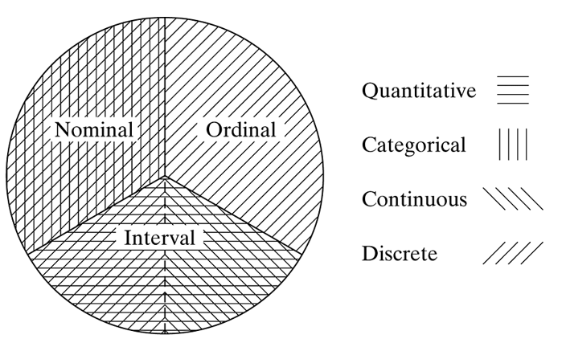
Summary of Quantitative-Categorical, Nominal-Ordinal-Interval, and Continuous-Discrete Classifications
Note: Ordinal Data are treated sometimes as categorical and sometimes as quantitive

Slide 13
2.2 Randomization
Inferential statistical methods use sample statistics to make predictions about values of population parameters. The quality of the inferences depends on how well the sample represents the population. This section introduces randomization, the mechanism for achieving good sample representation.
We let n denote the number of subjects in the sample. This is called the sample size.

Slide 14
Simple Random Sampling
Simple Random Sample - A simple random sample of n subjects from a population is one in which each possible sample of that size has the same probability (chance) of being selected.
Blind sampling
Or selecting a sample using a random number generator with software

Slide 15
How to Select a Simple Random Sample? (1 of 2)
To select a random sample, we need a list of all subjects in the population. This list is called the sampling frame.
The most common method for selecting a random sample is to
(1) number the subjects in the sampling frame,
(2) generate a set of these numbers randomly, and
(3) sample the subjects whose numbers were generated.

Slide 16
How to Select a Simple Random Sample? (2 of 2)
Random Numbers- Random numbers are numbers that are computer generated according to a scheme whereby each digit is equally likely to be any of the integers
and does not depend on the other digits
generated.
Table 2.1 A Table of Random Numbers
Line/Col. | (1) | (2) | (3) | (4) | (5) | (6) | (7) | (8)
1 | 90826 | 68432 | 36255 | 32536 | 92103 | 76082 | 82293 | 78852
2 | 77714 | 33924 | 86688 | 94720 | 45943 | 83064 | 68007 | 10523
3 | 34371 | 53100 | 81078 | 34696 | 92393 | 92799 | 72281 | 62696
Source: Constructed using sample function in R.

Slide 17
Collecting Data with Sample Surveys
Many studies select a sample of people from a population and interview them. This method of data collection is called a sample survey.
National polls such as the Gallup Poll are also sample surveys.
Many sample surveys use telephone interviews and obtain the sample with random digit dialing.

Slide 18
Collecting Data with an Experiment
In some studies, data result from a planned experiment. The purpose of most experiments is to compare responses of subjects on some outcome measure, under different conditions.
The conditions in an experiment are called treatments.

Slide 19
Collecting Data with an Observational Study
In social research, it is often not feasible to conduct experiments.
Many studies merely observe the outcomes for available subjects on the variables without any experimental manipulation of the subjects. Such studies are called observational studies.
There is no experimental control over subjects.
Comparing groups is difficult.
Not possible to establish cause and effect definitively

Slide 20
2.3 Sampling Variability and Potential Bias
Two researchers who separately select random samples from a population may have little overlap, if any, between the two sample memberships.
Therefore, the values of sample statistics will differ for the two samples, and the results of analyses based on these samples may differ.

Slide 21
Sampling Error (1 of 2)
Sampling Error - The sampling error of a statistic is the error that occurs when we use a statistic based on a sample to predict the value of a population parameter.

Slide 22
Sampling Error (2 of 2)
The population of adult Canadians who give the prime minister a favorable rating is 56%.
The Gallup organization predicted 53%. It had a sampling error of 53% − 56% = −3%.
In practice, the sampling error is unknown, because the values of population parameters are unknown.

Slide 23
Types of Bias
Sampling Bias
Response Bias
Nonresponse Bias

Slide 24
Sampling Bias: Nonprobability Sampling (1 of 3)
Probability sampling method - For simple random sampling, each possible sample of n subjects has the same probability of selection. Meaning that the probability any particular sample will be selected is known.
Inferential statistical methods assume probability sampling.

Slide 25
Sampling Bias: Nonprobability Sampling (2 of 3)
Nonprobability sampling methods are ones for which it is not possible to determine the probabilities of the possible samples. Inferences using such samples have unknown reliability and result in sampling bias.
The most common nonprobability sampling method is volunteer sampling.
Subjects volunteer for the sample.

Slide 26
Sampling Bias: Nonprobability Sampling (3 of 3)
The sampling bias inherent in volunteer sampling is also called selection bias.
It is problematic to evaluate policies and programs when individuals can choose whether or not to participate in them.
Even with random sampling, sampling bias can occur. One case is when the sampling frame suffers from under coverage: It lacks representation from some groups in the population.

Slide 27
Response Bias
The way a question is worded or asked can have a large impact on the results.
A New York Times/C B S News poll asked whether the interviewee would be in favor of a new gasoline tax, only 12% said yes.
When presented as reducing U.S. dependence on foreign oil, 55% said yes,
and when presented to help reduce global warming, 59% said yes.
Poorly worded or confusing questions result in response bias.

Slide 28
Nonresponse Bias: Missing Data
Some subjects selected for the sample may refuse to participate, or it may not be possible to reach them. This results in nonresponse bias.
A problem in many studies is missing data: Some subjects do not provide responses for some of the variables measured. This problem is especially common in studies that observe people over time (called longitudinal studies), as some people may drop out of the study for various reasons.

Slide 29
Summary of Types of Bias
Sampling bias occurs from using nonprobability samples, such as the selection bias inherent in volunteer samples.
Response bias occurs when the subject gives an incorrect response (perhaps lying), or the question wording or the way the interviewer asks the questions is confusing or misleading.
Nonresponse bias occurs when some sampled subjects cannot be reached or refuse to participate or fail to answer some questions.

Slide 30
2.4 Other Probability Sampling Methods
Section 2.2 introduced simple random sampling and explained its importance to statistical inference.
In practice, other probability sampling methods that utilize randomization can be simpler to obtain.

Slide 31
Systematic Random Sampling
Systematic Random Sample - Denote the sample size by n and the population size by N.
the population size divided by the
sample size. A systematic random sample (1) selects a subject at random from the first k names in the sampling frame, and (2) selects every kth subject listed after that one. The number k is called the skip number.

Slide 32
Stratified Random Sampling
Stratified Random Sampling - A stratified random sample divides the population into separate groups, called strata, and then selects a simple random sample from each stratum.
It is called proportional if the sampled strata proportions are the same as those in the entire population.
It is called disproportional if the sampled strata proportions differ from the population proportions.

Slide 33
Cluster Sampling
Cluster Random Sample - Divide the population into a large number of clusters, such as city blocks. Select a simple random sample of the clusters. Use the subjects in those clusters as the sample.

Slide 34
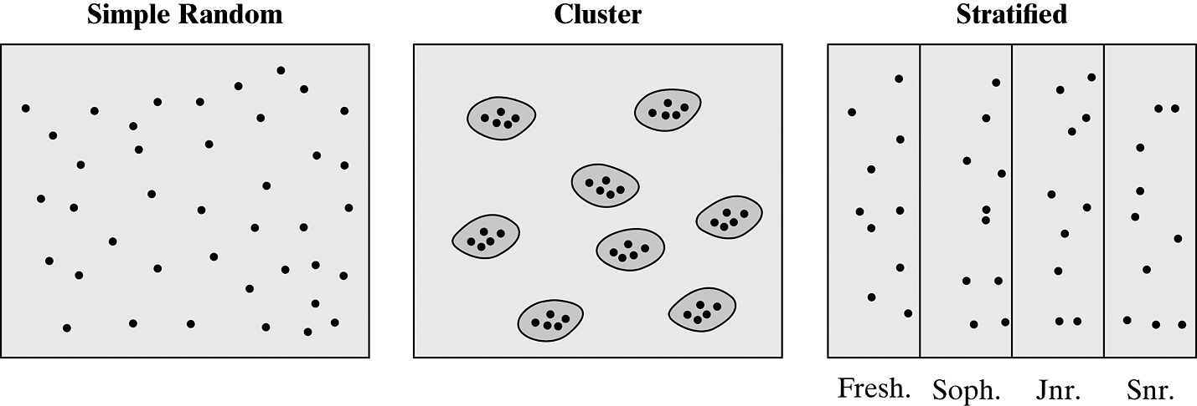
Ways of Random Sampling 40 Students
The figure is a schematic for a simple random sample, a cluster
random sample of 8 clusters of students who live together, and a stratified random sample of 10 students from each class (Freshman, Sophomore, Junior, Senior).

Slide 35
Multistage Sampling
When conducting a survey for predicting elections, the Gallup organization often identifies election districts as clusters and takes a simple random sample of them.
Then it also takes a simple random sample of households within each selected election district.
This is more feasible than sampling every household in the chosen districts.
This is an example of multistage sampling, which uses combinations of sampling methods.

Slide 36
Multistage Sampling Example
Here is an example of a multistage sample:
Treat counties (or census tracts) as clusters and select a random sample of a certain number of them.
Within each county selected, take a cluster random sample of square-block regions.
Within each region selected, take a systematic random sample of every 10th house.
Within each house selected, select one adult at random for the sample.

Slide 37
2.5 Chapter Summary (1 of 6)
Statistical methods analyze data on variables.
Numerically measured variables are quantitative. They are measured on an interval scale.
Variables taking in a set of categories are categorical.
Those measured with unordered categories have a nominal scale.
Those measured with ordered categories have an ordinal scale of measurement.

Slide 38
2.5 Chapter Summary (2 of 6)
Variables are also classified as discrete or continuous.
Categorical variables, whether nominal or ordinal, are discrete.
Quantitative variables can be of either type, but in practice are treated as continuous if they can take a large number of values.
Inferential statistical methods require probability samples.
Random sampling allows control over the amount of sampling error.

Slide 39
2.5 Chapter Summary (3 of 6)
Random samples are much more likely to be representative of the population than are nonprobability samples such as volunteer samples.
For a simple random sample, every possible sample has the same chance of selection.

Slide 40
2.5 Chapter Summary (4 of 6)
Systematic random sampling takes every kth subject in the sampling frame list.
Stratified random sampling divides the population into groups (strata) and takes a random sample from each stratum.

Slide 41
2.5 Chapter Summary (5 of 6)
Cluster random sampling takes a random sample of clusters of subjects and uses subjects in those clusters as the sample.
Multistage sampling uses combinations of these methods.

Slide 42
2.5 Chapter Summary (6 of 6)
Some social science research studies are experimental, with subjects randomly assigned to different treatments that we want to compare. Most studies, such as sample surveys, are observational.

