Slide 1

NORMA Lab. 3
Revision: Unary and Binary fact types
Adding Pages
Objectification
Independent Object Types
Set-Comparison Constraints (single-role and multi-role)
Setting Data Types
In this lab, we will enter the second page
of the following 2 page ORM schema
(you should have entered the first page in Lab 2).
File NORMA_Lab3.ppt. Author: T. Halpin. Last updated 2009 May 25

Slide 2
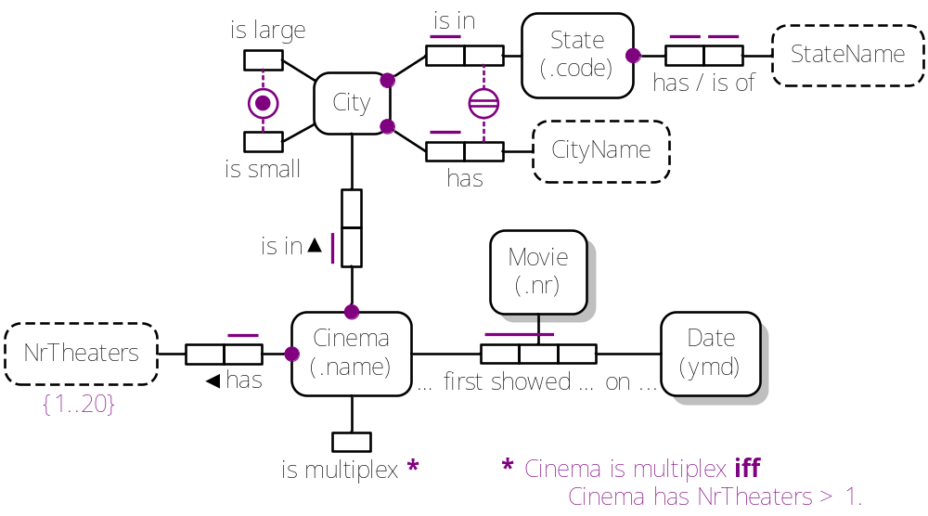
Page 1: Cinema

Slide 3
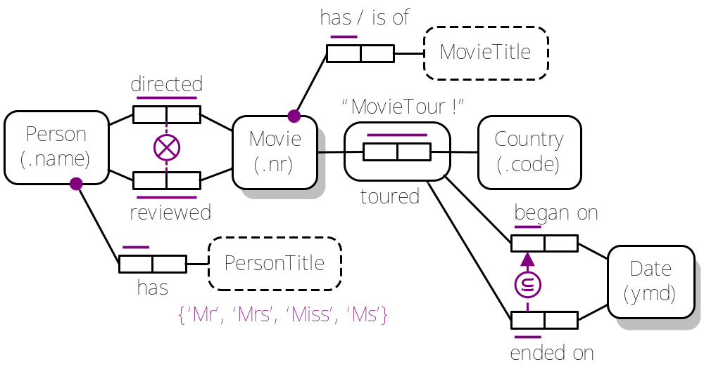
Page 2: Movie

Slide 4
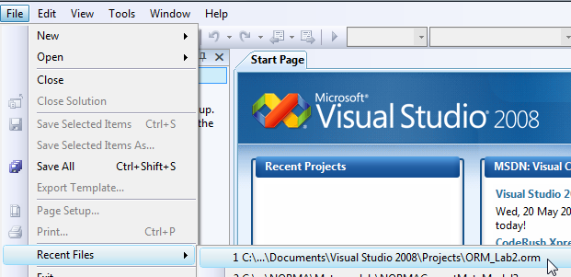
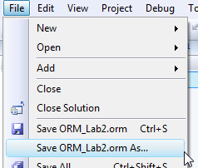
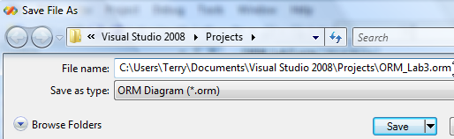
In Visual Studio, open the ORM file you worked on in Lab 2.
File > Recent Files > ORM_Lab2.orm
Save this new version as ORM_Lab3.orm:

Slide 5

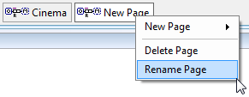
To add a new page,
right-click the Cinema tab
in the document window,
select New Page > ORMDiagram,
then
right-click the NewPage tab
and select Rename Page,
then
enter the name “Movie”.
A blank page called “Movie”
is now ready for you to add to the model.

Slide 6


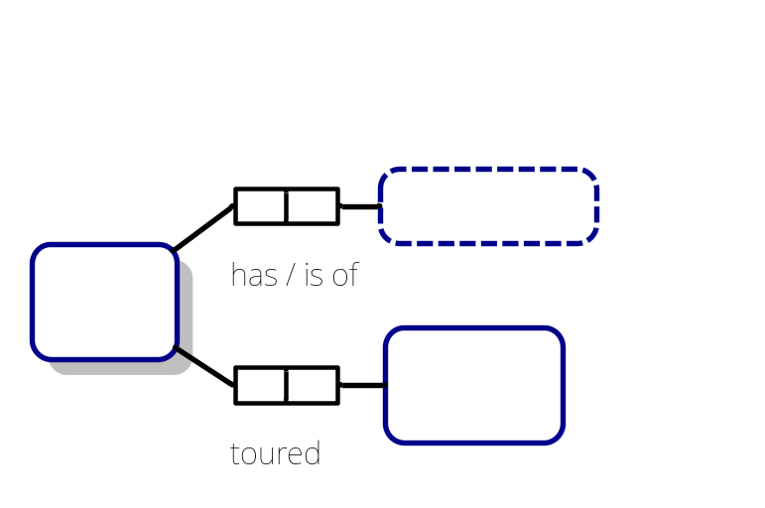
Open the Fact Editor,
either by clicking on its tab below the document window,
or by right-clicking a space on the document window
and selecting ORM Tool Windows > ORM Fact Editor.
In the Fact Editor, type the fact type
“Movie has / is of MovieTitle()”
and press Ctrl-Enter to add it to the diagram.
Similarly, enter
“Movie toured Country(.code)”
into the Fact Editor,
and align and position the shapes as shown.
Movie is shaded, since it is a duplicate of a shape displayed elsewhere
(in this example, Movie also occurs on the Cinema page).

Slide 7

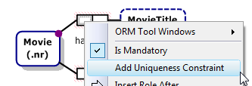
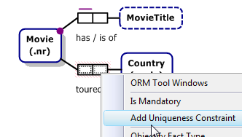
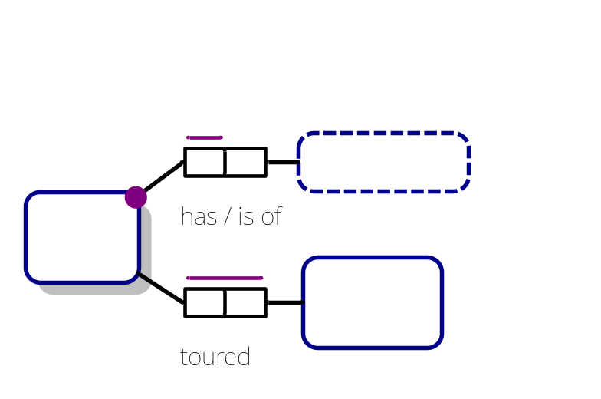
Right-click Movie’s “has” role and
select IsMandatory from its context menu.
Now right-click the same role
and select Add Uniqueness Constraint.
Now shift-click both roles of the toured
predicate and right-click to
select Add Uniqueness Constraint.
The diagram should now appear as shown.

Slide 8
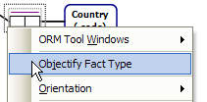
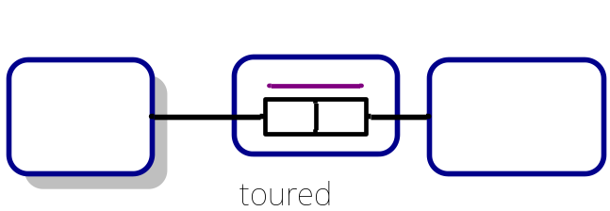
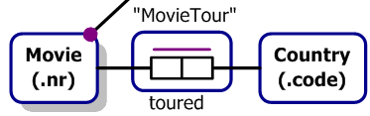
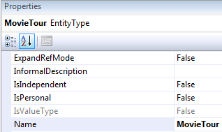
Select the toured predicate,
right-click, and select
Objectify Fact Type
from the context menu.
The objectified fact type is now displayed
with the name “MovieTouredCountry”.
Move the name to the position shown.
Edit this name in-place to “MovieTour”.
Alternatively,
select either “MovieTour”
or the objectified fact type,
and change its Name property
to “MovieTour”.

Slide 9
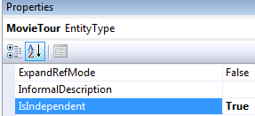
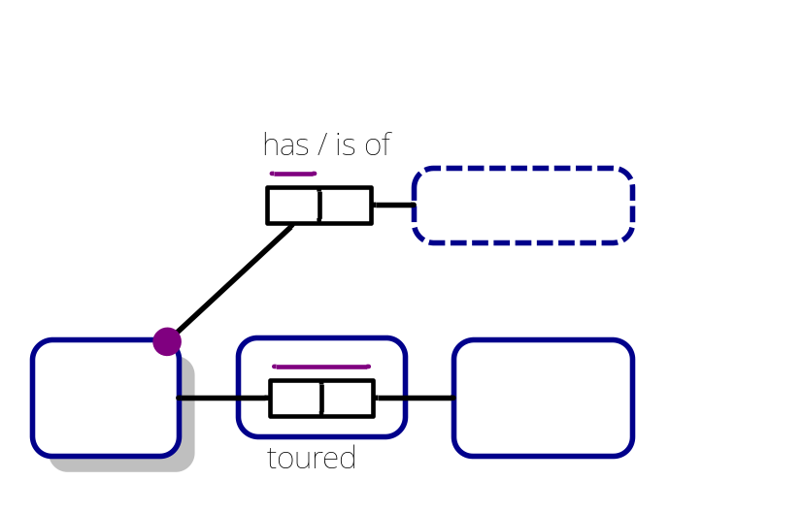
Select the name or the rounded rectangle
of the objectified fact type,
and double-click its
IsIndependent property
to toggle its value to True.
The name of the
objectified type now
displays with a “!”,
indicating the type is independent
(i.e. some instances in its population
might not play any other roles).

Slide 10
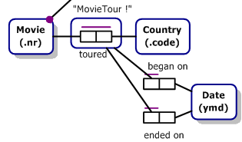
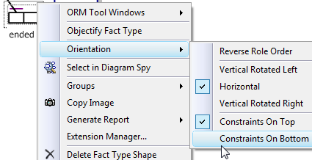

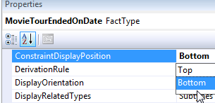
Now add the fact types
“MovieTour began on Date”
“MovieTour ended on Date”,
position them as shown,
and add uniqueness constraints
to their first roles.
Right-click the predicate “ended on”,
and select
Orientation > Constraints On Bottom
to move its uniqueness constraint
below the predicate.
Alternatively,
select the predicate and set its
ConstraintDisplayPosition property
to Bottom.

Slide 11
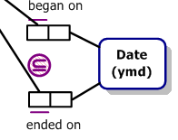


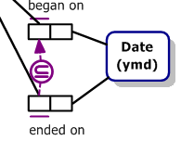
Now select the Subset Constraint shape
from the toolbox, and position it between
MovieTour’s roles as shown.
Double-click the constraint to activate the constraint pointer,
drag the pointer to the “ended on” role, then double-click it
to indicate the end of the first role sequence
(in this case, a single role, which displays as “1.1”).
Now drag the pointer to the “began on” role,
then double-click it to indicate
the end of the second role sequence
(in this case, a single role, which displays as “2.1”).
Click outside the shape
(or press Esc)
to display the final result.

Slide 12
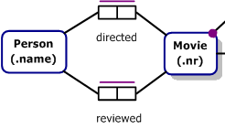
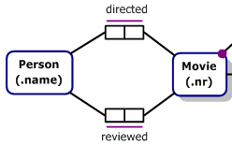

Enter the fact types
“Person(.name) directed Movie”
“Person reviewed Movie”
and move them to the left of Movie
(if needed, select the whole figure and move it to the right to make space)
and add spanning uniqueness constraints to both as shown.
Move “directed” above its predicate shape
then reposition the lower UC below its predicate,
e.g. right-click,
Orientation > Constraints On Bottom.
Drag the Exclusion Constraint shape from
the toolbox to between the predicates
as shown.

Slide 13




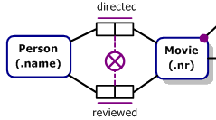
Double-click the constraint to activate the
constraint pointer, and click each role of the “directed” predicate
(they display as “1” and “2”).
Double-click to commit the first role-sequence
(the roles are now numbered 1.1 and 1.2).
Now click each role of the “reviewed” predicate
(they display as “1” and “2”).
Double-click to commit the second role-sequence
(these roles are now numbered 2.1 and 2.2).
Click outside or Press Esc
to display the result.

Slide 14
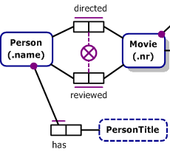

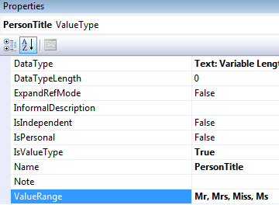

Add the fact type
“Person has PersonTitle()”
Right-click its left role, and
add a mandatory constraint
and uniqueness constraint as shown.
Select “PersonTitle”
and add the value constraint
shown to its ValueRange property
(don’t add quotes or braces,
as NORMA does that for you).
Reposition the displayed constraint
as shown.

Slide 15
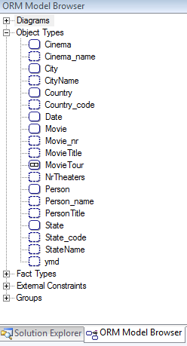
In Lab 1, we used Tools > Options > ORM Designer
to set the “Initial Data Type” to “TextVariableLength”
which is incomplete because it has a default length of 0.
Predefined refmodes (e.g. code, name, nr)
have other default data types. It is time now
to refine the data type settings for the value types.
Click the “ORM Model Browser”
tab in the Solution Explorer and
expand the “Object Types” node.
This shows all of the Object Types
(Entity Types, Value Types, Objectified
Fact Types) in the conceptual model (both pages).
Only the value types (shown with a dashed line)
have data types, so there is no need to
specify data types for the other types .

Slide 16
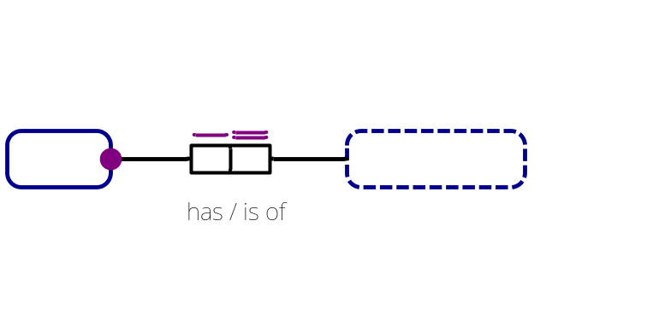

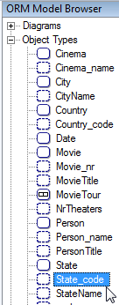
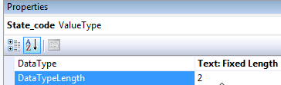
First, we will set the DataType for State_code.
Earlier, we set the reference mode on “State” to “.code”,
which automatically created the value type State_code for State.
Click “State_code” in the ORM Model Browser¹,
and view its properties in the Properties window².
The default DataType for “.code”
is Text: Fixed Length with a Length of 0.
Change the DataTypeLength property to 2
(e.g. ‘UT’, ‘MN’).
¹ You can also select a shape on the diagram to modify its data type,
but it’s much quicker to set all the data types in the model browser.
² If the Properties window is not open, press F4 in the Model Browser to invoke it.

Slide 17
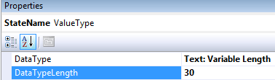
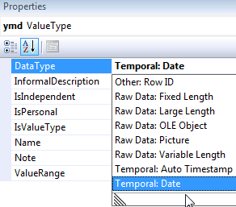
Next, click StateName in the Model Browser.
In the Properties window, change its
DataTypeLength to 30. Keep its default
DataType as “Text: Variable Length”.
Choose your preferred method for
setting these DataTypes to complete the model:
Set Cinema_name’s DataTypeLength to 30.
Set CityName’s DataTypeLength to 30.
Set Country_code’s DataTypeLength to 2.
Set Movie_nr to Unsigned Small Integer.
Set MovieTitle’s DataTypeLength to 30.
Set Person_name’s DataTypeLength to 30.
Set PersonTitle’s DataTypeLength to 10.
Change ymd’s DataType to Temporal: Date.
Notes:
Changing the DataTypes can also be done on the Relational Model, which will be discussed in a future lab.

Slide 18
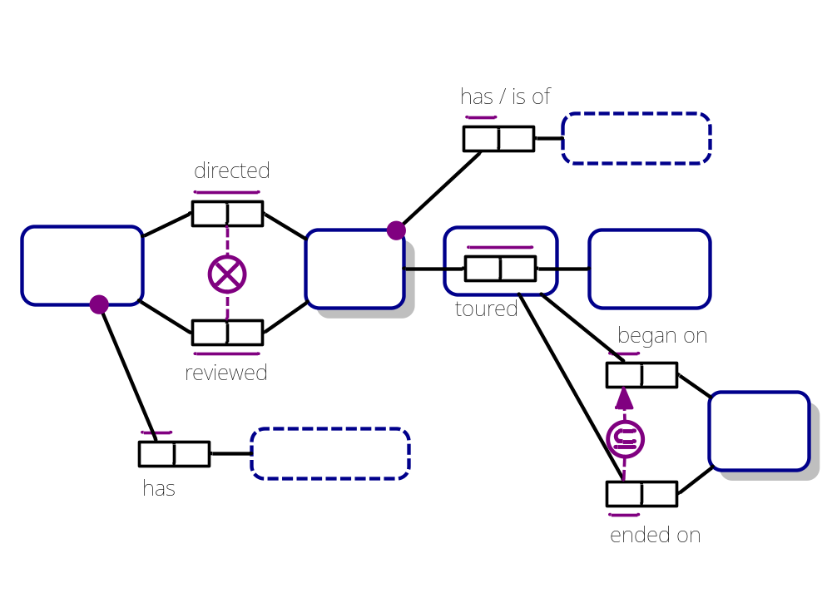

That completes the Movie page of the schema.
You may return to the Cinema page of the
ORM Model by clicking the Cinema tab.
Press Save, and then exit.

