Slide 1

NORMA Lab. 8
Further Aspects of Relational Mapping
Revision (relational view, data type refinement)
Controlling Table Names
Controlling Column names
Casing and Spacing Options
Subtype Mapping Options
File: NORMA_Lab8.ppt. Author: T. Halpin Last updated: 2011 March 26

Slide 2
In Visual Studio, open the ORM file you worked on in Lab 4 (or 7).
File > Recent Files > ORM_Lab4.orm
If this file is not listed in your recent files,
use Windows Explorer to locate the file
(e.g. in the Projects folder
within the Visual Studio 2008 (or 2005) folder)
then double-click the file to open it.
Use File > SaveAs
to save a new version of the file as ORM_Lab8.orm

Slide 3
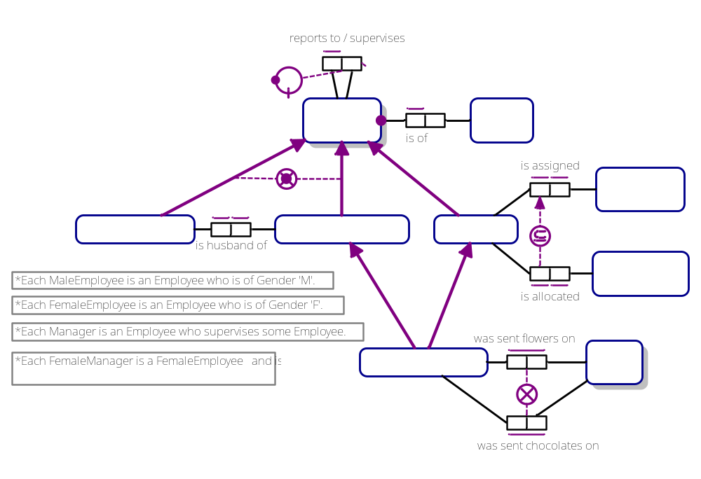
The ORM schema displays as the following 2 pages
(select the relevant Document Window tab to see the relevant page):
EmployeeSubtyping:

Slide 4
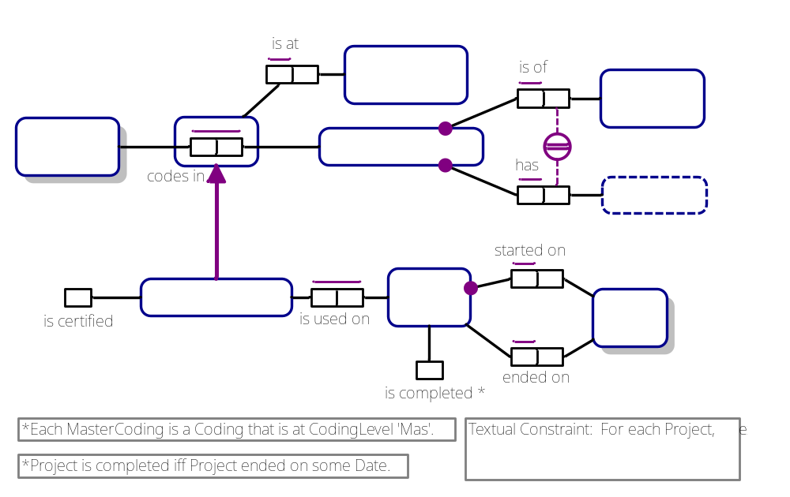
Coding&Projects:

Slide 5
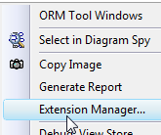
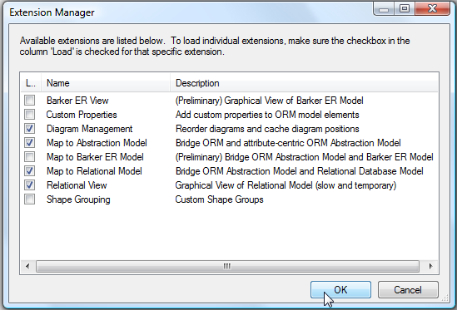
Right-click empty space
in the Document Window,
select Extension Manager
from the context menu
to open the
Extension Manager.
Check Relational View,
and press OK.

Slide 6
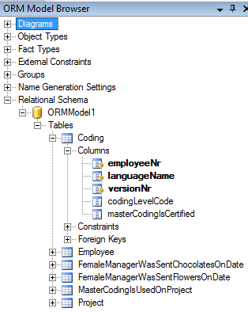
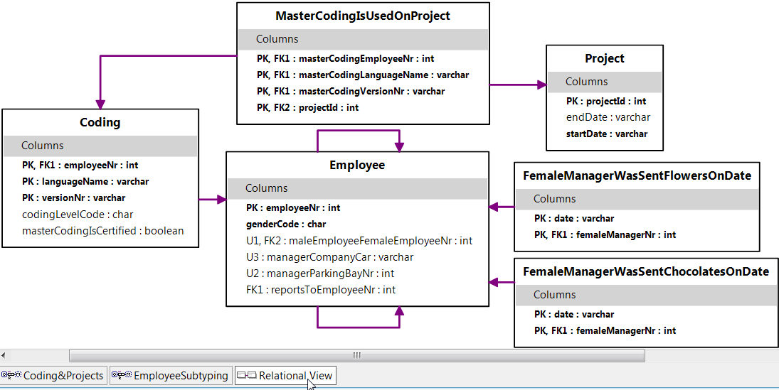
Select the Relational View tab at the bottom of the Document Window
to display the relational schema in diagram form.
Expand Relational Schema in the
ORM Model Browser
to display the schema in tree format.
Expand “+” icons to see more detail.

Slide 7
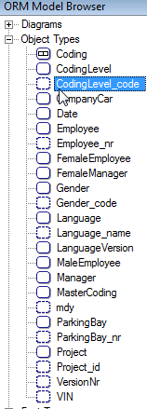
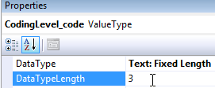
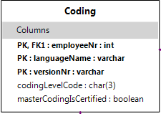
To refine the data types,
expand Object Types in the Model Browser
and edit the data type for each entry displayed
as a value type (ellipse with dashed line)¹.
Select CodingLevel_code
and in the Properties Window
enter 3 for DataTypeLength.
This change is immediately reflected
in the relational diagram.
¹It’s much faster to edit the data types at the ORM level rather than at the relational
level, because many roles of one ORM type map to many columns. This also helps to
avoid mistakes with mismatched data types (e.g. across foreign key relationships).

Slide 8
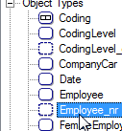
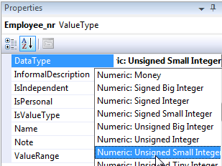






Select Employee_nr
and change its data type to
Unsigned Small Integer
(this displays as smallint
on the relational diagram).
Select Gender_code
and set its length to 1.
Select Language_name
and set its length to 20.
Select mdy and
set its data type to Temporal:Date.
Select ParkingBay_nr
and change its data type to
Numeric:Unsigned Tiny Integer.
Select Project_id
and change its data type to
Text: Variable Length with a length of 10.

Slide 9

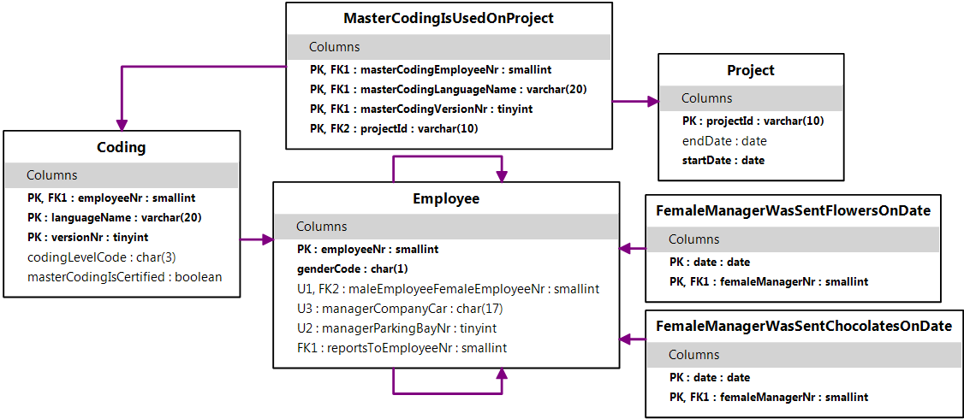
Select VersionNr
and change its data type to
Numeric: Unsigned Tiny Integer.
Select VIN
and change its data type to
Text: Fixed Length with a length of 17.
Move some shapes on the relational diagram to display it as shown.
The data types are now acceptable.

Slide 10
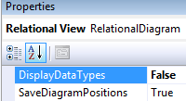
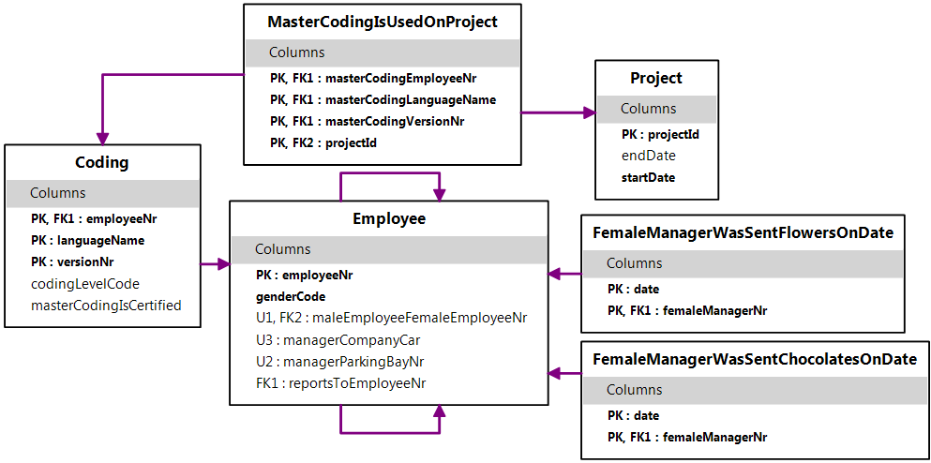
With the Relational View tab selected,
in its Properties Window
double-click the DisplayDataTypes property
to toggle its setting from True to False.
The diagram no
longer displays
the data types,
allowing a
more compact
diagram.
We now focus on
improving the generated names
of the tables and columns.

Slide 11

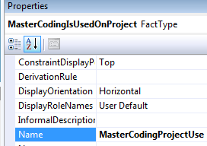


Controlling Table Names
NORMA automatically supplies default names for m:n fact types,
n -ary fact types (n > 2), and objectified types. These names become
the names of the tables generated from these fact types
(assuming the objectified predicate has a spanning uniqueness constraint).
To change any of these names, select the fact type,
open its Properties Window (press F4 if needed)
edit the Name property and press Enter.
e.g. select MasterCoding is used on Project
and change its name to
MasterCodingProjectUse.
Similarly, change the names of
FemaleManager was sent flowers on Date and
FemaleManager was sent chocolates on Date
to FlowersSent and ChocolatesSent.

Slide 12
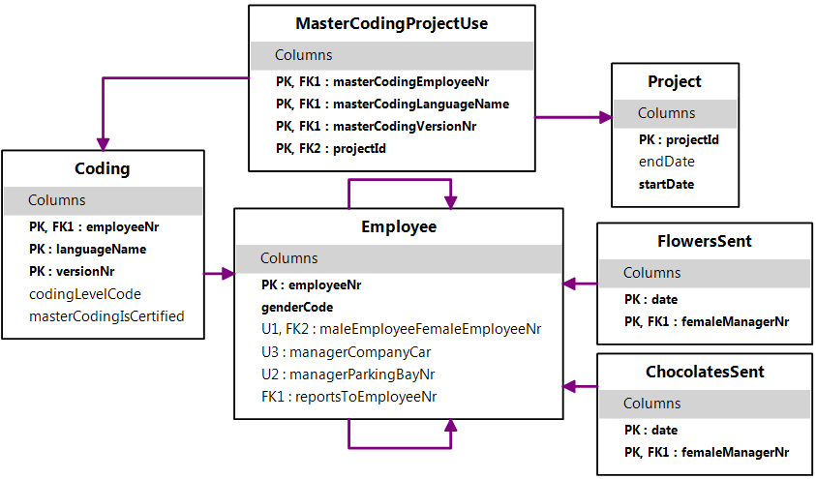
Another way to modify table names is to use the Abbreviation facility
discussed later for column names.
However, the table names are now satisfactory,
so let’s move onto the column names.

Slide 13
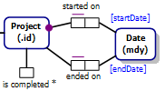
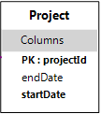

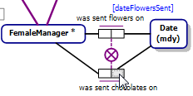
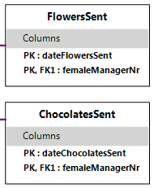
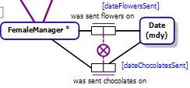
Controlling Column Names
Role names may often be used to control
column names.
This is already done for startdate and enddate,
so the Project table is acceptable as is.
Select the date role in the flower fact type
and name it in the Properties Window
to “dateFlowersSent”.
Select the date role in the chocolate fact type
and name it “dateChocolatesSent”¹.
The two columns
mapped from those roles
are now renamed.
¹It would be wrong to name both these roles “dateSent”
since the path expression FemaleManager.dateSent would then be ambiguous.

Slide 14



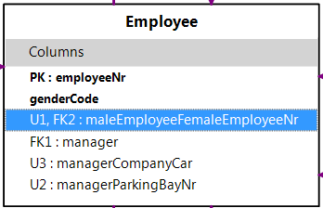
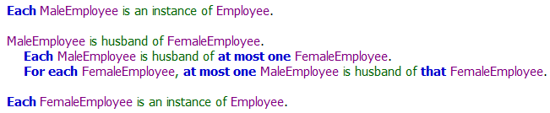
Select the supervises role
in the reporting fact type
and in the Properties Window
enter “manager” for its role name,
thus renaming its mapped column.
Notice that the fact type
MaleEmployee is husband of FemaleEmployee
is 1:1, with both roles optional.
This maps to the Employee table column
maleEmployeeFemaleEmployeeNr.
In principle, either role could be used for
the mapping, but NORMA chose to map
from the perspective of MaleEmployee.
To confirm this, select the column and note that MaleEmployee
is listed before
MaleEmployee
in the verbalization.

Slide 15

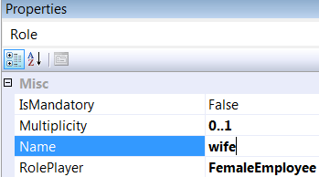
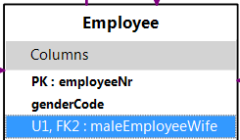
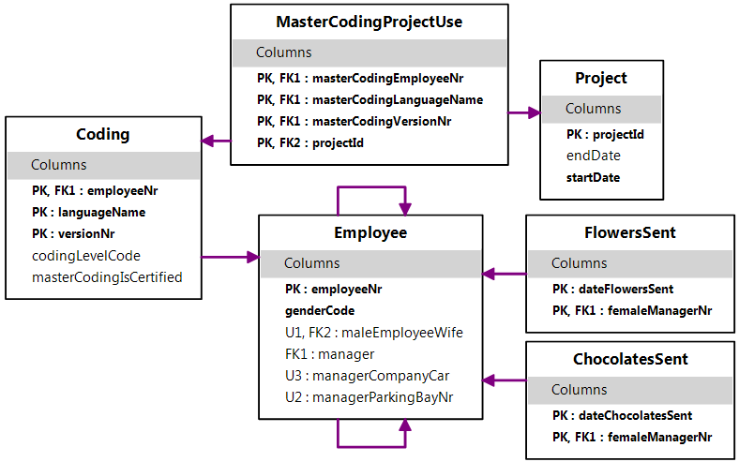
Select the FemaleEmployee role
in the marriage fact type
and in the Properties Window
enter “wife” for its role name.
The column it maps to
now has a more
meaningful name.
The relational
schema
should now
look
as shown.

Slide 16
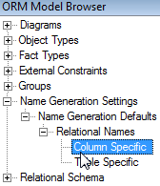
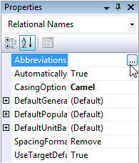
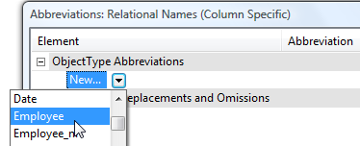
Abbreviations
In the Model Browser,
expand Name Generation Settings
and then Name Generation Defaults
and then Relational Names
and select Column Specific.
The Properties Window now offers many
options for controlling names.
In the Abbreviations property,
select the “…” button to open the
Abbreviations dialog.
Select Object Type Abbreviations
then New
then scroll down the drop-down list
to Employee, and press Enter.

Slide 17
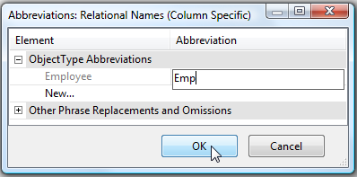
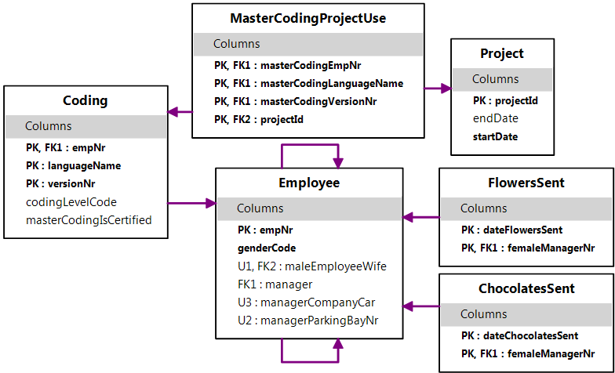
Enter “Emp” in the Abbreviation field
and press the OK button.
“Employee” is now shortened to “Emp”
when used in column names
obtained directly from the
Employee object type.
It is not desired to
abbreviate the table name
“Employee” in the same way,
but if you did want to do
this you could choose
Table Specific
and enter the abbreviation
there in a similar way.
Notice that “Employee” in “maleEmployeeWife”
was not abbreviated, because this column derives from
“MaleEmployee” rather than Employee.

Slide 18
You could abbreviate “maleEmployee” to “maleEmp”
by selecting MaleEmployee from the dropdown list
entering this abbreviation.
However, this could get tiresome if there were other columns based
on MaleEmployee that you also wanted to abbreviate “Employee”
in this way.
Instead, we will abbreviate all instances of “Employee” to “Emp”
in column names in one go, by using the
Other Phrase Replacements and Omissions option.
This option enables adding abbreviations for any phrases whatsoever,
regardless of whether they are object type names.
As this feature is quite powerful,
use it with care.

Slide 19
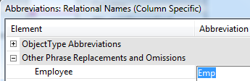
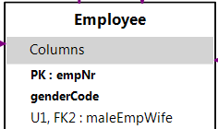
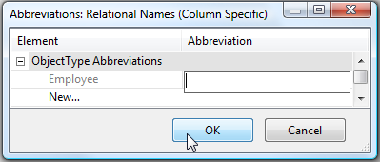
Expand this option, and enter “Emp”
as an abbreviation for “Employee”.
Now all the column-specific
entries of “Employee” are
abbreviated to “Emp”
while leaving name of the
Employee table unabbreviated, e.g.
Since this is stronger than the
earlier object type abbreviation for Employee,
we no longer need that earlier abbreviation.
To delete it, expand ObjectTypeAbbreviations,
select “Emp” in the Abbreviation column,
press the Delete key,
and then press OK.

Slide 20
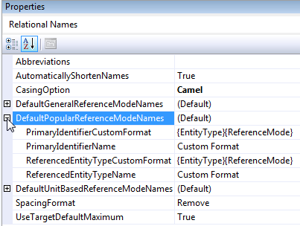
Naming Formats
In the Properties Window
expand
DefaultPopularReferenceModeNames.
This allows you to change the
format used by default when
an object type with a popular
refmode has a role that maps to
a primary key or another column.
By default, when mapping to a column,
the refmode name is appended to the entity type name
e.g. projectId and employeeNr.
This is reasonable for this model, so let’s leave the defaults unaltered.
The defaults for general and unit-based refmodes may also be
modified using this window. However, let’s leave them unaltered.

Slide 21

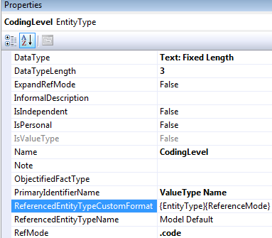
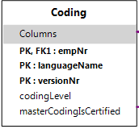
Instead, we will modify specific cases to override the default behavior.
On the Coding&Projects page of the ORM schema,
select CodingLevel.
In the Properties Window
select
ReferencedEntityTypeCustomFormat.
It’s set to {EntityType}{ReferenceMode}
indicating this format will be used when
a role for that object type maps to a
column that is not a simple primary key,
e.g. codingLevelCode.
Select {ReferenceMode} and press Delete
to reduce the format to {EntityType}.
Now “codingLevel”
is used instead
of “codingLevelCode”.

Slide 22

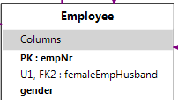
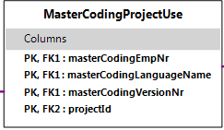
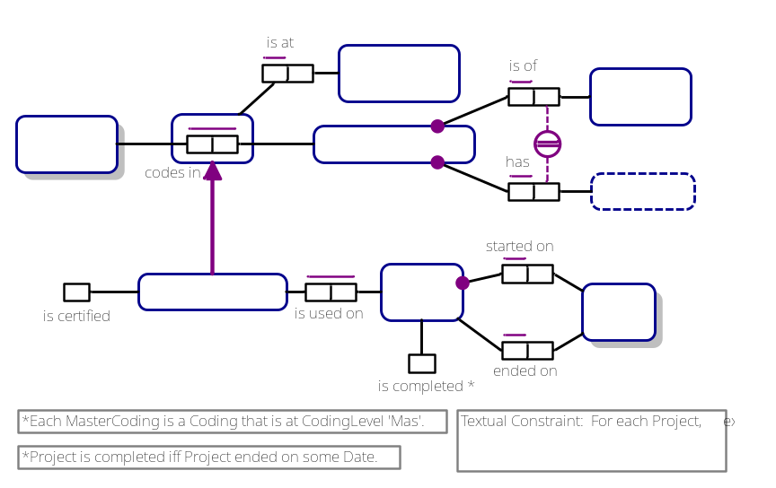
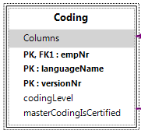
Similarly, on the Employee&Subtyping page
select Gender
and reduce its referenced format
to {EntityType},
so the genderCode
column is renamed “gender”.
The column names are now all reasonable,
except for “masterCodingVersionNr”
and “versionNr” which lose the sense that
the version number relates to a language.

Slide 23

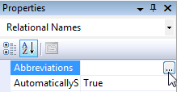
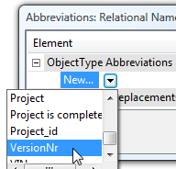
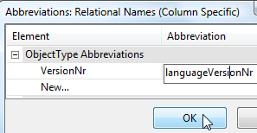

You could fix this by naming the role
played by VersionNr, but the default name
“versionNr” is fine, so let’s not do this.
Instead, open the Column Specific abbreviations,
select the object type VersionNr
and enter “languageVersionNr” as its
“abbreviation” (in this case, it’s a replacement
rather than an abbreviation).
The names are now all acceptable.

Slide 24
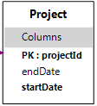
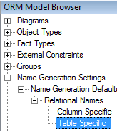
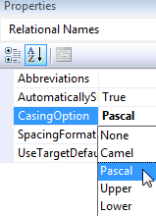
Casing and Spacing Options
By default, NORMA generates table names in Pascal case,
and column names in camel case,
with spaces removed, e.g.
I prefer to leave these defaults unaltered,
but let’s see how to change them if desired.
In the ORM Model Browser,
select ‘Table Specific’.
In the Properties Window,
click the CasingOption dropdown list
to see the choices available.

Slide 25
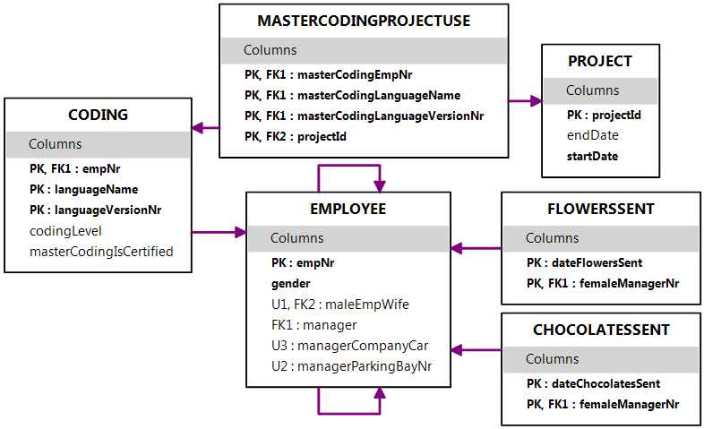
Change the casing option to Upper.
All tables now have their names displayed
with all letters in upper case.
Try the other options to see the effect.
Then revert back to Pascal case.

Slide 26

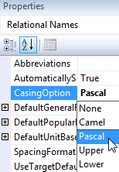

In the ORM Model Browser,
select ‘Column Specific’.
In the Properties Window,
click the CasingOption dropdown list
and change the casing option to Pascal.
All columns now have their names displayed
in Pascal case.
Try the other options to see the effect.
Then revert back to camel case.

Slide 27
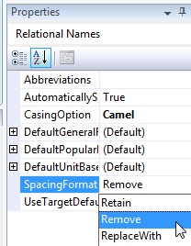

Still on Column Specific settings,
select SpacingFormat
to see the options.
The default “Remove” option
removes spaces between words.
Change the SpacingFormat to Retain
to retain the spaces between words.

Slide 28


Now change the SpacingFormat to ReplaceWith.
A SpacingReplacement option now appears
just below.
For this property
enter the underscore “_” character
to be used as a word separator in column names
(you can choose another character if you like).
Notice the effect.

Slide 29



Now choose Table Specific
and change the SpacingFormat
to ReplaceWith using an underscore.
The relational schema now displays with
underscore separators in both table and column names.
Now reset both table specific and column specific
spacing formats back to Remove
to return to our earlier display.

Slide 30


Subtype Mapping Options
By default, NORMA absorbs functional roles (with a simple UC)
on subtypes back into their top level supertype for relational mapping.
E.g., the “is certified” role maps to the masterCodingIsCertified
column in the Coding table, as shown.

Slide 31



To map this fact type to a separate table,
select MasterCoding
then in its Property Window
change its AbsorptionChoice
to Separate.
The relational schema
now displays
with a separate
MasterCoding table
for storing
certification facts.
Project usage facts
are still stored in the
MasterCodingProjectUse
table, since their subtype
role is not functional
so is not absorbed.

Slide 32

MaleEmployee’s role in the marriage fact type is functional,
so by default it is absorbed into the supertype table for Employee,
resulting in the maleEmpWife column.
Manager’s parking bay and company car roles are functional
so are also absorbed into the Employee table.
The FemaleManager roles are not functional, so cannot be absorbed.

Slide 33




Select MaleEmployee,
and change its absorption choice
to Separate.
A separate table for
MaleEmployee
is now created
to store marriage facts.
Reset the absorption choice for
MaleEmployee to Absorbed
to return it to the previous state.

Slide 34


Select Manager,
and change its absorption choice
to Separate.
A separate table for Manager
is now created to store facts about
parking bay and company car assignments.
The NORMA build I’m using
(build 1464) also wrongly
displays an extra
femaleMangerNr column
in the Employee table
marking it as a foreign key
to Manager.managerNr .
This is a bug to be fixed.

Slide 35



Absorption is the default because
it typically leads to a more efficient design.
This is likely the case with MasterCoding,
so reset the MasterCoding subtype
back to Absorbed.
With Manager, Separation could perhaps be preferred to Absorption
(it depends on the query/update pattern for focused transactions).

Slide 36
As a final note, it is possible to alter the names of tables
and columns directly on the Relational View.
If you are sure that the relational schema is otherwise in its
final form, then this does provide a quick way to modify the names.
However, once you make any change to the ORM schema that causes
the relational schema display to be regenerated,
any name changes made directly on the relational schema will be lost.
The ability to persist name changes made directly at the relational level
may be supported in a future NORMA release, but until that happens
try to control all your table and columns names by using the
techniques discussed on previous slides. In most cases, this should suffice
to give you reasonable names at the relational level.

