Slide 1
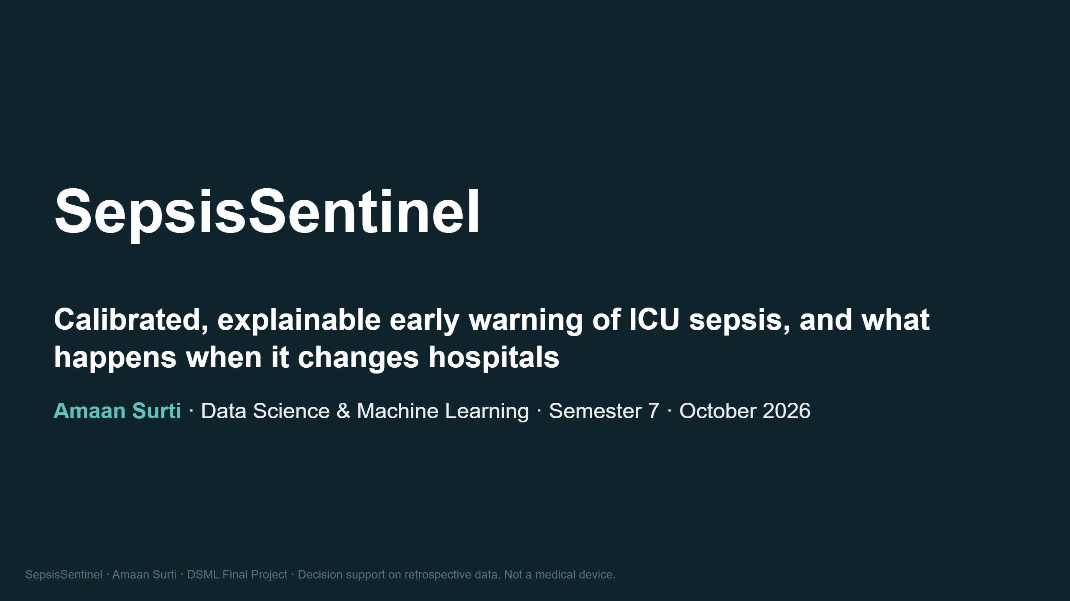
Notes:
SPEAKER NOTES (20 s)
Good morning. SepsisSentinel is a real-time early-warning system for sepsis in the ICU.
I'll show what it achieves on an untouched test set, where it breaks when it moves to a new hospital,
and a live dashboard that replays real test patients.
Every number on these slides comes straight from the repo's results tables; the test set was opened once, for the LightGBM model.

Slide 2
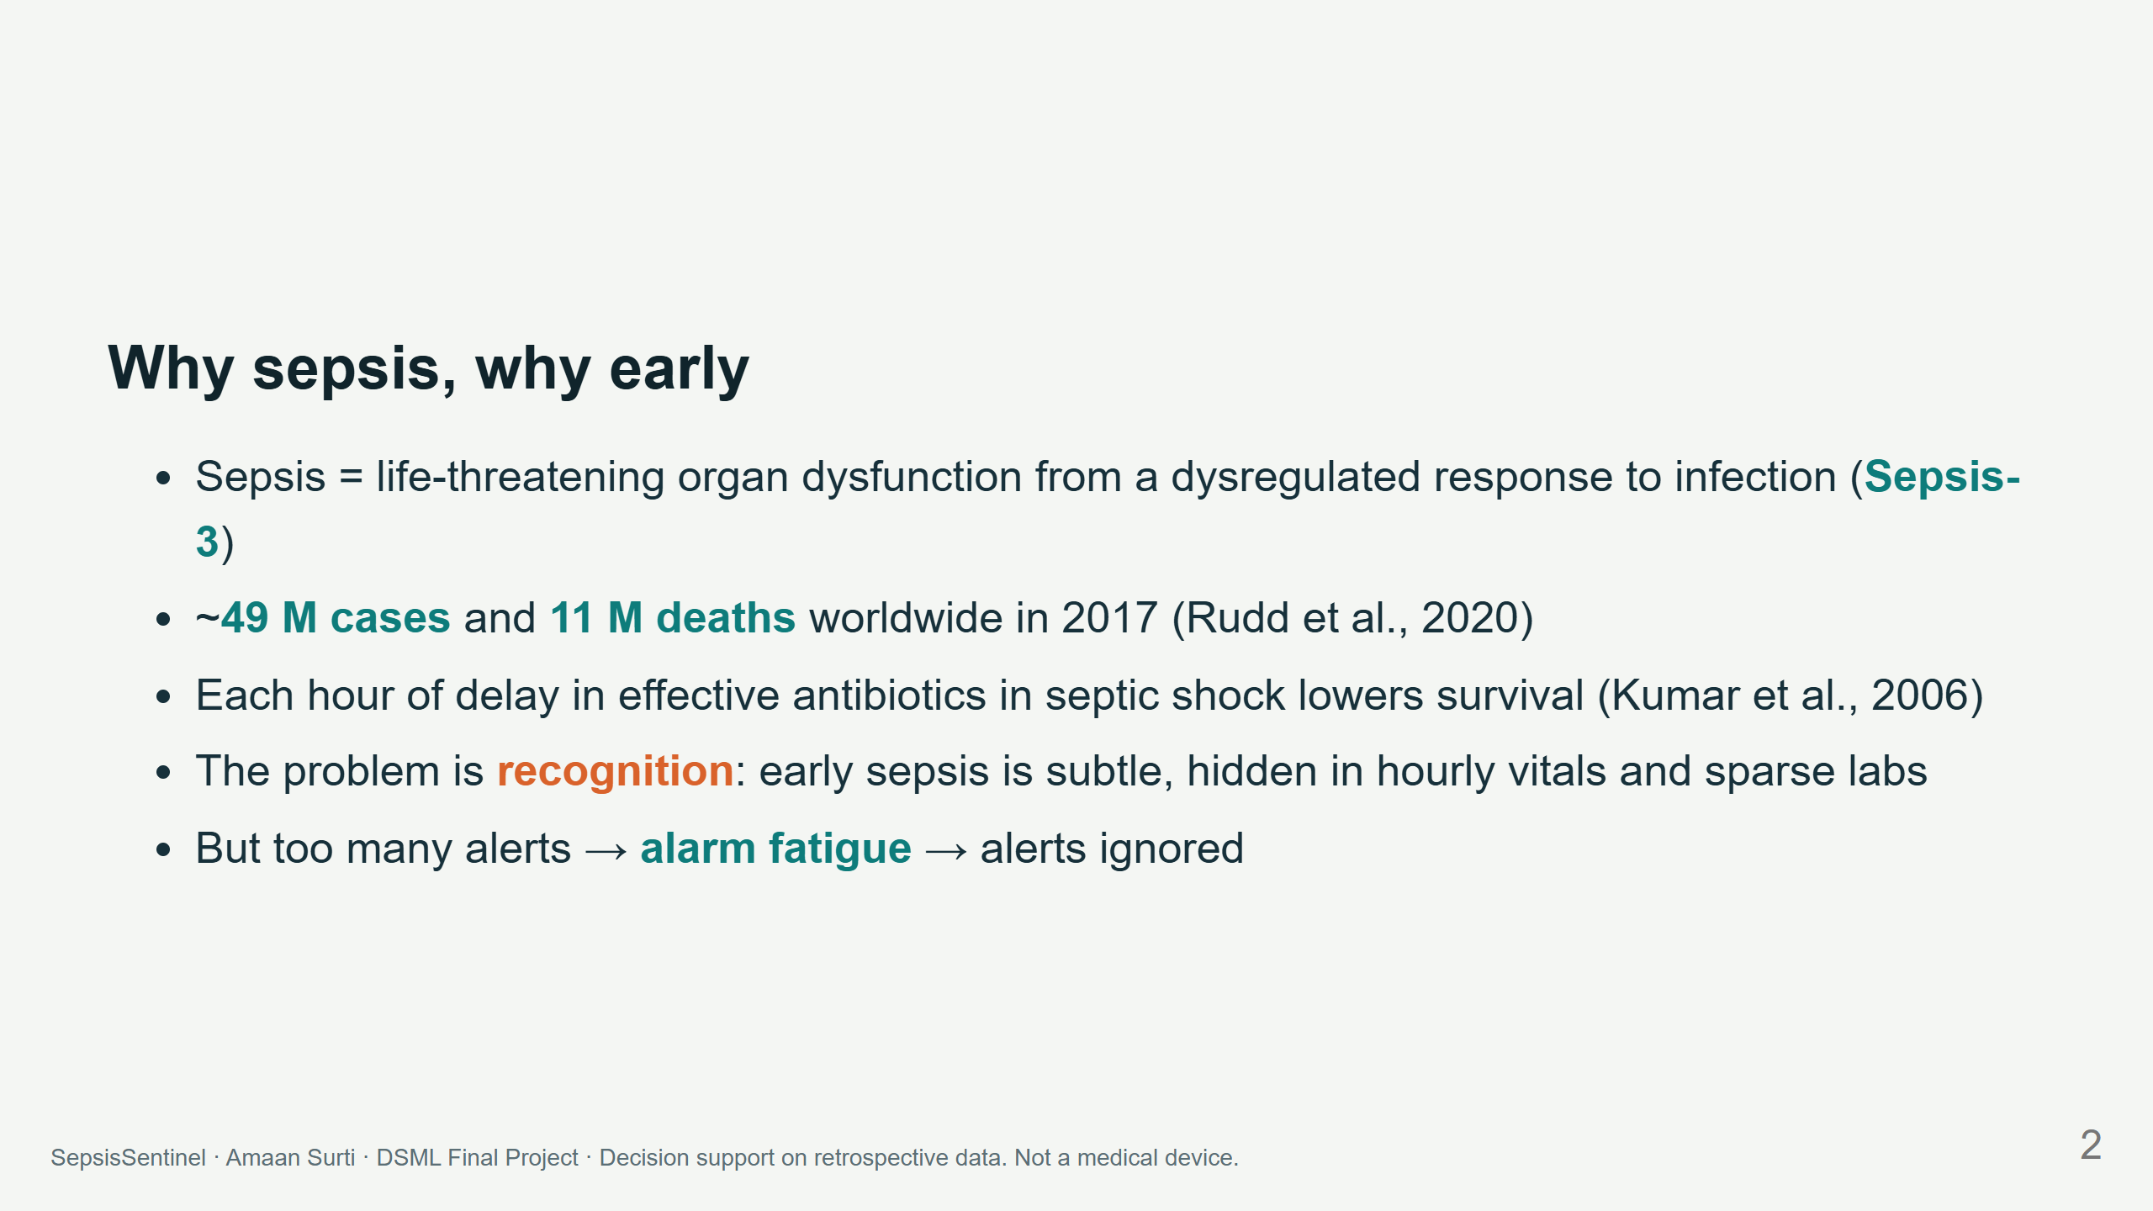
Notes:
LAYOUT: left text column; optional right-side icon of an ICU monitor. Keep to 5 bullets.
NOTES (45 s)
Sepsis kills about one in five people who die worldwide. Time-to-antibiotics matters hour by hour.
The clinical bottleneck is spotting it early, and an AI alert is only useful if clinicians trust it,
so we must care about false alarms as much as about catching cases.
TAKEAWAY: the goal is "early and trustworthy", not just "accurate".

Slide 3
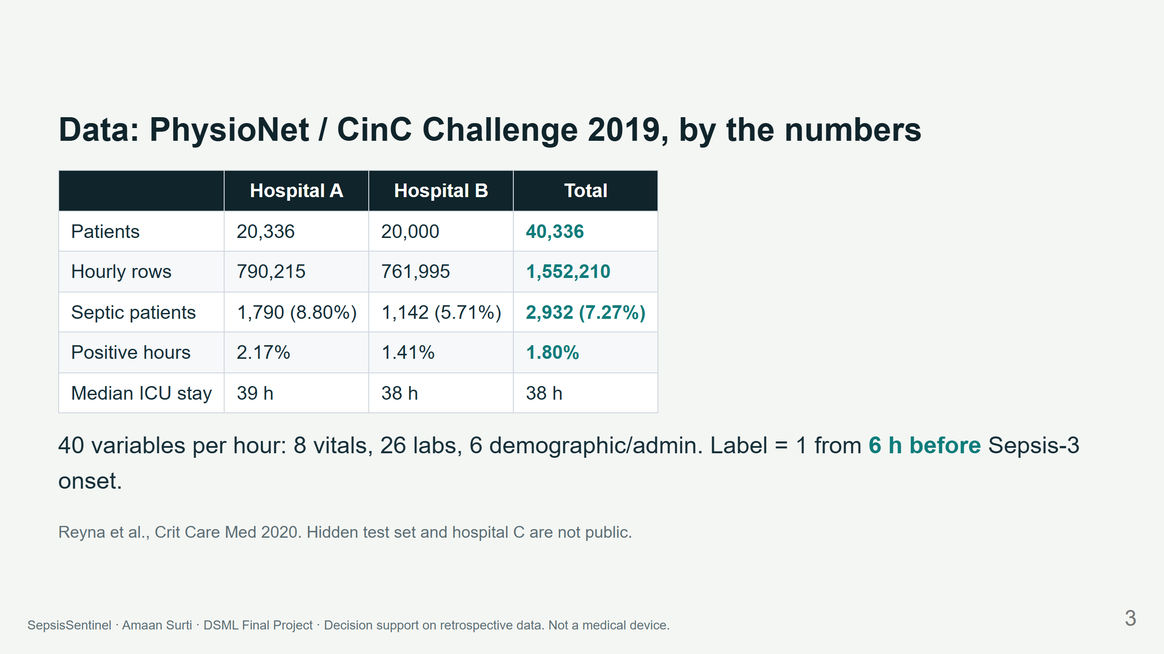
Notes:
NOTES (40 s)
Two hospitals, forty thousand stays, one and a half million hourly rows. Only 1.8% of hours are positive.
A model that never alerts is 98.2% accurate, which is why we never report accuracy.
The label switches on six hours before clinical onset, so predicting the label means anticipating onset.

Slide 4
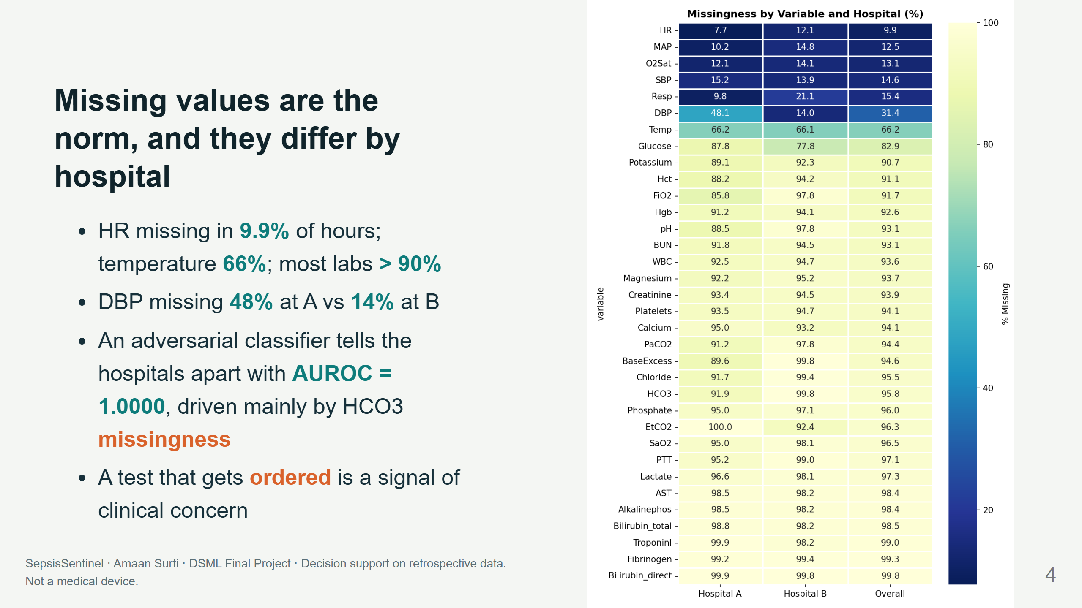
Notes:
LAYOUT: real missingness heatmap on the right half (replaces the illustrative grid from the proposal deck).
NOTES (45 s)
This is the real missingness map. Labs are mostly empty, and the patterns are hospital-specific:
a simple model can identify the hospital perfectly from what was measured.
That gives us an opportunity (missingness carries information) and a risk (the model may learn the hospital).

Slide 5
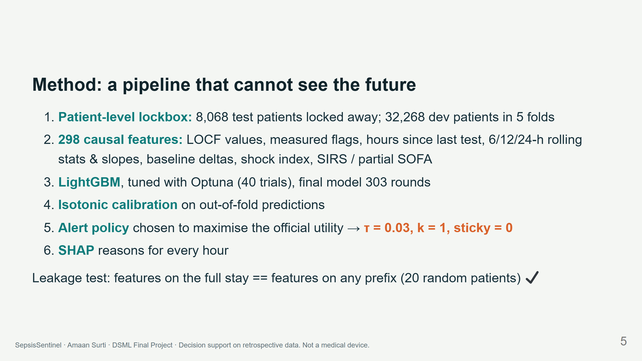
Notes:
LAYOUT: a horizontal pipeline diagram (boxes with arrows) works better than a list if time allows.
NOTES (60 s)
Every feature at hour t uses only hours up to t. We prove it with a test: compute features on the full stay
and on a truncated stay; the overlapping rows must be identical. Everything that is fitted (hyperparameters,
calibrator, threshold) used development patients only. The test set was opened exactly once at the end.

Slide 6
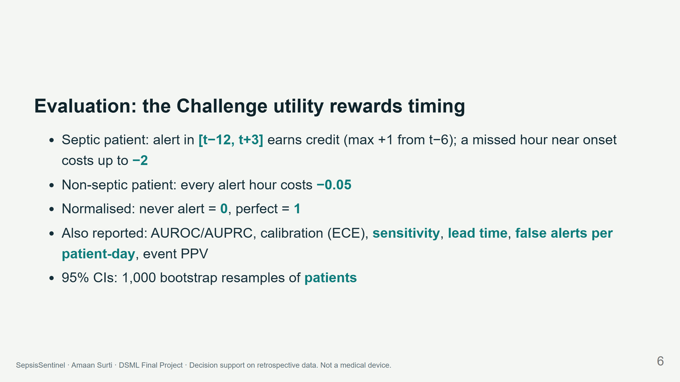
Notes:
LAYOUT: optional small sketch of the utility curve vs time-to-onset on the right.
NOTES (40 s)
The official score encodes the clinical trade-off: early true alerts are good, misses near onset are very bad,
and every false alarm costs a little. We also report the clinical numbers a ward manager would ask for.

Slide 7
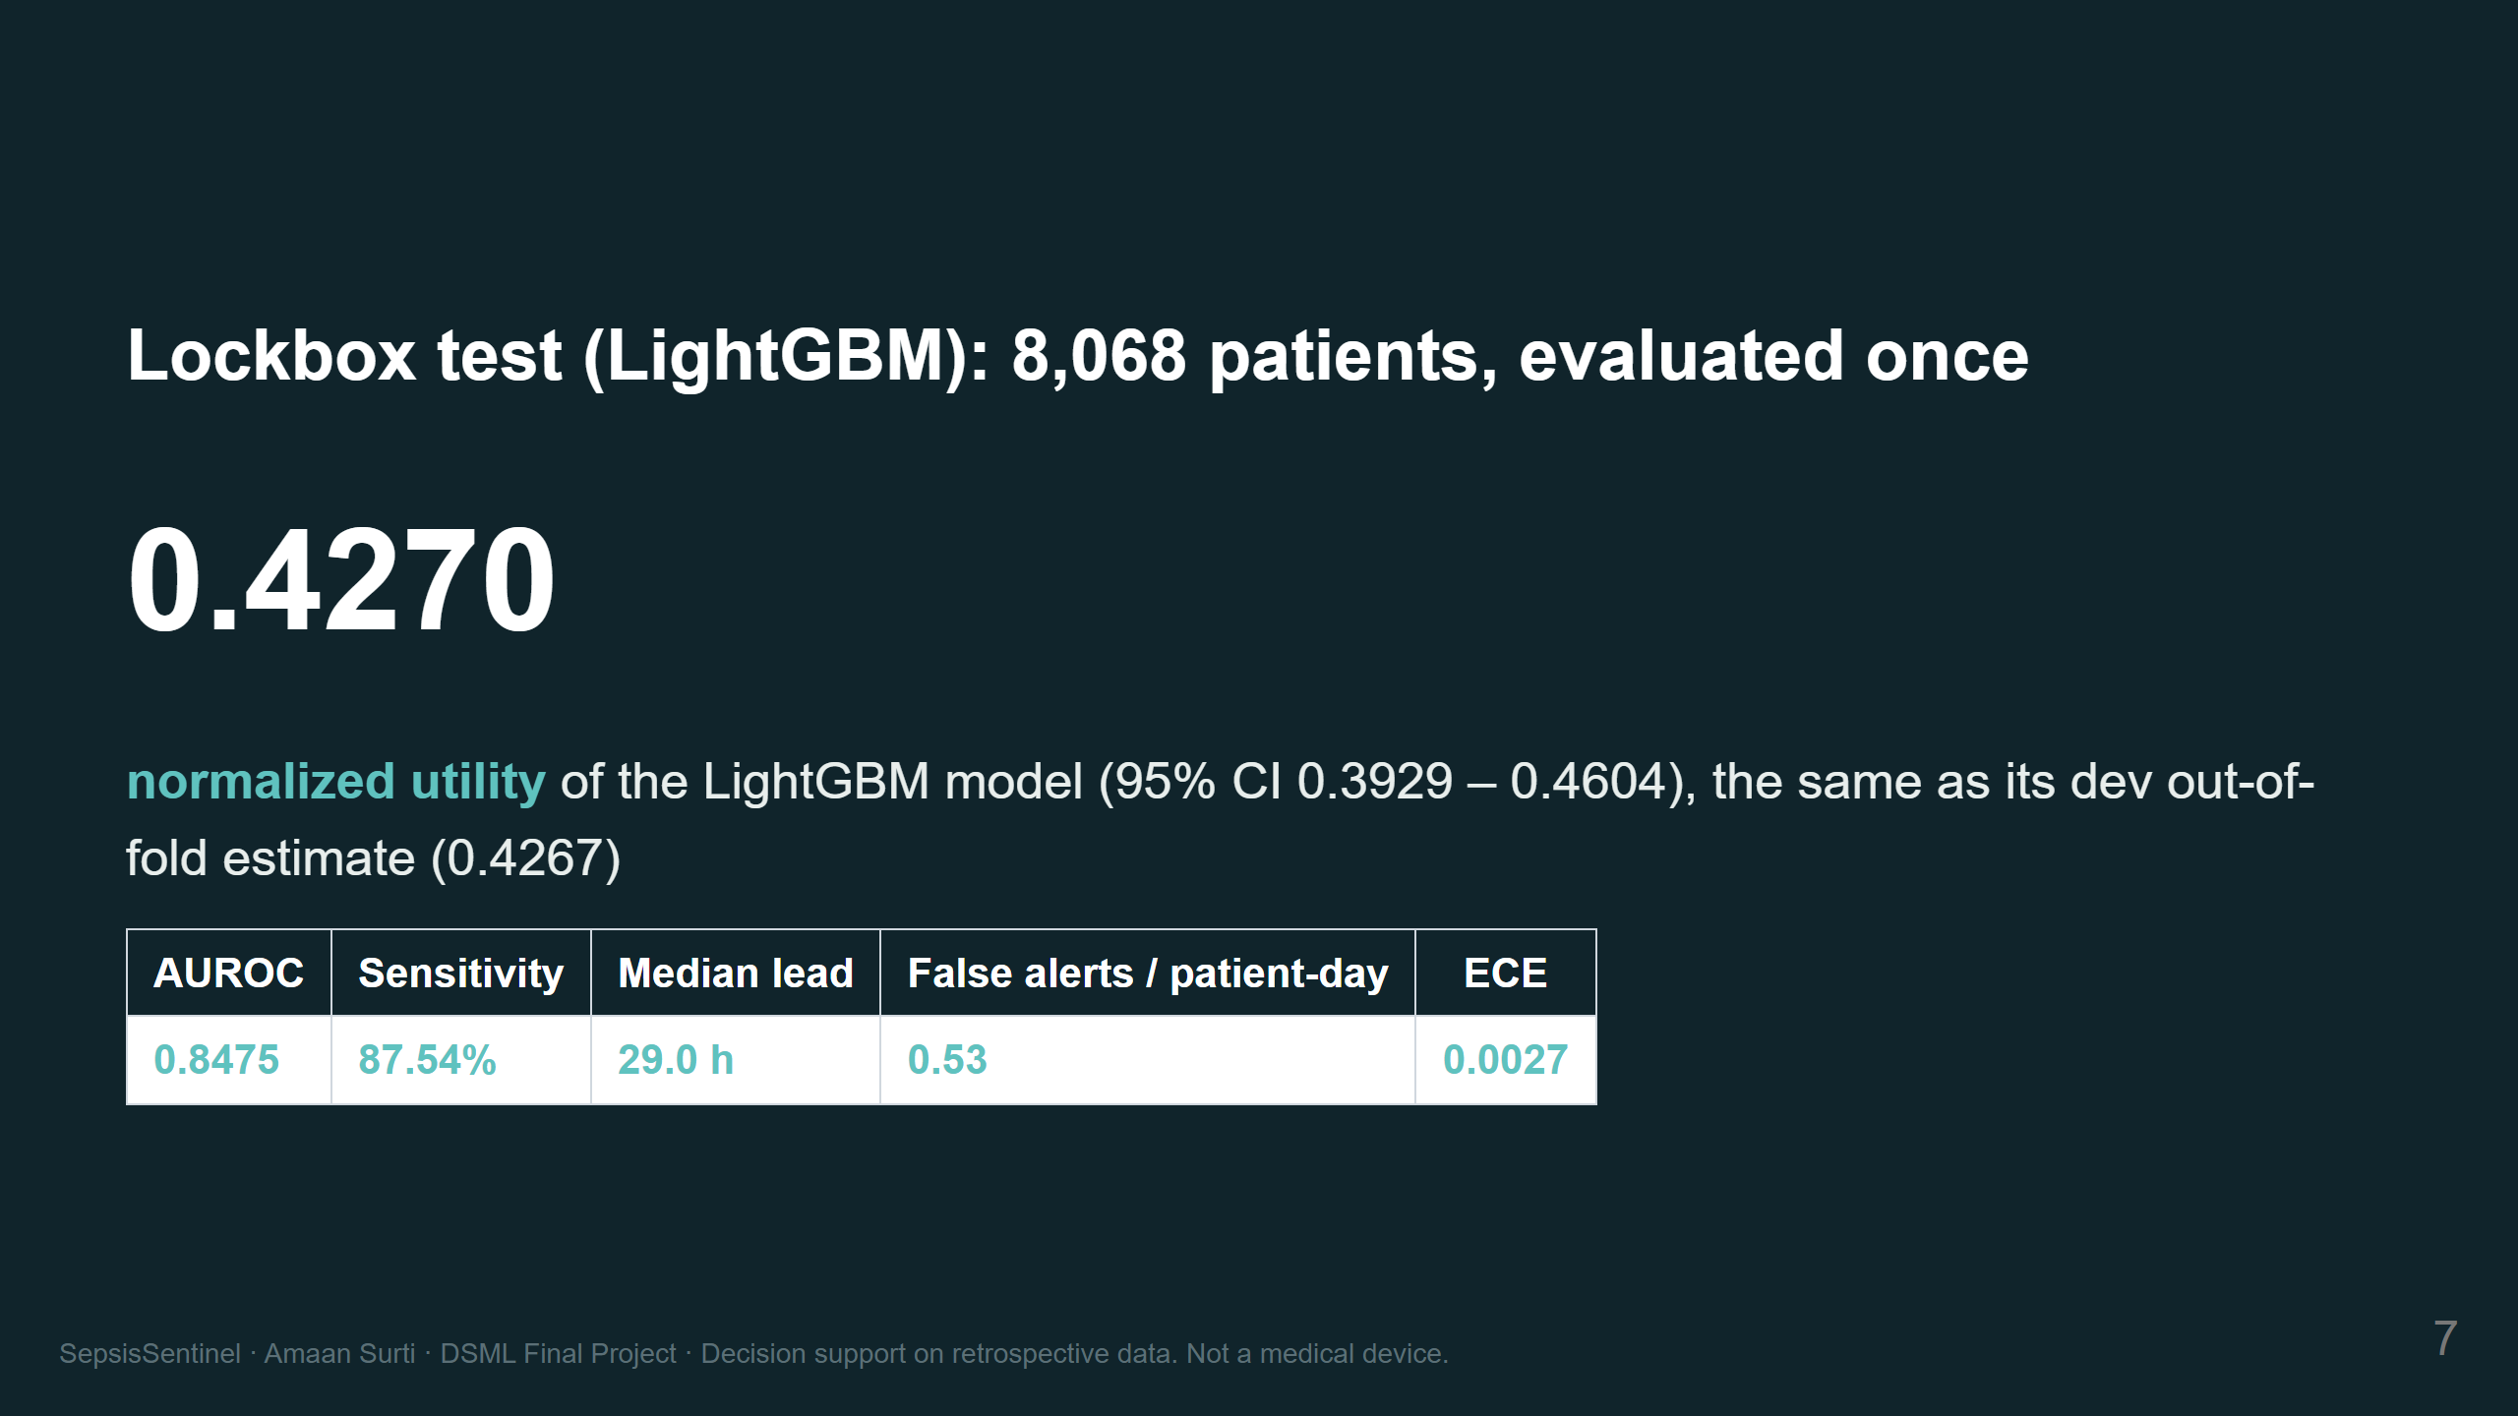
Notes:
NOTES (50 s)
On the untouched test set: utility 0.427, within 0.0003 of the development estimate, so there is no overfitting.
Nearly 9 in 10 septic patients get an alert in the clinically useful window. The median first alert comes
29 hours before onset, and calibration error is 0.003, so a displayed 3% risk really means about 3%.
Cost: about one false alert per non-septic patient every 45 hours.
TAKEAWAY: strong, honest, reproducible.

Slide 8
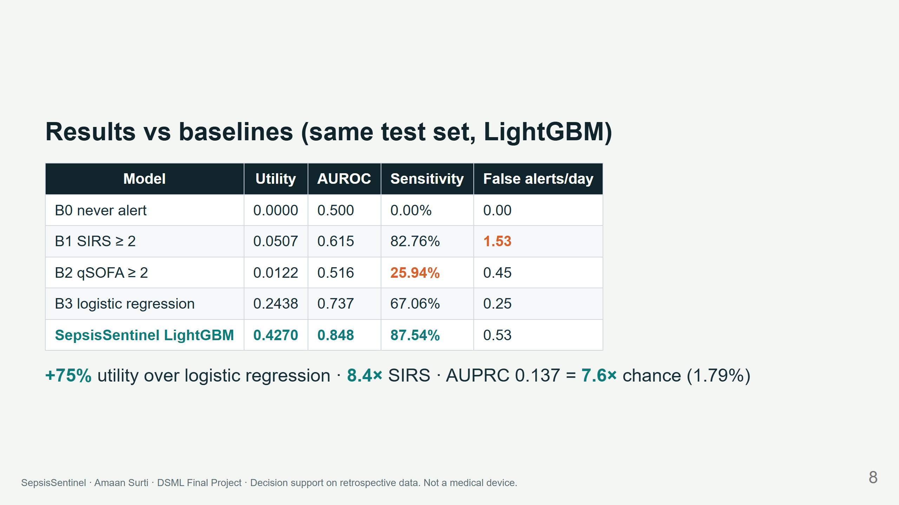
Notes:
NOTES (50 s)
SIRS catches almost as many patients but alarms three times as often, so its utility is near zero.
qSOFA is quiet but misses three quarters. Logistic regression is the real competitor; we beat it by 75%
and catch 20 percentage points more septic patients. If asked about AUPRC 0.137: chance level is the
positive rate, 1.8%, so this is 7.6 times better than chance.

Slide 9
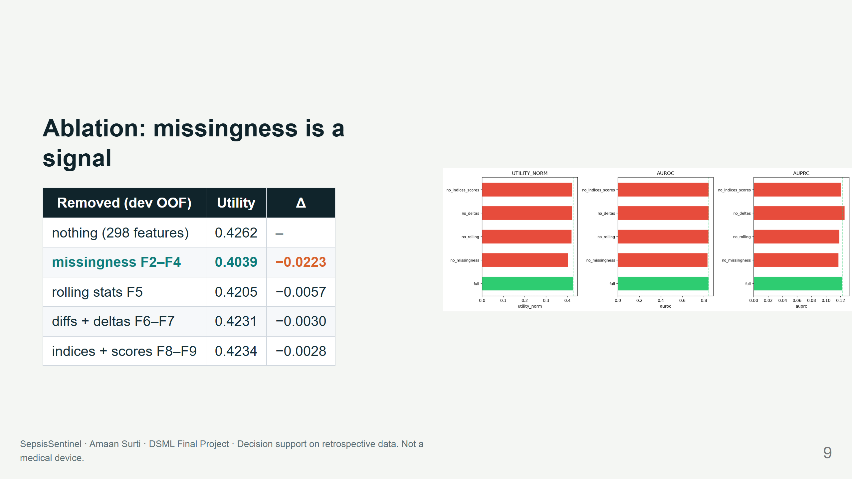
Notes:
NOTES (40 s)
Removing the "was it measured, and how long ago" features costs 5% of utility, by far the largest drop.
The tree model can rebuild rolling stats from raw values, but it can't rebuild ordering behaviour.
Top SHAP features agree: time in ICU, hours since FiO2 and lactate were recorded, then fever, WBC, BUN, shock index.

Slide 10
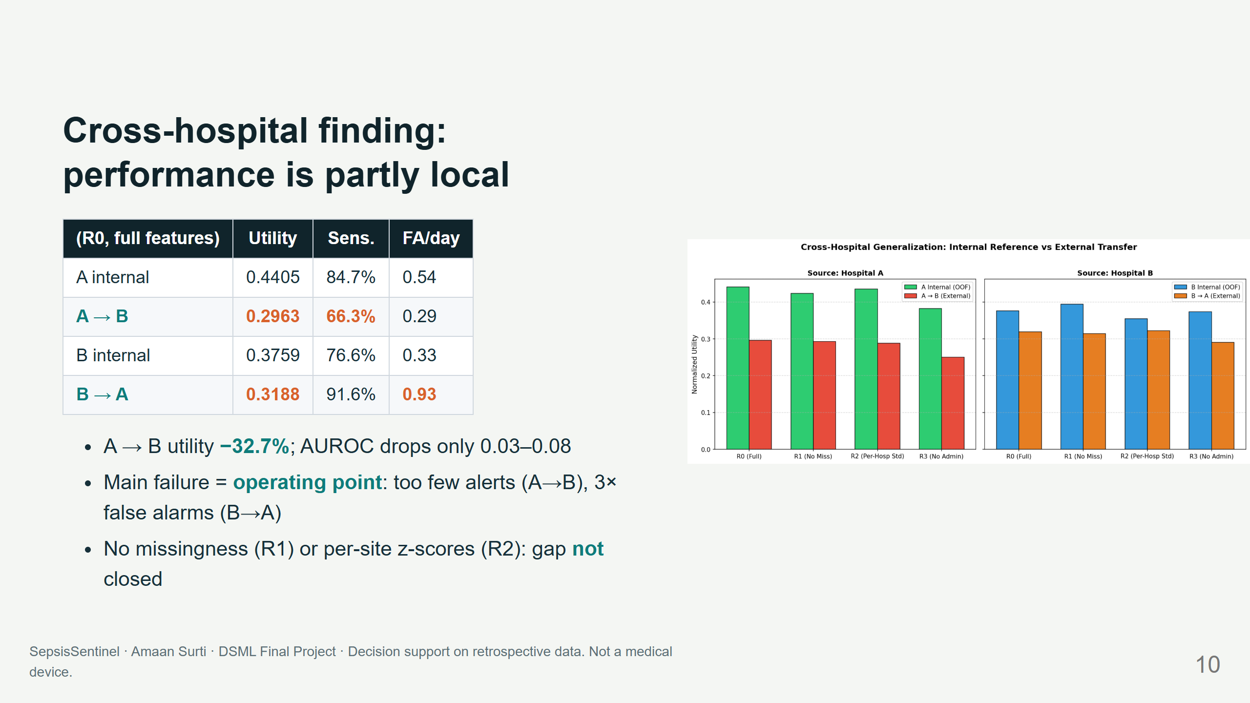
Notes:
NOTES (60 s) THE HEADLINE FINDING
Train at one hospital, deploy at the other, and you lose up to a third of the utility.
Ranking survives; the threshold does not. A's threshold is too strict at B, so sensitivity falls to 66%;
B's threshold at A nearly triples false alarms. It's not just missingness: removing those features
leaves the gap unchanged, and z-scoring per hospital doesn't fix it either.
TAKEAWAY: never deploy without local threshold tuning and a silent trial. This matches what happened
to hospital C in the Challenge and to commercial sepsis models in the literature.

Slide 11
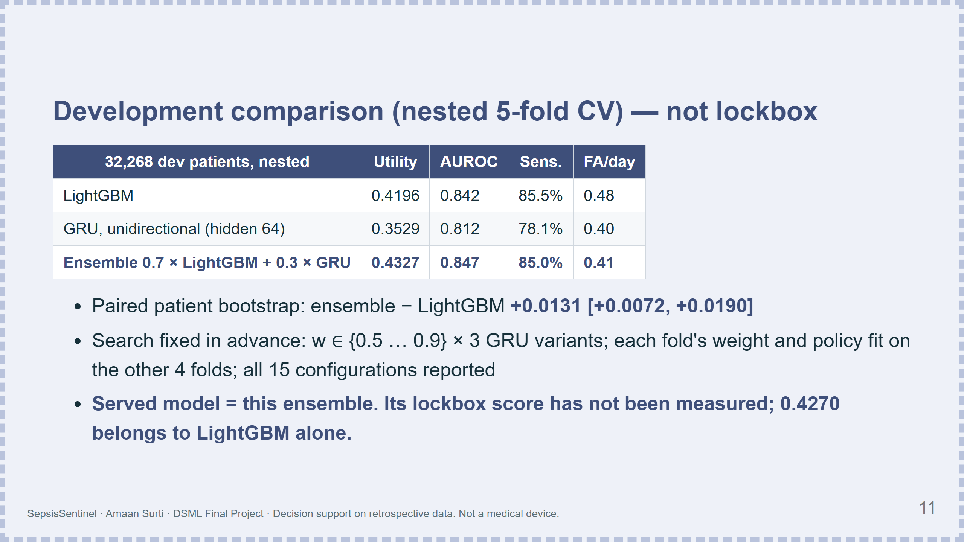
Notes:
LAYOUT: dashed slate border marks development-only numbers; never place next to the lockbox slide's numbers.
NOTES (50 s)
A recurrent network on its own is clearly worse than the trees, 0.35 against 0.42 on development data.
But averaging the two helps: 0.433, with fewer false alarms at the same sensitivity, and the bootstrap
interval stays above zero. We fixed the search space before running it and report every configuration.
We did not test the ensemble on the lockbox: that set was used once, for LightGBM, and opening it again to
check a model chosen afterwards would turn it into a validation set. So the app serves the ensemble, and the
test-set claim stays with LightGBM. The app can switch back with MODEL_KIND=lgbm.

Slide 12
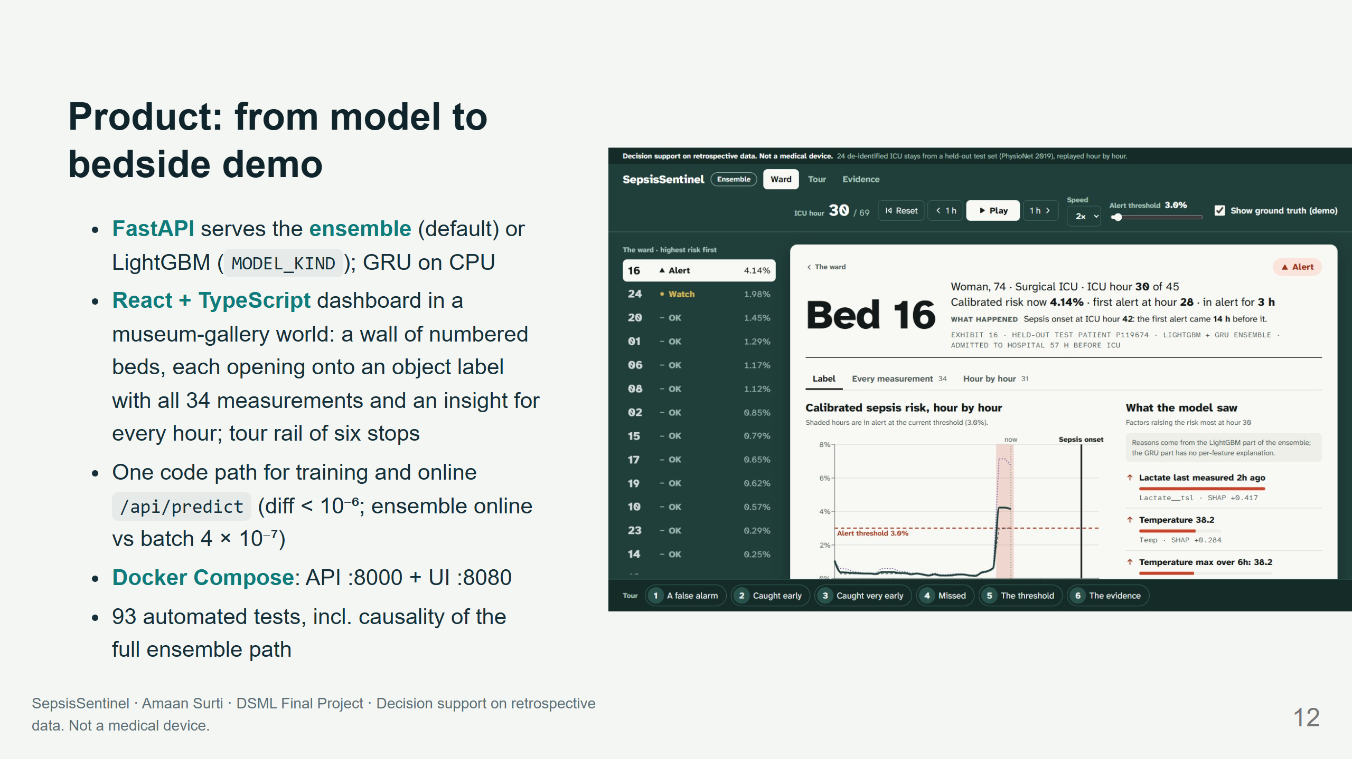
Notes:
LAYOUT: real screenshot of a demo patient (Bed 16) on the right ("one patient's stay" slide uses this).
NOTES (40 s)
The dashboard replays 24 real test patients hour by hour. Under the ensemble Bed 16 first alerts at hour 28; turning on
ground truth shows onset at hour 42. The reasons panel (from the LightGBM half) says lactate was drawn two hours ago and
she has a fever. The demo deliberately includes missed septic patients and false alarms; the beds were picked with
LightGBM and were not reselected for the ensemble.

Slide 13
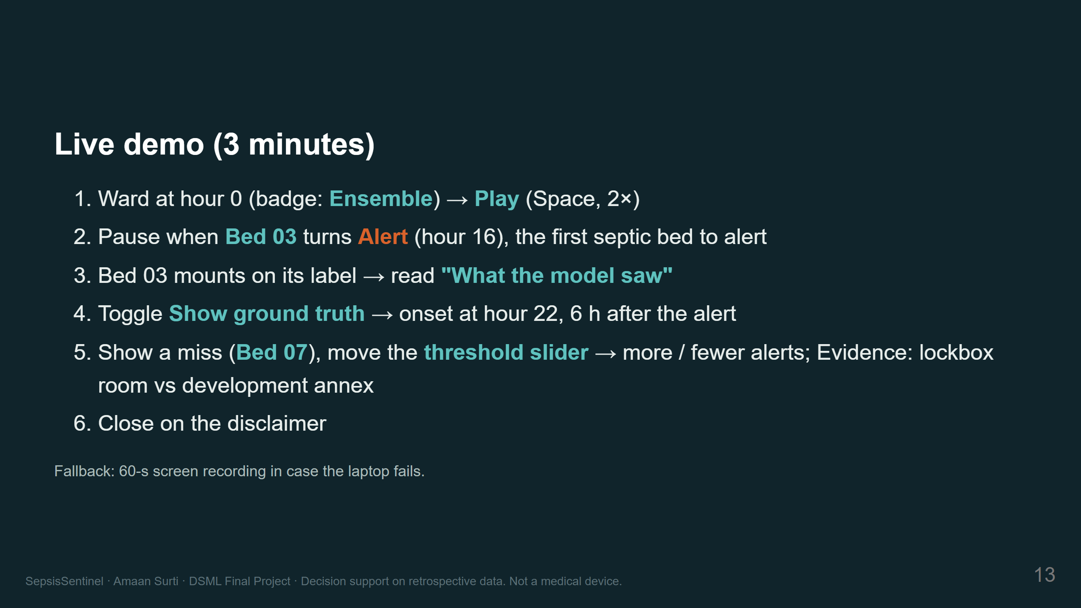
Notes:
NOTES: follow reports/demo_script.md exactly. If the backend fails, switch to the recording.

Slide 14
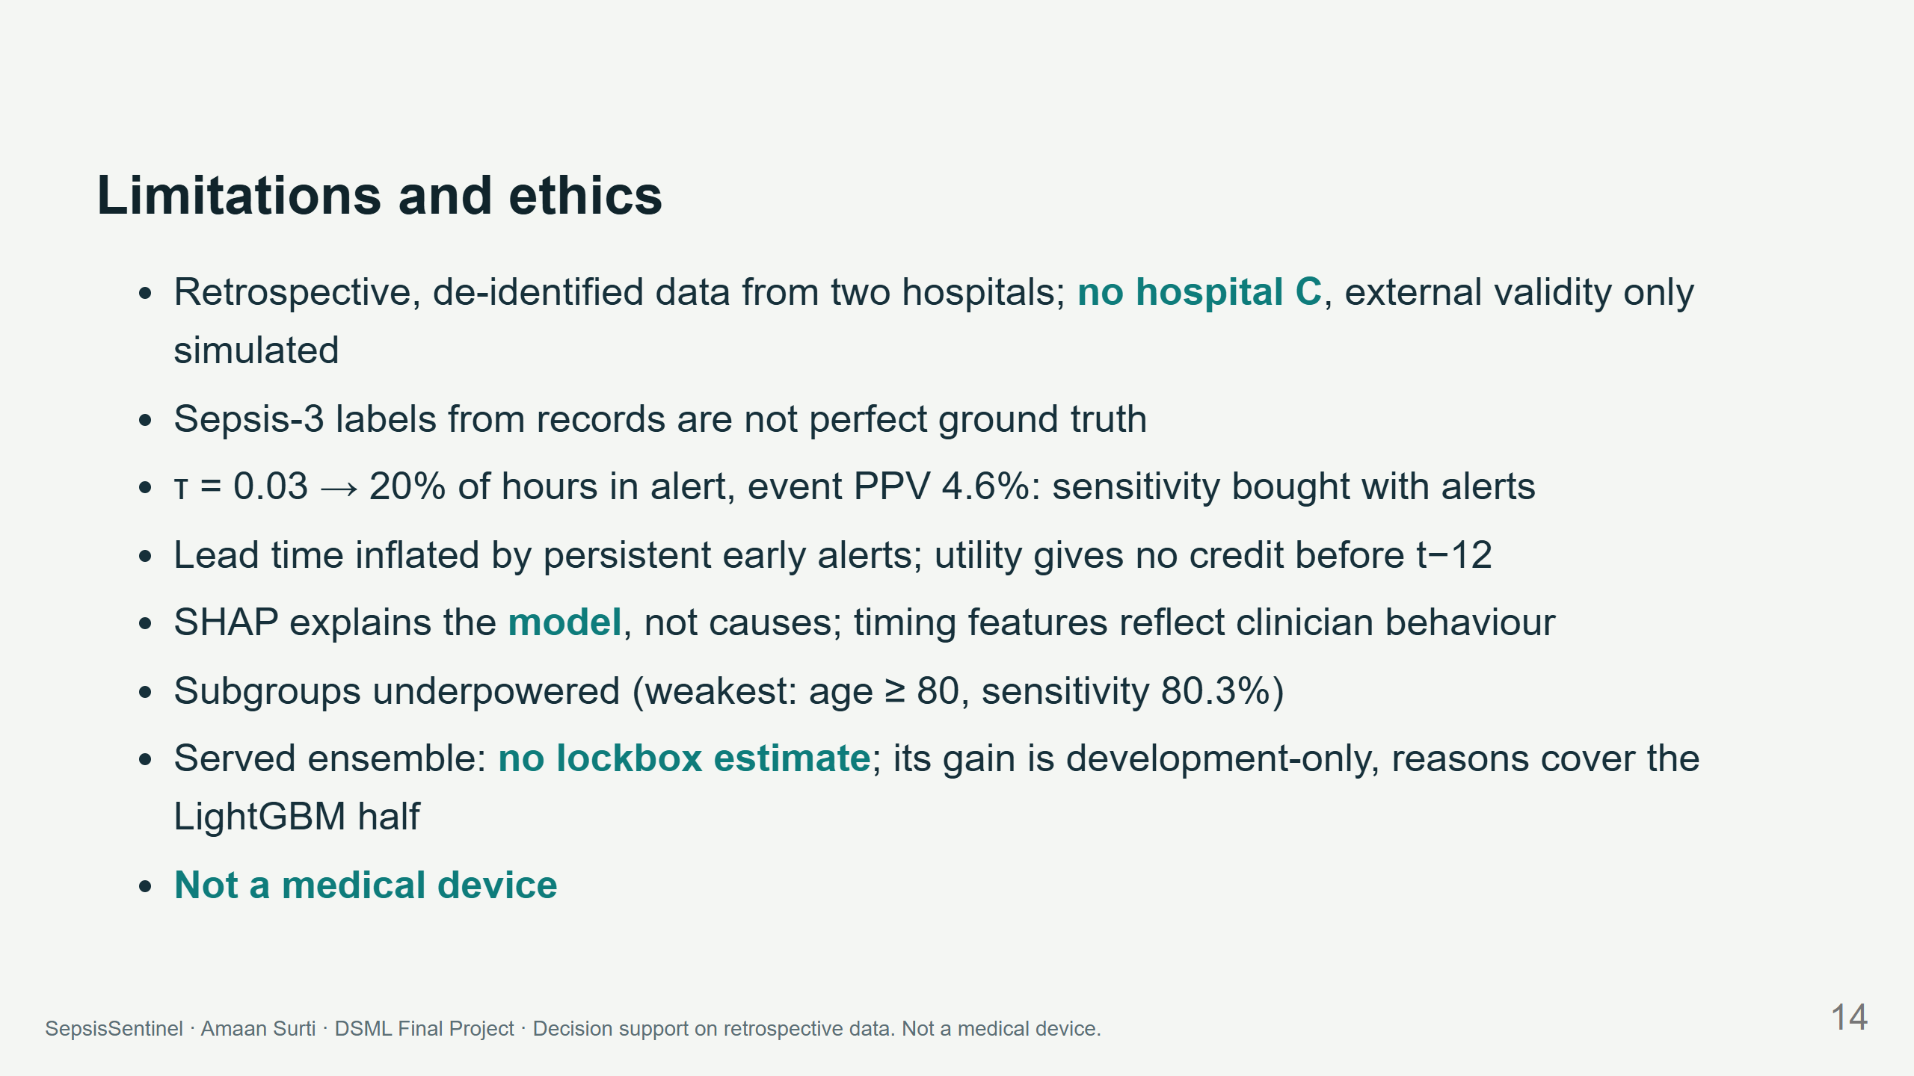
Notes:
NOTES (45 s)
I want to be explicit about what this does not show. It is retrospective; the cross-hospital result says
local validation is mandatory; the low threshold means many alerts. Deployment would need local tuning,
a silent-mode trial, workflow design and monitoring.

Slide 15
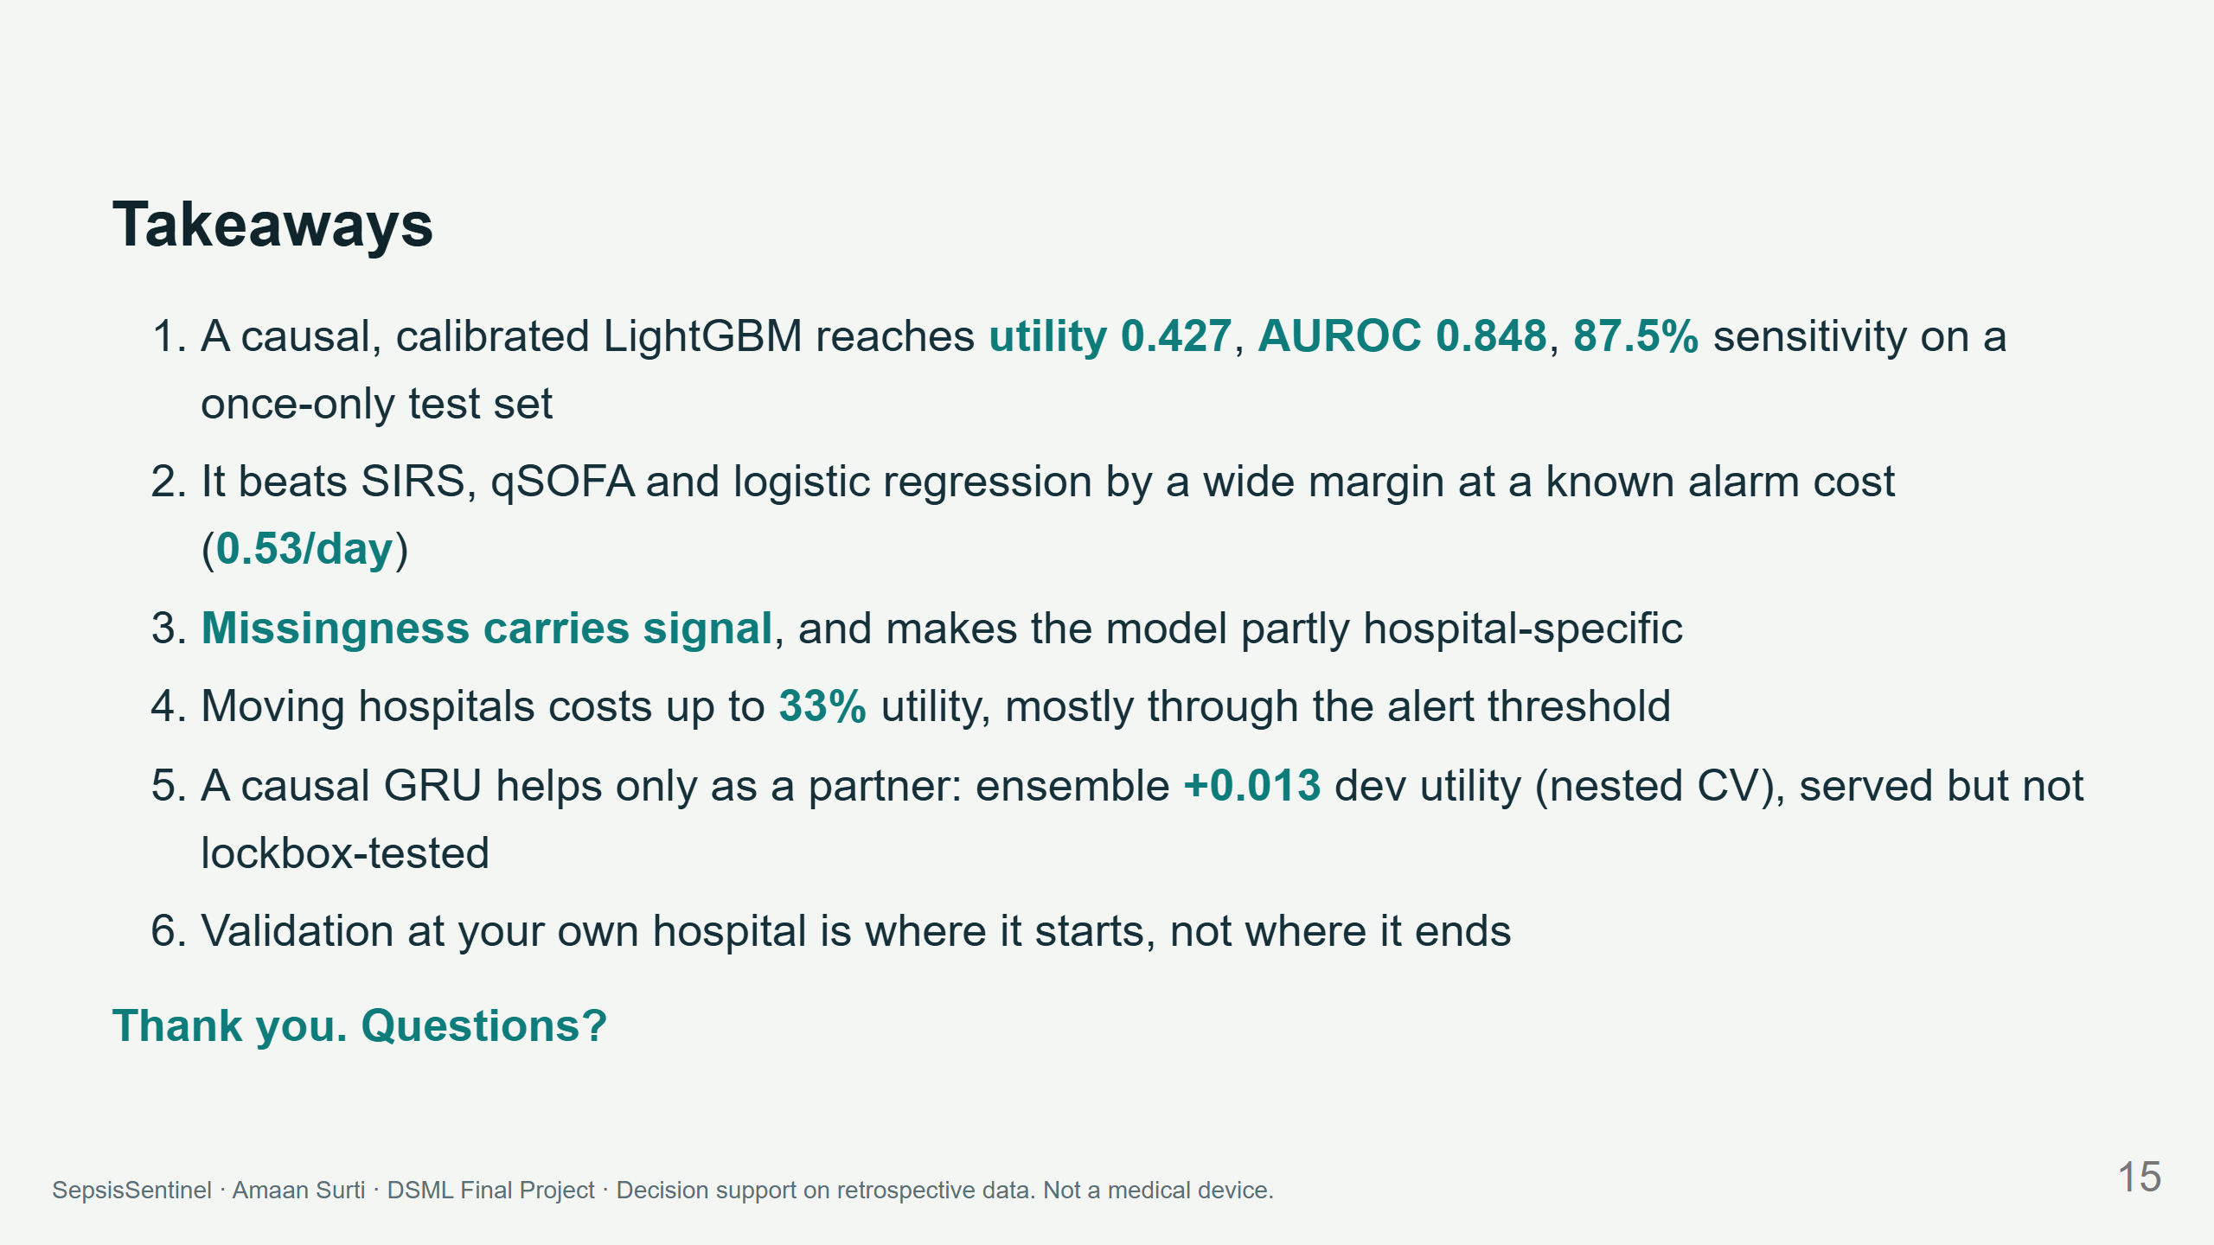
Notes:
NOTES (30 s) Pause for questions. Viva prep: reports/viva_qa.md.

