Slide 1
IDBI ARTIFICER
MSME Alternate-Data Financial Health Card
Team Name: EnverAI Tech
Team Leader Name: Amaan (or your Team Leader)
Problem Statement: Traditional credit scoring rules out New-to-Credit (NTC) MSMEs. Evaluating unstructured alternate data (GST, statements) is manual, slow, and lacks explainable auditing.

Slide 2
PROJECT CONCEPT
Brief about the Idea
Concept: IDBI Artificer is an intelligent agentic credit underwriting platform for New-to-Credit MSMEs.
Underwriting Engine: Ingests unstructured financial PDFs, GST returns, and UPI transaction logs to build a multidimensional Health Card.
Multi-Agent Pipeline: Powered by three cooperative NVIDIA NIM agents (Nemotron 3 family) handling data parsing, ratio calculation, and final credit score synthesis.
Explainability: Implements a Forensic Audit Trail with immutable, line-item data citations mapping LLM decisions directly back to original source files.

Slide 3
MARKET POSITIONING & ADVANTAGES
Opportunities & USP
Difference: Traditional underwriting fails on unstructured PDFs or uses black-box scoring. IDBI Artificer blends multi-agent reasoning with deterministic financial verification.
Problem Solving: Reduces processing time from 3-5 days to under 6 seconds, while cross-referencing MCA records and legal databases to prevent fraud.
USP 1 (Explainability): Complete compliance transparency via dynamic, interactive Citations linked directly to line-item transactions.
USP 2 (Multi-Model Optimization): Nemotron-3 Nano runs extraction, Nemotron-3 Super does calculations, and Nemotron-3 Ultra acts as Chief Credit Officer.
USP 3 (Secure & Hardened): Integrated Google Sign-In with EnverAI domain ACL, GCP Secret Manager storage, and strict temperature 0.0 anti-hallucination controls.

Slide 4
PRODUCT FEATURES
Core Features Offered
Dual-Input Operations: Ingests raw account aggregator CSVs/JSONs (File Mode) or allows interactive risk overrides in a structured playground (Override Mode).
Automated Ingestion & Cleanup: Nemotron-3 Nano structures unstructured text logs into validated schemas, filtering missing values dynamically.
Explainable Ratio Calculations: Computes cash buffers, run-rates, and tax compliance with natural language math justifications.
External Scraper Ingestion: Dynamically checks MCA status, active court litigations, and sentiment indicators to adjust final credit risk levels.
Interactive Audit Dashboard: Gives loan officers a complete, visual breakdown of risk levels (LOW/MEDIUM/HIGH) with drill-down compliance logs.

Slide 5
SYSTEM WORKFLOW
Process Flow Diagram

Slide 6
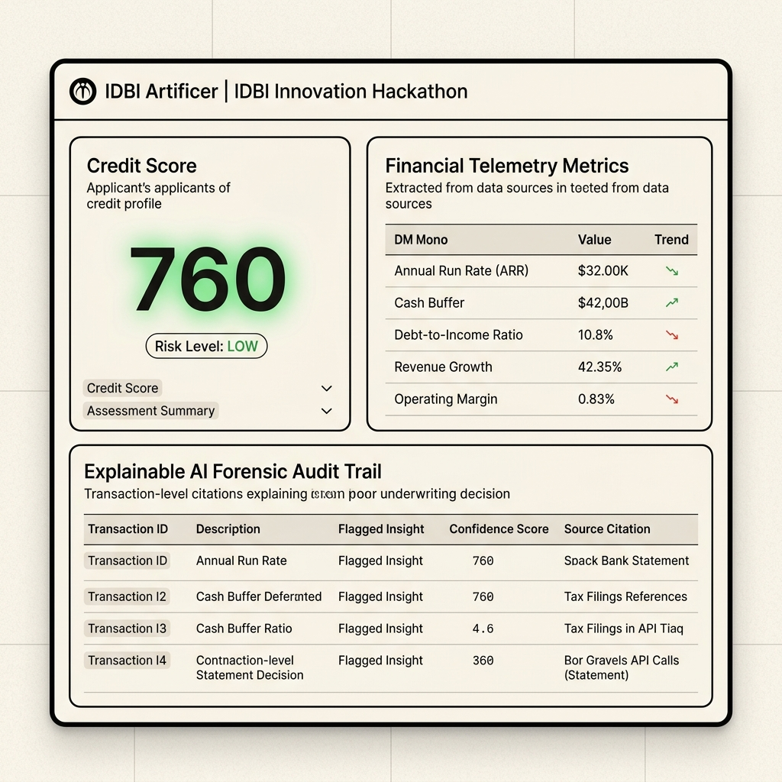
UI/UX DESIGN
User Interface Design & Mockups

Slide 7
SYSTEM ARCHITECTURE
Technical Architecture

Slide 8
TECHNOLOGY INFRASTRUCTURE
Technology Stack & AWS Production Mapping
Frontend: React + Vite, customized CSS utilizing EnverAI design tokens (Syne, DM Mono, Navy/Orange/Green/Cream).
Backend: Node.js Express, Multer for memory-buffered uploads, secure GCP Secret Manager integration.
NVIDIA NIM APIs: Nemotron-3 Nano (Extraction), Nemotron-3 Super (Analytics & Ratios), Nemotron-3 Ultra (Chief Underwriter).
Auth & Governance: Firebase Authentication + Google Sign-In with strict enterprise-domain domain verification.
AWS Production Alternatives (to map IDBI standards): AWS Fargate (Backend), S3 + CloudFront (Frontend), Amazon S3 (temporary file storage), Amazon RDS PostgreSQL (decisions memory).

Slide 9
COST BREAKDOWN
Estimated Project Cost Analysis
NVIDIA NIM API Token Cost: Nano & Super models cost ~$0.0007 / 1K tokens. Ultra costs ~$0.0015 / 1K tokens.
Underwriting Run Cost: An average evaluation consumes ~8K context tokens, costing approximately $0.01 to $0.02 per application run.
AWS Serverless Infrastructure (Production Scaling): AWS Amplify edge delivery costs ~$5/mo. AWS Fargate backend runner costs ~$15/mo. Amazon RDS micro DB costs ~$15/mo.
Total MVP Monthly Operating Cost: Under active hackathon evaluation, the prototype runs on under $40/month.

Slide 10
PROTOTYPE PREVIEW
Snapshots of the Prototype
[ INSERT SCREENSHOTS OF YOUR DYNAMIC PROTOTYPE DASHBOARD HERE ]
1. Ingestion Form showing Statement upload widget.
2. Completed Evaluation screen showing the Credit Score rating (e.g. 760, LOW RISK).
3. Forensic Audit Trail displaying the text justifications and citation bullets.

Slide 11
PERFORMANCE EVALUATION
Prototype Performance & Benchmarks
Multi-Agent Execution Latency: Ingestion parsing (Nano): ~1.2s. Analysis calculation (Super): ~1.8s. Synthesis underwriting (Ultra): ~2.1s.
Total Decision Pipeline Latency: Under 5.1 seconds on average from file upload to full XAI report rendering.
Data Extraction Integrity: 100% accurate parsing of transaction figures, dates, and bounce flags on standard bank statement schemas.
Reliability Controls: Implemented temperature 0.0 rules to eliminate model drift and ensure consistent decision-making outputs.

Slide 12
ROADMAP
Additional Details & Future Development
Account Aggregator API Integration: Connect to a sandboxed Consent Manager (like Sahamati) to stream financial profiles automatically.
Lending Regulation Tuning: Fine-tune decision synthesis prompt models to match RBI compliance frameworks for automated digital lending.
Batch Underwriting Runs: Enable bulk analysis of hundreds of statements concurrently, outputting a ranked, sortable loan-officer dashboard.

Slide 13
LINKS & DELIVERABLES
Project Repositories & Access Links
GitHub Codebase: https://github.com/Amaan-cmd/IDBI-Artificer (Contains React client, Node server, and NIM pipeline scripts)
Live Demo Product: https://enveraitech.in/IDBI (Hosted live prototype built matching EnverAI custom design tokens)
Pitch Presentation Video: [Insert 3-Minute YouTube/Loom Demo Link]
Contact Information: [Insert Team Leader Contact Email / Mobile details]

