Slide 1
Football Data Analysis
Amaan Abid(DA23)

Slide 2
Problem Statement.
Enabling data-driven decisions in player recruitment and team strategy.
Objectives.
To check how a player's attributes result in performance.
Suggest the best player to buy for the next season.

Slide 3


Data Cleaning and Pre-Processing
Checking for null values
Checking null value percentage.
Dropping column.
Imputing Missing values.

Slide 4
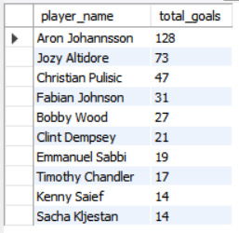
Top 10 players with most Goals.
Aaron Johannsson scored the most Goals with 128 goals.

Slide 5
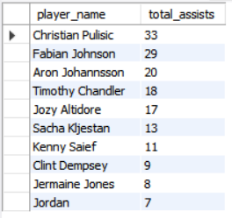
Top 10 players with most Assists.
Christian Pulisic has the most Assists with 33 assists.

Slide 6
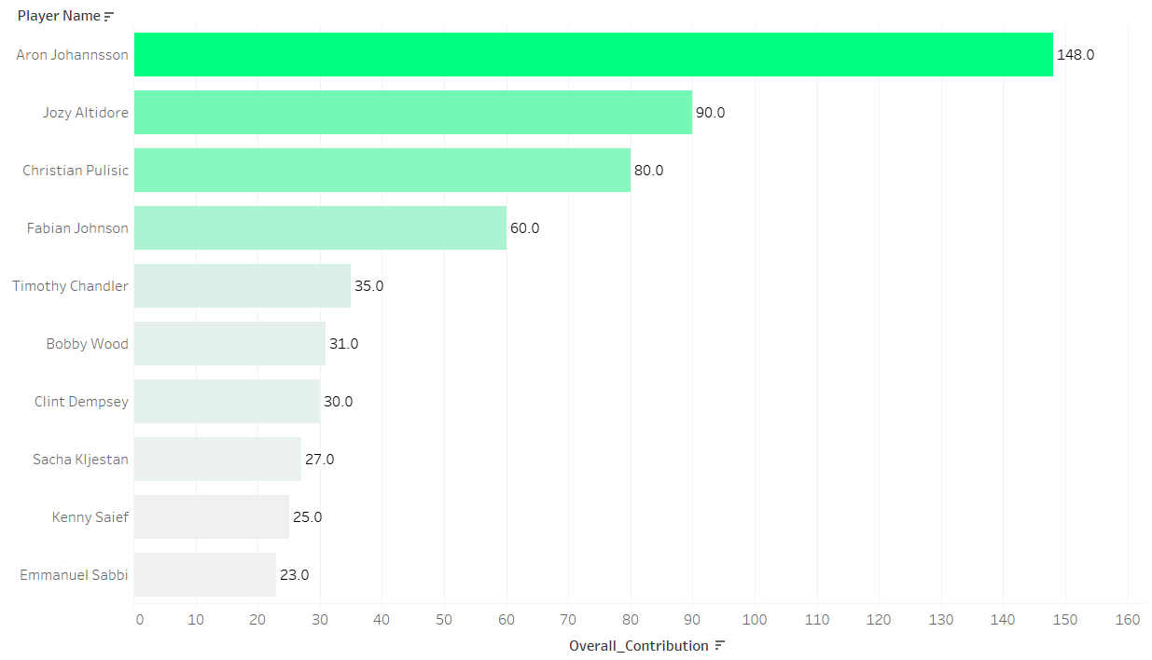
Who are the top 10 players with the most G/A contribution?
Aaron Johansson has the most Goal plus Assist contribution with total of 148 goals + assists.

Slide 7
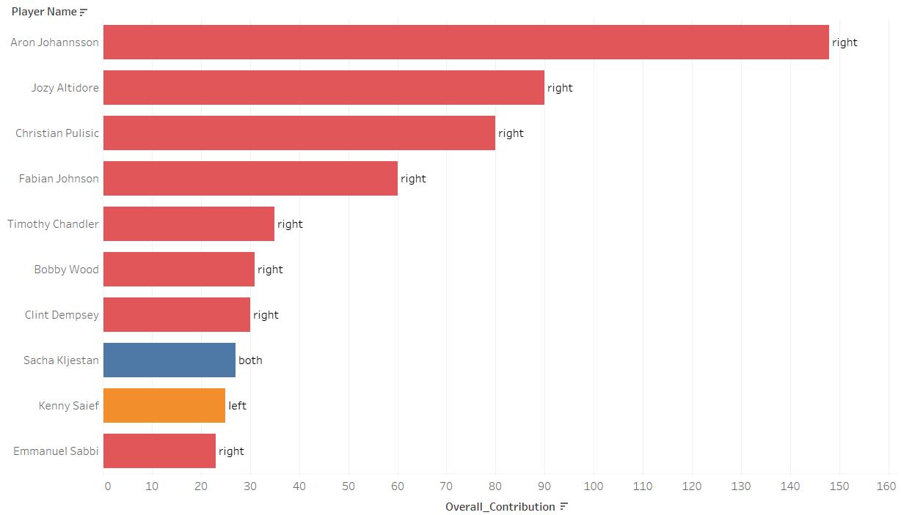
What is the preferred foot for the top 10 scorers?
The majority of scorers are right footed.

Slide 8
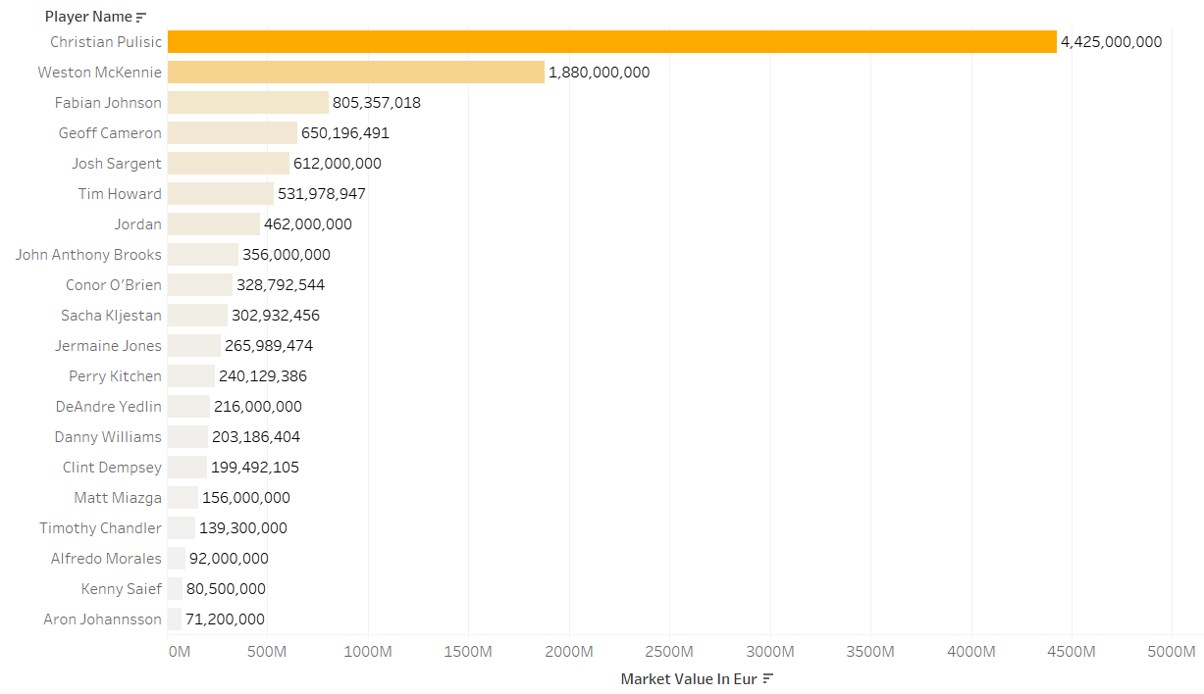
Players with the highest market value.
Christian Pulisic is the most expensive player in the market.

Slide 9
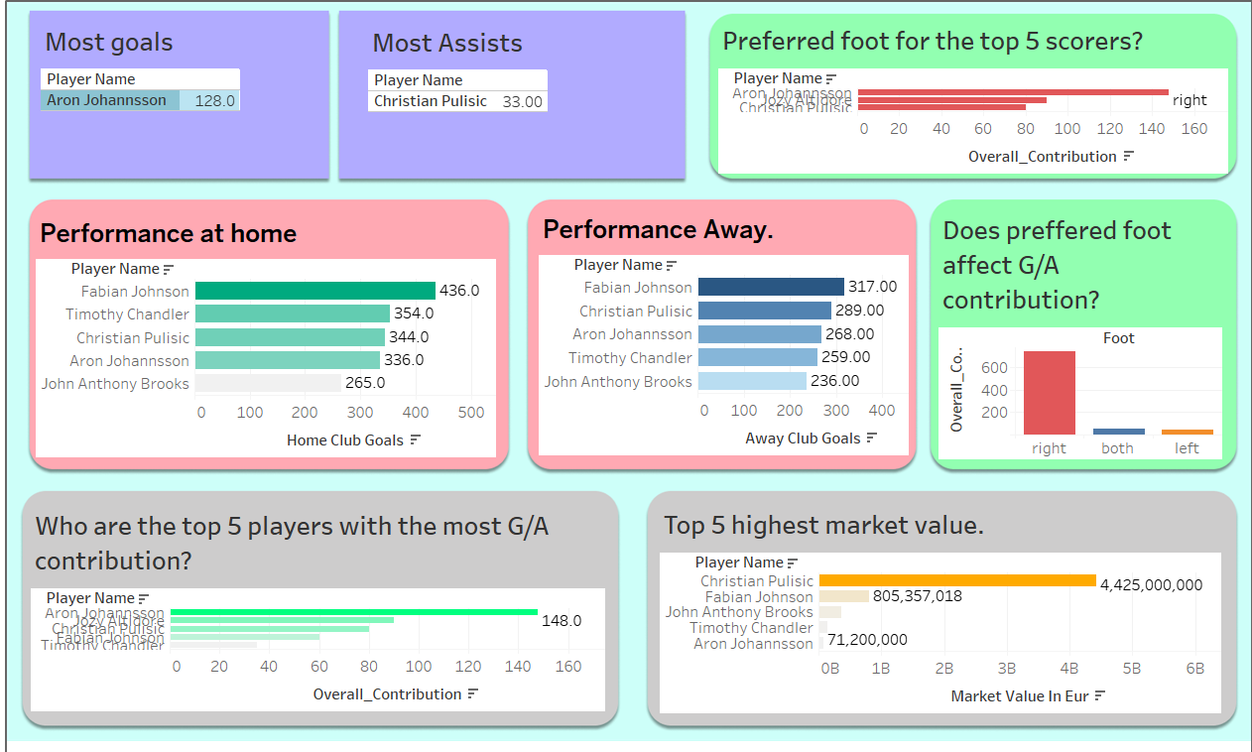
Dashboard
Click to access dashboard.

Slide 10
Summary
Aaron Johanssen is the player with most goals.
Christian Pulisic has the most Assists.
Aaron Johanssen has the most goals and assists combined.
The Right foot is the preferred foot for majority of players.
The most Expensive player in the market is Christian Pulisic.

Slide 11
Conclusion.
The best player to buy right now is Aaron Johanssen.
He has scored the most goals.
His Overall contribution is also the highest.
His Preferred foot is the right foot.
His market value is only 71M. He is not in the top 15 expensive players. For his performance, this price tag is too low. This player is the best in market right now.

