Slide 1
Fitness Website
Aarnav Kaushal(2310991671)
Amaan Ur Rehman(2310991686)
Chirag Baboota(2310991725)
Submitted To:
Ms. Tapalagna Chakraborty

Slide 2
agenda
Description
Features
Target Audience
Website Visuals
Conclusion

Slide 3

Description
EnerGise is your ultimate fitness platform, offering personalized workout and nutrition plans, live and on-demand training sessions, and progress tracking. With expert guidance, a variety of fitness products, and real-time support, we empower you to transform your health and achieve your goals. Energize your fitness journey with us today!

Slide 4
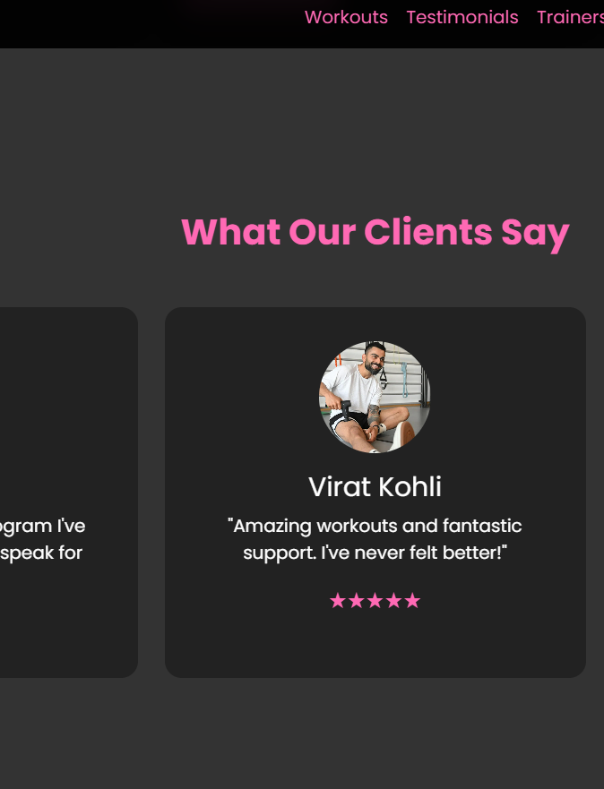
Features
Workout Plans:
Personalized Plans: Custom-tailored workout and nutrition plans designed to meet individual goals.
2. E-Commerce:
Product Sales: A selection of fitness-related products including apparel, supplements, and equipment.
Subscription Plans: Various membership plans, class packs, and training packages available for purchase.
3. Virtual Training:
On-Demand Videos: A comprehensive library of pre-recorded workout videos available for anytime access.
4. Inclusion:
Senior Citizens: Specialized fitness programs designed to help older adults maintain mobility and overall health.

Slide 5
Target Audience
1. Fitness Enthusiasts: Individuals actively engaged in fitness looking for additional resources, challenges, and advanced workouts.
2. Busy Professionals: Those with tight schedules seeking efficient workout solutions that fit into their busy lives.
3. Beginners and Newcomers: Individuals new to fitness who need guidance, motivation, and beginner-friendly programs.
4. Seniors: Older adults in search of fitness programs tailored to their age group, focusing on maintaining mobility and overall wellness.

Slide 6
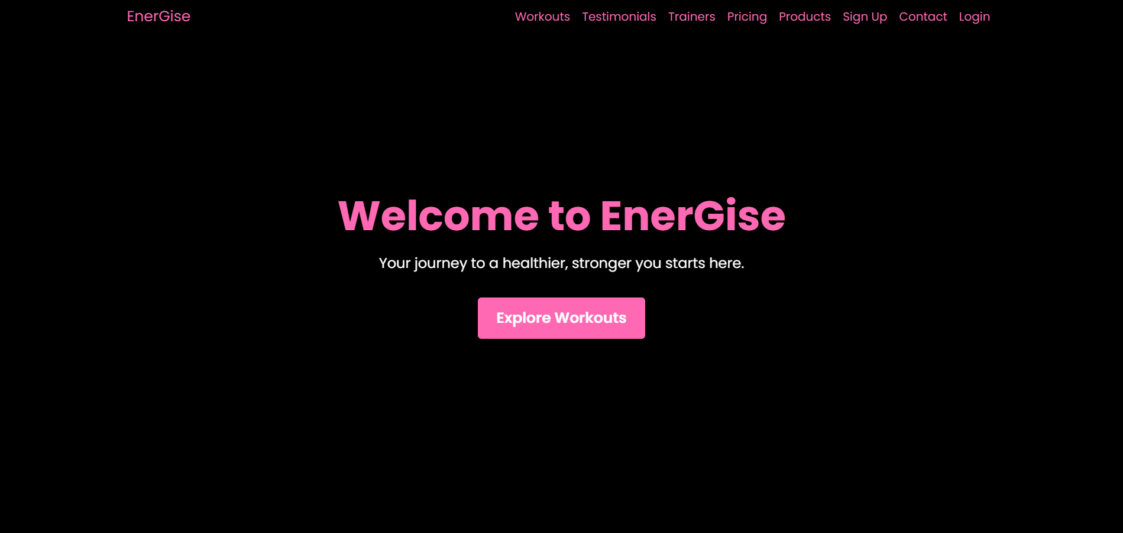

Slide 7
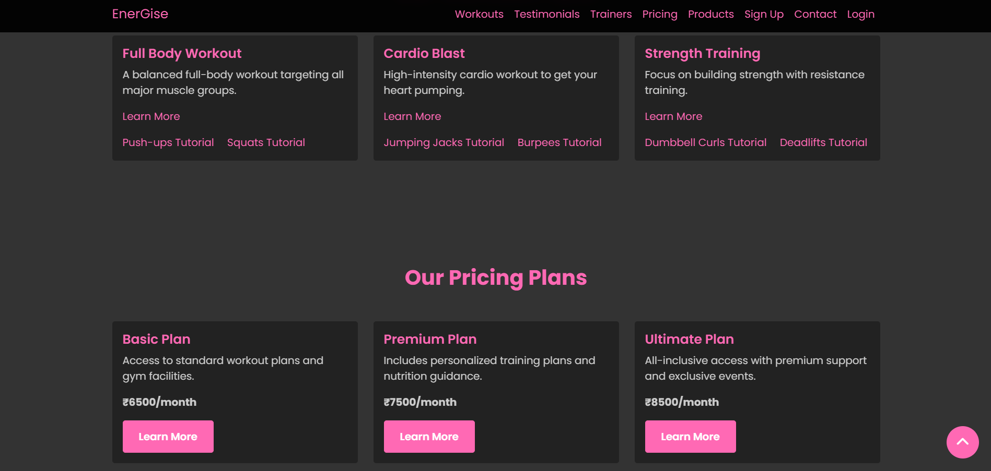

Slide 8
Conclusion
In conclusion, EnerGise is dedicated to empowering you on your fitness journey by providing personalized plans, expert guidance, and real-time support. Whether you're a beginner or an experienced athlete, our platform offers the tools and resources to help you achieve your health goals. Join EnerGise today and take the first step towards a healthier, more energized life.

Slide 9
thank you

