Slide 1

ATLIQ GRANDS · PERFORMANCE BRIEF
ATLIQ GRANDS:
STRATEGIC
PERFORMANCE
ANALYTICS 📊
ATLIQ GRANDS
Data-driven insights for revenue optimization in India’s luxury and business hotel segment.
Domain : Hospitality
Developed by Mohd Amaan Ali

Slide 2
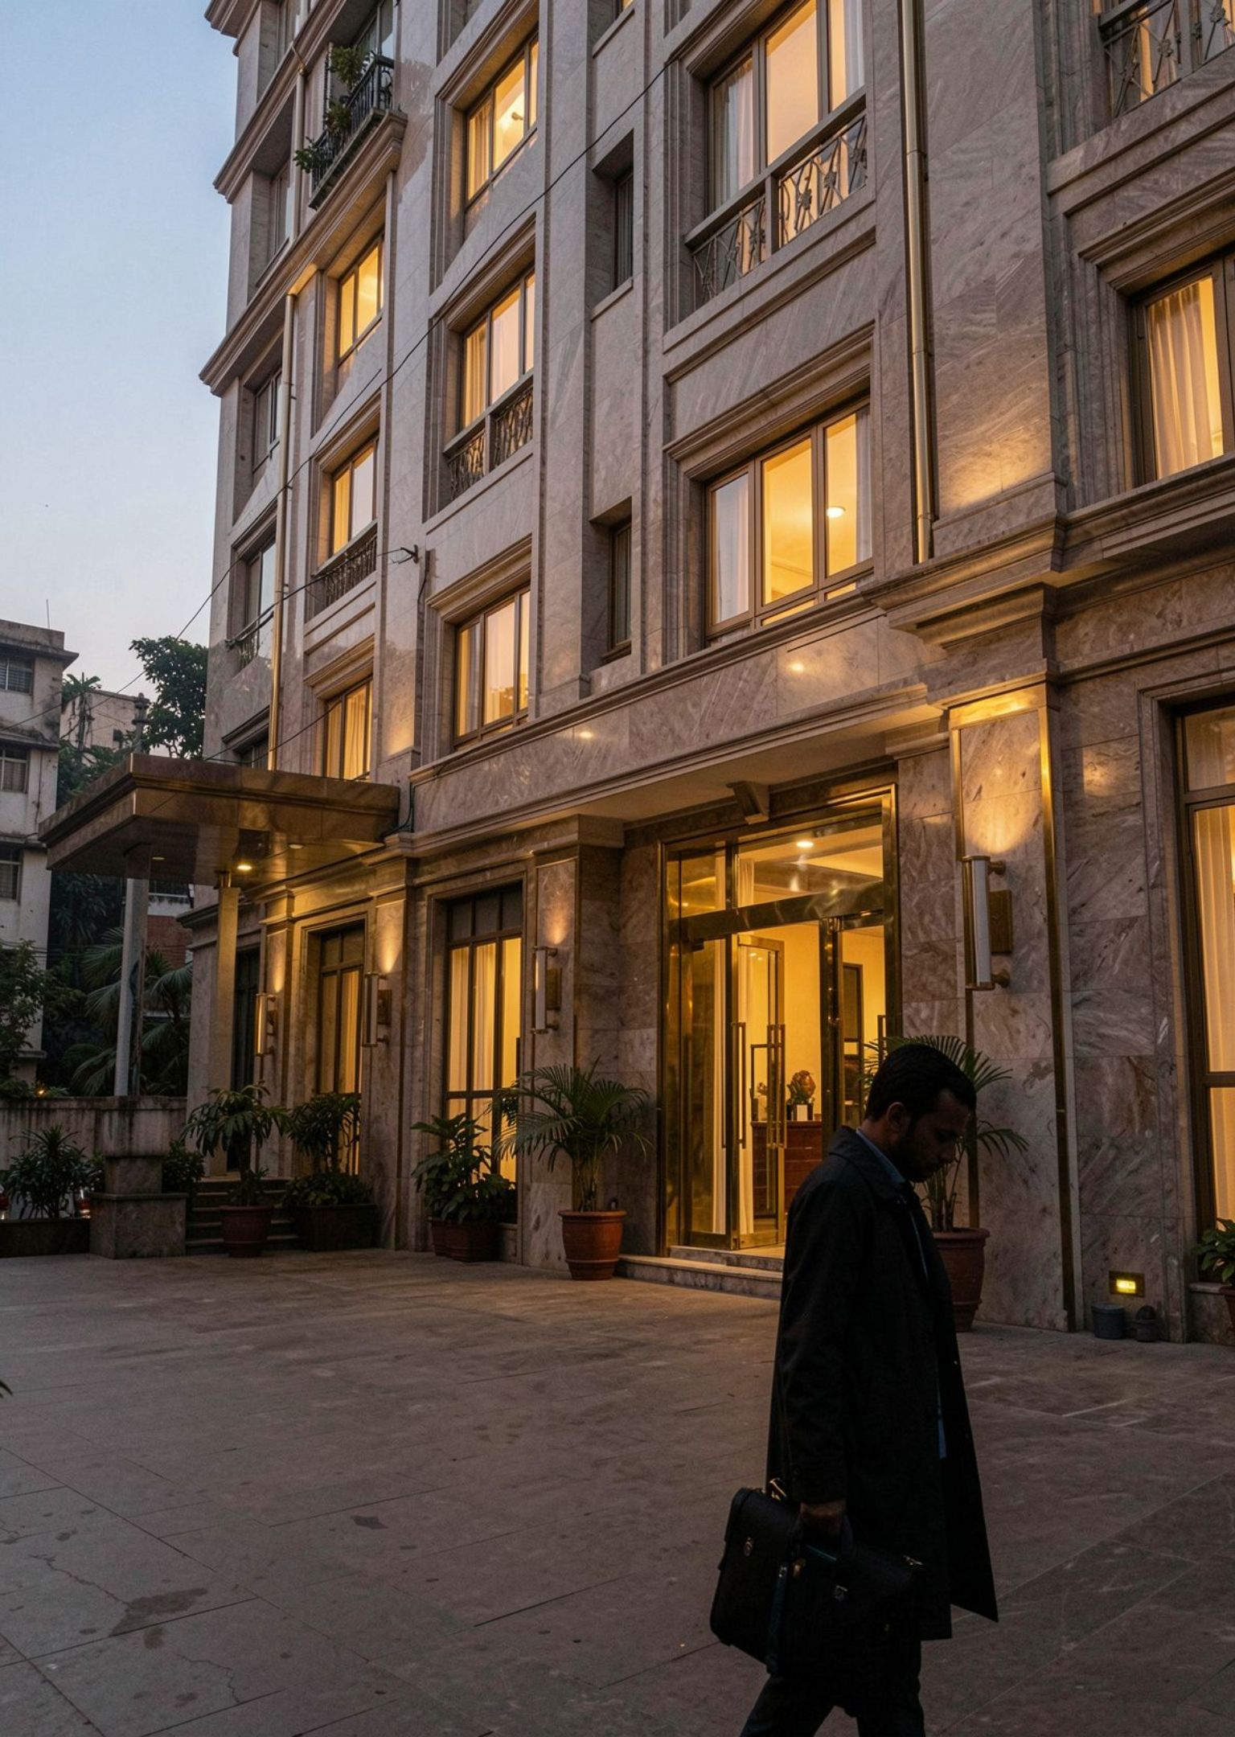
BUSINESS CHALLENGE
REVENUE AND MARKET SHARE ARE UNDER PRESSURE
FOOTPRINT
AtliQ Grands operates five-star hotels across Bangalore, Mumbai, Hyderabad and Delhi ( India ).
PROBLEM
The company is losing revenue and market share in the luxury and business hotel segment.
02

Slide 3
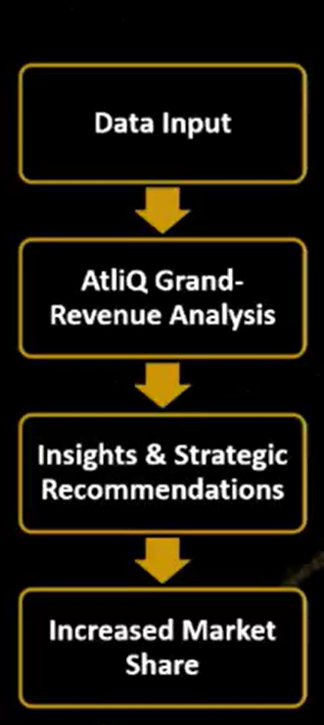
Project Goal
Analyze revenue data for AtliQ Grands Hotels
Identify Key trends , opportunities & challenges
Develop Data – driven strategies to reclaim market share.
03

Slide 4
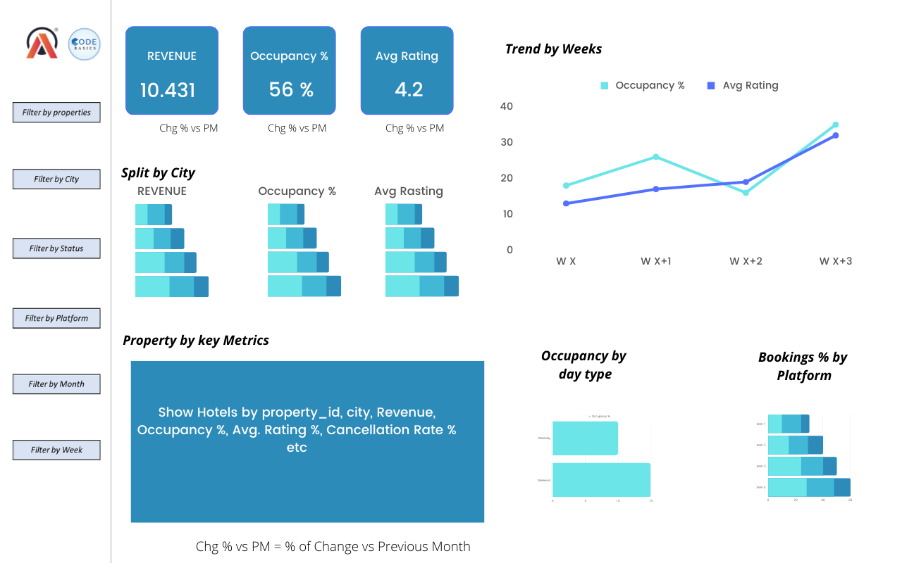

ANALYTIC FRAME
THE ANALYSIS CONNECTS GUEST BEHAVIOR TO HOTEL PERFORMANCE
Three months ( May to July 2026 ) of booking data across AtliQ hotels.
Five source tables: dates, hotels, rooms, aggregated bookings, and bookings.
Supporting metric definitions and a mock dashboard.
SOURCE TABLES
GUEST BEHAVIOR
PERFORMANCE DECISIONS
04

Slide 5
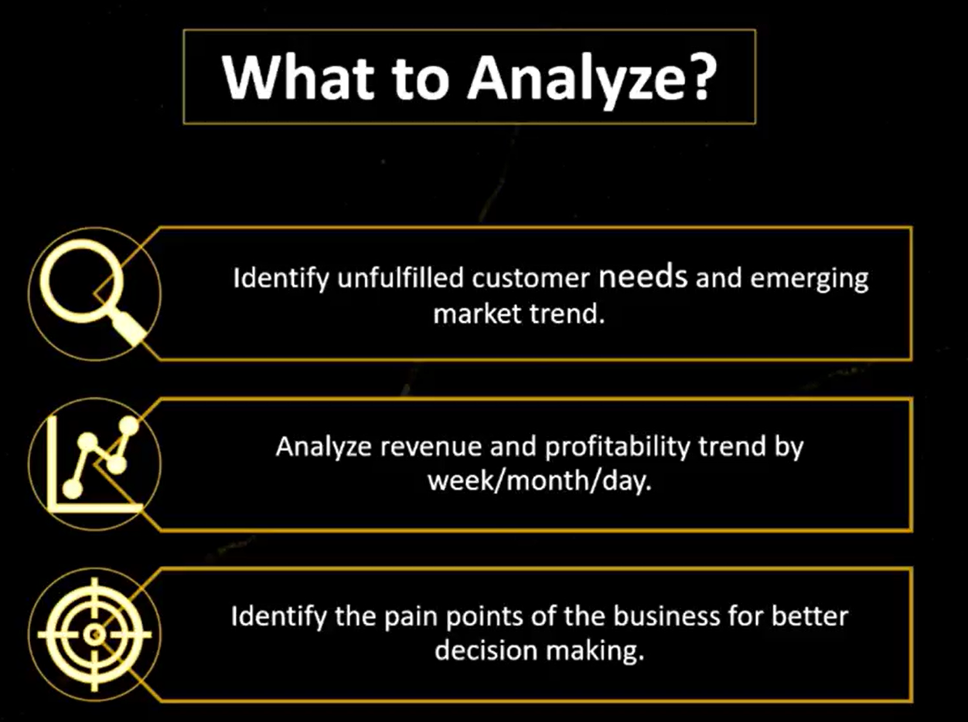
05

Slide 6
Key Insights
REVENUE SHARE BY HOTEL CATEGORY
HIGHEST
LOWER
LUXURY HOTELS CARRY THE LARGEST REVENUE SHARE
Luxury
Business
Largest revenue share
Lower revenue share
FIRST EVIDENCE POINT · REVENUE IS CONCENTRATED IN LUXURY
Luxury contributes the highest revenue share versus Business.
06

Slide 7
DEMAND × PRICING
WEEKDAY VERSUS WEEKEND DEMAND
WEEKEND DEMAND IS STRONGER, BUT PRICING IS NOT FOLLOWING IT
PERIOD | OCCUPANCY | REVPAR UPLIFT
Weekday | 55.8% | Baseline
Weekend | 62.6% | Approximately ₹900 higher
OCCUPANCY
PRICING SIGNAL
+6.8 PTS
ADR stays relatively stable
Weekend demand is stronger.
Price should follow demand.
ADR stays relatively stable while occupancy fluctuates, signaling room to align pricing with demand.
07

Slide 8
RECOVERY MOVES
Clearer cancellation policies
REVENUE LEAKAGE
Incentives for confirmed bookings
24.8%
OF BOOKINGS ARE CANCELLED
That is nearly 1 in every 4 bookings.
REDUCE LEAKAGE
08

Slide 9
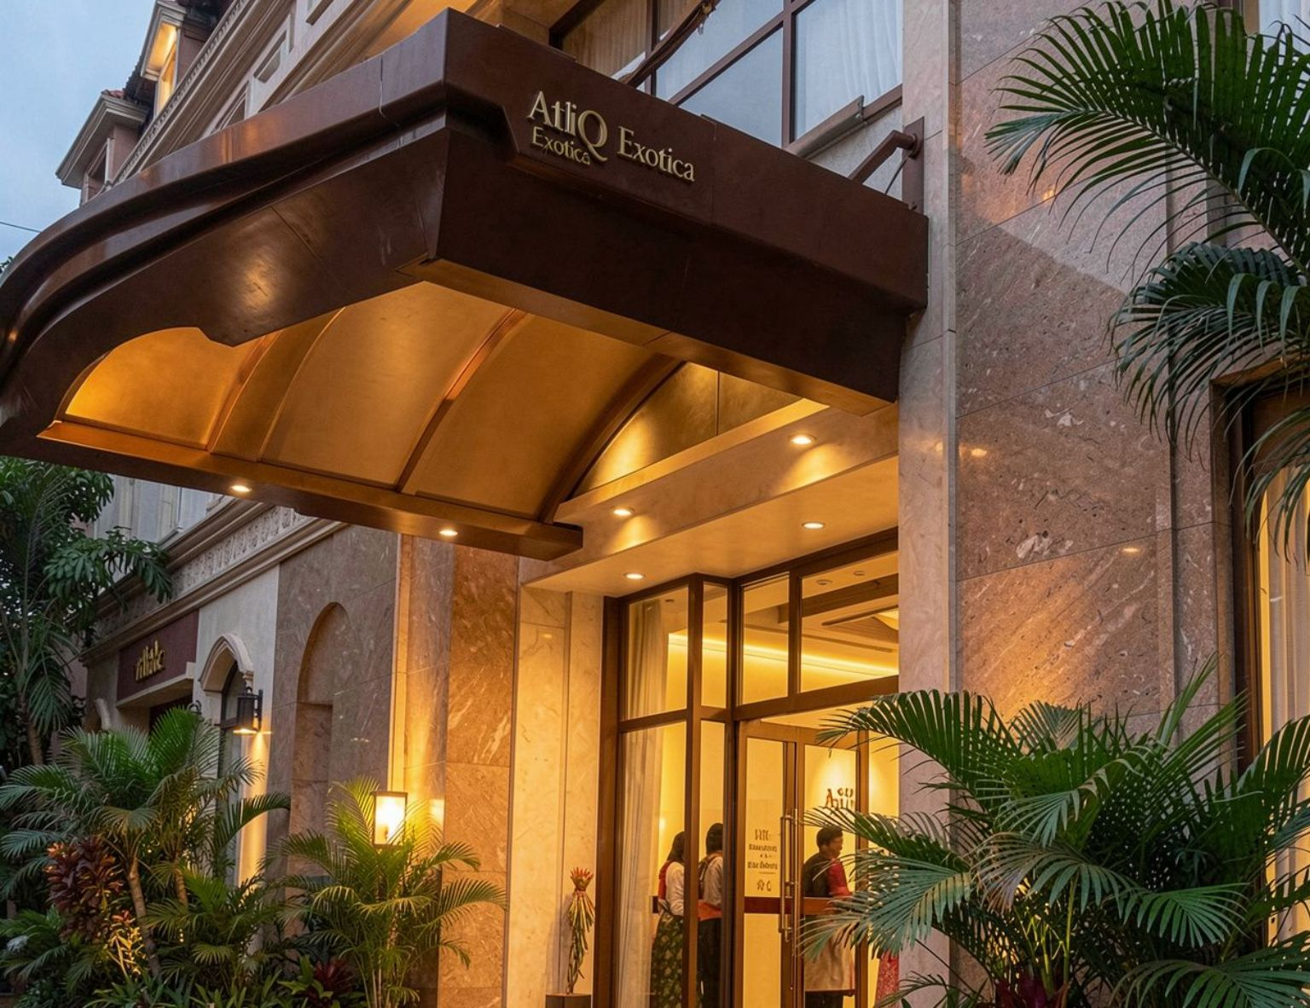
CITY × PROPERTY BENCHMARK
MUMBAI LEADS, WITH ATLIQ EXOTICA AS THE BENCHMARK PROPERTY
Mumbai is the highest-performing city in the analysis. Use the strongest property as the source of practices to replicate.
CITY SIGNAL
PROPERTY BENCHMARK
MUMBAI
$212M
Highest-performing city in the analysis.
AtliQ Exotica · 4.3 rating
09

Slide 10
UPSIDE IDENTIFIED
GUEST SATISFACTION AND CHANNEL MIX STILL LEAVE UPSIDE
AVERAGE GUEST RATING
TARGET GAP
3.6 / 5
−0.4
Below the 4.0 target.
Focus service improvements on properties below 4.0.
SERVICE
CHANNELS
Improve properties below 4.0
Invest where ADR and realization are stronger
Reduce dependency on weaker channels.
10

Slide 11
RECOVERY FRAMEWORK
FIVE MOVES CAN HELP RECLAIM MARKET SHARE
01
02
03
04
05
Adopt dynamic pricing
Raise weekend rates
Reduce cancellation leakage
Replicate Exotica practices
Build property action plans
Tie pricing to occupancy and demand.
Price into the strongest demand.
Scale the benchmark across underperforming properties.
Connect guest experience to channel performance.
Review policies and reward confirmed bookings.
11

Slide 12
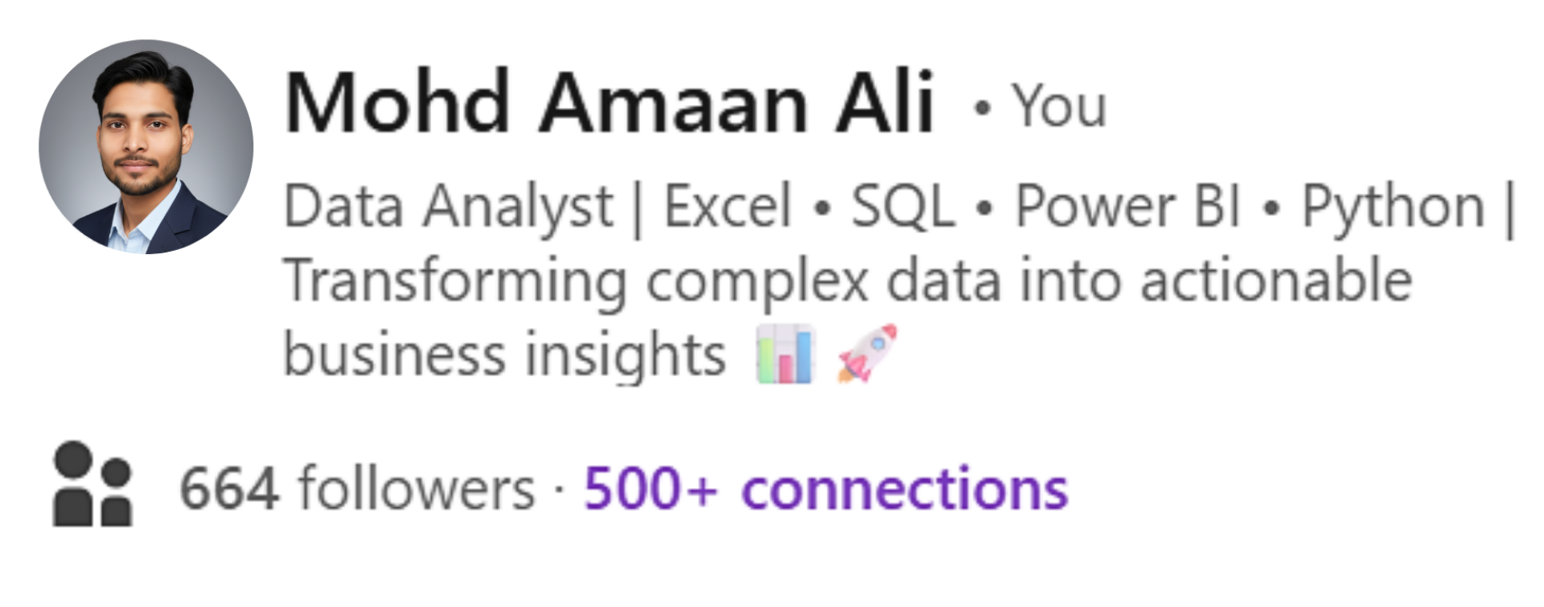
Thank You to watch ☺
THE NEXT DECISION
FROM ANALYTICS
TO REVENUE
RECOVERY
AtliQ Grands Performance Analytics
Tool used · Power BI

