Slide 1
Insights from Airbnb Analysis from Pre-COVID Period

Slide 2
AGENDA
Objective
Background
Key Findings
Recommendations
Appendix
Methodology

Slide 3
OBJECTIVE
Derive important insights from Airbnb’s NYC business in the pre-COVID period.
Provide an overall understanding of the customer preferences and the host properties from the Airbnb NYC database.
Airbnb wants to use those insights to make decisions for the NYC Airbnb business for travel in the post-COVID period.

Slide 4
BACKGROUND
Airbnb saw a major decline in its revenue due to COVID-19.
Airbnb business was affected due to travel restrictions.
Now that the restrictions have started lifting and people have started to travel more, Airbnb wants to ensure that it is fully prepared for this change.

Slide 5
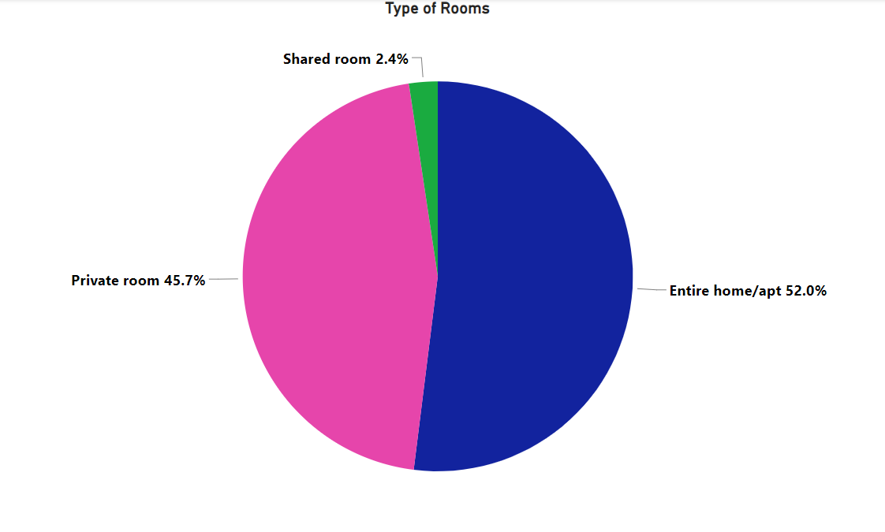
Most preferred types of rooms
Airbnb hosts offering rentals in New York City prefer 'Entire home/apt' and 'Private room’ over shared rooms.
'Entire home/apt' and 'Private room’ make up around 97.7% of all listed properties in the area.
Shared rooms account for only 2.4% of the total listed properties.

Slide 6
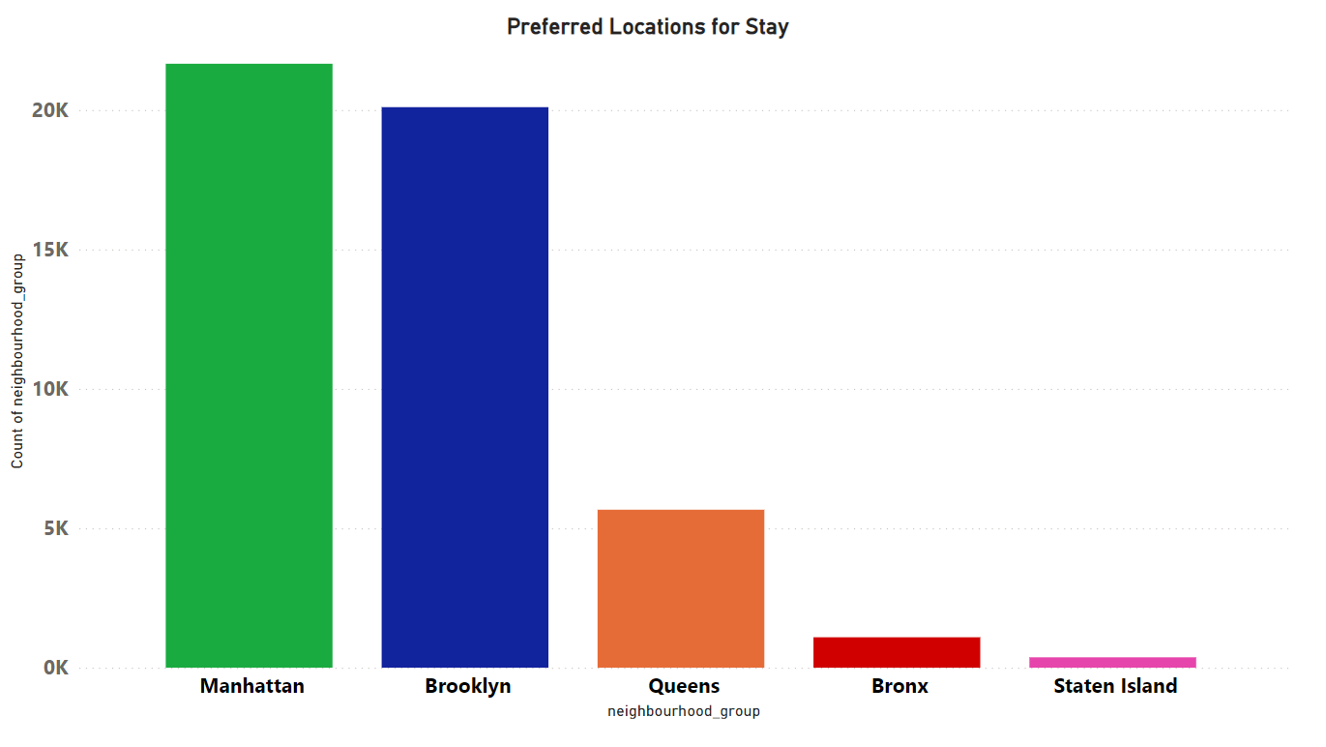
Most preferred locations
Manhattan and Brooklyn are the most popular places to stay in.
Queens came at third.
The least preferred locations are Bronx and Staten Island

Slide 7
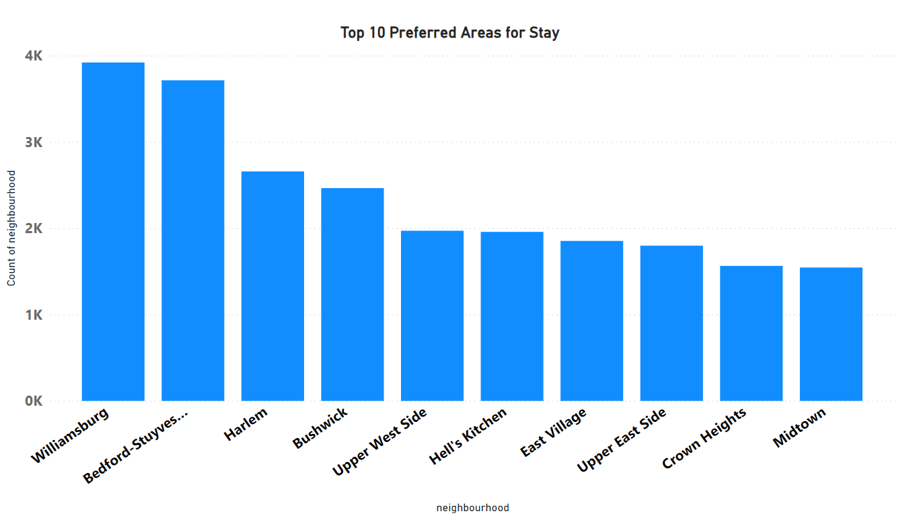
Top 10 preferred areas for stay
Williamsburg and Bedford-Stuyvesant have the highest number of listings, with counts above 3K.
Harlem also shows a high count.
Bushwick and the Upper West Side also have good count values which are just below 3K.

Slide 8
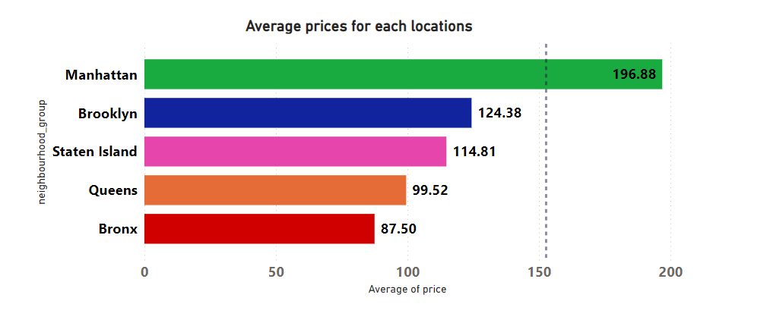
Average Prices of Each locations
Despite its popularity, Manhattan had highest average prices.
Brooklyn and Staten Island follow Manhattan in terms of average price.
Queens and Bronx have the lowest average prices.

Slide 9
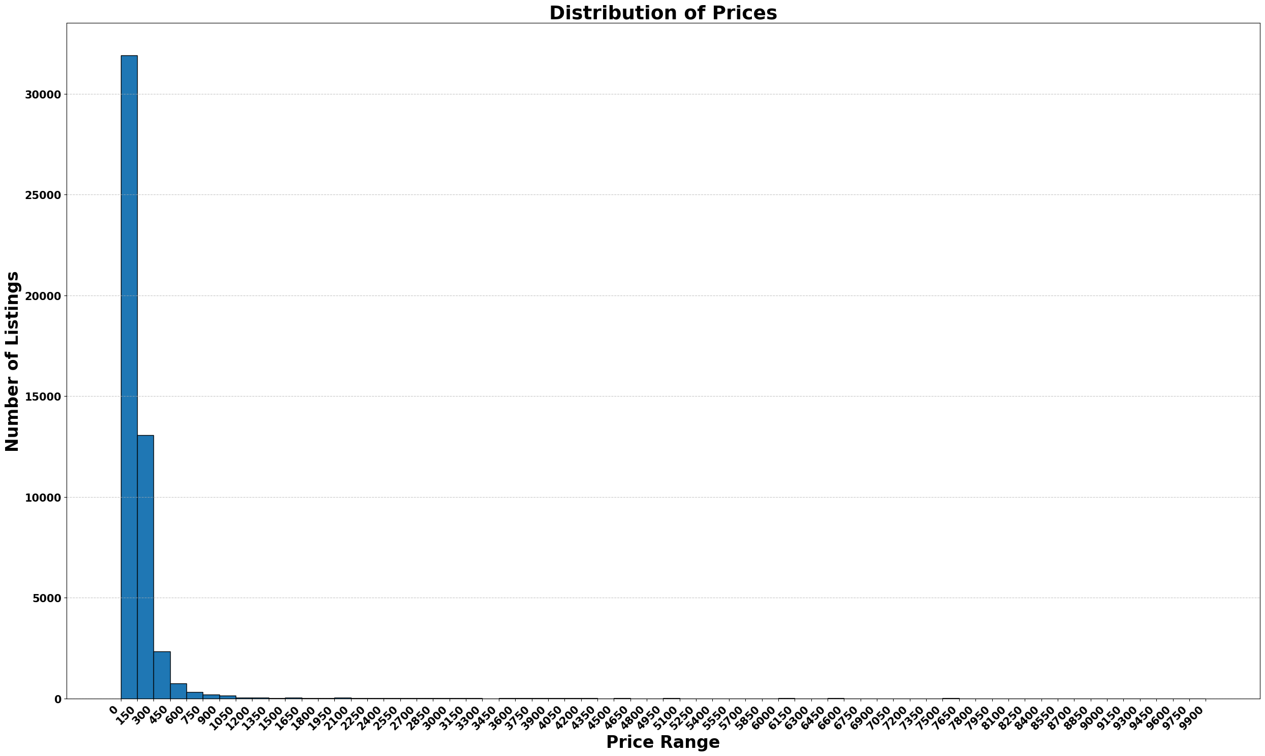
Pricing ranges preferred by customers
Average price of listings was $152.72.
Most preferred price range was from $0 to $150.
Majority of Airbnb listings were priced at the lower end of the spectrum. Airbnb was a popular choice for budget-conscious travellers during the pre-COVID era.
Airbnb could focus on promoting these affordable listings to attract more budget-conscious travellers.

Slide 10
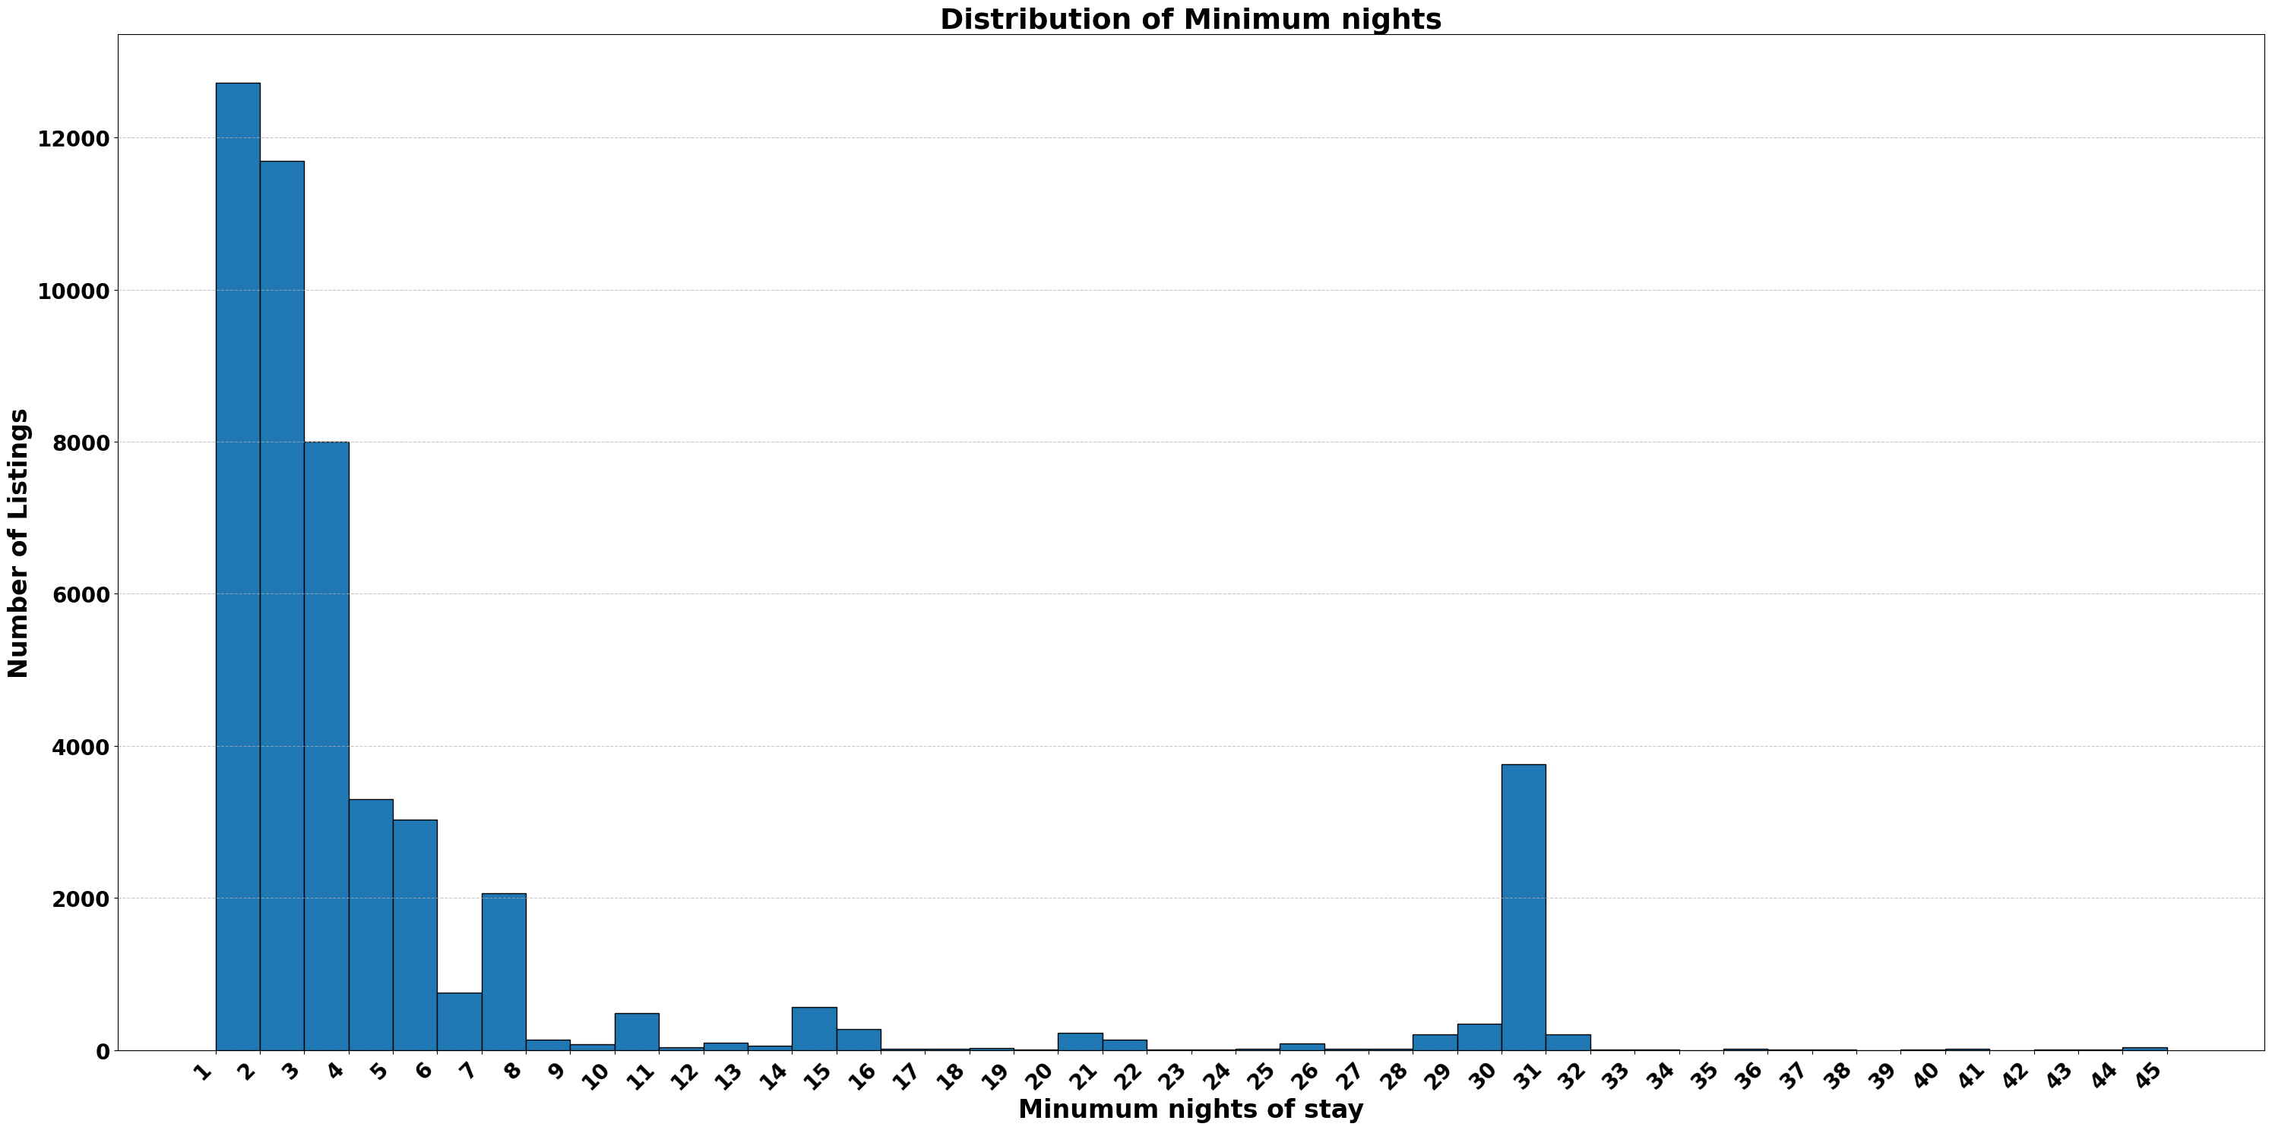
Preferences for minimum nights
Most listings require fewer minimum nights, with a significant number of listings requiring only 1 or 2 nights minimum stay. Airbnb could focus its marketing efforts on promoting these short-term stays.
There is also a noticeable peak around 30 nights. Airbnb could analyze this market segment to understand its potential. If it proves to be a lucrative segment, Airbnb could devise strategies to cater to it.

Slide 11
APPENDIX - METHODOLOGY
Understood the problem statement and became familiar with Airbnb’s business.
The data was loaded in Pandas DataFrame in Python.
Missing Values and Outliers were detected.
Cleaned the data by removing redundant columns and imputing null values with 0 in the reviews_per_month column.
Did analysis, and visualizations and derived insights from them.
Majority of the visualizations were done in Power BI.

