Slide 1
Strengthen the business of Airbnb and enhance it’s revenues

Slide 2
AGENDA
Objective
Background
Key Findings
Recommendations
Appendix
Methodology

Slide 3
OBJECTIVE
Derive important insights from Airbnb’s business in the pre-COVID period.
Increase the Airbnb’s revenue in the post-COVID era.
Provide an overall understanding of the customer preferences and the host properties from the Airbnb NYC database.

Slide 4
BACKGROUND
Airbnb saw a major decline in its revenue due to COVID-19.
Now that the restrictions have started lifting and people have started to travel more, Airbnb wants to ensure that it is fully prepared for this change.
Airbnb wants to understand the insights it could draw from pre-COVID data to increase its revenue post-COVID.

Slide 5
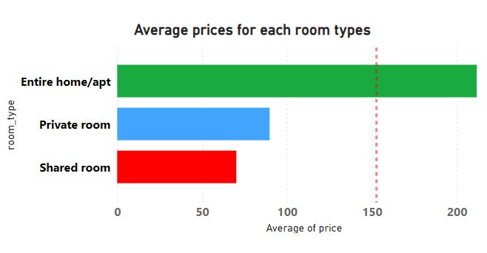
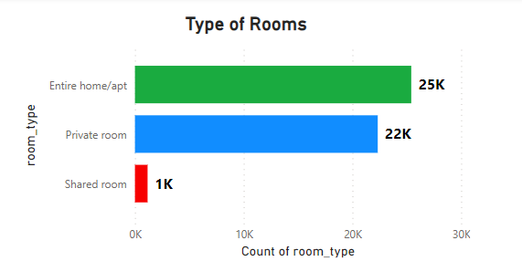
Room type preferences and their prices
The entire home/apt had the highest average price and was also the most popular type of room.
Private rooms came in second position both in terms of popularity and it’s average price.
Shared room were least popular and most affordable in terms of average price

Slide 6
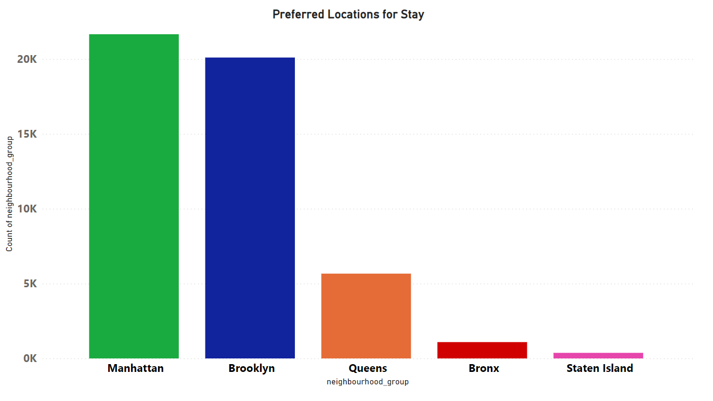
Most Preferred Locations
Manhattan and Brooklyn are the most popular places to stay in.
Queens came at third.
The least preferred locations are Bronx and Staten Island

Slide 7
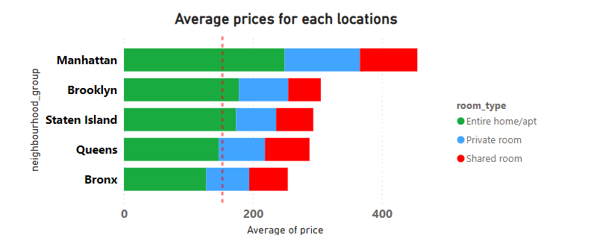
Average Prices of each Locations
Despite its popularity, Manhattan had the highest average prices.
Brooklyn and Staten Island follow Manhattan in terms of average price.
Queens and Bronx had the lowest average prices.

Slide 8
Recommendations regarding locations prices
Promote Affordable Options: Market Bronx as an affordable option to travellers on a budget while highlighting its proximity to popular destinations. This could be done through targeted marketing campaigns or special discounts.
Enhance Experience in Staten Island & Queens: Improve guest experience in Staten Island & Queens through better amenities or experiences to increase their popularity. This could involve partnering with local businesses to offer unique experiences or improving the quality of listings.
Dynamic Pricing Strategy: Implement dynamic pricing strategies where prices can be adjusted based on demand and supply to maximize revenue especially in popular areas like Manhattan and Brooklyn. This could involve increasing prices during peak travel seasons or reducing prices during off-peak times to ensure high occupancy rates.

Slide 9
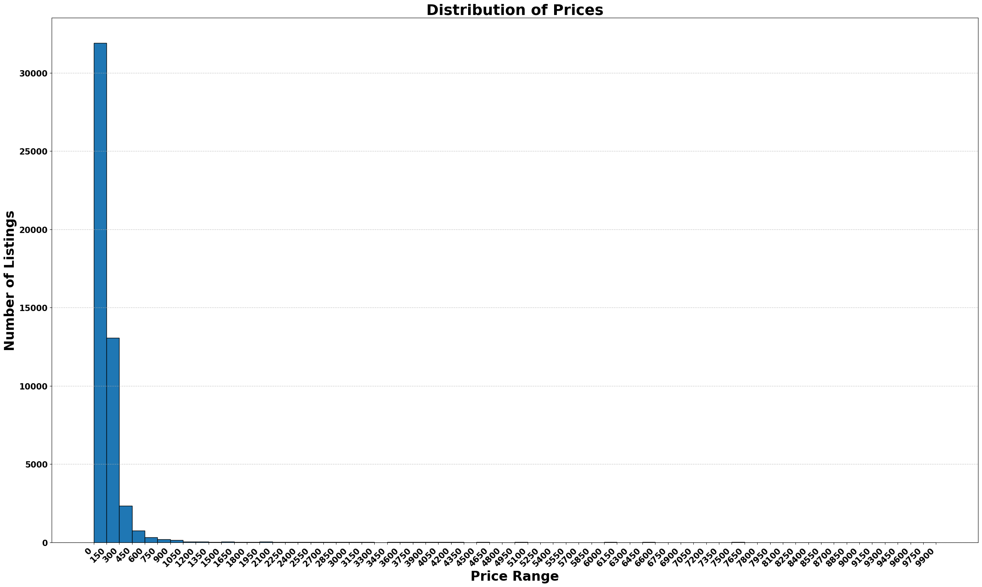
Pricing Ranges preferred by Customers
Average price of listings was $152.72.
Most preferred price range was from $0 to $150.
Majority of Airbnb listings were priced at the lower end of the spectrum. Airbnb was a popular choice for budget-conscious travellers during the pre-COVID era.
Airbnb could focus on promoting these affordable listings to attract more budget-conscious travellers.

Slide 10
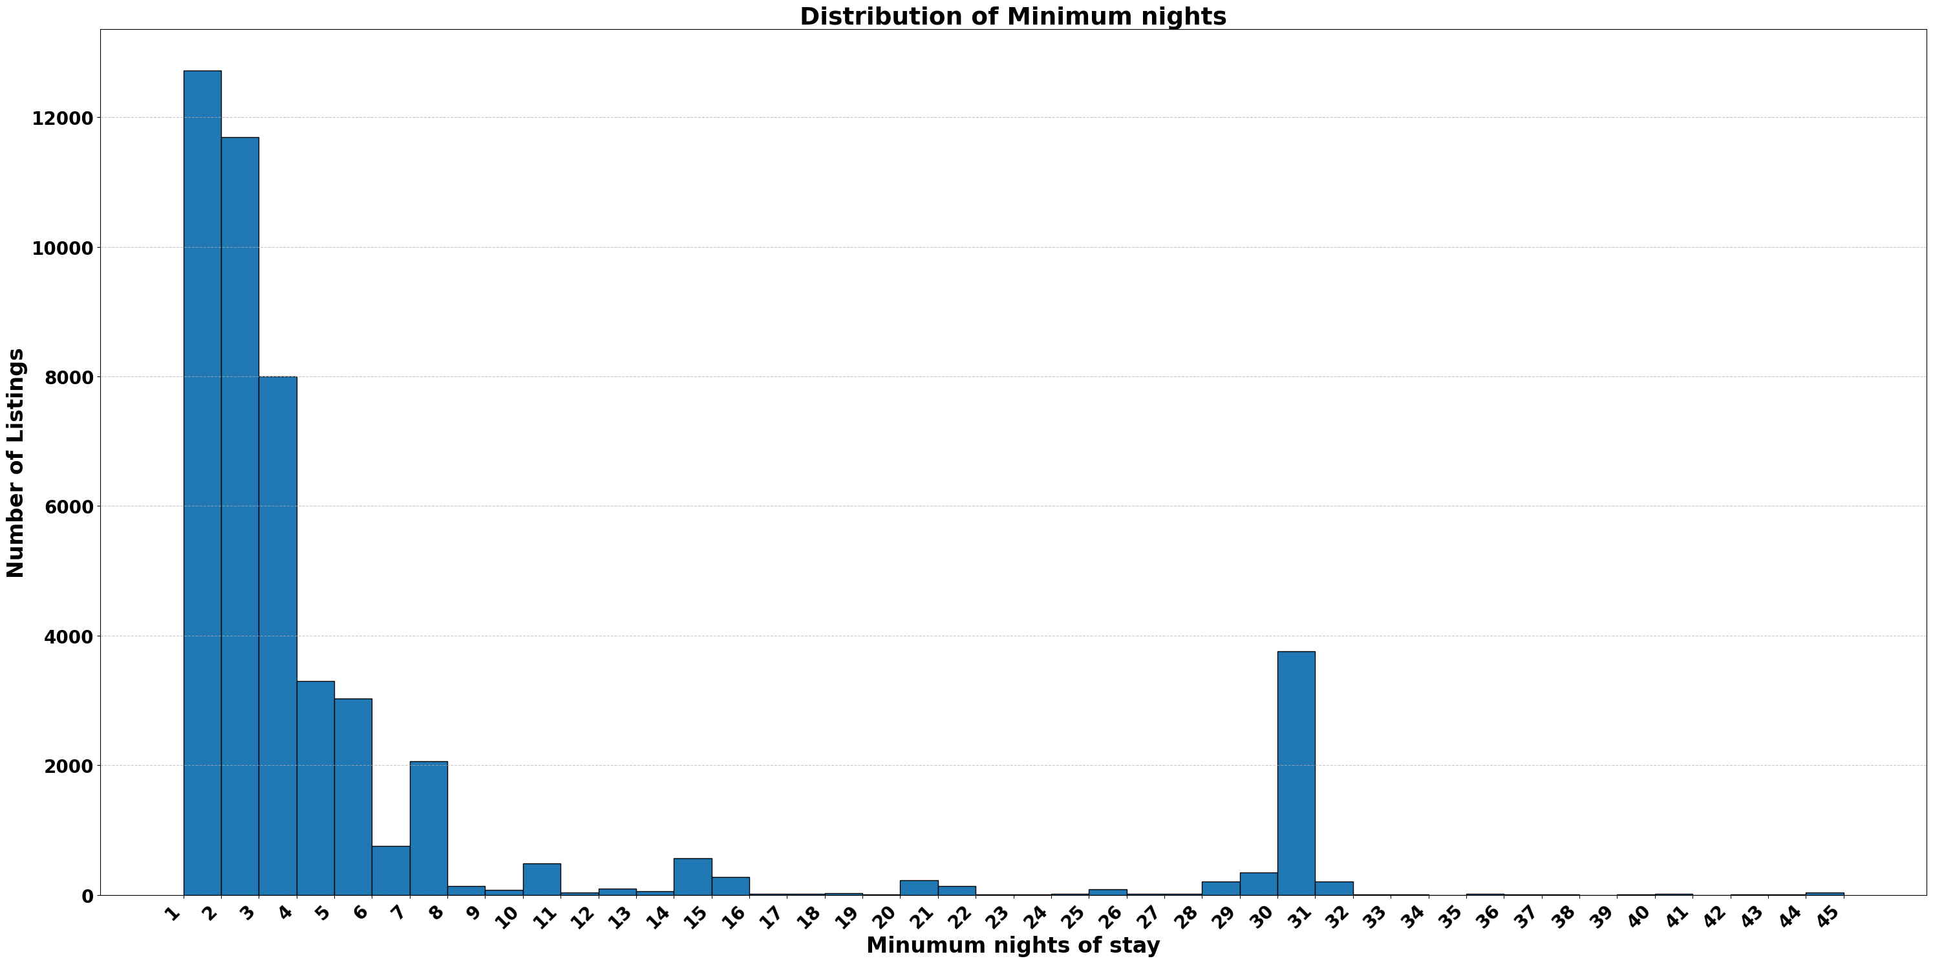
Properties with least minimum nights stay offered maximum bookings
Most listings require fewer minimum nights, with a significant number of listings requiring only 1 or 2 nights minimum stay. Airbnb could focus its marketing efforts on promoting these short-term stays.
There is also a noticeable peak around 30 nights. Airbnb could analyze this market segment to understand its potential. If it proves to be a lucrative segment, Airbnb could devise strategies to cater to it.

Slide 11
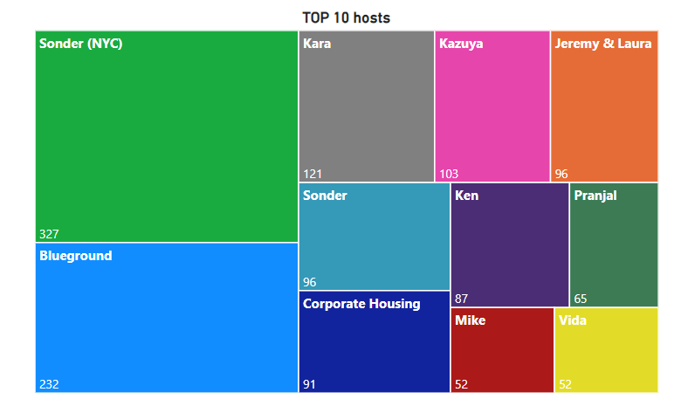
Top 10 Hosts
Sonder (NYC) is the top host with the most number of listings followed by Blueground, Kara, Kazuya, Sonder, Jeremy & Laura, Corporate Housing, Ken, Pranjal, Mike and Vida.
Establish stronger partnerships with the top hosts identified.
Provide enhanced visibility to listings from these hosts on the Airbnb platform.

Slide 12
APPENDIX - METHODOLOGY
Understood the problem statement and became familiar with Airbnb’s business.
The data was loaded in Pandas DataFrame in Python.
Missing Values and Outliers were detected.
Cleaned the data by removing redundant columns and imputing null values with 0 in the reviews_per_month column.
Did analysis, and visualizations and derived insights from them.
Majority of the visualizations were done in Power BI.

