Slide 1
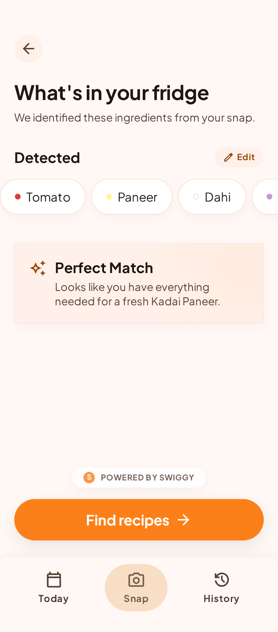
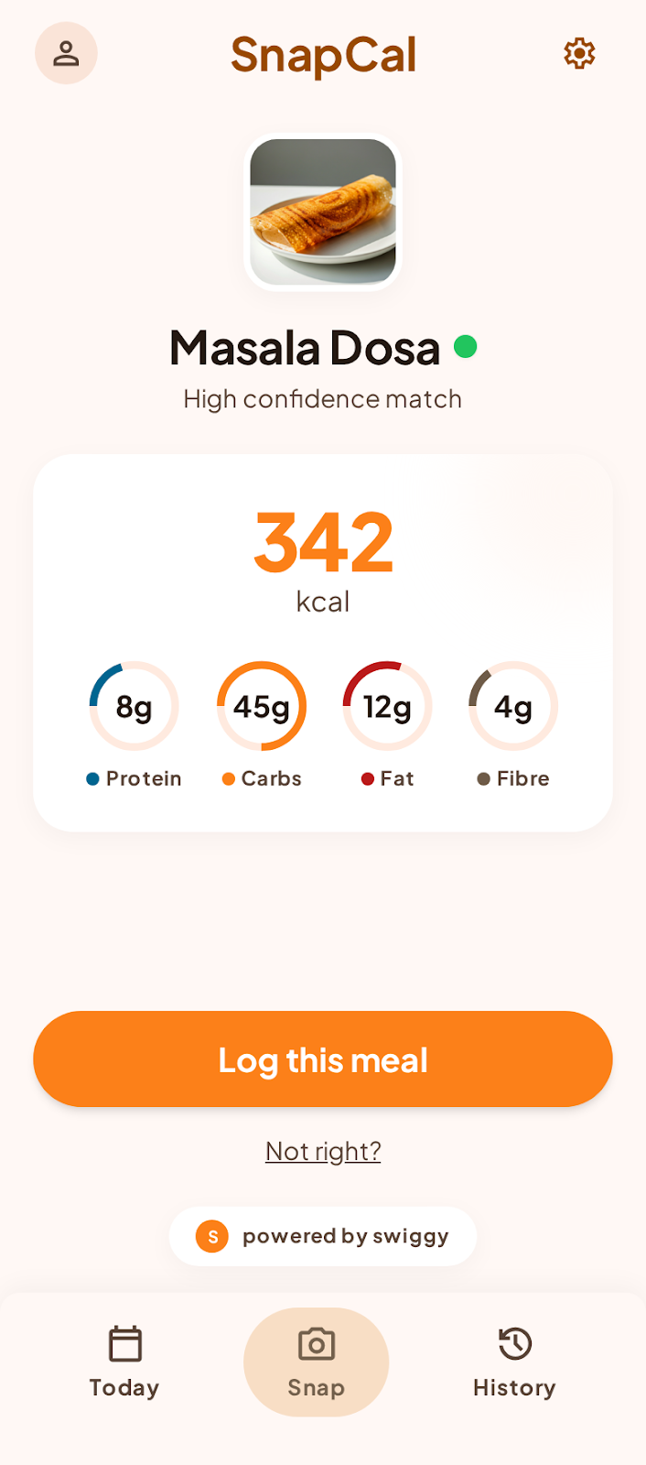
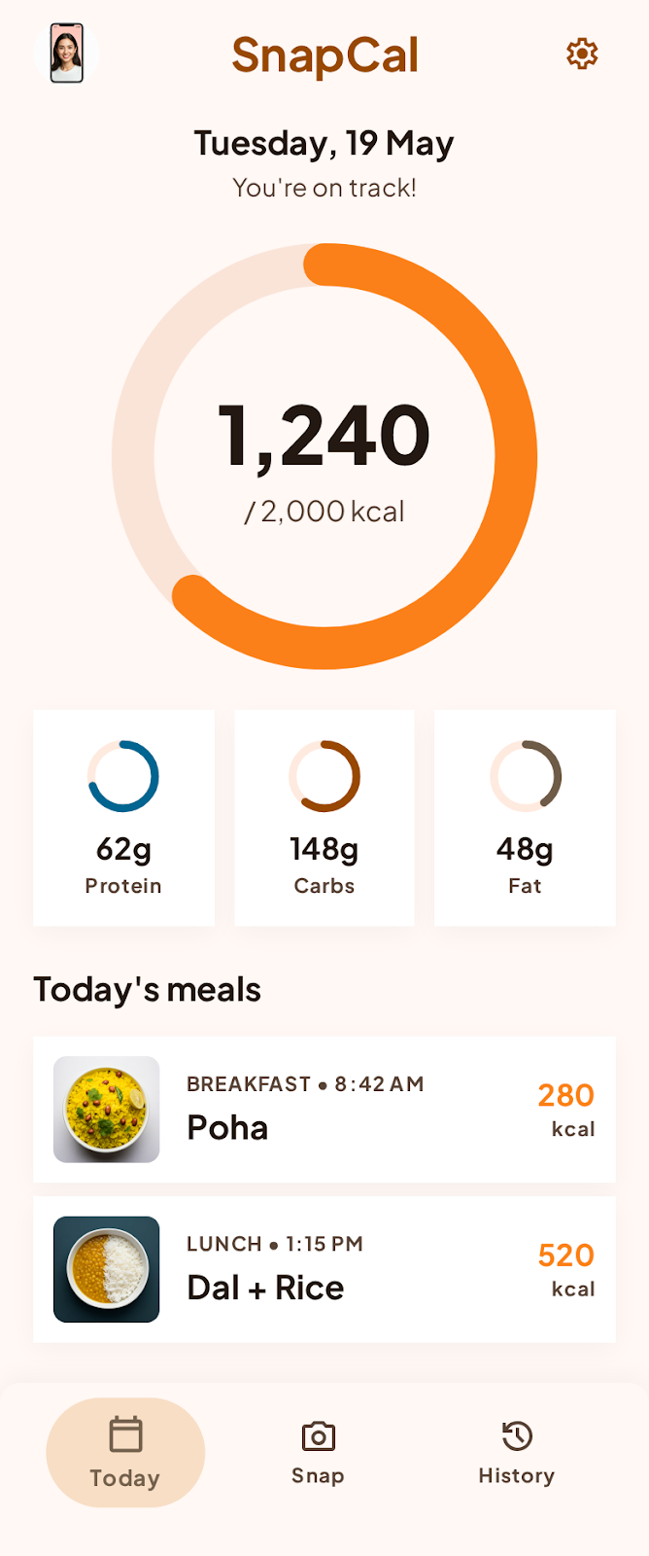



SnapCal
FridgeScan + Cal AI · Built for India
WHAT YOU CAN DO TODAY
FridgeScan
Snap fridge → AI detects ingredients → 3 Indian recipes ranked by fewest missing items → Swiggy Instamart auto-cart in one tap
Meal Snap (Cal AI)
Snap any meal → vision AI identifies the dish + serving size → India-accurate calories & macros. Poha, dal makhani, biryani — not Western-biased
FridgeScan
Meal Snap
Today
Today Dashboard
3 modes · 1 camera · 0 manual entry
Daily calorie ring + protein / carbs / fat rings. Auto-populated from every scan. Zero manual entry, ever.
S
POWERED BY SWIGGY
Applying to Swiggy Builders Club

Slide 2




What We Need from Swiggy
Two MCP servers. Each powers a core feature that's structurally impossible without Swiggy.
Swiggy Instamart MCP
Swiggy Food Delivery MCP
POWERS · FRIDGESCAN → ORDER
POWERS · MEAL SNAP → NUTRITION
search_products
get_orders
Find real purchasable SKUs for each missing ingredient near the user's address
Detect if a snapped meal came from Swiggy — link the photo to the exact delivery order
your_go_to_items
search_menu
Personalise brand choices from the user's actual Swiggy purchase history
Fetch the menu item + nutrition data from the exact restaurant on Swiggy
update_cart
Build a native Instamart cart with live ₹ prices and 10-min delivery ETA
Why this is novel
First nutrition app to ground Indian dish estimates in real Swiggy restaurant menu data — instead of generic Western databases like Cal AI or MyFitnessPal.
This is the standout API use case we're applying with. No other database has the breadth of Indian restaurant menu data that Swiggy does.
checkout
One-tap order via Swiggy's logistics. SnapCal never touches money or routing
Why only Instamart?
The only 10-min grocery service at this scale across 131 Indian cities — with personalised purchase history.
Swiggy Builders Club · mcp.swiggy.com/builders · builders@swiggy.in

Slide 3





WHERE WE'RE GOING
One stop shop for
everything food.
Lose it. Maintain it. Gain it. Cook it. Order it. Track it.
Cook Smart
Track Everything
Order What's Missing
Scan fridge → Indian recipes → Instamart auto-orders missing ingredients. 10-min delivery across 131 Indian cities.
Home-cooked or Swiggy delivery — snap it and get India-accurate nutrition instantly. Zero manual entry.
One tap to order the exact ingredient you're short of. Only Instamart has this depth across India.
Log Takeout Calories
Hit Your Goals
What's Next
Swiggy Food MCP auto-pulls your delivery orders. Takeout calories logged without lifting a finger.
Lose, maintain, or gain — one calorie intelligence layer across cooking, ordering, and logging.
Family profiles · dietary filters · voice mode · weekly history · AI insights · Dineout integration.
snapcal.app · Built by Oltaflock · Powered by Swiggy

