Slide 1

Public engagement activity
Amaan Mujawar
Notes:
Good afternoon, my name is Amaan Mujawar, and today I will be presenting my project on Implementing an Arithmetic Unit Utilizing Approximate Computing into a RISC-V SoC.

Slide 2
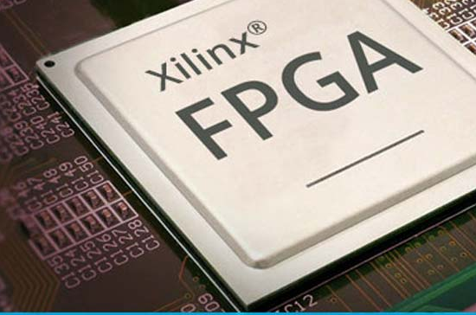

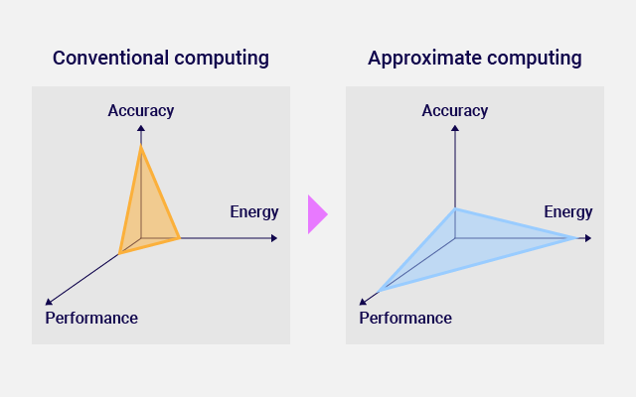
ABOUT the project
Implement an Arithmetic Unit Utilizing Approximate Computing into RISC-V SoC.
Supervisor: Mr. Neil Powell
2
Notes:
This work is supervised by Mr. Neil Powell at The University of Sheffield.

Slide 3
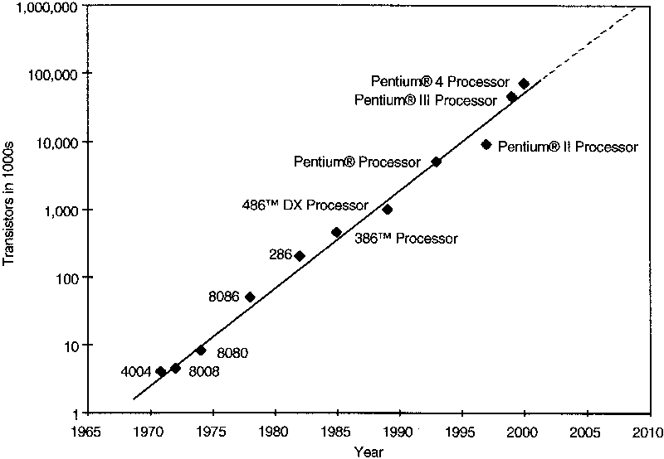
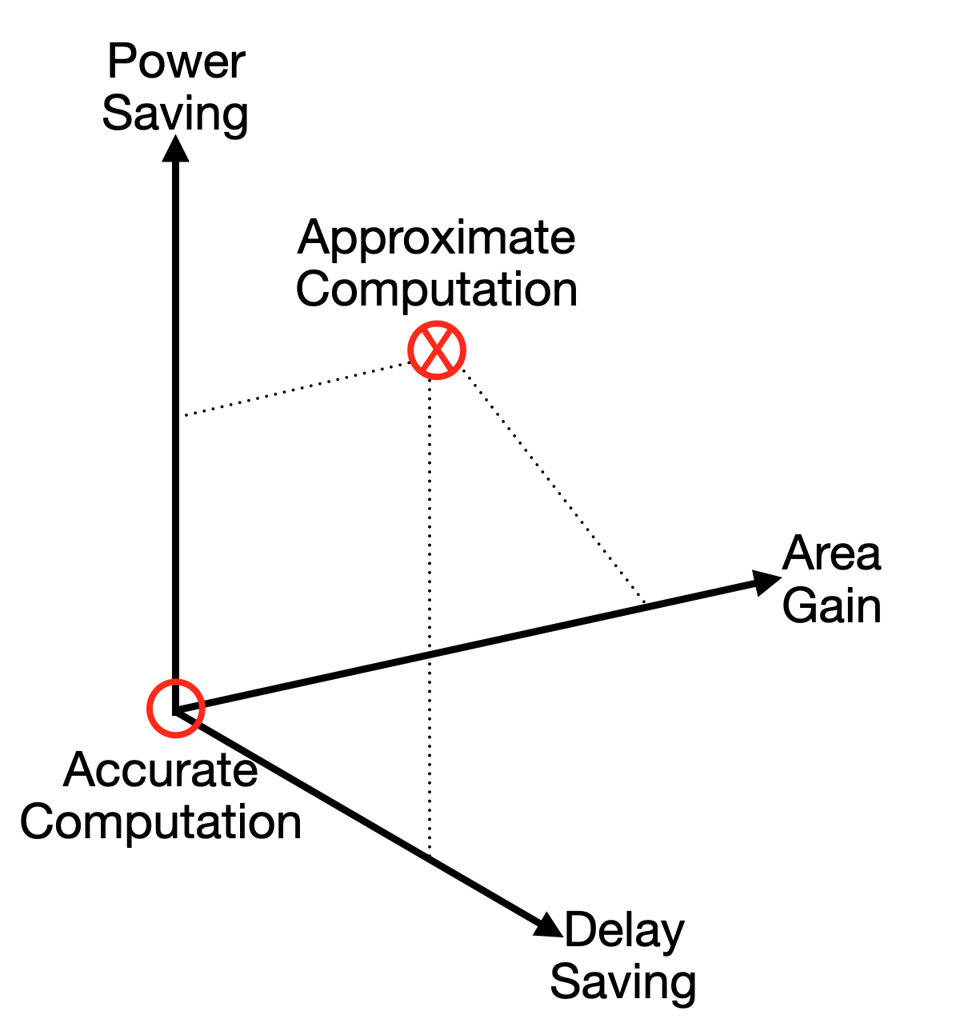
Background & motivation
Context
Growing demand for high-performance computing in machine learning, computer vision, and multimedia processing.
challenge
Traditional computing approaches are limited by the slowing of Moore's Law.
opportunity
Approximate computing allows controlled errors for faster and energy-efficient computation.
importance
Enables energy-efficient digital systems, suitable for error-tolerant applications like image processing.
Notes:
We live in an era where high-performance computing is essential for applications like machine learning, computer vision, and multimedia processing. However, traditional computing approaches are facing limitations due to the slowing down of Moore’s Law, making it increasingly difficult to achieve significant improvements in speed and efficiency.
To address this, we turn to Approximate Computing—a technique that allows controlled errors in calculations, in exchange for higher energy efficiency and faster processing. This is especially useful for error-tolerant applications such as image processing and AI, where perfect accuracy is not always necessary.

Slide 4
Real-World Problem Addressed
Energy-Efficiency
Traditional computation
Reduced power consumption by allowing controlled errors
Lower energy requirements make it suitable for battery-powered devices
Precise arithmetic units consume more power and area
High accuracy but less energy-efficient
Approximate computing
Ideal tasks
Trades off accuracy for efficiency, reducing power and area
Suitable for error-tolerant applications like image processing and AI
Image processing (denoising, compression)
Machine learning
Signal processing in embedded systems
4
Notes:
Why does this matter? Let’s compare traditional computing with approximate computing:
Traditional computation prioritizes precision but at the cost of higher power consumption and larger chip area.
Approximate computing, on the other hand, trades off some accuracy in exchange for significant energy savings and faster processing.
This makes it ideal for applications such as: Image processing (denoising, compression) Machine learning Signal processing in embedded systems
By leveraging approximate computing, this project contributes to the development of energy-efficient digital systems for future computing technologies.

Slide 5
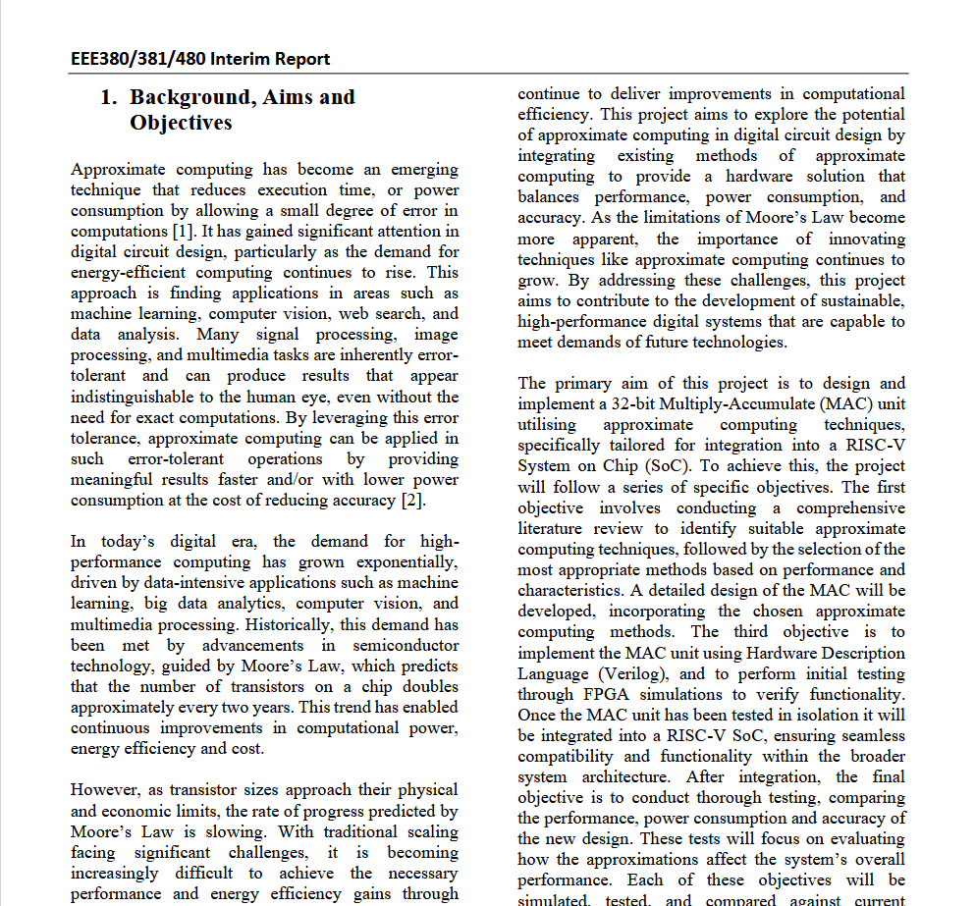
Aims & Objectives
AIMS
Design and implement an 8-bit Multiply-Accumulate (MAC) unit using approximate computing techniques
Implement an arithmetic unit utilizing approximate computing into a RISC-V SoC
Optimize the arithmetic unit for energy efficiency while maintaining acceptable computational accuracy.
OBJECTIVES
Design and simulate the MAC unit using Verilog on FPGA
Integrate the MAC unit into a RISC-V SoC
Evaluate, analyze and compare performance, power consumption, and accuracy against traditional designs
Validate the design using simulation tools
Assess the impact of approximation on computational accuracy
Evaluate the MAC unit’s performance in a fuzzy memoized FIR filter for image processing
Notes:
The primary aim of this project is to design and implement an 8-bit MAC unit using approximate computing techniques and integrate it into a RISC-V SoC. To achieve this, we set the following objectives: - Design and simulate the MAC unit using Verilog on FPGA - Validate the design through unit testing and FPGA simulations
- Evaluate power consumption, accuracy, and speed
- Integrate the MAC unit into a RISC-V SoC

Slide 6
Problem specification
Problem:
Balancing accuracy, power consumption, and speed in arithmetic units
Expected Results:
Enhanced computational efficiency with minimal accuracy loss
Reduced power consumption and chip area
Methodology:
Using Verilog for implementation and FPGA simulations
Implementing Approximate Adders and Approximate Multipliers based on existing designs
Notes:
The key challenge in this project is achieving a balance between accuracy, power, and speed.
To address this, we implemented: Approximate Adders and Multipliers based on existing research Verilog for implementation and FPGA-based simulations Performance evaluations to compare with traditional MAC units

Slide 7
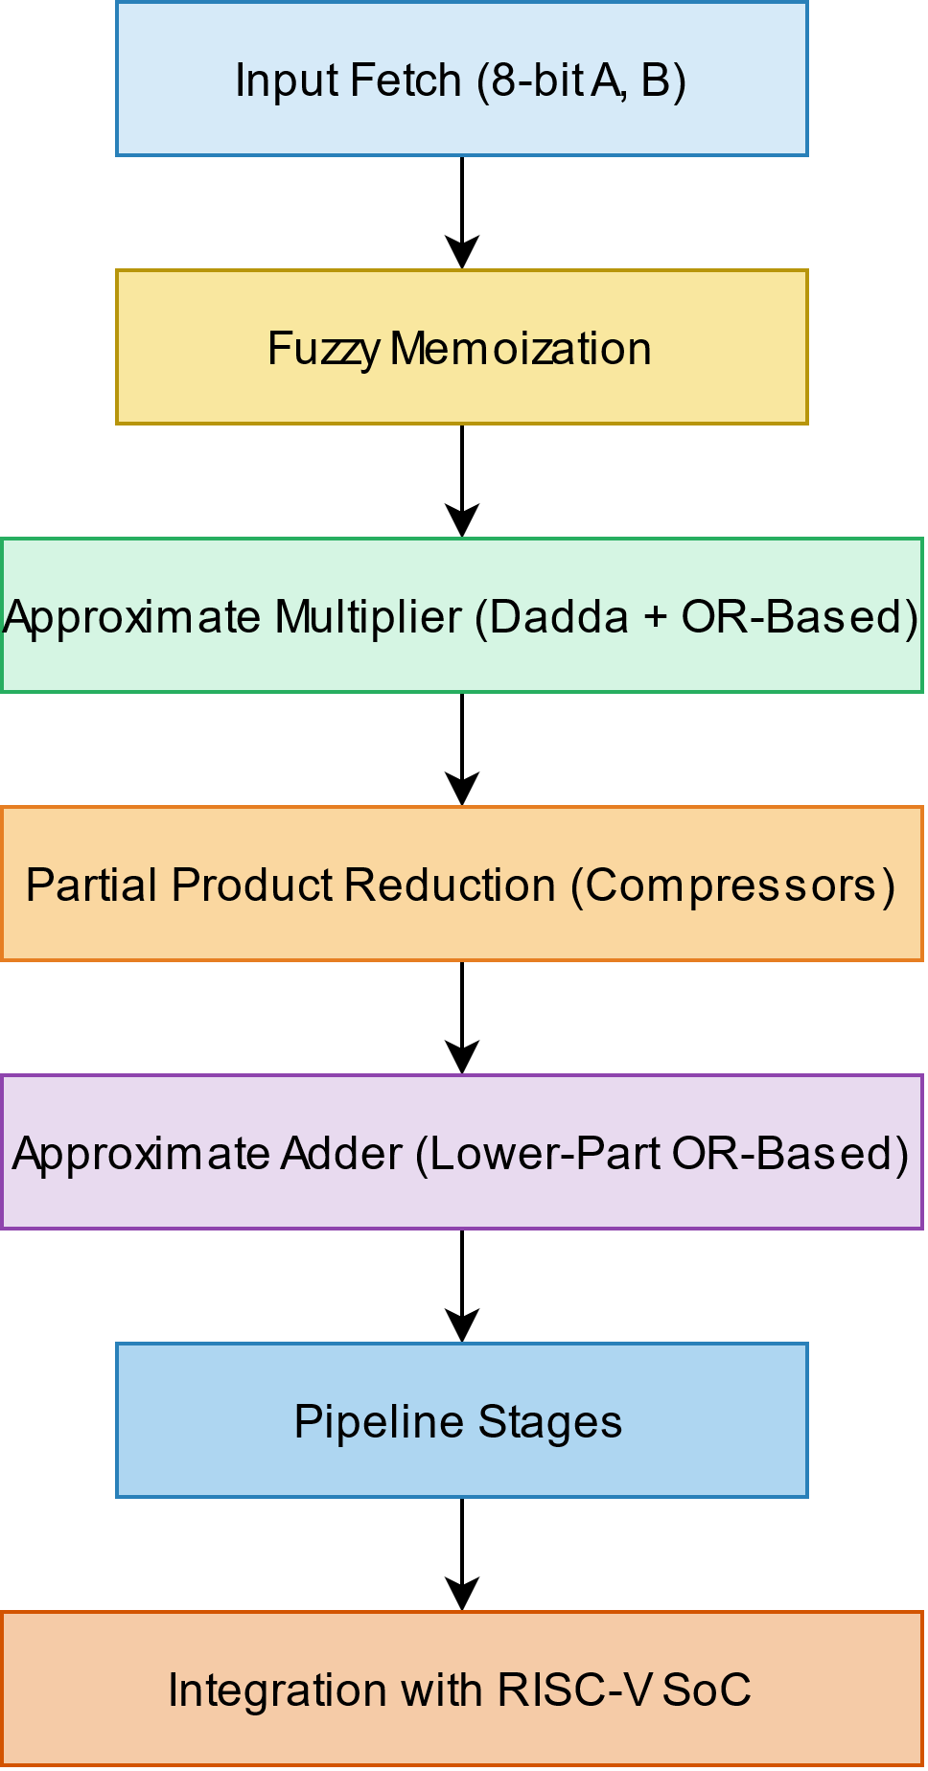
ARCHITECTURE
8-bit Approximate MAC Unit
Input Fetch Stage
8-bit operands (A and B) for multiplication
Inputs are passed into the fuzzy memoization block to check for stored approximate results
Fuzzy Memoization Block
Caches previous computations to avoid redundant calculations
Uses Hamming distance to find a similar previously stored input-output pair.
If a match is found, cached result is used instead of recalculating.
Approximate Multiplication Stage
Lower-Part OR-based Approximate Multiplier:
MSB (Most Significant Bits) handled with a Dadda Multiplier
LSB (Least Significant Bits) approximated using OR-based logic
Partial Product Reduction Stage
Uses compressor-based approximate multipliers
Approximate Addition Stage
Accumulation performed using Lower-Part OR-based Approximate Adders
Notes:
At the heart of this project is an 8-bit Approximate Multiply-Accumulate (MAC) Unit, which is designed to improve computational efficiency while reducing power consumption.
The architecture consists of several key components:
Input Fetch Stage
Fuzzy Memoization Block
Approximate Multiplication Stage:
MSBs (Most Significant Bits
LSBs (Least Significant Bits)
4. Partial Product Reduction Stage:
5. Approximate Addition Stage:

Slide 8
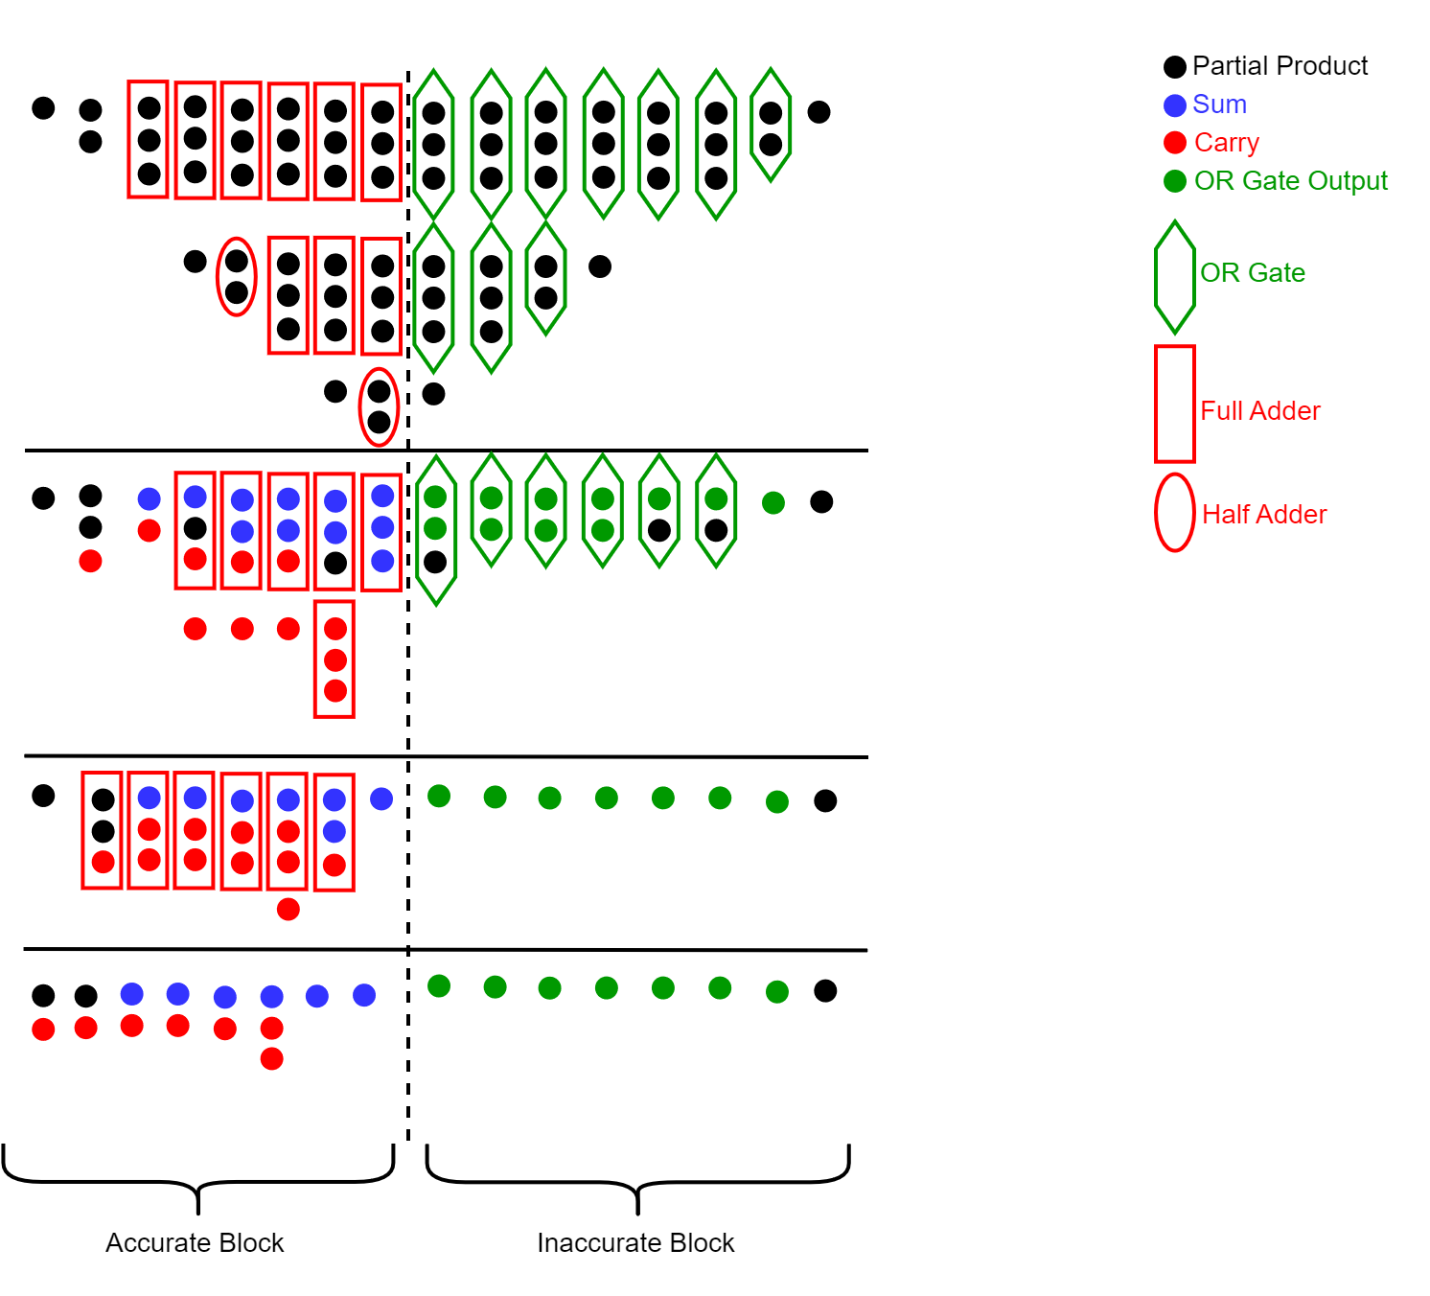
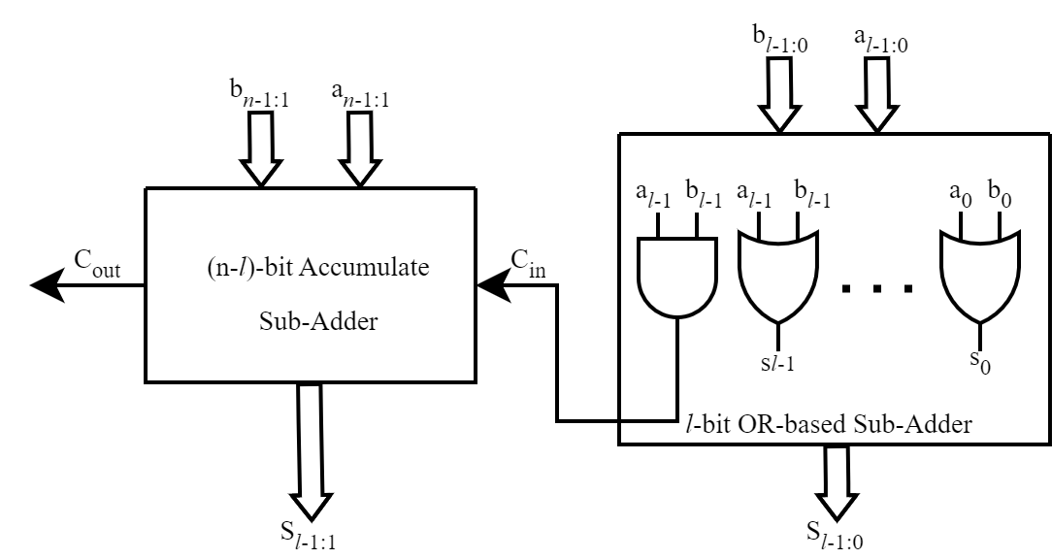
Comparison: Aims and milestones
Achievements
Established a benchmark with a pipelined MAC unit
Implemented Approximate Adder and Approximate Multiplier
Unit testing completed and modules validated
Completed integration of approximate multipliers and adders
Pending Tasks
Explore Fuzzy memoization implementation
Research and Learn how to implement a RISC-V SoC on FPGA
Conduct comprehensive testing for power, speed, and accuracy
Compare against other approximation units to evaluate performance
Notes:
So far, the project has achieved: Benchmarking of a pipelined MAC unit Implementation of Approximate Adders and Multipliers Unit testing and validation of individual modules

Slide 9
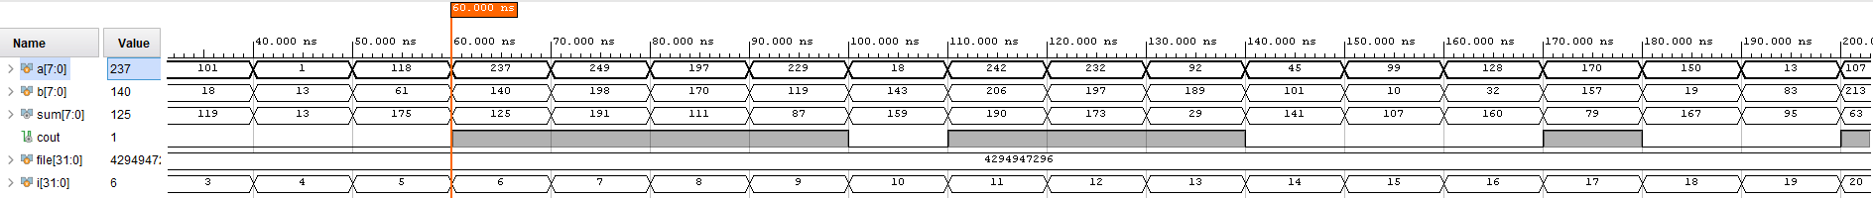
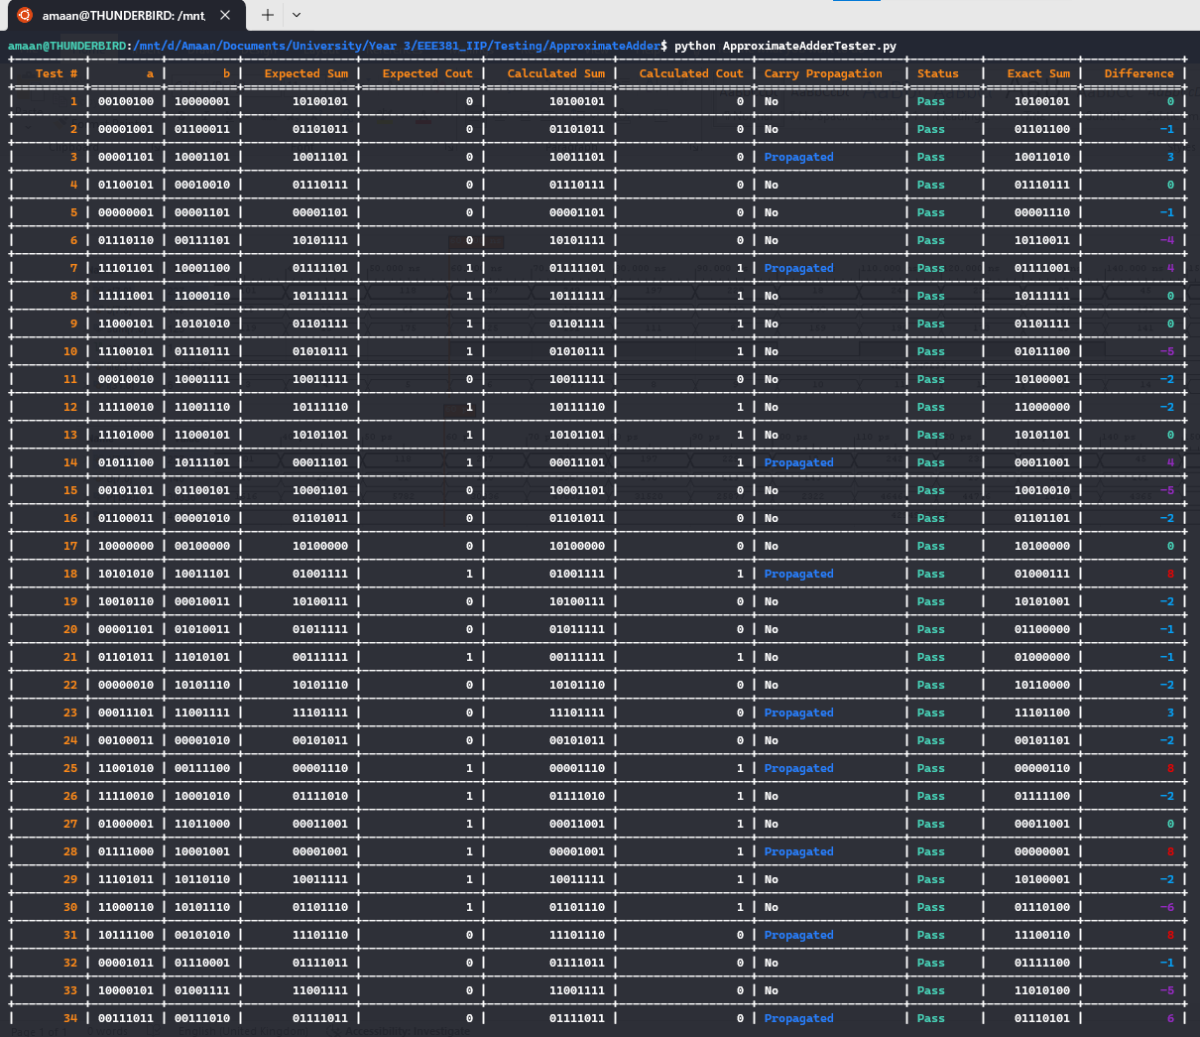
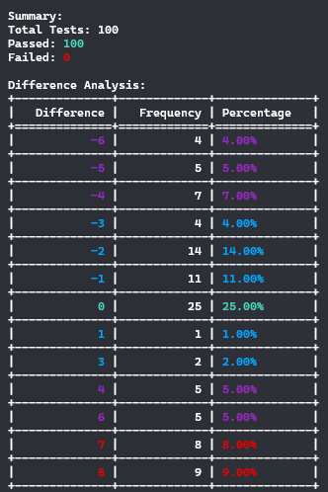
SIMULATION RESULTS - ADDER
9

Slide 10

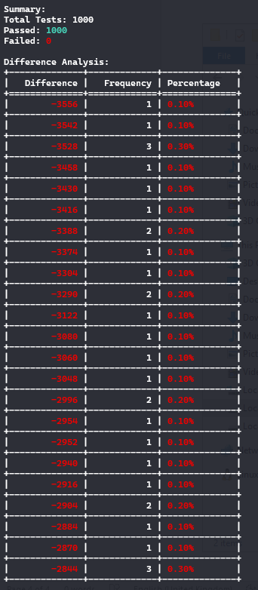
SIMULATION RESULTS - Multiplier
10

Slide 11
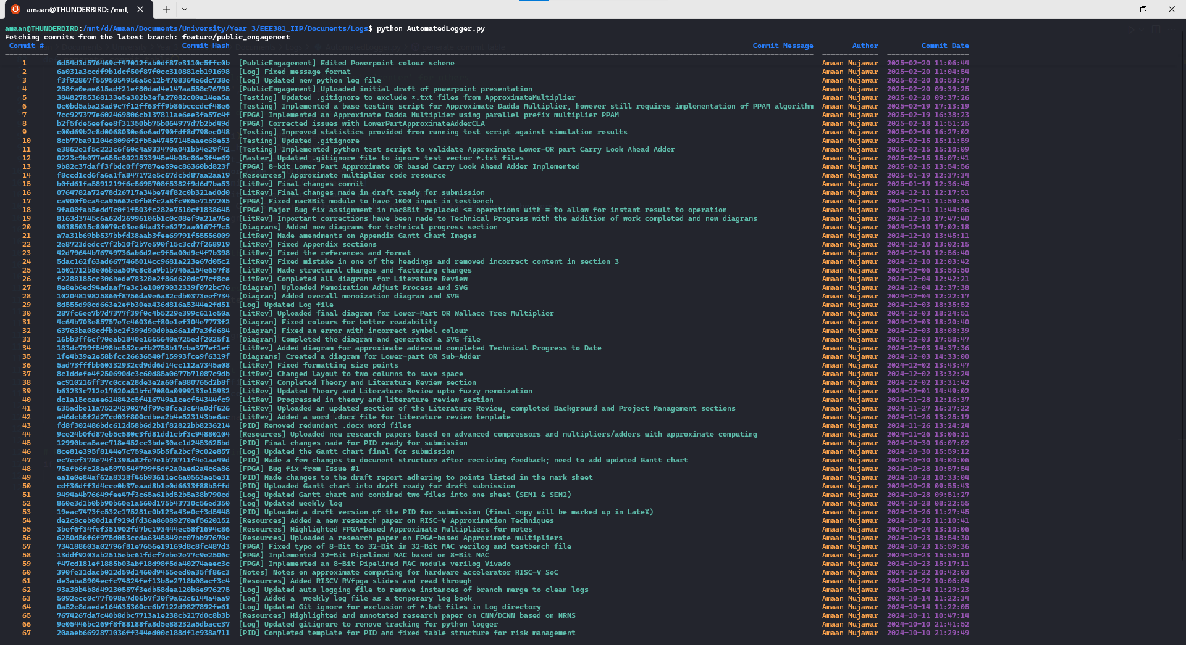

Slide 12
THANK YOU
Amaan Mujawar​
aurmujawar1@sheffield.ac.uk
The University of Sheffield – Electronics and Computer Engineering

