Slide 1
Introduction To computer vision
Computer vision is a field of artificial intelligence that enables machines to interpret and understand the visual world. It involves developing algorithms to extract meaningful information from digital images or videos.

Slide 2
Introduction To computer vision
Computer vision is a field of artificial intelligence that enables machines to interpret and understand the visual world. It involves developing algorithms to extract meaningful information from digital images or videos.

Slide 3
Overview Of artificial neural network (ann)
01.
Mimicking the human brain
03.
02.
Training and optimization
Applications in deep learning
ANNs are designed to replicate the way the human brain processes information. They consist of interconnected nodes that work collectively to solve complex problems.
Training an ANN involves adjusting the weights and biases of the network to minimize the error, often using optimization algorithms like gradient descent.
ANNs are fundamental in deep learning, performing tasks like image recognition, natural language processing, and more.

Slide 4
Overview Of artificial neural network (ann)
01.
02.
Mimicking the human brain
Applications in deep learning
03.
Training and optimization
ANNs are designed to replicate the way the human brain processes information. They consist of interconnected nodes that work collectively to solve complex problems.
ANNs are fundamental in deep learning, performing tasks like image recognition, natural language processing, and more.
Training an ANN involves adjusting the weights and biases of the network to minimize the error, often using optimization algorithms like gradient descent.

Slide 5
Overview Of artificial neural network (ann)
01.
02.
03.
Mimicking the human brain
Applications in deep learning
Training and optimization
ANNs are designed to replicate the way the human brain processes information. They consist of interconnected nodes that work collectively to solve complex problems.
ANNs are fundamental in deep learning, performing tasks like image recognition, natural language processing, and more.
Training an ANN involves adjusting the weights and biases of the network to minimize the error, often using optimization algorithms like gradient descent.

Slide 6
Understanding recurrent neural network (rnn)
01.
02.
03.
Sequential data processing
Long-term dependencies
Challenges in training
RNNs are specialized in processing sequences of data, making them suitable for tasks involving sequential information such as time series and natural language
RNNs are capable of capturing long-term dependencies in sequential data, making them effective in tasks that require understanding of context over time.
RNNs face issues like vanishing and exploding gradients during training, which have led to the development of variations like LSTM and GRU.

Slide 7
Applications of computer vision in deep learning
1.Image classification
2.Object detection
3.Image generation
Using CNNs to classify images into various categories, such as identifying objects or scenes within the image.
Locating and classifying objects within images or video frames, often used for surveillance and security purposes.
Generating new images or modifying existing ones, such as deepfake generation or style transfer techniques.

Slide 8
Applications of computer vision in deep learning
1.Image classification
2.Object detection
3.Image generation
Using CNNs to classify images into various categories, such as identifying objects or scenes within the image.
Locating and classifying objects within images or video frames, often used for surveillance and security purposes.
Generating new images or modifying existing ones, such as deepfake generation or style transfer techniques.

Slide 9
Training and optimization in ann
1.Data collection
2.Model training
3.Hyperparamter tuning
Collecting and preprocessing the relevant dataset to be used for training and testing the ANN.
Feeding the training data to the neural network, optimizing the weights and biases through backpropagation, and adjusting the network's parameters.
Optimizing the learning rate, batch size, and other hyperparameters to improve the network's performance.

Slide 10
Training and optimization in ann
1.Data collection
2.Model training
3.Hyperparamter tuning
Collecting and preprocessing the relevant dataset to be used for training and testing the ANN.
Feeding the training data to the neural network, optimizing the weights and biases through backpropagation, and adjusting the network's parameters.
Optimizing the learning rate, batch size, and other hyperparameters to improve the network's performance.

Slide 11
Training and optimization in cnn

Slide 12
Training and optimization in cnn
Convolutional layers
Gradient descent
Regularization techniques
Understanding the activation maps, pooling layers, and filters used in the convolutional layers of CNNs.
Implementing optimization algorithms like Stochastic Gradient Descent and Adam to optimize the weights and biases in CNNs.
Using techniques like dropout and batch normalization to improve the generalization and performance of CNNs.

Slide 13
Training and optimization in cnn
Convolutional layers
Gradient descent
Regularization techniques
Understanding the activation maps, pooling layers, and filters used in the convolutional layers of CNNs.
Implementing optimization algorithms like Stochastic Gradient Descent and Adam to optimize the weights and biases in CNNs.
Using techniques like dropout and batch normalization to improve the generalization and performance of CNNs.

Slide 14
Training and optimization in cnn
Convolutional layers
Gradient descent
Regularization techniques
Understanding the activation maps, pooling layers, and filters used in the convolutional layers of CNNs.
Implementing optimization algorithms like Stochastic Gradient Descent and Adam to optimize the weights and biases in CNNs.
Using techniques like dropout and batch normalization to improve the generalization and performance of CNNs.

Slide 15
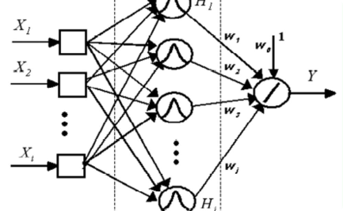
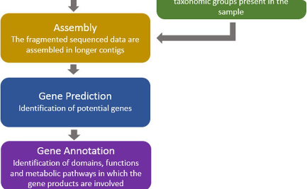
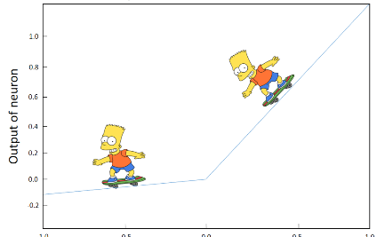
Training and optimization in rnn
Backpropagation through time
Sequential data processing
Addressing gradient issues
Understanding how backpropagation is applied through the time steps in recurrent neural networks
Optimizing RNN training to minimize error while processing sequential data, often involving long short-term memory cells.
Dealing with problems such as vanishing or exploding gradients that can occur during RNN training.

Slide 16
Conclusion and future directions
1.Continued innovation
2.Ethical considerations
3.Integration with other technologies
Anticipating advancements in computer vision through new architectures, algorithms, and applications.
Exploring the ethical implications and responsible use of computer vision technology in various fields and industries.
Examining the integration of computer vision with emerging technologies like augmented reality and IoT for novel applications.

Slide 17
Conclusion and future directions
1.Continued innovation
2.Ethical considerations
3.Integration with other technologies
Anticipating advancements in computer vision through new architectures, algorithms, and applications.
Exploring the ethical implications and responsible use of computer vision technology in various fields and industries.
Examining the integration of computer vision with emerging technologies like augmented reality and IoT for novel applications.

Slide 18
Thank you !
Content written by : amaan || ppt design and animations by : vineet

