Slide 1
Federated Learning for Image Classification
Amaan Wani B.Tech CSE
University of Kashmir

Slide 2
Introduction
The exponential growth of digital systems drives the daily generation of massive data volumes, measured in zettabytes.
How can we use this for building more intelligent models?
What issues would we face?
- Privacy/Storing data

Slide 3
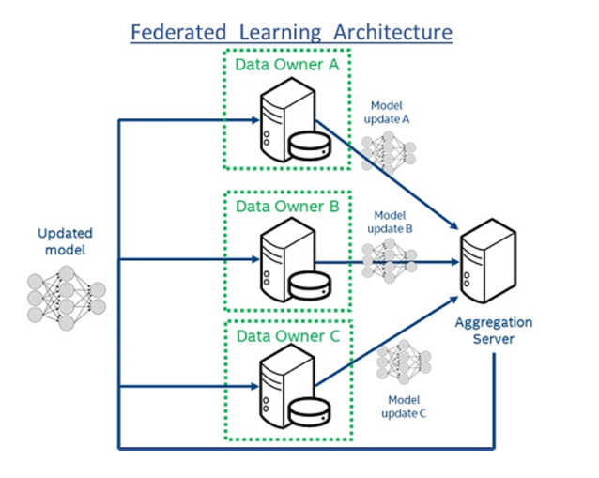
What is Federated Learning
Standard machine learning: Requires storing data centrally for training.
Federated Learning: Trains models collaboratively without centralizing data.
Communication: Devices send model updates, not raw data, to the server.
Advantages: No direct access to raw data, reducing privacy and security risks.

Slide 4
Key Properties
Privacy: Data stays local; only model updates are shared
Decentralized: Training occurs across devices without data centralization
Efficient: Reduces communication with optimized updates
Secure & Scalable: Ensures security and supports large-scale deployment

Slide 5
Model Outline
Fixed set of K clients
Each client performs a local computation on the given global state and produces an update
The server sends the current global model to each client
Each update from each client is aggregated to the global model/updated to central server
All steps are repeated

Slide 6
Implementation
In medical sciences, Federated Learning allows hospitals to jointly train models without sharing sensitive data.
This project simulates Federated Learning for disease classification using hospital-specific image dataset.

Slide 7
Dataset
The dataset contains medical imaging data distributed across three hospitals, categorized into four classes: COVID, Lung, Normal, and Viral.
COVID : 3,570 images (Hospital 1: 1,205, Hospital 2: 1,177, Hospital 3: 1,188)
Lung: 6,012 images (2,004 in each hospital)
Normal: 10,191 images (Hospital 1: 3,398, Hospital 2: 3,397, Hospital 3: 3,396)
Viral: 1,338 images (Hospital 1: 447, Hospital 2: 446, Hospital 3: 445)

Slide 8
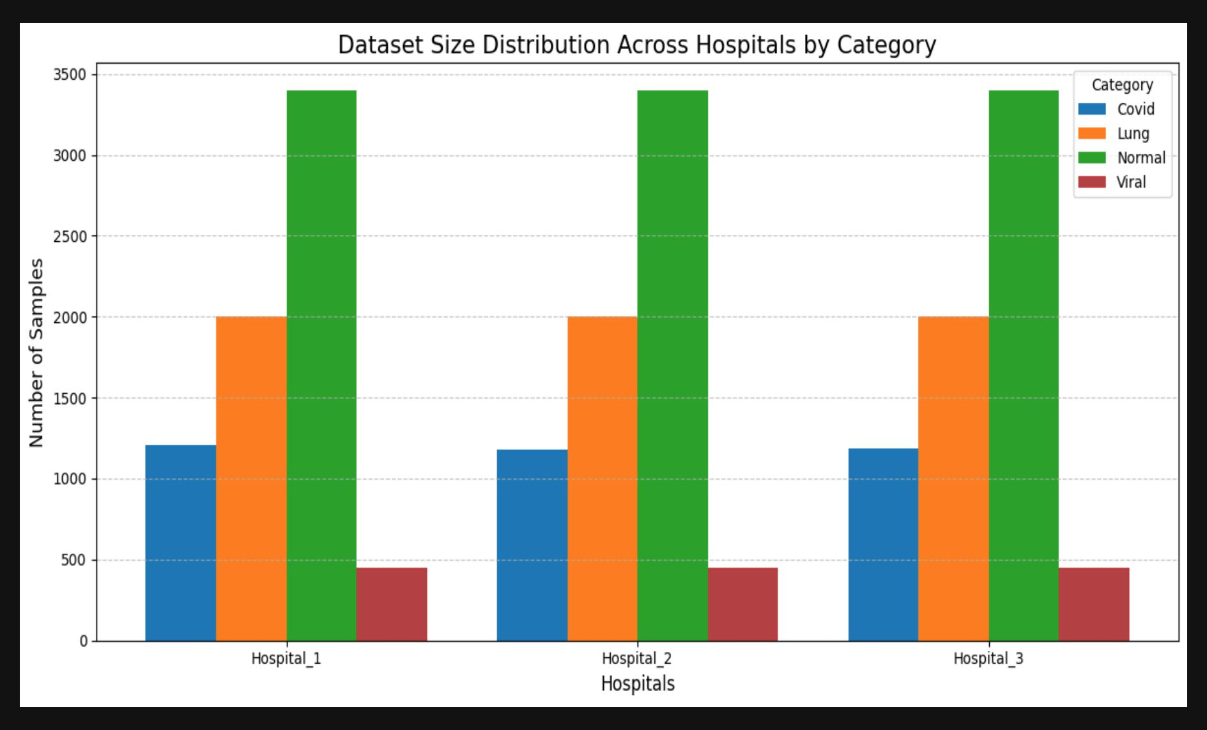
Categorization of images in different classes for each hospital
https://www.kaggle.com/datasets/tawsifurrahman/covid19-radiography-database

Slide 9
Implementation Details
Framework: PyTorch
Device setup: CUDA or CPU
Custom DataLoader for each hospital (client).
Transformations include resizing all images to 128x128, normalization, and tensor conversion
Computational Efficiency:
Total CPU time: 13min 35s
Wall time: 14min 8s
The dataset was split into (80-20): 80% for training and 20% for validation

Slide 10
Model Architecture
The model is based on a pre-trained ResNet-18, modified for the specific classification task:
Fully connected layer replaced with:
512 hidden units.
Batch Normalization
ReLU activation.
Dropout (20%) for regularization.
Final layer with the number of output classes (4).
Optimizer:
Stochastic Gradient Descent (SGD) with a learning rate of 0.01 and momentum of 0.9 is used for local training at each hospital.
Loss Function:
CrossEntropyLoss for classification.
Federated Aggregation:
Weighted averaging of model weights is performed after each round, considering the dataset sizes of individual hospitals.
Training Configuration:
10 rounds of federated learning.
10 local epochs per client in each round.
Global validation accuracy and loss was calculated after every round.

Slide 11
Results
Training Summary: The model trained iteratively on three hospital datasets, showing consistent improvements over 10 rounds.
Validation Accuracy: Starts at 87.50% (Hospital 1), 91.87% (Hospital 2), and 86.88% (Hospital 3), peaking at 94.37% for Hospitals 1 and 2 by Round 9.
Global Performance:
Accuracy: Improved from 88.54% in Round 1 to 90.83% in Round 10.
Loss: Reduced from 0.8423 to 0.7245.
Metrics: Precision: 90.30%, Recall: 90.21%, F1-Score: 90.09%.

Slide 12
References
https://github.com/yonetaniryo/federated_learning_pytorch
https://www.kaggle.com/datasets/tawsifurrahman/covid19-radiography-database
https://www.youtube.com/watch?v=X8YYWunttOY&t=125s
https://www.v7labs.com/blog/federated-learning-guide

Slide 13
Thank you

