Slide 1

AI-Based User & Entity Behaviour Analytics System
IN-HOUSE PROJECT · B.TECH CSE (CYBER SECURITY)
Learning what normal looks like, and catching what isn't
Amaan Saify
Tarun Jadhav
7th Semester · Batch 2023–2027
7th Semester · Batch 2023–2027
Under the supervision of Dr. Rathnakar Achary, Associate Professor
Alliance School of Advanced Computing · Alliance University, Bengaluru
Notes:
AMAAN (0:30 for this slide):
Good morning everyone. We are presenting our in-house project, an AI-based User and Entity Behaviour Analytics system - a security tool that learns how each person in an organisation normally behaves, and raises an alert when someone suddenly behaves out of character.
TARUN (0:30 for this slide):
I'm Tarun Jadhav, and with me is Amaan Saify. We are seventh-semester B.Tech students in Cyber Security, and we did this project under the supervision of Dr. Rathnakar Achary. Let me start with the problem we are solving.

Slide 2





Attackers who log in look like employees
01 · THE PROBLEM
Signature-based tools
Behaviour analytics (UEBA)
Is this a known-bad pattern?
Is this normal for this person?
Match known malware and attack signatures
Miss stolen passwords and insiders
Miss techniques never seen before
Learn each user's and device's habits
Flag unusual hours, places and volumes
Catch first-time and out-of-character actions
Real attack patterns the system is built to catch
A finance user logs in at 2:20 am and reads payroll
An employee uploads 3.3 GB to a new website
A sales account suddenly runs admin commands
Notes:
TARUN (0:45 for this slide):
Most traditional security tools work on signatures: they ask whether something matches a known attack. That works for known malware, but today many breaches start with a stolen password or with an insider. Once an attacker logs in with a real account, everything they do looks legitimate, so signatures don't fire. Behaviour analytics asks a different question: is this normal for this person? For example, a finance user logging in at 2:20 in the morning and reading payroll, someone uploading 3.3 gigabytes to a website they have never used, or a sales account suddenly running admin commands. None of these is malware, but each one is out of character, and those are exactly the cases our system is built to catch.

Slide 3





What we set out to build
02 · OBJECTIVES
Learn
Detect
Explain
Operate
A personal and a department baseline for every user and device, from their own history
Statistics, machine learning and threat rules together, with no labelled attacks needed
Every alert says why in plain numbers, mapped to MITRE ATT&CK techniques
A working security console: log collection, cases, roles, audit and notifications
Built with Python · pandas · scikit-learn · Streamlit · SQLite · Plotly · Ollama (local language model)
Notes:
TARUN (0:40 for this slide):
We set four objectives. First, learn: build a personal baseline and a department baseline for every user and every device from their own history. Second, detect: combine statistics, machine learning and threat rules, without needing any labelled examples of attacks, because real organisations almost never have them. Third, explain: every alert must say in plain numbers why it was raised. And fourth, operate: deliver it as a working security console, not just a notebook experiment. It is built in Python with scikit-learn, Streamlit and SQLite, plus a local language model through Ollama.

Slide 4
Where existing research falls short
03 · RELATED WORK
Capability | Reviewed work (IEEE TIFS, TII, ACM TOPS) | This project
Needs labelled attacks? | Yes - DD-GCN, LAN train on known insiders | No - fully unsupervised + rules
Who is profiled | Users only, or hosts only | Users and devices together
Explains the alert | Score only | Plain-English reasons + ATT&CK
False-alarm control | Euler: AUC 0.99 but precision 0.006 | Layers must agree before an alert
Usable day to day | Offline experiments | Live console, incremental scoring
The techniques exist. The contribution is combining them into one explainable, label-free system you can actually run.
Notes:
TARUN (0:45 for this slide):
Before building, we reviewed recent work from IEEE and ACM journals. Graph models like DD-GCN report around 98 percent accuracy on the CERT insider dataset, but they need labelled insiders to train. Most papers profile only users or only hosts, and they output a score without an explanation. One system, Euler, has an excellent AUC of 0.99, yet only 0.6 percent of its alerts are real - almost every alert is false. So the gap is not a better single algorithm. It is combining these techniques into one system that needs no labels, explains itself, controls false alarms, and can actually be run day to day. Amaan will now show how we built it.

Slide 5








From raw logs to an explained alert
04 · ARCHITECTURE
Collect
Normalise
Profile
Detect
Score
Respond
Linux auth.log, Windows .evtx / Sysmon, web proxy, CSV
One common format; columns mapped automatically
44 user + 19 device features per day
Stats + ML ensemble + 33 rules
0-100 risk; alert at 45+
Cases, AI summary, notifications
Logs arrive by upload, a watched drop folder, an authenticated REST API or an endpoint agent. New data is scored incrementally in seconds, identical to a full re-run.
Notes:
AMAAN (0:50 for this slide):
Thank you, Tarun. This is the pipeline. We collect logs - Linux auth logs, Windows event logs including Sysmon, web proxy logs, or any CSV. We normalise them into one common format, and column names are mapped automatically. Then we profile: every day, each user gets 44 behavioural features and each device 19 - things like login hours, new countries, data uploaded, new websites and first-time admin actions. The detection layer scores how unusual each day is, the scores are combined into a risk from 0 to 100, and anything above 45 becomes an alert, grouped into a case. Logs can arrive by upload, a drop folder, a secured API or an endpoint agent, and new data is scored in seconds.

Slide 6



Three layers that must agree
05 · DETECTION ENGINE
Behavioural statistics
Machine-learning ensemble
Threat rules
Robust z-scores against the person's own history and their department peers
Plain evidence: "3,300 MB uploaded vs usual 1.2"
Isolation Forest
Local Outlier Factor
Neural-network autoencoder
Unsupervised: trained on normal days only
33 rules mapped to MITRE ATT&CK
Brute force, impossible travel, exfiltration
Log clearing, encoded PowerShell, USB
Fused into one 0-100 risk score. The threshold is set so one statistic alone can never raise an alert - ML or a rule must back it up. Suspicious days are never learned as normal.
Notes:
AMAAN (0:50 for this slide):
Detection has three layers. The first is behavioural statistics: how far today is from this person's own history and from their department. The second is a machine-learning ensemble of three unsupervised models - Isolation Forest, Local Outlier Factor and a neural-network autoencoder. They are trained only on normal days, so they need no attack labels and can flag attacks they have never seen. The third is 33 threat rules mapped to MITRE ATT&CK, like brute force or clearing the security log. The key design decision is that the threshold is set so one statistic alone can never raise an alert - the ML or a rule has to agree. That is what keeps false alarms low. And suspicious days are never learned as normal, so an attacker cannot slowly train the system.

Slide 7
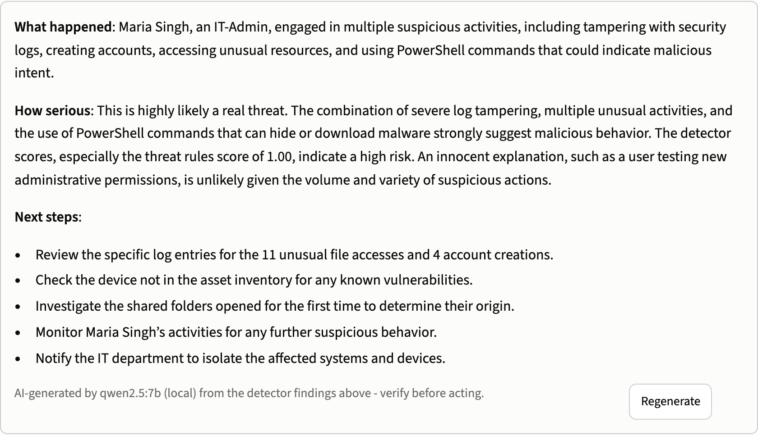




A local language model explains every case
06 · GENERATIVE AI ASSISTANT
Qwen 2.5 7B through Ollama
Runs on the laptop - no log data leaves the machine
Case summaries
What happened, how serious, 3-5 next steps
Command explainer
What a PowerShell or sudo command does and why it is risky
Explains, never decides
Alerts come only from the detectors; log text is fenced off against prompt injection
Real output from the console: case maria.singh, security log tampering
Notes:
AMAAN (0:45 for this slide):
On top of detection we added generative AI. A language model, Qwen 2.5 with 7 billion parameters, runs locally through Ollama - no log data ever leaves the machine, which matters for a security tool. With one click it writes a case summary: what happened, how serious it is, and next steps. This is real output for one of our cases. It can also explain a suspicious PowerShell or sudo command. Importantly, the language model only explains - it never decides what is an alert, and text from the logs is fenced off so an attacker cannot hide instructions in a log.

Slide 8
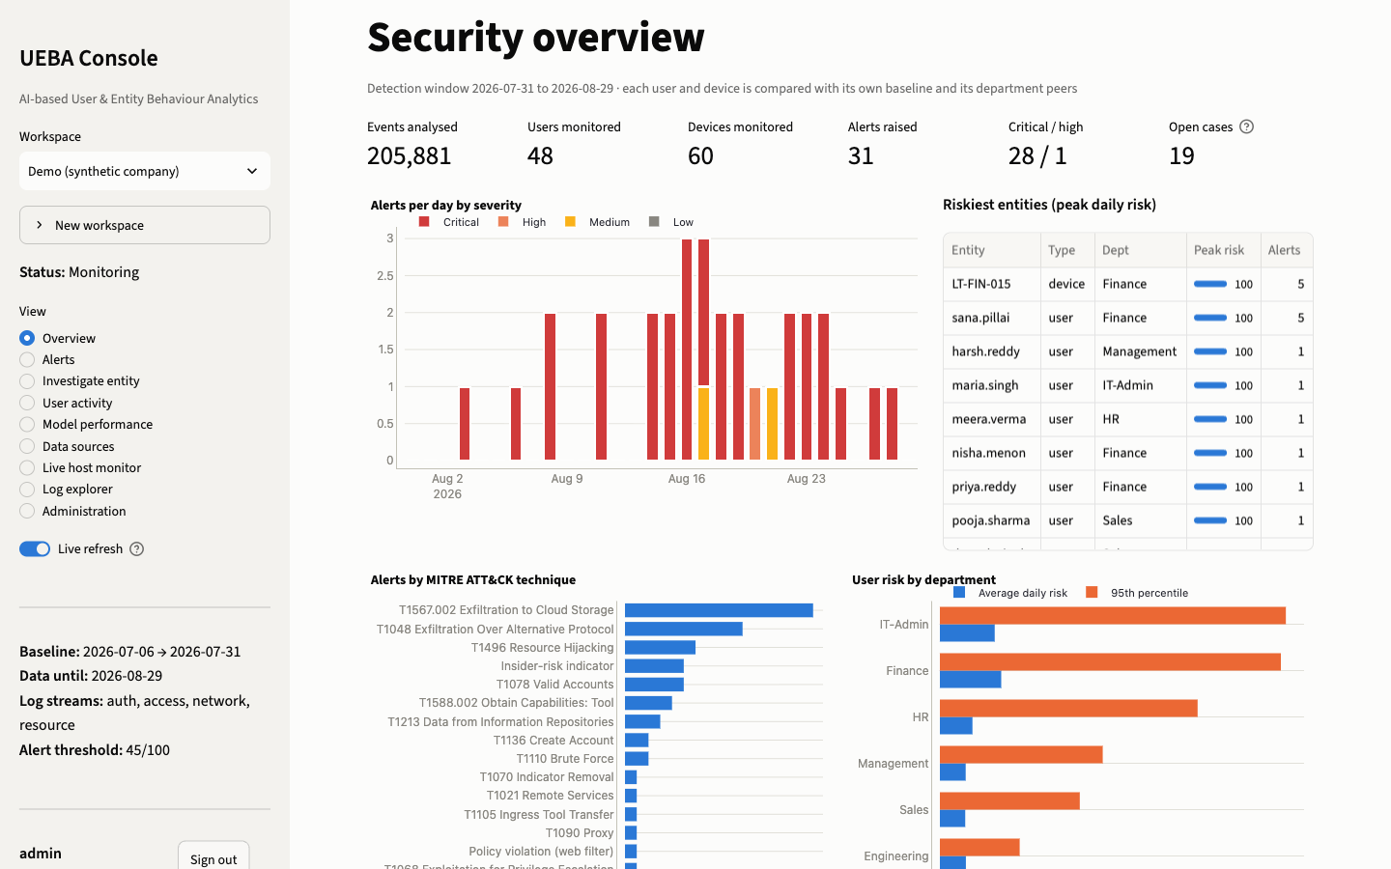
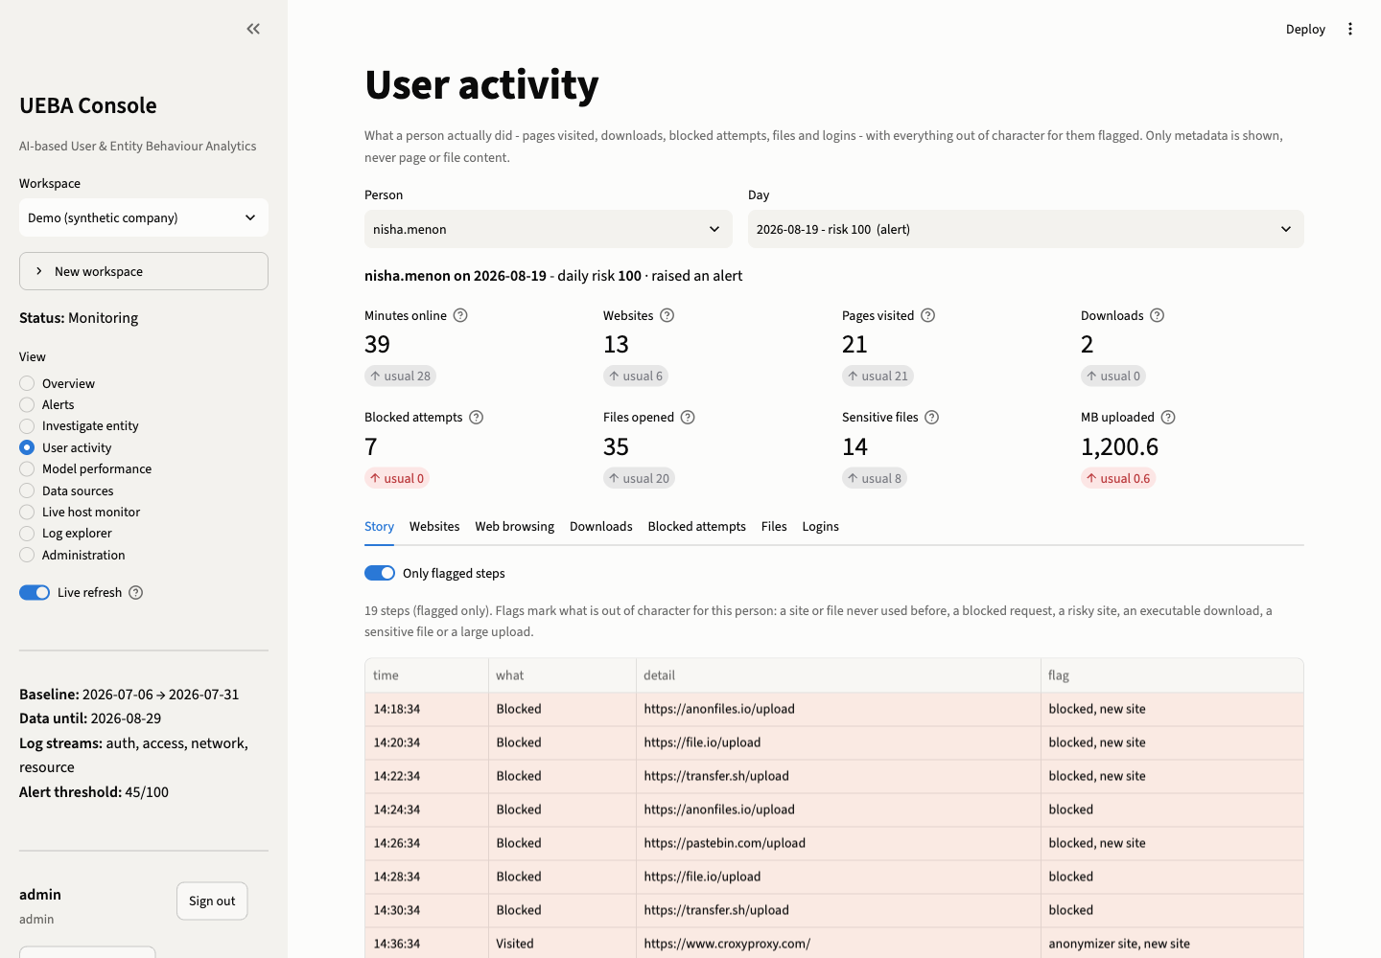
A security console analysts can work in
07 · THE CONSOLE
Overview
User activity
Alerts per day, riskiest people, MITRE techniques, risk by department
What a person did that day - sites, downloads, blocks, files, USB, PowerShell - out-of-character steps flagged
Notes:
AMAAN (0:35 for this slide):
Everything comes together in this console. The overview shows alerts per day, the riskiest people and the attack techniques seen. The user activity page shows what a person actually did on a given day - the websites, downloads, blocked attempts, files, USB devices and PowerShell commands - with the out-of-character steps highlighted. So the analyst sees not just a score, but the story. Tarun will walk you through the results.

Slide 9
It catches the attacks, with very few false alarms
08 · RESULTS
12 / 12
planted attacks caught on day one
0.95
F1 score (precision 0.94, recall 0.97)
1
alert per day on average
6 / 6
attacks found in raw Linux, Windows and proxy logs
CERT r4.2: public CMU insider-threat data we did not design - 22 of 36 held-out insiders at under one alert a day.
Notes:
TARUN (0:50 for this slide):
We tested on three datasets. First, a simulated company of 48 people with 12 planted attacks: all 12 were caught on their first day, with an F1 score of 0.95 and on average just one alert per day. Second, a set of raw Linux, Windows and proxy logs with 6 attacks: all 6 were found, and the system read every format by itself. Third - and this is the honest test - the public CERT insider-threat dataset from Carnegie Mellon, which we did not design. There it found 22 of 36 insiders at under one alert a day. The ones it misses are slow, gradual data theft, which we come back to in our limitations.

Slide 10






A security tool has to be secure itself
09 · SECURE AND TESTED
Salted password hashes
Lock-out
Roles
PBKDF2-SHA256, 310,000 iterations
5 failed logins lock the account for 15 minutes
Viewer, analyst, admin - each sees only what it may change
Scoped API tokens
Audit trail
44 automated tests
One workspace per token, revocable, stored hashed
Every login, verdict, upload and setting change recorded
Including: incremental update = full re-run
Notes:
AMAAN (0:35 for this slide):
A security tool must also be secure itself. Passwords are stored as salted PBKDF2 hashes, five wrong logins lock the account for 15 minutes, and there are three roles - viewer, analyst and admin. API tokens are scoped to one workspace and can be revoked, and every action is recorded in an audit trail. The system has 44 automated tests, including one proving that the fast incremental update gives exactly the same result as re-running everything.

Slide 11


What we would improve next
10 · LIMITATIONS AND FUTURE WORK
Limitations
Future work
Main results use a simulated company - hence the independent CERT benchmark
Slow, gradual data theft (job-seeking insiders) is still mostly missed
Registry, DLL and Active Directory events are not analysed yet
Sequence-aware models for gradual insiders (LSTM / transformer over daily activity)
More log sources: registry, cloud apps (Microsoft 365, Google Workspace)
Let the AI assistant answer questions over the data and draft incident reports
Notes:
TARUN (0:40 for this slide):
We want to be clear about the limitations. Our main results use a simulated company, which is why we also ran the independent CERT benchmark. Slow, gradual data theft is still mostly missed, because each day on its own looks normal. And some Windows event types, like registry changes, are not analysed yet. For future work, we would add sequence-aware models such as LSTMs or transformers to catch gradual insiders, support more log sources like Microsoft 365, and let the AI assistant answer questions over the data and draft incident reports.

Slide 12

Behaviour, not signatures
11 · CONCLUSION
Learns normal for every user and device - no attack labels needed
Catches attacks early with about one alert a day, each explained
Thank you
Reads real Linux, Windows and proxy logs and runs as a working console
Questions?
Machine learning detects; a local language model explains
Amaan Saify · Tarun Jadhav · Supervisor: Dr. Rathnakar Achary · Alliance University, Bengaluru
Notes:
AMAAN (0:40 for this slide):
To conclude: our system learns what normal looks like for every user and device without any attack labels, and it catches attacks early with about one alert a day, each one explained.
TARUN (0:40 for this slide):
It reads real Linux, Windows and proxy logs and runs as a working console, where machine learning detects and a local language model explains. Thank you for listening - we are happy to take your questions.

