Slide 1
Red-black trees
Definition: A binary tree, satisfying:
Every node is red or black
The root is black
Every leaf is NIL and is black
If a node is red, then both its children are black
For each node, all paths from the node to descendant leaves contain the same number of black nodes.
Purpose: To keep the tree balanced.

Slide 2
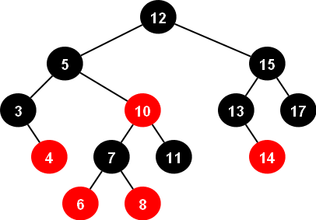
Example:

Slide 3
Properties:
Left, right, ,parent, color, key.
bh(x), black-height of x, the number of black nodes on any path from x (excluding x) to a leaf.
A red-black tree with n internal nodes has height at most 2log(n+1).
Note: internal nodes: all normal key-bearing nodes. External nodes: Nil nodes or the Nil Sentinel.
A subtree rooted at x contains at least 2^{bh(x)}-1 internal nodes.
By property 4, bh(root)≥h/2.
n ≥ 2^{h/2}-1

Slide 4
Some operations in log(n)
Search, Minimum, Maximum, Successor, Predecessor.
Let us discuss insert or delete.

Slide 5
Rotation
The search-tree operations TREE-INSERT and TREE-DELETE, when run on a red-black tree with n keys, take O(lgn) time.
Because they modify the tree, the result may violate the red-black properties.
To restore these properties, we must change the colors of some of the nodes in the tree and also change the pointer structure.
We change the pointer structure through rotation,

Slide 6
Left-Rotation
When we do a left rotation on a node x, we assume that its right child y is not NIL; x may be any node in the tree whose right child is not NIL.
The left rotation “pivots” around the link from x to y. It makes y the new root of the subtree, with x as y’s left child and y’s left child as x’s right child.
The pseudocode for LEFT-ROTATE is:

Slide 7
Pseudo Code
LEFT-ROTATE(T,x)
y = x:right
x:right = y:left
If y:left != T:nil
y:left:p = x
y:p = x:p
if x:p == T:nil
T:root = y
elseif x == x:p:left
x:p:left = y
else x:p:right = y
y:left = x
x:p = y

Slide 8
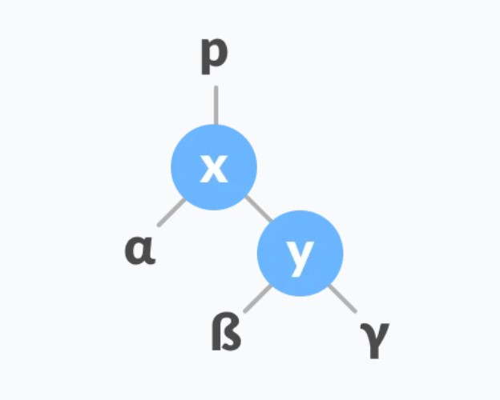
Example of Left-Rotation
Let the initial tree be:
Initial Tree

Slide 9
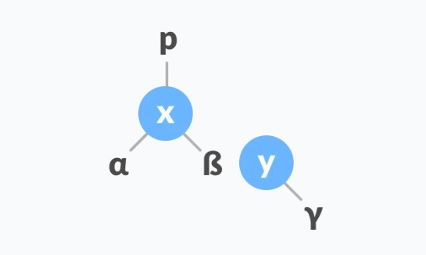
Example of Left-Rotation
If y has a left subtree, assign x as the parent of the left subtree of y.
Assign x as the parent of left subtree of y

Slide 10
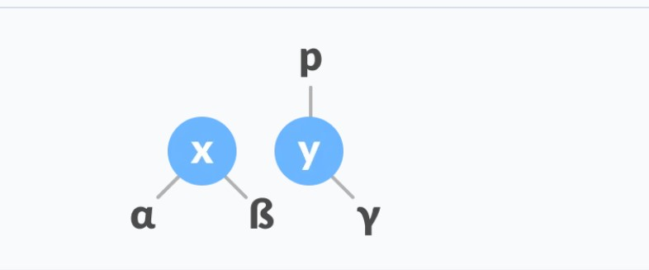
Example of Left-Rotation
3. If parent of x is NIL, make y as root of tree.
4. Else if x is left child of p, make y as left child of p.
Else assign y as right child of p.
Change the parent of x to that of y.

Slide 11
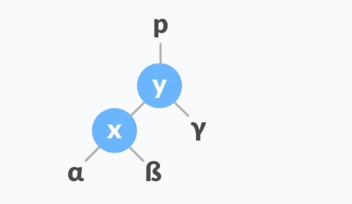
Example of Left-Rotation
Make y as the parent of x.
Assign y as parent of x

Slide 12
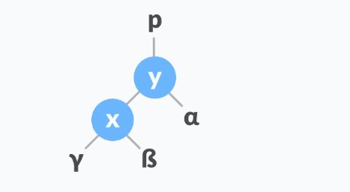
Right-Rotation
In right-rotation, the arrangement of the nodes on the left is transformed into the arrangements on the right node.
1. Let the initial tree be:

Slide 13
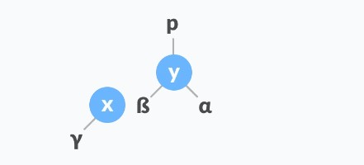
Right-Rotation
2. If x has a right subtree, assign y as the parent of the right subtree of x.

Slide 14

Right-Rotation
3. If the parent of y is NIL, make x as a root of tree.
Else if y is right child of it’s parent p, make x as right child of p.
Else assign x as left child of p.
Assign parent of y as parent of x

Slide 15
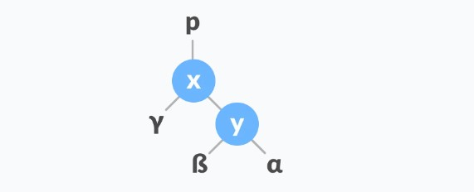
Right-Rotation
Make x as parent of y.
Assign x as parent of y.

Slide 16
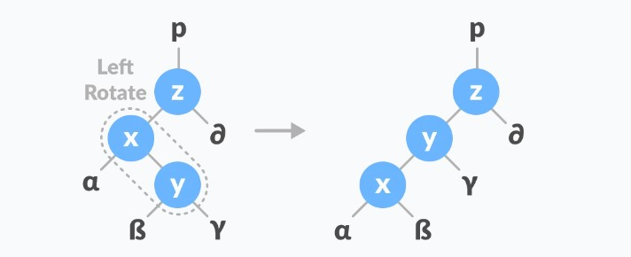
Left-Right Rotations
In left-right rotation, the arrangements are first shifted to the left and then to the right.
Do left rotation on x-y.
Left rotate x-y

Slide 17
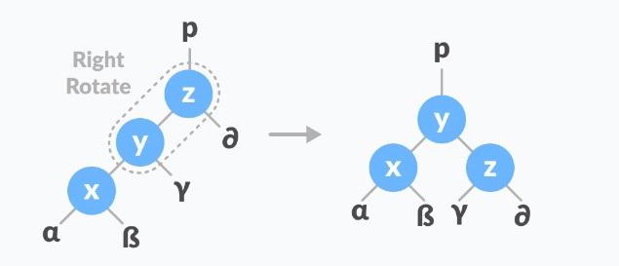
Left-Right Rotations
Do right rotation on y-z.
Right rotation on y-z.

Slide 18
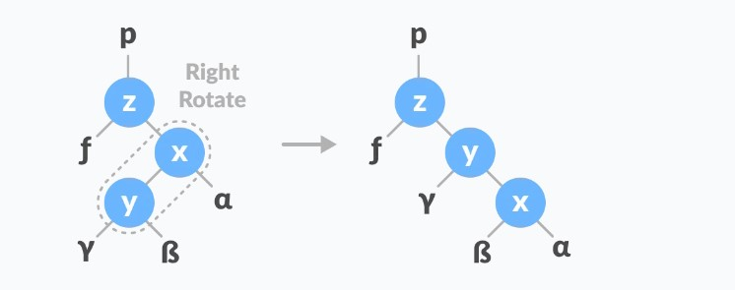
Right-Left Rotations
In right-left rotation, the arrangements are first shifted to the right and then to the left.
Do right rotation on x-y.
Right rotation on x-y

Slide 19
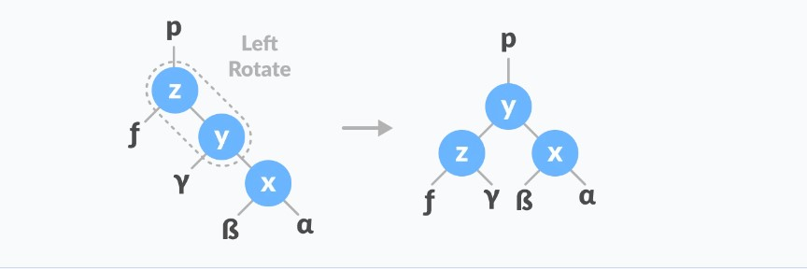
Right-Left Rotations
Do left rotation on z-y.
Left rotation on z-y

Slide 20
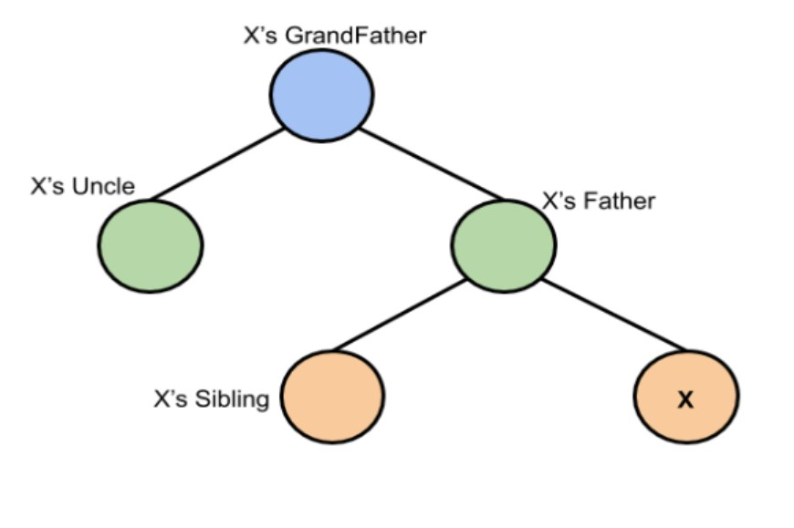
Insertion in Red Black-Tree

Slide 21
Insertion in Red Black-Tree
Logic to insert:
First, you have to insert the node similarly to that in a binary tree and assign a red colour to it.
If the node is a root node then change its colour to black, but if it is not then checking the colour of the parent node.
If its colour is black, then don’t change the colour but if it is not i.e. it is red then check the colour of the node’s uncle.
If the node’s uncle has a red colour then change the colour of the node’s parent and uncle to black and that of grandfather to red colour and repeat the same process for him (i.e. grandfather).
If grandfather is root then don’t change grandfather to red colour.

Slide 22
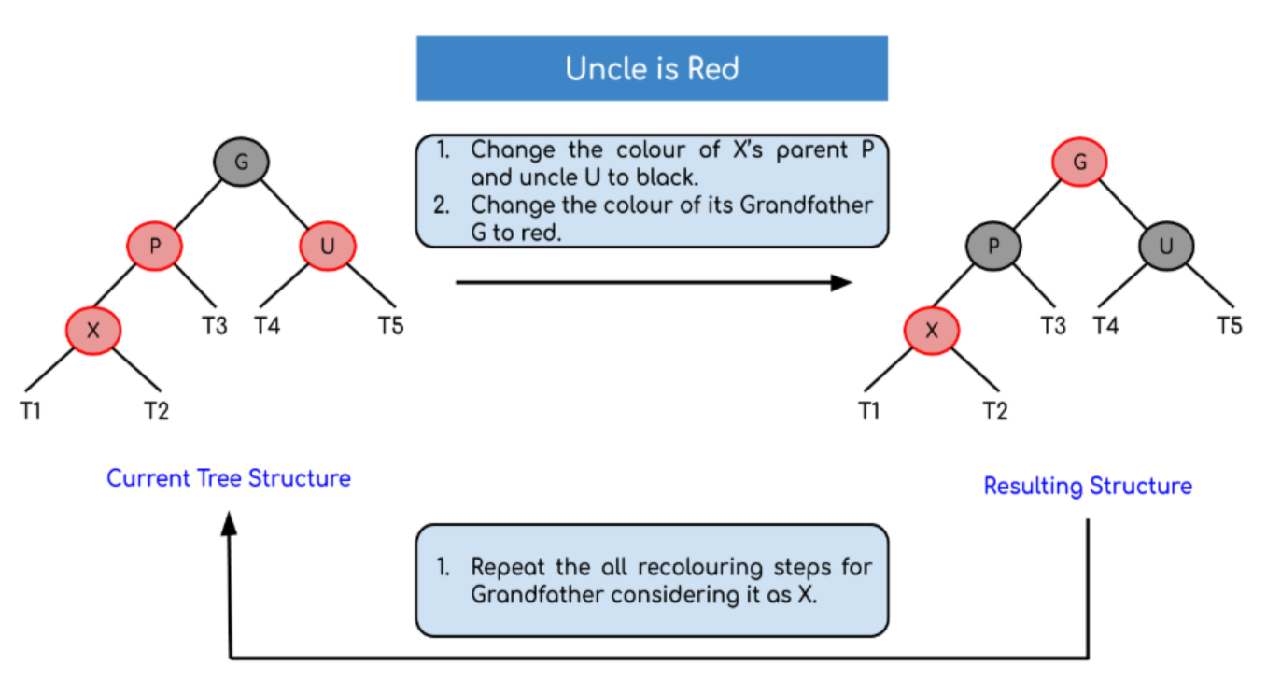
Insertion in Red Black-Tree

Slide 23
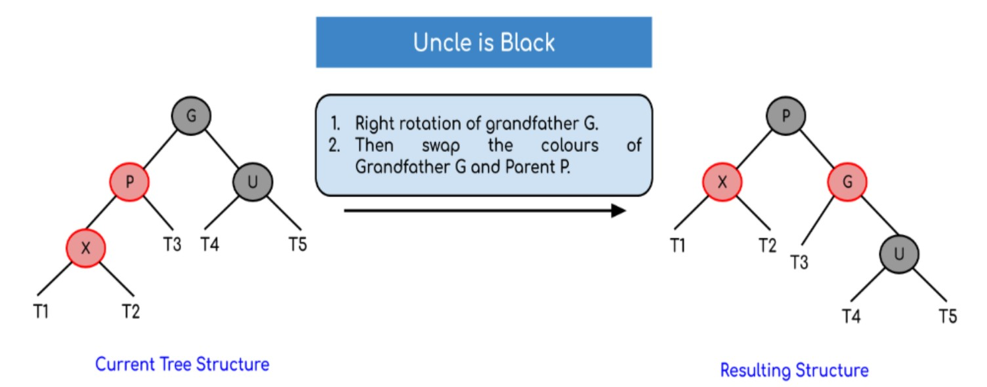
Insertion in Red Black-Tree
If the node’s uncle has black colour then there are 4 possible cases:
Left-Left Rotation:

Slide 24
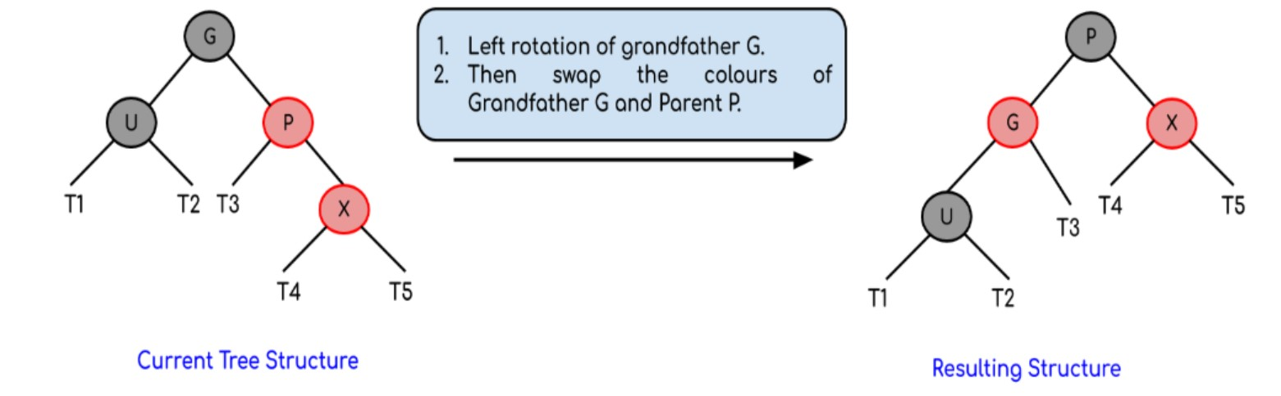
Insertion in Red Black-Tree
Right-Right Case:

Slide 25
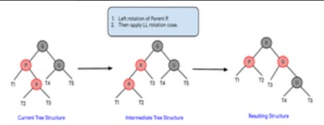
Insertion in Red Black-Tree
Left-Right Rotation:

Slide 26
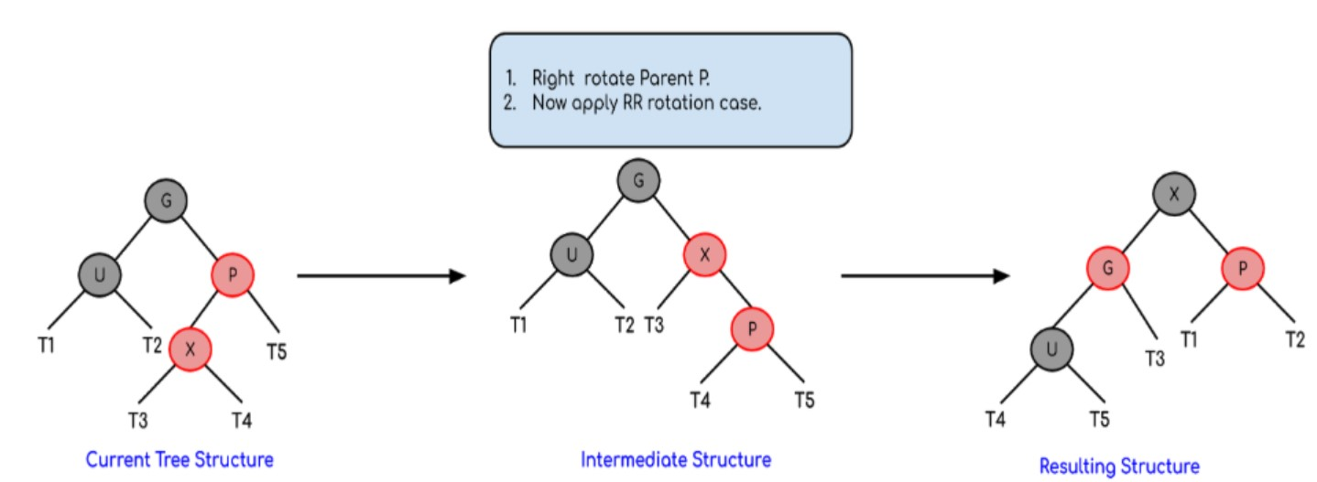
Insertion in Red Black-Tree
Right-Left Rotation:

Slide 27
Deletion in Red Black-Tree
In the delete operation, we check the color of the sibling to decide the appropriate case.
The main property that violates after insertion is two consecutive reds. In delete, the main violated property is, change of black height in subtrees as deletion of a black node may cause reduced black height in one root to leaf path.

Slide 28
Deletion in Red Black-Tree
Simple Case: If either u or v is red.
If Both u and v are Black.
If sibling s is black and at least one of sibling’s children is red
If sibling is black and its both children are black
If sibling is red, perform a rotation to move old sibling up, recolor the old sibling and parent. The new sibling is always black
If u is root, make it single black and return (Black height of complete tree reduces by 1).

Slide 29
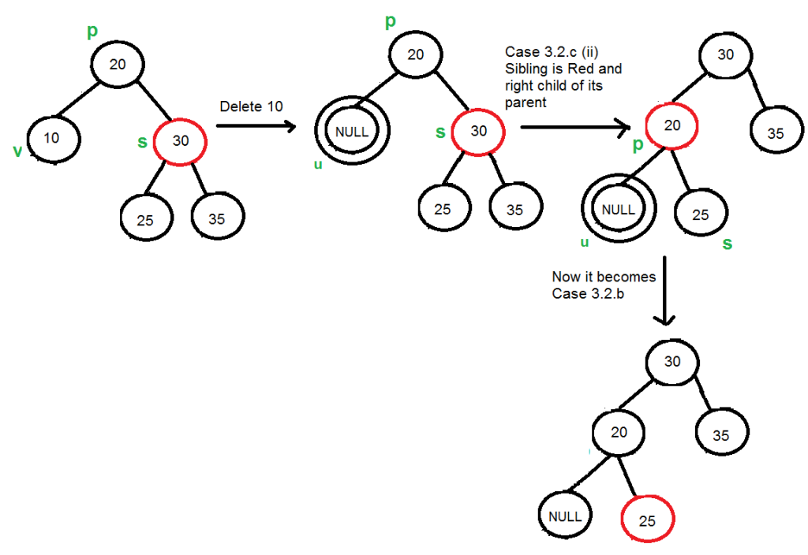
Deletion in Red Black-Tree

Slide 30
Thank You

