Slide 1
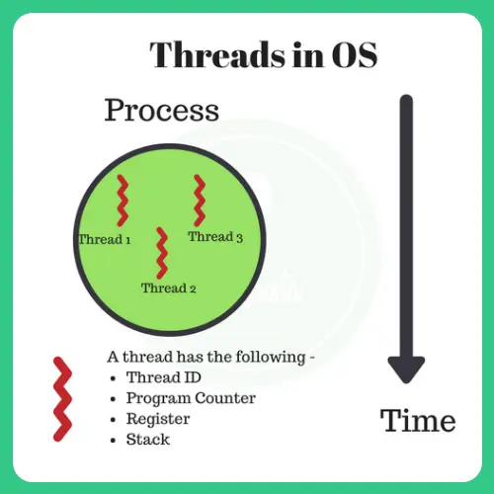
POP-UP THREADS
Submitted By: Amad Irfan
Reg No: 2021-CS-25
Submitted To: Sir Nauman Shafi

Slide 2
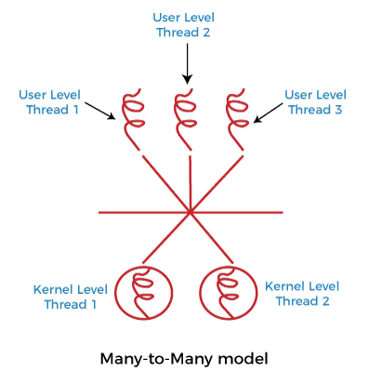
THREADS
Firstly, we must know about threads what is thread?
A thread refers to a single sequential flow of activities being executed in a process; it is also known as the thread of execution or the thread of control.
A distinct program counter, a stack of activation records as well as control blocks are used by each thread of the same process. Thread is frequently described as a light technique.

Slide 3
POP-UP THREAD
Threads are often useful in distributed systems.
The traditional approach is to have a process or thread that waits for an incoming message.
When a message arrives, it is accepted, unpacked, and processed.
An alternative approach is to create a new thread (a pop-up thread) for each incoming message.
This is useful for handling incoming messages quickly and efficiently.

Slide 4
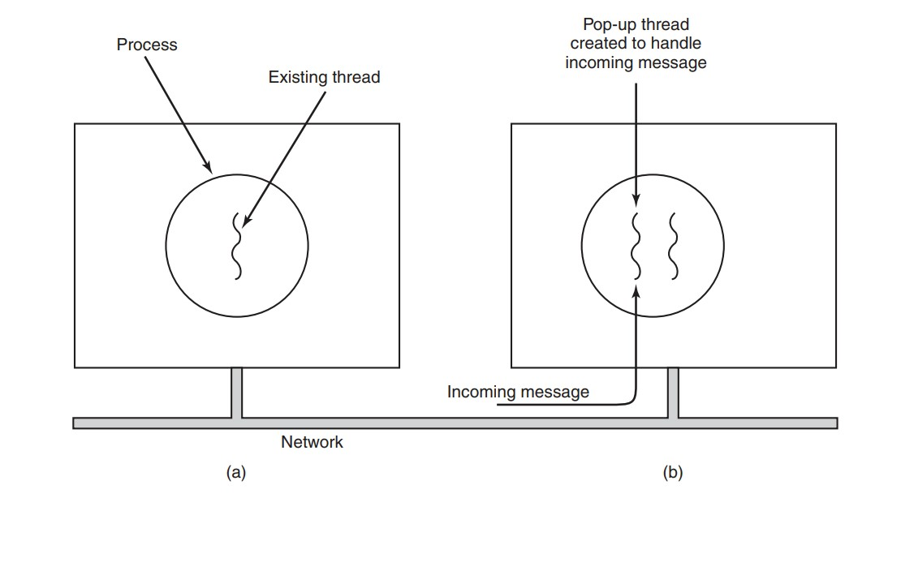
POP-UP THREAD
The picture shows creation of new thread.
Before the message arrives.
After the message arrives.

Slide 5
Why are threads needed?
It takes far less time to create a new thread in an existing process than to create a new process.
Threads can share the common data; they do not need to use Inter- Process communication.
Context switching is faster when working with threads.
It takes less time to terminate a thread than a process.

Slide 6
Types of Threads
User Level Thread
Kernal Level Thread

Slide 7
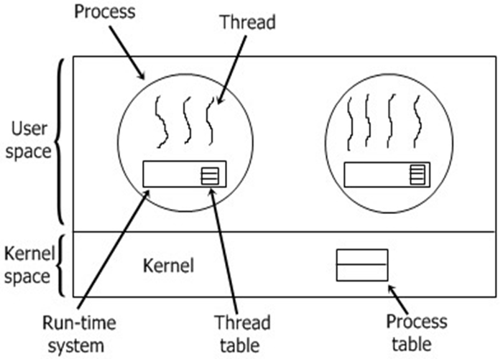
User Level Thread
The operating system does not recognize the user-level thread. User threads can be easily implemented, and it is implemented by the user.
If a user performs a user-level thread blocking operation, the whole process is blocked. The kernel level thread does not know nothing about the user level thread.
Examples: Java thread, POSIX threads, etc.

Slide 8
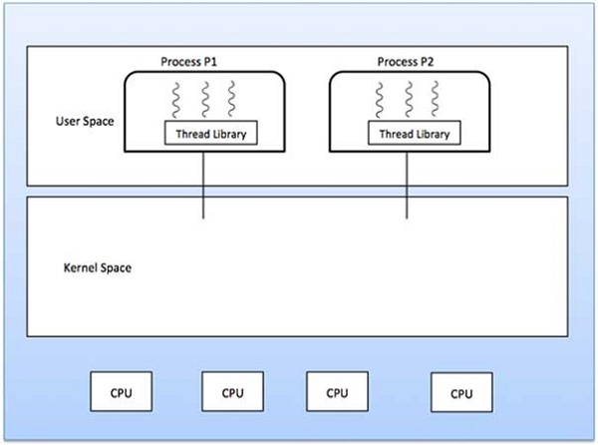
Kernel Level Thread
The kernel thread recognizes the operating system. There is a thread control block and process control block in the system for each thread and process in the kernel-level thread.
The kernel-level thread is implemented by the operating system. The kernel knows about all the threads and manages them.
The implementation of kernel threads is more difficult than the user thread. Context switch time is longer in the kernel thread.
Example: Window Solaris.

Slide 9
Syntax to create thread
Header File
Include the header file pthread.h
e.g., #include <pthread.h>
Creating a Thread
A thread is created and starts using the function pthread_create(). It takes four parameters. The four parameters are:

Slide 10
Syntax to create thread
Name | Type | Description
ID | pthread_t* | Reference (or pointer) to the ID of the thread.
Attributes | pthread_attr_t * | Used to set the attributes of a thread(e.g., the stack size, scheduling policy, etc.)
Starting Routine | void * | The name of the function that the thread starts to execute. If the function’s return type is void *, then its name is simply written; otherwise, it must be type-cast to void *.
Arguments | void * | This is the argument that the starting routine takes. If it takes multiple arguments, a struct is used.

Slide 11
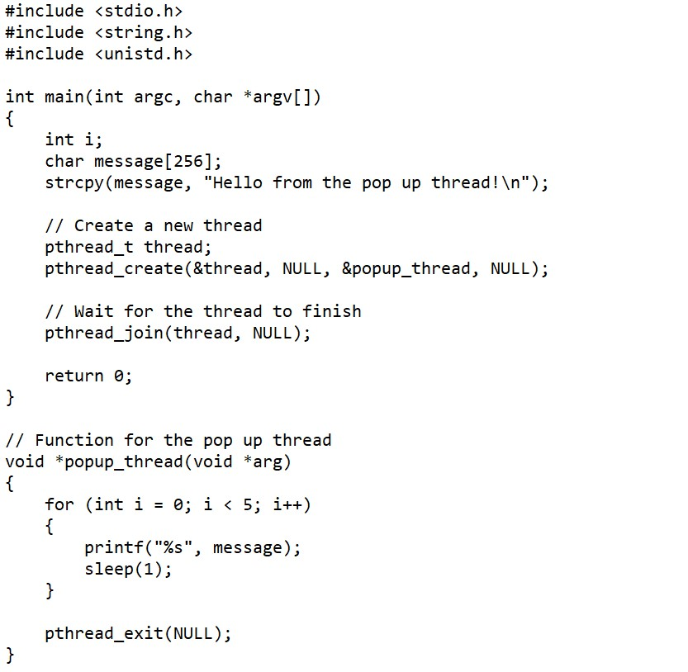
Example no 1
In the main() function, a string is declared and initialized with a message that will be printed by the thread.
The pthread_t thread data type is used to create a new thread, which is done with the pthread_create() function. The first argument to this function is the thread id, the second is the thread attributes and the third is the thread function, which in this case is popup_thread().
The pthread_join() function is used to wait for the thread to finish before the main() function returns.
The popup_thread() function prints the message 5 times, with a 1 second delay between each print.
Finally, the pthread_exit() function is used to exit the thread.

Slide 12
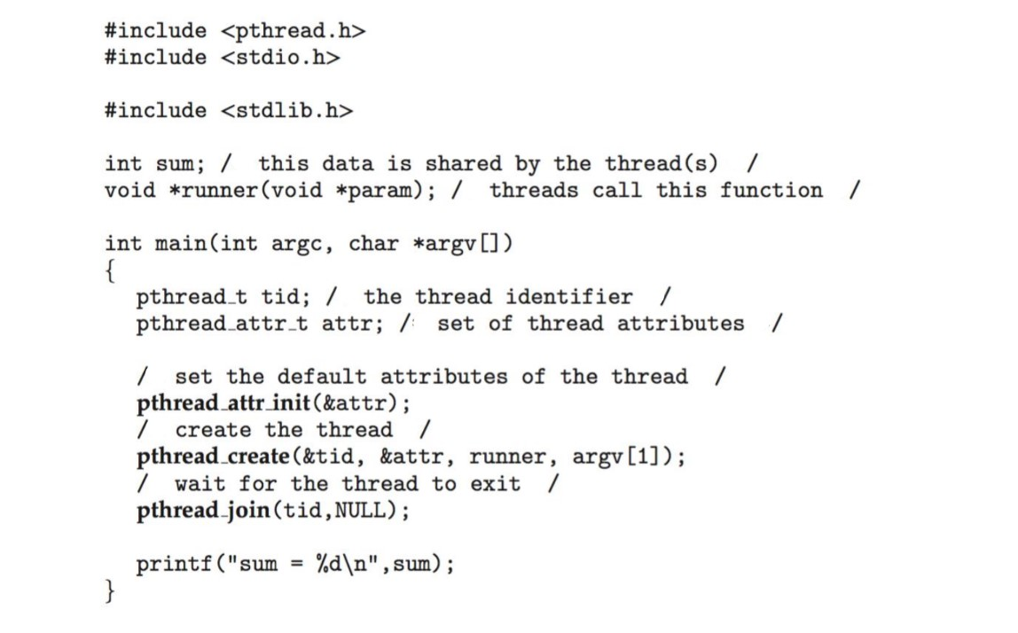
Example no 2
In main function first make set of thread attributes and then set the default attributes create the thread wait for thread to exit and print sum.
Before begin of main thread call the runner function.

Slide 13
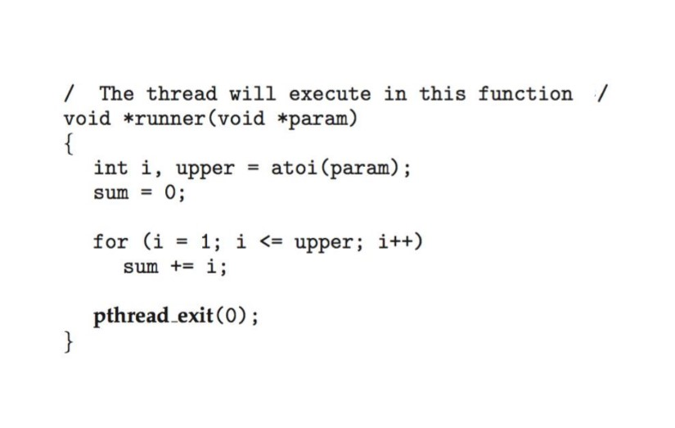
Example no 2
Before begin of main thread call the runner function.
Thread execute this function and exit.

