Slide 1


NOTEBOOK LESSON
Here starts the lesson!

Slide 2
Contents of this template
Here’s what you’ll find in this Slidesgo template:
A slide structure based on a lesson presentation, which you can easily adapt to your needs. For more info on how to edit the template, please visit Slidesgo School or read our FAQs.
An assortment of illustrations to use in the presentation can be found in the alternative resources slide.
A thanks slide, which you must keep so that proper credits for our design are given.
A resources slide, where you’ll find links to all the elements used in the template.
Instructions for use.
Final slides with:
The fonts and colors used in the template.
A selection of illustrations. You can also customize and animate them as you wish with the online editor. Visit Storyset to find more.
More infographic resources, whose size and color can be edited.
Sets of customizable icons of the following themes: general, business, avatar, creative process, education, help & support, medical, nature, performing arts, SEO & marketing, and teamwork.
You can delete this slide when you’re done editing the presentation.

Slide 3

Table of Contents!
Overview
Assignment
Topic features
About the topic
Describe the topic of the section here
Describe the topic of the section here
Describe the topic of the section here
Describe the topic of the section here

Slide 4

01
OVERVIEW
You can enter a subtitle here if you need it

Slide 5



Introduction
Neptune is the farthest planet from the Sun and also the fourth-largest by diameter in the entire Solar System

Slide 6
Introduction
You can give a brief description of the topic you want to talk about here. For example, if you want to talk about Mercury, you can say that it’s the smallest planet in the entire Solar System

Slide 7

—Someone Famous
Book Title. P52
“This is a quote. Words full of wisdom that someone important said and can make the reader get inspired.”

Slide 8




—Someone Famous
“This is a quote. Words full of wisdom that someone important said and can make the reader get inspired.”

Slide 9

What is this topic about?
You can explain what the topic is about here
You can explain what the topic is about here
You can explain what the topic is about here
You can explain what the topic is about here
You can explain what the topic is about here
You can replace this picture if you wish

Slide 10


Why don’t we talk about his topic now?
Images reveal large amounts of data, so remember: use an image instead of a long text. Your audience will appreciate it

Slide 11
Definition of concepts
Mercury
Mars
Saturn
Venus
Mercury is the smallest planet
Despite being red, Mars is a cold place
It’s composed of hydrogen and helium
Venus is the second planet from the Sun

Slide 12
Concepts we should not forget
Venus
Jupiter
Mars
Saturn
Venus is the second planet from the Sun
It’s the biggest planet in the Solar System
Despite being red, Mars is a cold place
Saturn is a gas giant and has several rings

Slide 13

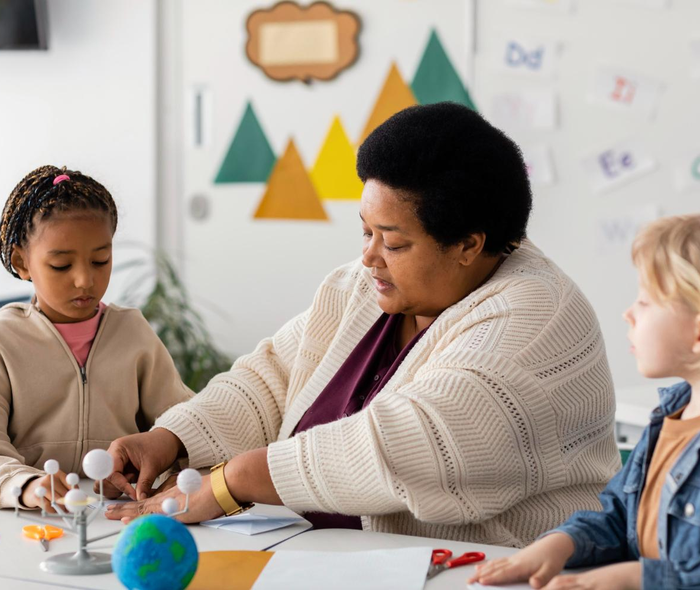
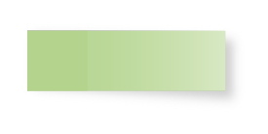
02
LESSON NAME
You can enter a subtitle here if you need it

Slide 14
Features of the topic
Mercury
Jupiter
Mars
It’s the closest planet to the Sun
Jupiter is the biggest planet
Venus is the second planet from the Sun
Mars is actually a cold place

Slide 15
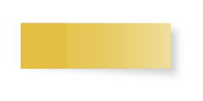
Main characteristics
Venus
Mars
Mercury
Venus has a beautiful name and it is very hot
Mars is actually a cold place, despite its red color
It’s the closest planet to the Sun and the smallest one

Slide 16


Some important numbers
2,569
1,458
4,759
Mercury is the closest planet to the Sun
Jupiter is the biggest planet of them all
Neptune is the farthest planet from the Sun

Slide 17
10%
50%
40%
Despite being red, Mars is a cold place
Saturn is the only planet
with rings
Venus has a beautiful name, but it’s hot

Slide 18
55%
25%
75%
35%
Mercury is the smallest planet
Venus has a beautiful name
Saturn is the ringed planet
Mars is a very cold place

Slide 19

Practical uses of this subject
Mercury
Jupiter
Mercury is the closest planet to the Sun
Venus is the second planet from the Sun
Jupiter is the biggest planet of them all

Slide 20
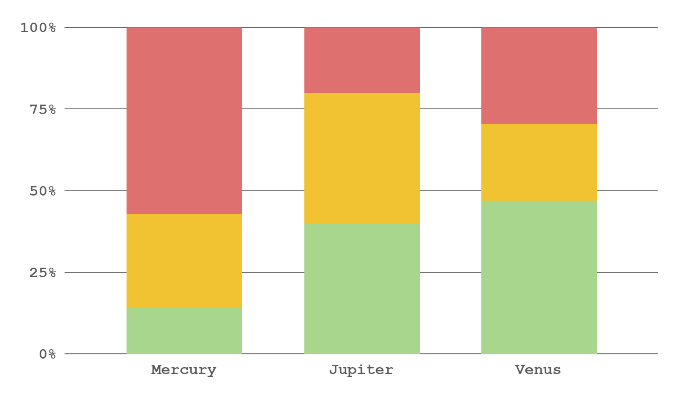
Did you know this?
35%
65%
To modify this graph, click on it, follow the link, change the data and replace this
Mercury is a small planet
Jupiter is the biggest one
Factor 1
Factor 2
Factor 3

Slide 21

31,500
Big numbers catch your audience’s attention

Slide 22

589
This is the number of students per year
Big numbers catch your audience’s attention

Slide 23


Problem
Solution
Neptune is the fourth-largest planet in the Solar System
Jupiter is a gas giant and the biggest planet in the Solar System

Slide 24
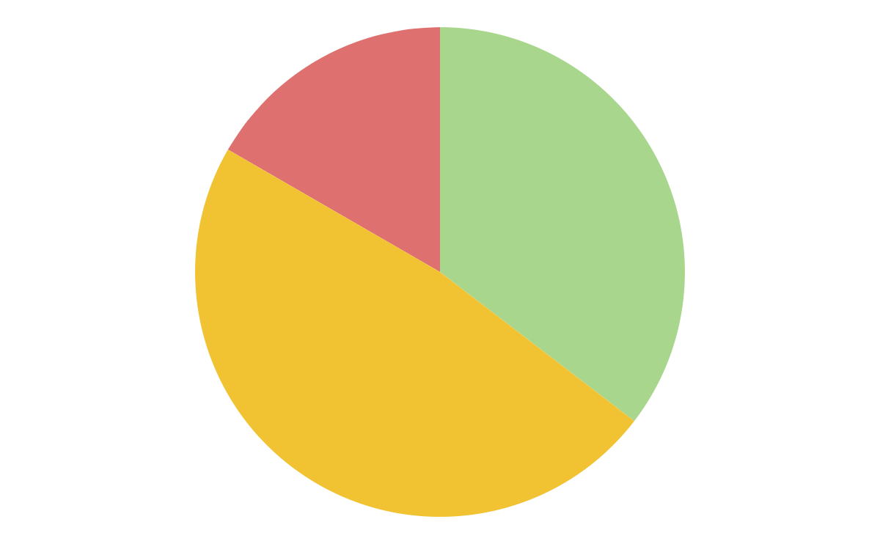
Did you know?
34%
Mercury
Mercury is the smallest planet
46%
Venus
Venus has a beautiful name
16%
Saturn
Follow the link in the graph to modify its data and then paste the new one here. For more info, click here
Saturn is the ringed planet

Slide 25


Process
Step 1
Step 2
Step 3
Step 4
Mercury is the smallest planet
Saturn is the ringed planet
Venus has a beautiful name
Mars is a very cold place

Slide 26

The learning process
1
Mercury is the smallest planet
4
Saturn is the ringed planet
2
Venus has a beautiful name
5
Jupiter is the biggest planet
3
Mars is a very cold place
6
Neptune is far from the Sun

Slide 27


Relations between concepts
Mercury is a small planet
Mars is a cold place
Jupiter is a gas giant
Venus is a hot planet
Only Saturn has rings

Slide 28
Exams and
retakes calendar
April 2022
Saturn
 |  |  |  | 1 | 2 | 3
4 | 5 | 6 | 7 | 8 | 9 | 10
11 | 12 | 13 | 14 | 15 | 16 | 17
18 | 19 | 20 | 21 | 22 | 23 | 24
25 | 26 | 27 | 28 | 29 | 30
Saturn is a gas giant with rings
Neptune
Neptune is far from the Sun

Slide 29
Insert your multimedia content here
Despite being red, Mars is actually a cold place full of iron oxide dust

Slide 30
Main concepts to know
Mercury
Venus
Saturn
Mercury is the smallest planet
Venus has a beautiful name
Only Saturn
has rings
Mars
Neptune
Mars is a very cold place
Neptune is far from the Sun

Slide 31
Exam’s grades
Grades
Student | Q1 | Q2
Last name, name | A+ | F
Last name, name | A | B
Last name, name | C | A
Last name, name | F | A+
Grades
Student | Q1 | Q2
Last name, name | C | A+
Last name, name | A+ | F
Last name, name | A | B
Last name, name | B | C

Slide 32
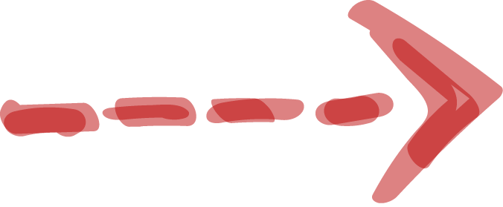

Overview diagram
30%
Mercury is smallest one
Venus is a hot planet
Mars is a cold place
Only Saturn has rings

Slide 33
This is a gantt chart
 | Week 1 | Week 2 | Week 3
Activity 1
Activity 2
Activity 3
Activity 4
Activity 5

Slide 34
Homework checklist
Saturn
Saturn is the ringed planet
Mercury
Jupiter
Mercury is the smallest planet
It’s a giant and the biggest one
Venus
Neptune
Venus has a beautiful name
Neptune is the
farthest planet
Mars
Earth
Mars is a very cold place
Earth is the planet with life

Slide 35


In case you need another diagram
The Solar System
Mars is a very cold place
Saturn is the ringed planet
Neptune is far from the Sun
Mercury is the smallest planet
Venus has a beautiful name

Slide 36



Learn the difference
First concept
Second concept
Despite being red, Mars is actually a cold place. It’s full of iron oxide dust
Venus has a very beautiful name and is the second planet from the Sun

Slide 37
Classes timetable
 | Mon | Tue | Wed | Thu | Fri
7-8 am | Physics | English | Arts | Physics | Maths
8-9 am | Maths | Arts | Maths | Arts | English
9-10 am | English | Physics | English | Physics | Arts
10-11am | Arts | Maths | Physics | English | Physics

Slide 38
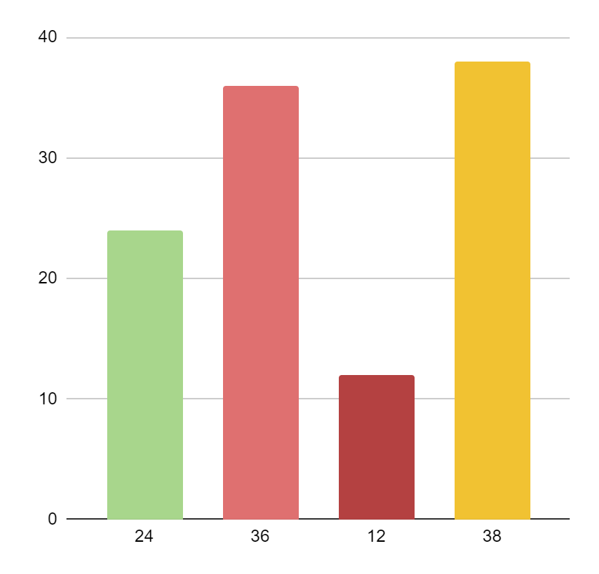
Let’s have a look at this graphic
Mercury
Saturn
It is the smallest planet
Saturn is the ringed planet
Venus
Mars
Venus has a beautiful name
Mars is a very cold place
Follow the link in the graph to modify its data and then paste the new one here. For more info, click here

Slide 39

Awesome words

Slide 40
You can use this diagram
Mercury
Saturn
It is the smallest planet
Saturn is the ringed planet
The Solar System
Venus
Neptune
Venus has a beautiful name
Neptune is far from the Sun
Mars
Jupiter
Mars is a very cold place
Jupiter is the biggest planet

Slide 41
Some percentages
50%
60%
90%
40%
70%
80%
Pluto
Saturn
Venus
Mars
Jupiter
Earth

Slide 42
Locations
Saturn is a gas giant
Mars is a cold place

Slide 43

A picture reinforces the concept

Slide 44
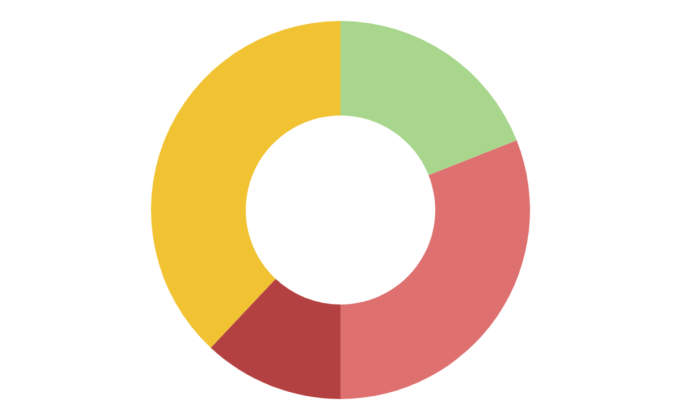
You can use this graph
38%
19%
12%
31%
Mercury
Saturn
Mercury is the smallest planet
Saturn is the ringed planet
Venus
Mars
Venus has a beautiful name
Mars is a very cold place
Follow the link in the graph to modify its data and then paste the new one here. For more info, click here

Slide 45

A picture is worth a thousand words
Despite being red, Mars is a cold place. It’s full of iron oxide dust

Slide 46
This infographic might help
1
Mercury is the
Smallest planet
Mercury
2
It’s a giant and the biggest one
Jupiter
3
Mars is actually a cold place
Mars
4
Neptune is far from the Sun
Neptune

Slide 47
Data review
Study 1 | Study 2 | Study 3
0.3 | 1.2 | 4.5
1.4 | 0.6 | 7.8
Study 1 | Study 2 | Study 3
2.5 | 6.9 | 1.6
3.5 | 7.7 | 1.8

Slide 48

A little brainstorming
Venus
Venus has a
beautiful name
Mars
Mars is actually a cold place
Saturn
Only Saturn
has rings
Neptune
Neptune is far from the Sun

Slide 49
Some geography of your country
Mercury
Mercury is the
Smallest planet
Jupiter
Jupiter is the biggest planet
Mars
Mars is actually a cold place

Slide 50
Review of concepts
Mercury
Venus
Mars
Jupiter
Saturn
Neptune
Mercury is the
Smallest planet
Venus has a
beautiful name
Mars is actually a cold place
Jupiter is the biggest planet
Saturn is a gas giant with rings
Neptune is far from the Sun

Slide 51
Revise concepts
Jupiter
Venus
Saturn
Mars
Neptune
Mercury
Jupiter is the biggest planet
Venus has a
beautiful name
Saturn is the
ringed one
Mars is actually a cold place
Neptune is the
farthest planet
Mercury is the
Smallest planet

Slide 52
Percentages per classroom
35%
55%
75%
65%
Mercury
Venus
Jupiter
Mars
Mercury is smallest one
Venus is a hot planet
Jupiter is a gas giant
Mars is a cold place

Slide 53

You might not know this
Neptune
Neptune is far from the Sun
Mercury
Mercury is the
Smallest planet

Slide 54
Exercise
Venus has a beautiful name and is the second planet from the Sun
Despite being red, Mars is actually a cold place

Slide 55



Materials for every class
Physics
English
Arts
Your list goes here
Your list goes here
Your list goes here
Your list goes here
Your list goes here
Your list goes here
Your list goes here
Your list goes here
Your list goes here

Slide 56
Progress made
Saturn
80%
Venus
40%
Saturn is a gas giant with rings
Venus has a
beautiful name
Neptune
50%
Mercury
90%
Neptune is far from the Sun
Mercury is the
Smallest planet

Slide 57
Conclusions
Jupiter
A)
Jupiter is the biggest planet
A)
B)
Neptune
B)
Neptune is far from the Sun
Mars
C)
Mars is actually a cold place
C)
D)
Mercury
D)
Mercury is the
Smallest planet

Slide 58
Assignment
Which planet has a beautiful name and is the second one from the Sun

Slide 59
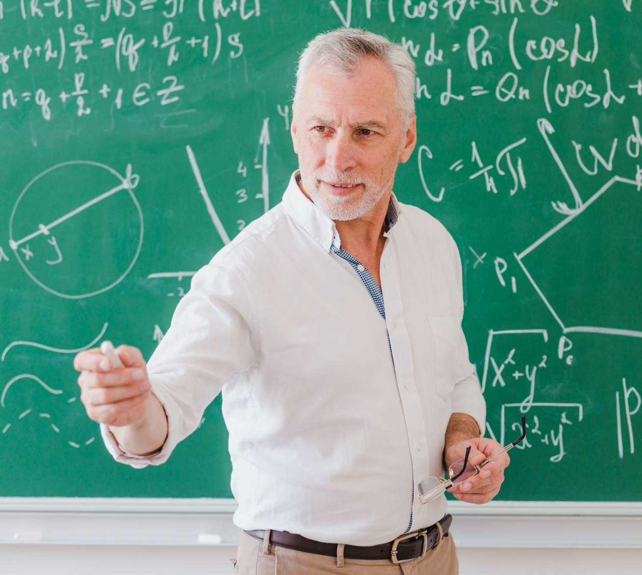

Our teachers
Timmy Jimmy
Kaliyah Harris
You can speak a bit about this person here
You can speak a bit about this person here

Slide 60
Thanks!
Do you have any questions? youremail@freepik.com +91 620 421 838 yourcompany.com
Please keep this slide for attribution.

Slide 61
Universal Icon Pack

Slide 62
Universal Icon Pack (I)

Slide 63
Premium alternative infographics
The solar system
Saturn
Earth
Mercury
Venus
Pluto
Mars
Jupiter
Neptune

Slide 64



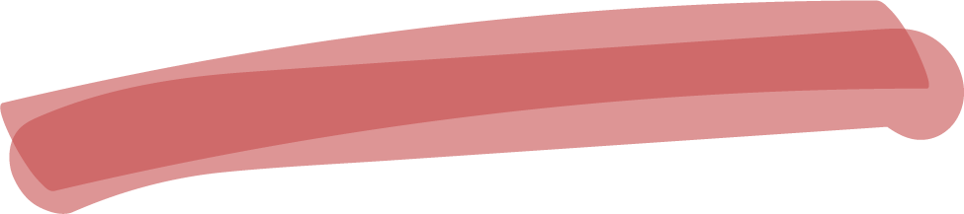

Alternative resources

Slide 65
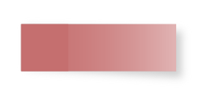





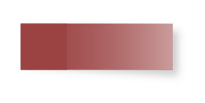
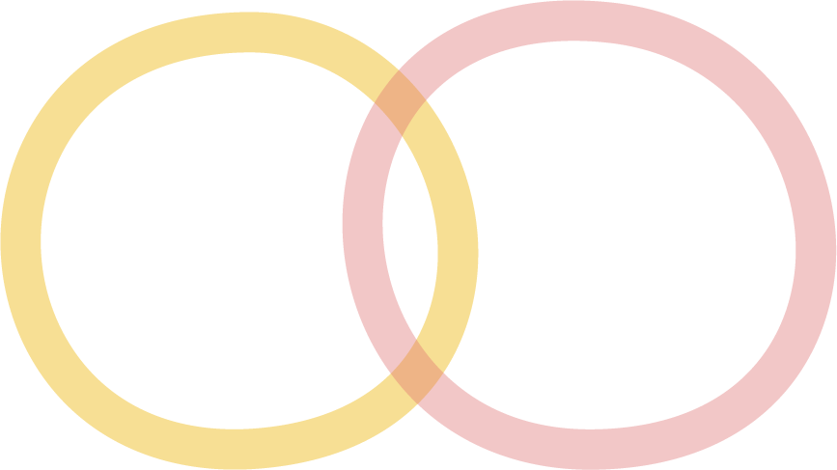







Premium alternative resources

Slide 66
Resources
Did you like the resources on this template? Get them for free at our other websites
PHOTOS:
Student taking notes side view
Teenage student sitting at table with notebook and writing
African american man writing front view
Smiling teenage girl showing something on book to her friend
Happy teen girl at lesson
Girl on armchair reading
Crop student writing in notepad

Slide 67
Resources
VECTORS:
Wooden background with checklist and pen
Open notebook with accessories
Notebook page vector
Collection of leaves and colored notes
Tablet background with hand-drawn learning items
Schedule with nice notes
ets of paper with sticky tape
Assortment of arrows highlighter
Pack of small sticky notes in realistic style

Slide 68
Premium resources
PHOTOS:
Front view school kids at the table
Youngsters communicating in library room
Close up smiley student holding books
Kids learning about planets in classroom
Young students learning together during a group study
Young black woman with book at table
Young student learning in the library
Medium shot student studying with laptop
Medium shot woman recording herself
Sociable male teacher standing at blackboard and pointing by hand

Slide 69
Premium resources
VECTORS:
Realistic post-it collection
School infographic elements in colorful markers pack
Collection of various sticky notes in realistic style
ICONS:
Icon Pack: Universal

Slide 70
Instructions for use
In order to use this template, you must credit Slidesgo by keeping the Thanks slide.
You are allowed to:
- Modify this template.
- Use it for both personal and commercial projects.
You are not allowed to:
- Sublicense, sell or rent any of Slidesgo Content (or a modified version of Slidesgo Content).
- Distribute Slidesgo Content unless it has been expressly authorized by Slidesgo.
- Include Slidesgo Content in an online or offline database or file.
- Offer Slidesgo templates (or modified versions of Slidesgo templates) for download.
- Acquire the copyright of Slidesgo Content.
For more information about editing slides, please read our FAQs or visit Slidesgo School:
https://slidesgo.com/faqs and https://slidesgo.com/slidesgo-school

Slide 71
Instructions for use (premium users)
As a Premium user, you can use this template without attributing Slidesgo or keeping the "Thanks" slide.
You are allowed to:
Modify this template.
Use it for both personal and commercial purposes.
Hide or delete the “Thanks” slide and the mention to Slidesgo in the credits.
Share this template in an editable format with people who are not part of your team.
You are not allowed to:
Sublicense, sell or rent this Slidesgo Template (or a modified version of this Slidesgo Template).
Distribute this Slidesgo Template (or a modified version of this Slidesgo Template) or include it in a database or in any other product or service that offers downloadable images, icons or presentations that may be subject to distribution or resale.
Use any of the elements that are part of this Slidesgo Template in an isolated and separated way from this Template.
Register any of the elements that are part of this template as a trademark or logo, or register it as a work in an intellectual property registry or similar.
For more information about editing slides, please read our FAQs or visit Slidesgo School:
https://slidesgo.com/faqs and https://slidesgo.com/slidesgo-school

Slide 72
Fonts & colors used
This presentation has been made using the following fonts:
Concert One
(https://fonts.google.com/specimen/Concert+One)
Roboto Mono
(https://fonts.google.com/specimen/Roboto+Mono)
#a8d68c
#f1c232
#b44141
#df7070
#7a9e64
#595959

Slide 73
Storyset
Create your Story with our illustrated concepts. Choose the style you like the most, edit its colors, pick the background and layers you want to show and bring them to life with the animator panel! It will boost your presentation. Check out How it works.
Pana
Amico
Bro
Rafiki
Cuate

Slide 74
Use our editable graphic resources...
You can easily resize these resources without losing quality. To change the color, just ungroup the resource and click on the object you want to change. Then, click on the paint bucket and select the color you want. Group the resource again when you’re done. You can also look for more infographics on Slidesgo.

Slide 77
JANUARY
FEBRUARY
MARCH
APRIL
MAY
JUNE
PHASE 1
Task 1
Task 2
PHASE 2
Task 1
Task 2
JANUARY
FEBRUARY
MARCH
APRIL
PHASE 1
Task 1
Task 2

Slide 80


