Slide 1
Uniquexcel Supply Chain Dashboard
Dashboard insights, operational risks, and recommended actions
1

Slide 2
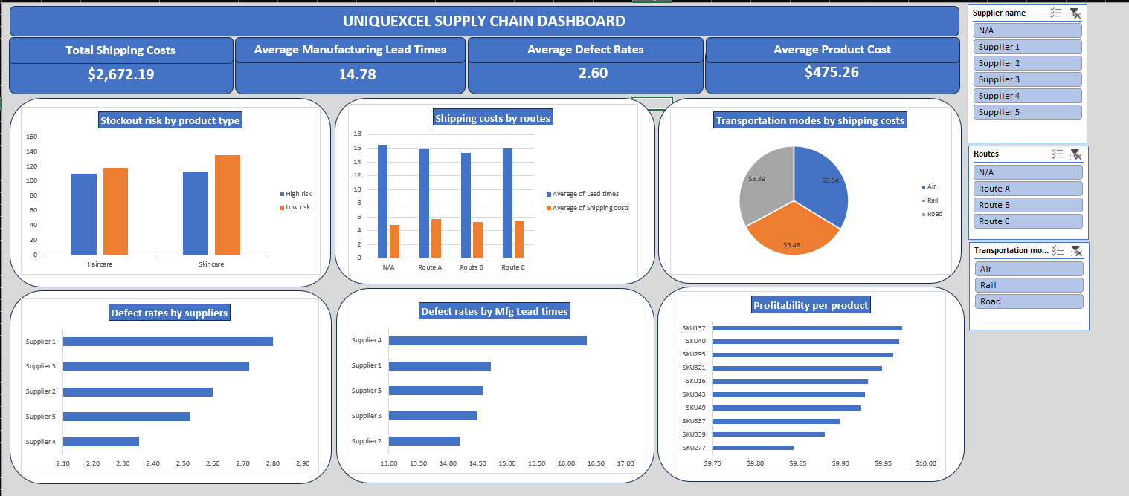
Dashboard Overview
A consolidated view of cost, lead time, quality, inventory risk, and profitability.
2

Slide 3
Headline Performance Indicators
Total Shipping Costs
$2,672.19
Avg. Manufacturing Lead Time
14.78 days
Avg. Defect Rate
2.56%
Avg. Product Cost
$475.26
• The dashboard combines logistics, supplier, quality, stockout-risk, and profitability measures.
• The largest improvement opportunities are inventory replenishment, supplier quality, and route/supplier cost management.
• Transportation mode itself has only a small cost difference, so route and supplier decisions matter more.
3

Slide 4
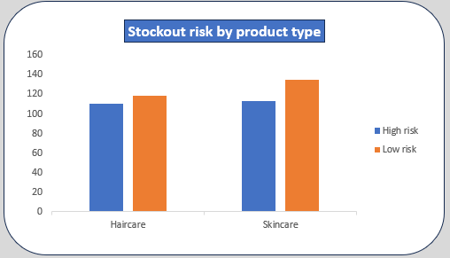
Stockout Risk: Immediate Replenishment Priority
• High-risk records exceed low-risk records in both product categories: 135 in skincare and 118 in haircare.
• SKU152 and SKU372 are the highest priorities, each with availability 96 units below order quantity.
• Other severe shortages include SKU35, SKU427, SKU195, SKU391, SKU83, SKU432, and SKU487.
• Use an exception-based replenishment list and review it weekly, with extra attention to skincare.
4

Slide 5
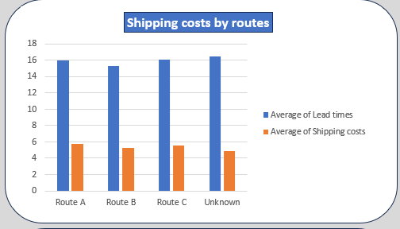
Routes and Suppliers: Delay and Cost Drivers
• Route C has the longest average lead time at about 16.05 days.
• Route B performs best overall, with about 15.30 days lead time and $5.25 average shipping cost.
• Supplier 4 has the longest supplier lead time (17.04 days) and manufacturing lead time (16.35 days).
• Supplier 5 has the highest average shipping cost at about $5.71.
• Shift suitable volume toward Route B, improve Supplier 4 lead time, and renegotiate Supplier 5 freight.
5

Slide 6
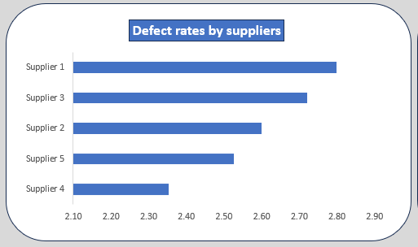
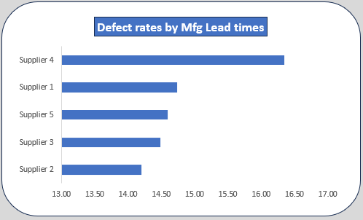
Quality: Defect Rates Are Supplier-Specific
• Supplier 1 has the highest average defect rate at about 2.80%; Supplier 3 follows at 2.72%.
• Supplier 4 has the lowest average defect rate at about 2.35%, despite its long manufacturing lead time.
• Manufacturing lead time and defect rate have approximately 0.02 correlation, almost no relationship.
• Prioritize incoming quality controls and corrective action for Suppliers 1 and 3; manage Supplier 4 mainly for speed.
6

Slide 7
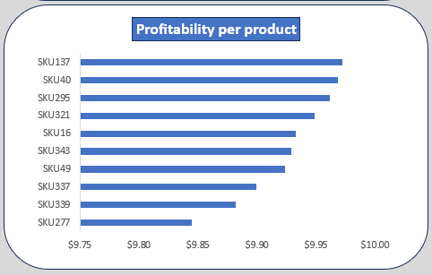
Product Profitability: Protect Winners, Review Weak SKUs
• Top net-profitability SKUs: SKU198 ($976.02), SKU146 ($968.80), SKU393 ($960.15), SKU208 ($956.36), and SKU378 ($948.36).
• Weakest SKUs: SKU61 ($10.08), SKU184 ($15.62), SKU169 ($29.60), SKU299 ($29.64), and SKU271 ($31.96).
• Protect inventory and capacity for the strongest SKUs.
• Review pricing, manufacturing cost, order quantity, and shipment method for low-profit products; consider repricing, redesign, bundling, supplier changes, or discontinuation.
7

Slide 8
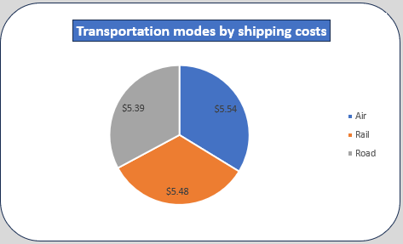
Transportation Mode: Cost Differences Are Small
• Average shipping costs are close: Air ≈ $5.54, Rail ≈ $5.48, Road ≈ $5.39.
• The Air-to-Road difference is only about $0.15 per shipment, so mode has a weak practical cost relationship.
• Choose Road where feasible, Rail for steady bulk replenishment, and Air for urgent stockout avoidance or high-margin items.
• Focus savings efforts on route and supplier negotiations rather than mode switching alone.
8

Slide 9
Recommended Action Priorities
Immediate: Replenish the most stockout-risky SKUs
Expected benefit: Avoid lost sales and emergency replenishment
Immediate: Fix problems with Supplier 1 and Supplier 3
Expected benefit: Reduce defects, returns, and complaints
Near term: Test larger loads on Route B; reduce unnecessary A/C usage
Expected benefit: Lower freight charges and lead time
Near term: Improve Supplier 4 lead time; renegotiate Supplier 5 freight
Expected benefit: Increase reliability and reduce cost
Monthly: Review SKU-level net profitability
Expected benefit: Improve product mix and operating margin
9

