Slide 1
The 10 Tracks Feature The Most in Playlists
“2 Minutes to Midnight” track appears the most in playlists with a record of 13 time.
With a 5 playlists’ appearances for tracks on average.

Slide 2
What Is The Best Selling Genres?
With a record of 826.7$ Rock Genre comes at the top with a big difference than Latin which comes next with 382.1$.
Rock And Roll comes last off chart with 6$
The average of earnings is 97$

Slide 3
The 3 Best Selling Genres Performance Throughout The Years
As from the last visualization it’s clear that Rock Genre is dominating the market without any competition.
While Latin and Metal is quite close to each other with Latin doing slightly or no better except for 2011.

Slide 4
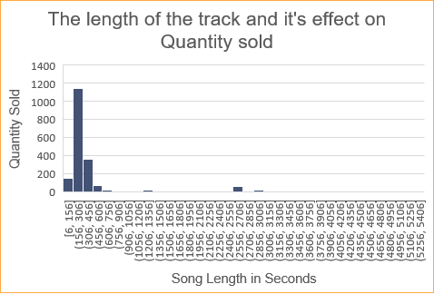
The Length Of The Track And It's Effect On Quantity Sold
As from the data tracks between 156 to 306 Seconds make the most sales.
There are a lot of outliers with the longest track being 5286 Seconds!

