Slide 1
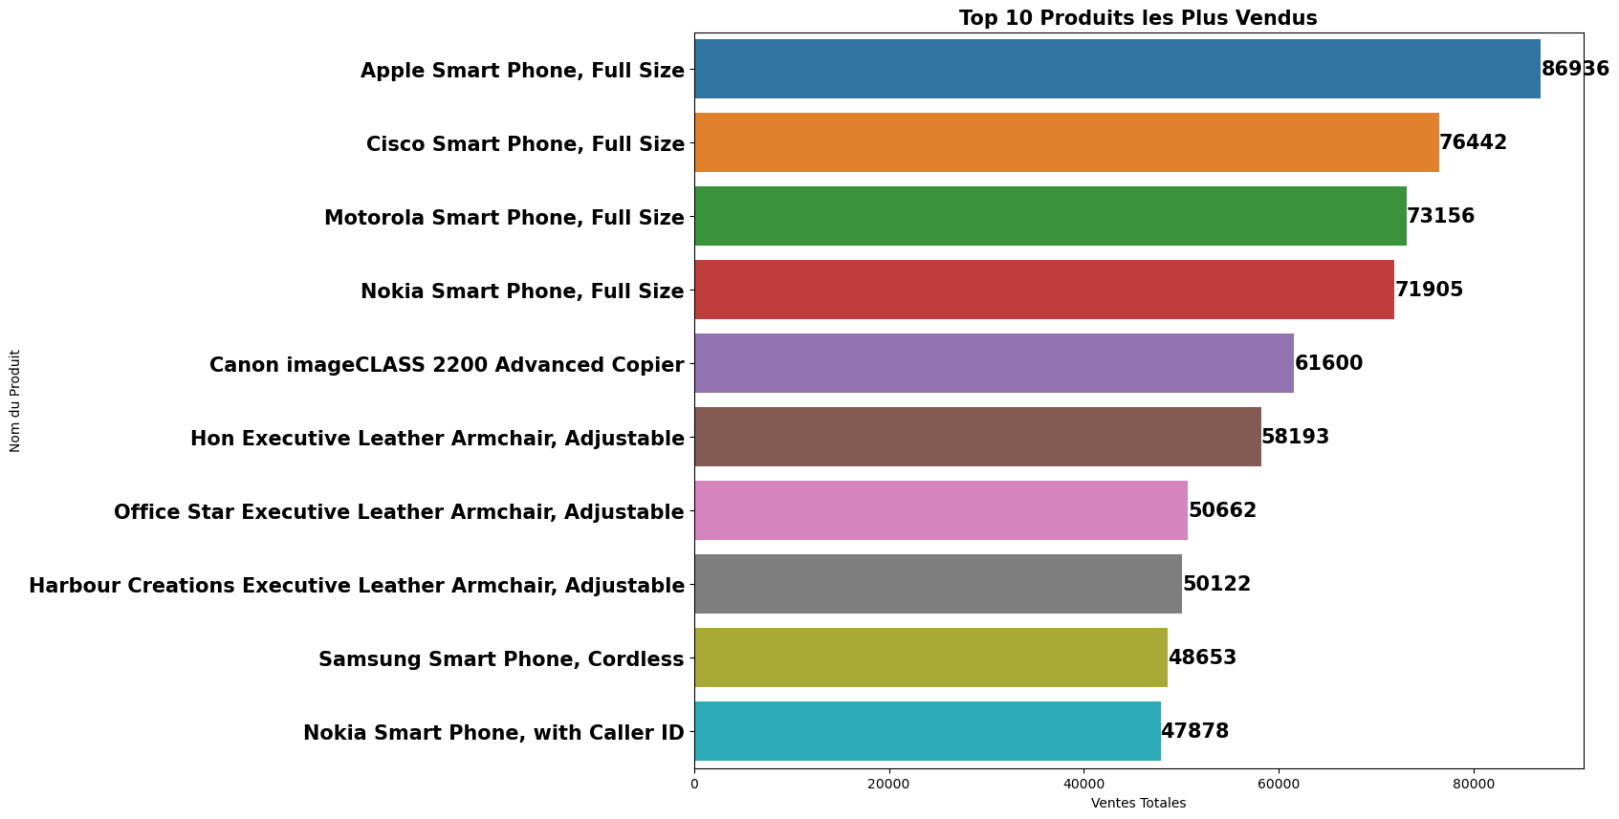

Slide 2
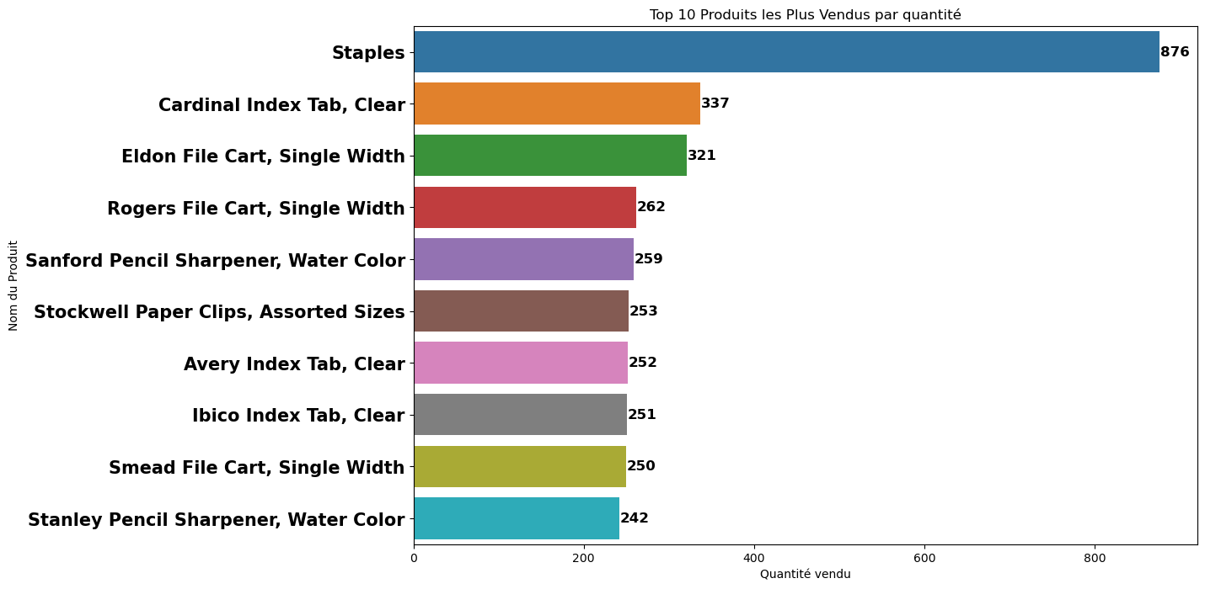

Slide 3
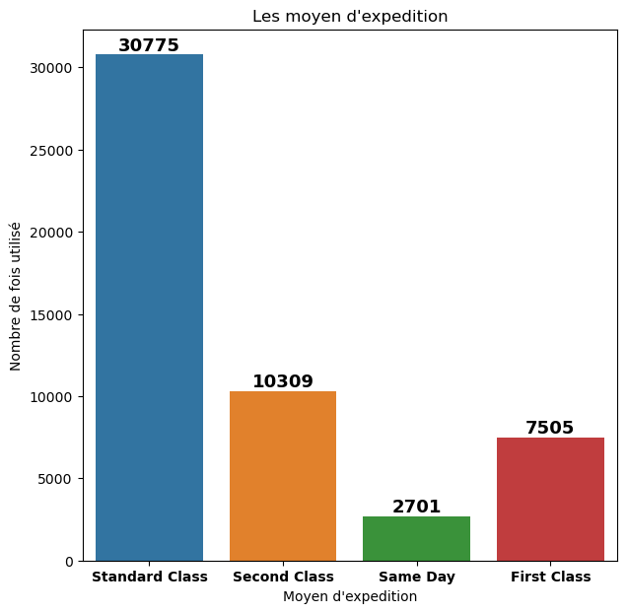
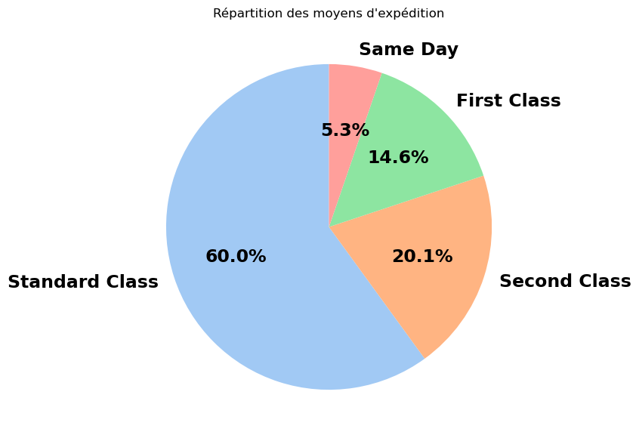

Slide 4
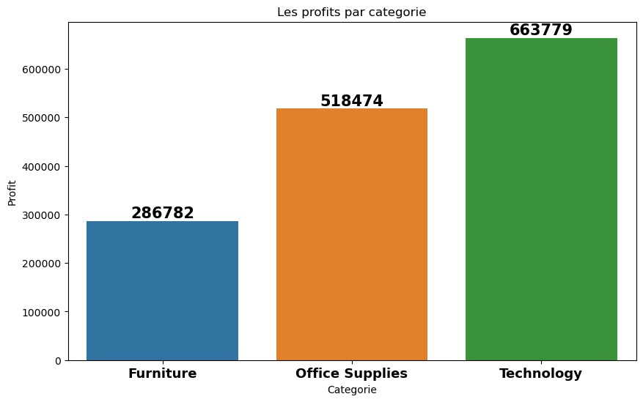

Slide 5
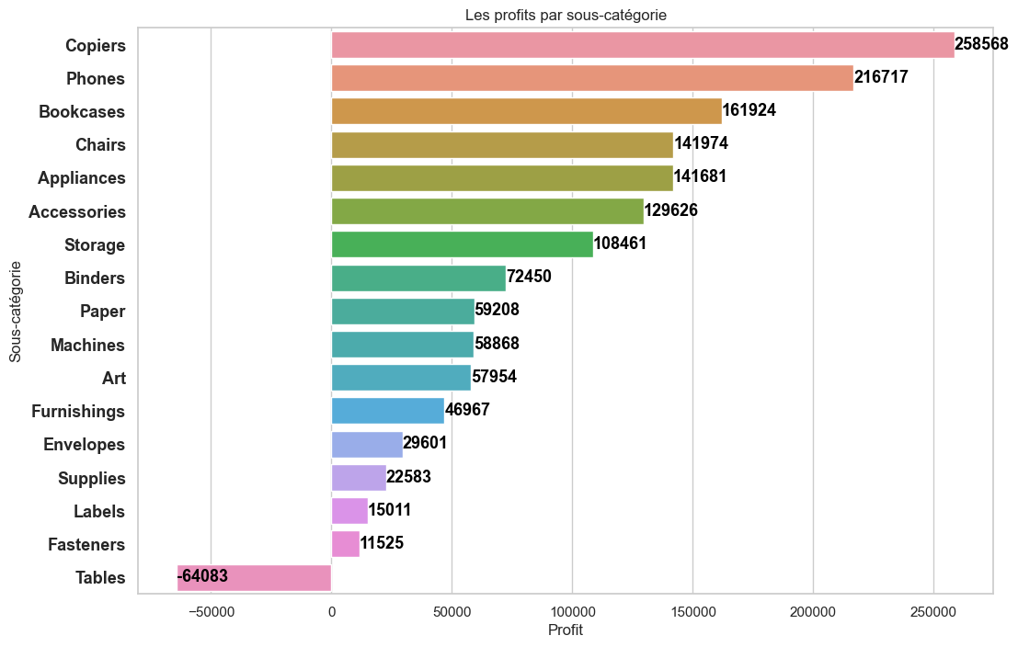

Slide 6
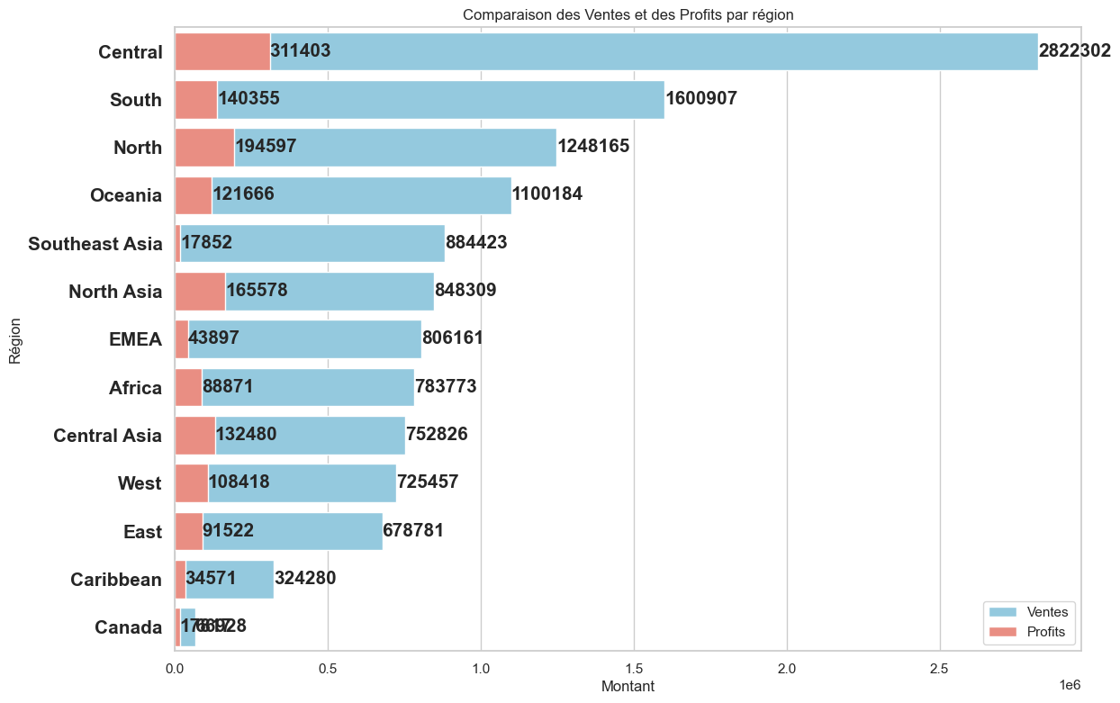
Profit: 17871
Ventes: 669288

Slide 7
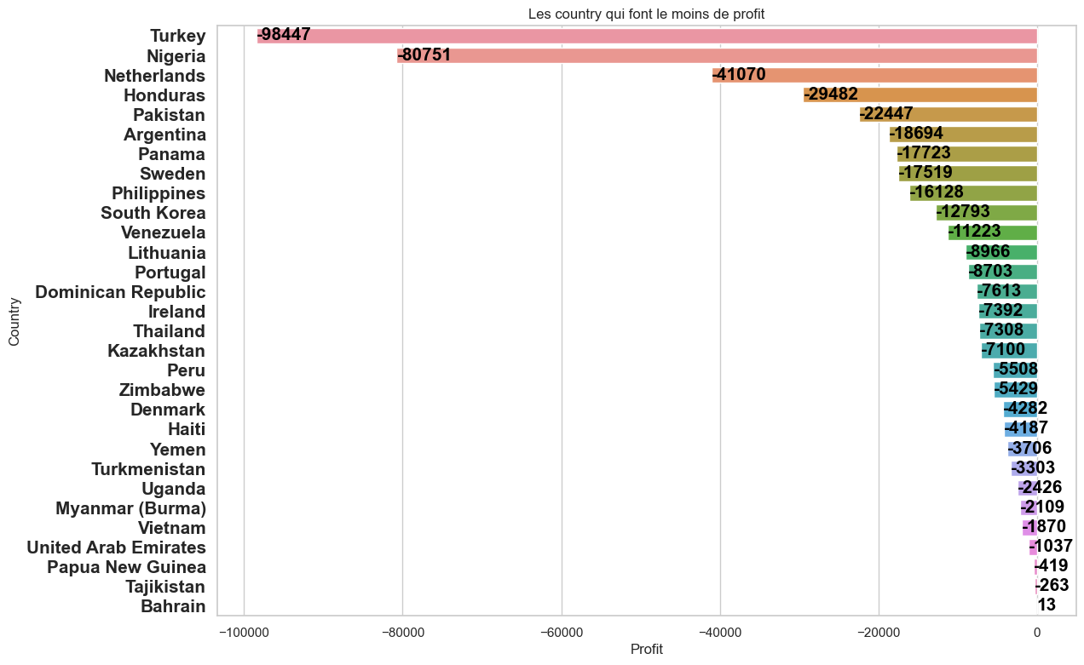

Slide 8
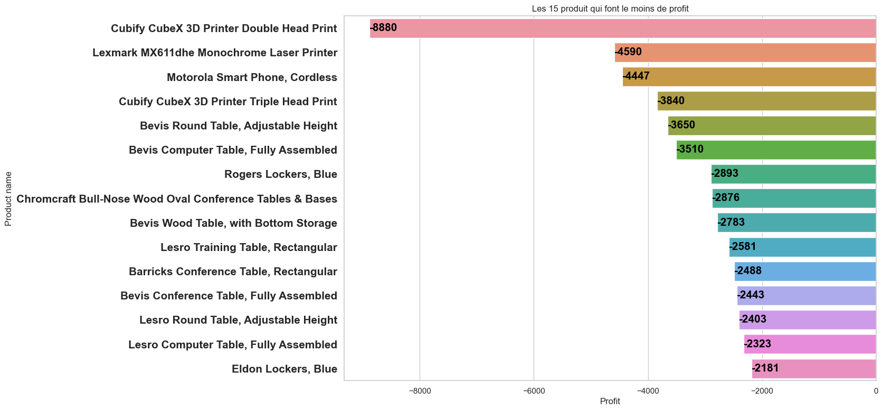

Slide 10
Pitch deck
Mirjam Nilsson

Slide 11
ABOUT US
At Contoso, we empower organizations to foster collaborative thinking to further drive workplace innovation. By closing the loop and leveraging agile frameworks, we help business grow organically and foster a consumer-first mindset.

Slide 12
PROBLEM
MARKET GAP
Few, if any, products on the market help customers like we do
CUSTOMERS
66% of US consumers spend money on multiple products that only partially resolves their issue
FINANCIALS
Millennials account for about a quarter of the $48 billion spent on other products in 2018
COSTS
Loss of productivity costing consumers thousands of dollars

Slide 13
SOLUTION
CLOSE THE GAP
TARGET AUDIENCE
Our product makes consumer lives easier, and no other product on the market offers the same features
Our target audience is Gen Z (18-25 years old)
COST SAVINGS
EASY TO USE
Reduce expenses for replacement products
Simple design that gives customers the targeted information they need

Slide 14
PRODUCT BENEFITS
Cool and stylish product
Areas for community connections
Online store and market swap

Slide 15
COMPANY OVERVIEW

Slide 16
BUSINESS MODEL
ABSTRACT
We based our research on market trends and social media
DESIGN
We believe people need more products specifically dedicated to this niche market
RESEARCH
Minimalist and easy to use

Slide 17
MARKET OVERVIEW
$3 Billion
$1 Billion
$2 Billion
Freedom to invent
Selectively inclusive market
Serviceable available market
Opportunity to build
Fully inclusive market
Total addressable market
Few competitors
Specifically targeted market
Serviceable obtainable market

Slide 18
Market comparison
$3B
$2B
$1B
Opportunity to build
Freedom to invent
Few competitors
Addressable market
Serviceable market
Obtainable market

Slide 19
OUR COMPETITION
CONTOSO
COMPETITORS
Our product is priced below that of other companies on the market
Design is simple and easy to use, compared to the complex designs of the competitors
Affordability is the main draw for our consumers to our product
Company A Product is more expensive
Companies B & C Product is expensive and inconvenient to use
Companies D & E Product is affordable, but inconvenient to use

Slide 20
Our competition
Convenient
Contoso
Competitor A
Affordable
Expensive
Competitor D
Competitor C
Competitor B
Competitor E
Inconvenient

Slide 21
Growth strategy
Feb 20XX
Roll out product to high profile or top-level participants to help establish the product
Mar 20XX
Release the product to the general public and monitor press release and social media accounts
Oct 20XX
Gather feedback and adjust product design as necessary

Slide 22
TRACTION
Forecasting for success
Key Metrics
 | Clients | Orders | Gross revenue | Net revenue
20XX | 10 | 1100 | $10,000 | $7,000
20XX | 20 | 200 | $20,000 | $16,000
20XX | 30 | 300 | $30,000 | $25,000
20XX | 40 | 400 | $40,000 | $30,000
REVENUE BY YEAR

Slide 23
TWO-YEAR ACTION PLAN
DRAFT BLUEPRINTS
GATHER FEEDBACK
DELIVER TO CLIENT
20XX
JAN
FEB
MAR
APR
MAY
JUN
JUL
AUG
SEP
OCT
NOV
DEC
20XX
JAN
FEB
MAR
APR
MAY
JUN
JUL
AUG
SEP
OCT
NOV
DEC
RUN FOCUS GROUPS
TEST DESIGN
LAUNCH DESIGN

Slide 24
FINANCIALS
 | Year 1 | Year 2 | Year 3
INCOME
Users | 50,000 | 400,000 | 1,600,000
Sales | 500,000 | 4,000,000 | 16,000,000
Average price per sale | 75 | 80 | 90
Revenue @ 15% | 5,625,000 | 48,000,000 | 216,000,000
GROSS PROFIT | 5,625,000 | 48,000,000 | 216,000,000
Expenses
Sales & marketing | 5,062,500 | 38,400,000 | 151,200,000 | 70%
Customer service | 1,687,500 | 9,600,000 | 21,600,000 | 10%
Product development | 562,500 | 2,400,000 | 10,800,000 | 5%
Research | 281,250 | 2,400,000 | 4,320,000 | 2%
TOTAL EXPENSES | 7,593,750 | 52,800,000 | 187,920,000

Slide 25
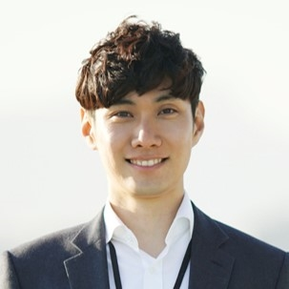



MEET THE TEAM
TAKUMA HAYASHI​
MIRJAM NILSSON​
FLORA BERGGREN​
RAJESH SANTOSHI​
President
Chief Executive Officer
Chief Operations Officer
VP Marketing

Slide 26
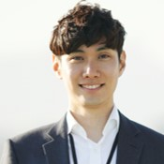







MEET THE TEAM
TAKUMA HAYASHI
MIRJAM NILSSON​
FLORA BERGGREN​
RAJESH SANTOSHI
President
Chief Executive Officer
Chief Operations Officer
VP Marketing
GRAHAM BARNES
ROWAN MURPHY
ELIZABETH MOORE
ROBIN KLINE
VP Product
SEO Strategist
Product Designer
Content Developer

Slide 27
FUNDING
$14,000
$12,000
$82,000
$32,000
ANGEL INVESTMENTS
PROPERTY
SHARES
CASH
Amount obtained through other investors
Revenue obtained from property rentals
Number of shares converted into USD
Liquid cash we have on hand

Slide 28
SUMMARY
At Contoso, we believe in giving 110%. By using our next-generation data architecture, we help organizations virtually manage agile workflows. We thrive because of our market knowledge and great team behind our product. As our CEO says, "Efficiencies will come from proactively transforming how we do business.”

Slide 29
THANK YOU
Mirjam Nilsson​
206-555-0146
mirjam@contoso.com
www.contoso.com

