Slide 1

Maxima
A Computer Algebra System

Slide 2
Download Links
Windows
Linux
MacOS
Android

Slide 3
Introduction to Maxima
Associated Google Docs File
What is Maxima?
Why Maxima?
Why should we learn it?
How do we learn it?

Slide 4




Introduction to Maxima Syntax
Command-Line System
Command:
Input: 13*(7+5)^2;
Output: 1872
Syntax:

Slide 5

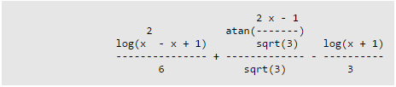

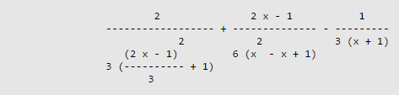


Symbolic Integration
Indefinite Integral:
Differentiation:

Slide 6

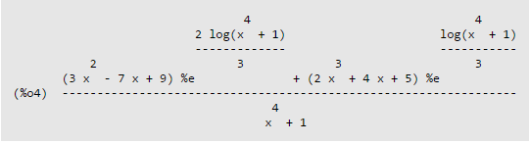
A Display of Power
Complicated Integral:

Slide 7



Variables
Working with Variables:
Formula:

Slide 8



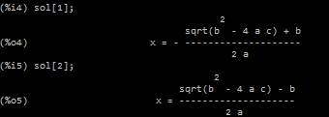
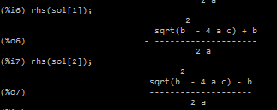
Functions
Understanding Functions in Maxima:

Slide 9


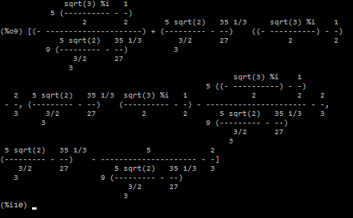
Functions cont.
Finishing Up:
Variation:

Slide 10



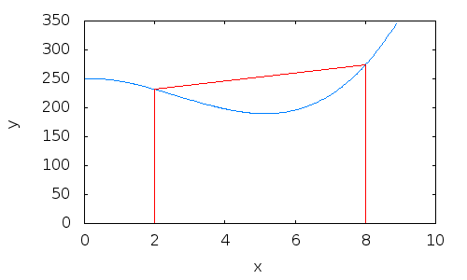
Trapezoidal Rule
Approximation of Definite Integrals:

Slide 11
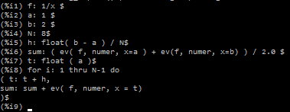

Trapezoidal Rule in Maxima
Function, Variables, h, Evaluation.
Answer?

Slide 12
References
Wikipedia - Trapezoidal Rule
P. Lutus - Files and Functions
Boris Gaertner - Introduction to Maxima
Steve Kifowit - Maxima and Trapezoid

