Slide 1
Clustering-based feature augmentation for fine-grained question classification on the TREC dataset
Presented by:
Giorgio Basilice, 886186
Hadis Forghani, 920040
Amaiza Jamil, 885861

Slide 2
Overview
this project explores whether unsupervised clustering techniques can be exploited to extract latent semantic structure from the data and use it as auxiliary features to improve fine-grained question classification.
The main objectives:
Apply clustering techniques on semantic sentence embeddings.
Analyze the semantic coherence of the resulting clusters.
Derive cluster-based features.
Evaluate their impact on downstream fine-grained classification performance.
1

Slide 3
Dataset
Data structure
Label hierarchy
Each instance consists of:
a short natural language question (typically one sentence).
a coarse-grained label.
a fine-grained label.
Coarse-grained labels (6 classes):
ABBR, abbreviations and acronyms.
DESC, definitions and descriptions.
ENTY, entities.
HUM, human-related questions.
LOC, locations.
NUM, numerical answers.
50 fine-grained labels.
2
Training set: 5,440 questions
Test set: 500 questions

Slide 4
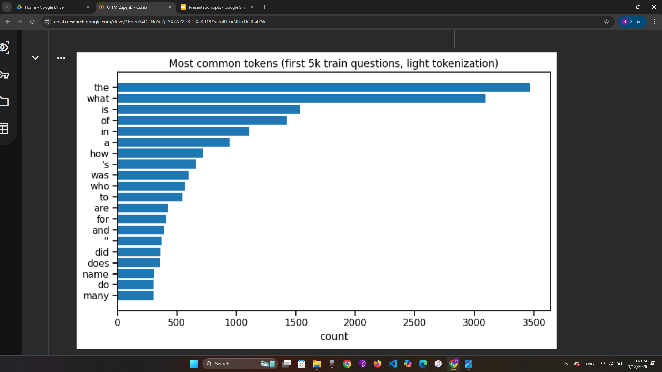
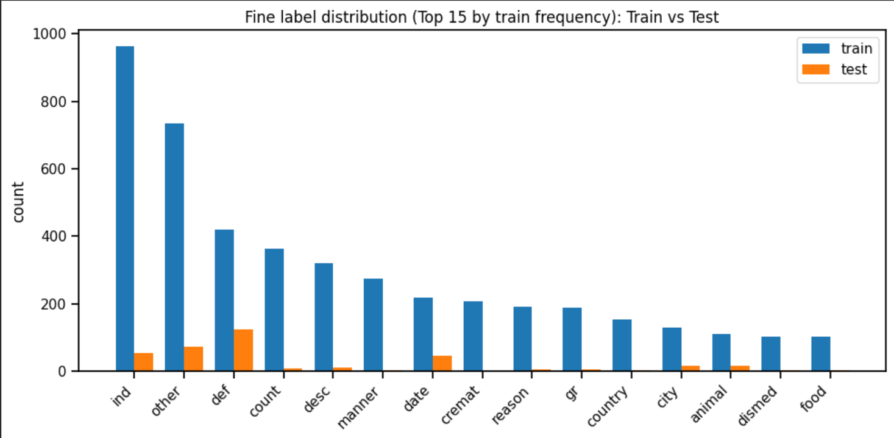
As expected, the vocabulary is dominated by question words and function words such as “what”, “who”, “where”, “how”. This confirms that the dataset is strongly question-oriented, and these tokens are likely to carry important signals for classification (e.g., “who” → Human, “where” → Location).
3
The distribution is clearly imbalanced, where a few fine labels appear very frequently while many others are much rarer. Train and test follow a similar overall pattern, but rare classes have fewer samples, which may make them harder for the model to learn and can reduce performance on minority categories.

Slide 5
Text preprocessing
General preprocessing
Preprocessing for SBERT
Preprocessing for TF-IDF
For all representations, the following minimal normalizations are applied: ​
whitespace normalization​
removal of leading and trailing spaces​
Casing is preserved when required.​
​
As Sentence-BERT uses raw text, only whitespace normalization is applied to preserve syntax, word order, and function words essential for semantic encoding.
lowercasing​
whitespace normalization​
custom tokenization using Spacy​
extraction of unigrams and bigrams​
Stop-words removal avoided to keep question words (e.g. What, Who, etc)
4

Slide 6
Text representation
TF-IDF representation
Sentence embeddings (SBERT)
Specifications:​
L2 normalization​
vocabulary limited to the top 10,000 terms​
Effective for:​
question templates​
lexical clues associated with fine-grained labels​
high interpretability
This model produces dense 768-dimensional vectors that are effective for:
short texts
semantic similarity
distance-based clustering
5

Slide 7
Clustering
Purpose
Avoiding data leakage
Algorithm
capture latent semantic groupings of questions.
generate high-level auxiliary features.
improve downstream fine-grained classification performance.
To prevent data leakage clustering is performed exclusively on the training set. This ensures that no test information influences feature construction.
The chosen algorithm is K-means, motivated by the following reasons: ​
compatibility with dense embeddings​
computational efficiency​
availability of centroids for feature derivation​
The number of clusters K is selected in the range [30, 70] using: ​
silhouette score (intrinsic evaluation)​
downstream classification performance
6

Slide 8
Cluster-derived feature engineering
We extract the following Soft assignment features from the obtained clustering:​
distance to each centroid ​
cosine similarity to each centroid​
distance to assigned centroid ​
These measures allow us to encode the global structure of the questions, creating a richer and more discriminative representation, without using hard clustering feature which could have introduced some bias.
7

Slide 9
Classification
Classifier
Feature Combinations
Logistic Regression (multinomial)​
Linear SVM ​
These models are well suited for high dimensional sparse data and do not require to much data
Configuration​ | Dimension​
TF-IDF​ | 10000​
TF-IDF + Clustering Features​ | 10000 + 139 (10139)​
SBERT​ | 768​
SBERT + Clustering Features​ | 768 + 139 (907)​
All Features​ | 10000 + 768 + 139 (10907)​
8

Slide 10
Experimental setup
Evaluation metrics
Experimental protocol
Accuracy
F1-Micro
F1-Macro
F1-Weighted
Preprocess, train and test sets separately.
Generate SBERT embeddings for both sets.
Generate TF-IDF vectors.
Perform clustering on the train set only.
Extract cluster features for both sets using training centroids.
Train classifiers on the train set, evaluate on the test set.
Compare all feature configurations.
9

Slide 11
Results
Clustering analysis
Optimal number of clusters: K = 58 (silhouette score 0.0651)
Low silhouette is expected due to:
high-dimensional SBERT space (768 dimensions)
semantic overlap between question types
The goal is feature usefulness, not perfect cluster separation
Cluster purity w.r.t. coarse labels is 61.1%, while w.r.t. fine labels is 44.9%
well above random baseline (16.7%)
indicates meaningful but non-redundant semantic structure
10

Slide 12
Results
Classification Results & Clustering Impact
Linear SVM consistently outperforms Logistic Regression
accuracy gains of 10–17% across all configurations
Clustering features strongly improve TF-IDF models:
+9.0% accuracy (LR), +5.0% accuracy (SVM)
substantial gains in F1-Macro (minority classes)
Minimal improvement for SBERT-based models
SBERT already captures much of the semantic structure
11

Slide 13
Interpretation of results
Low Silhouette, High Utility
Low silhouette score (0.0651) does not limit downstream usefulness
Cluster features act as soft semantic coordinates:
position questions relative to 58 semantic prototypes
encode uncertainty near cluster boundaries
Clustering doesn’t need to produce well structured clusters to be useful.
12

Slide 14
Interpretation of results
Cluster Structure & Classifier Behavior
Cluster purity: 61.1% (moderate and desirable)
avoids redundancy with coarse labels
captures cross-category semantic patterns
Linear SVM consistently outperforms Logistic Regression due to:
maximum-margin decision boundaries
effectiveness in high-dimensional spaces
robustness to class imbalance
strong handling of sparse TF-IDF features
13

Slide 15
Interpretation of results
Feature Impact & Complementarity
Clustering features strongly benefit TF-IDF models
especially Logistic Regression (large F1-Macro gains)
Minimal impact on SBERT models
SBERT already encodes rich semantic structure
Best results with TF-IDF + SBERT + Clustering:
92.0% accuracy
Features are complementary:
TF-IDF → lexical patterns
SBERT → semantic meaning
Clustering → latent structure & prototype-based positioning
14

Slide 16
Error analysis
Error pattern & Question words
Overall: 461/500 correct (92.2 % accuracy and 39 errors)
Main finding: LOC → ENTY confusion
54/81 LOC questions (66.7%) misclassified as ENTY
LOC recall: only 32.1% (despite 100% precision)
ENTY:other acts as “attractor” for ambiguous questions.
Question word impact:
“What” = 90.1% accuracy
“When”, “Why”, “Who” = 97-100% accuracy
Addressing LOC/ENTY confusion coiuld improve accuracy.
15

Slide 17
Conclusion
This project successfully demonstrated that clustering-derived features can enhance question classification performance on the TREC dataset, even when clustering quality metrics suggest modest cluster separation.
Best model: TF-IDF + SBERT + Clusters (Linear SVM)
92.0% accuracy, 86.6% F1-Macro
Clustering-for-features works
soft assignment features improve TF-IDF by +5–9% accuracy
Feature complementarity matters
lexical (TF-IDF) + semantic (SBERT) + structural (clustering)
Classifier choice is crucial
Linear SVM outperforms Logistic Regression by 10–17%
16

Slide 18
Thank You

