Slide 1

WEB
Project
Exia A2
Groupe 3

Slide 2




Table of Contents
Introduction
Conception
Production
Synthesis

Slide 3
Introduction

Slide 4




Introduction
Conception
Production
Synthesis
Goals of the project :
Develop a website that proposes two services :
Students board events managements
Online sales shop
Differentiation of accounts types : Students, CESI Staff and BDE members

Slide 5
Introduction
Conception
Production
Synthesis
Team presentation
MOYON
Matthis
CHÉRAUD
Florentin
PASQUET
Vincent
VINCENT
Amaury

Slide 6




Introduction
Conception
Production
Synthesis
Division of labor
Vincent Pasquet : Front end programmer
Florentin Chéraud : Front end programmer
Amaury Vincent : Back end programmer
Matthis Moyon: Project Manager

Slide 7
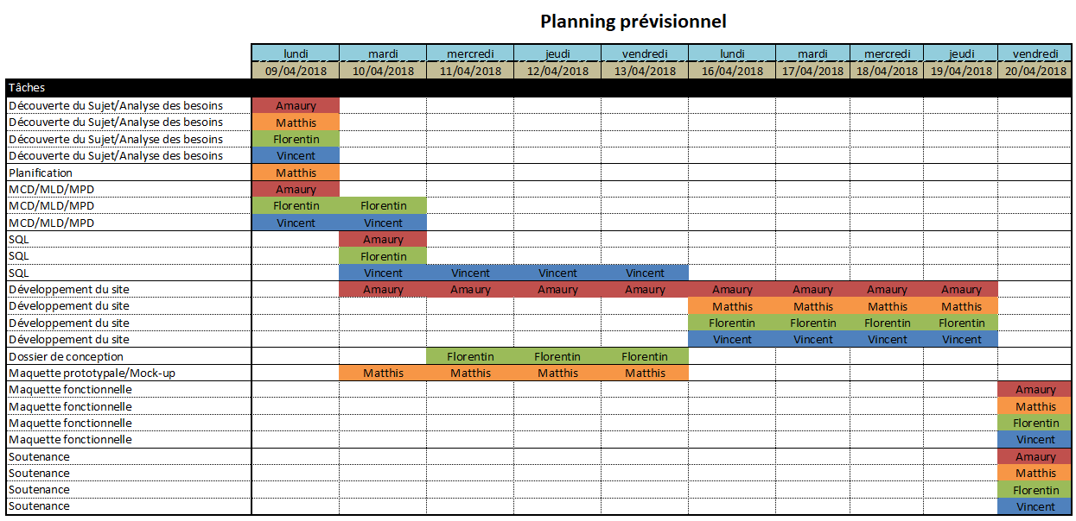
Introduction
Conception
Production
Synthesis
Planning

Slide 8
Conception

Slide 9


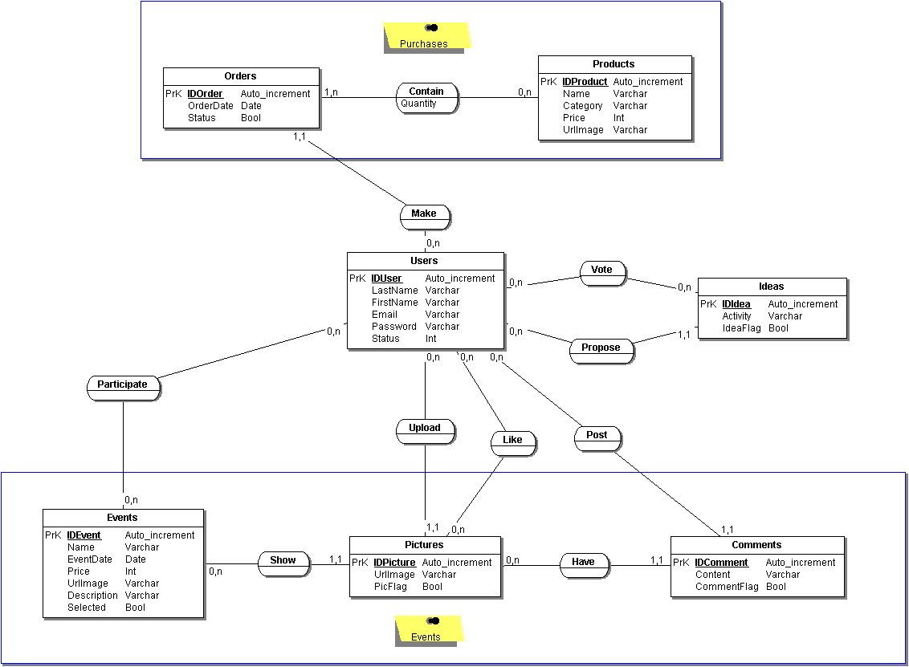
Introduction
Conception
Production
Synthesis
Data-Base - MCD

Slide 10
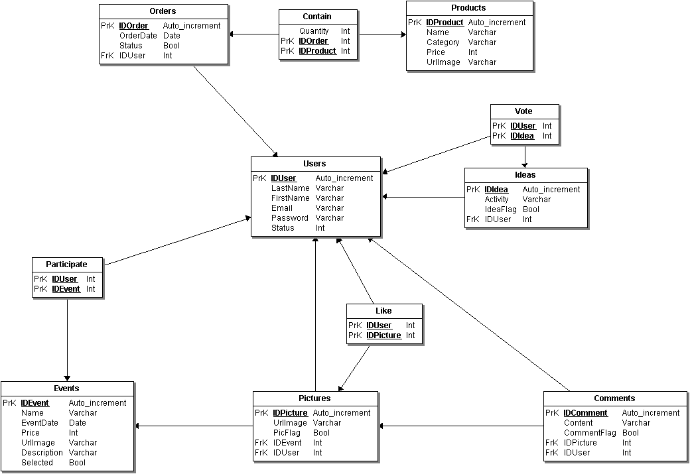
Introduction
Conception
Production
Synthesis
Data-Base - MLD

Slide 11

Introduction
Conception
Production
Synthesis
Mock-up

Slide 12
Production

Slide 13


Introduction
Conception
Production
Synthesis
Website

Slide 14
Synthesis

Slide 15


Introduction
Conception
Production
Synthesis
Conclusion
Importance of conception
Imbricated different languages
Work together in parallel
Notes:
We realized the importance of conception
We learned to use imbricated different languages on a single project
We trained ourselves to parallelize the work of everyone

Slide 16

Thank you for your attention

