Slide 1

WEB
Project
Exia A2
Groupe 3

Slide 2




Table of Contents
Introduction
Conception
Production
Synthesis

Slide 3
Introduction

Slide 4




Introduction
Conception
Production
Synthesis
Goals of the project :
Develop a website to primarily manage the promotion of events and an online shop selling
Role management on the website

Slide 5
Introduction
Conception
Production
Synthesis
Context of the project:
Create a website for CESI’s BDE.
Manage event promotion and an online sales shop.
Create separated roles for students, employees and BDE members.
That each role has positivity of actions.

Slide 6
Introduction
Conception
Production
Synthesis
Team presentation
MOYON
Matthis
CHÉRAUD
Florentin
PASQUET
Vincent
VINCENT
Amaury

Slide 7




Introduction
Conception
Production
Synthesis
Division of labor
Vincent Pasquet : Front end programmer
Florentin Chéraud : Front end programmer
Amaury Vincent : Back end programmer
Matthis Moyon: Project Manager

Slide 8
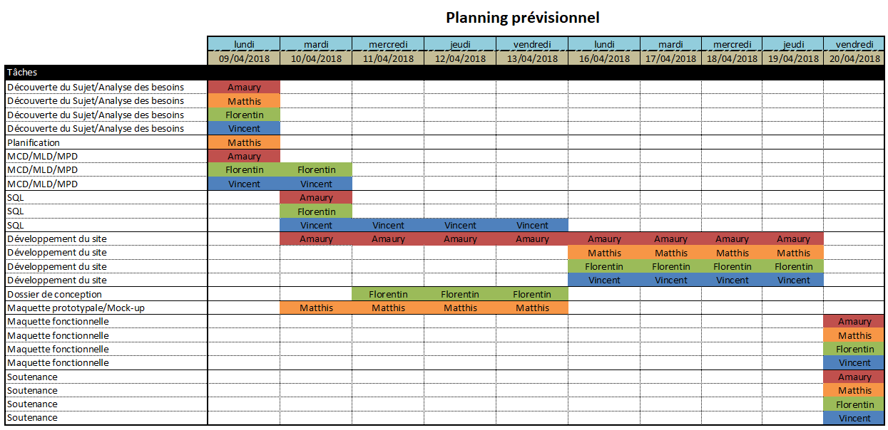
Introduction
Conception
Production
Synthesis
Planning

Slide 9
Conception

Slide 10


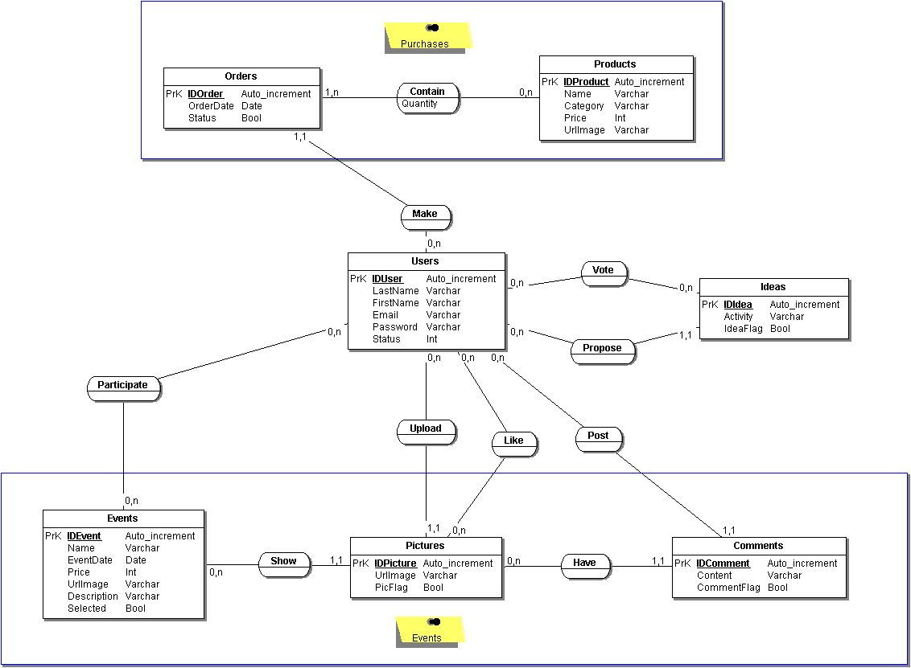
Introduction
Conception
Production
Synthesis
Bata-Base - MCD

Slide 11
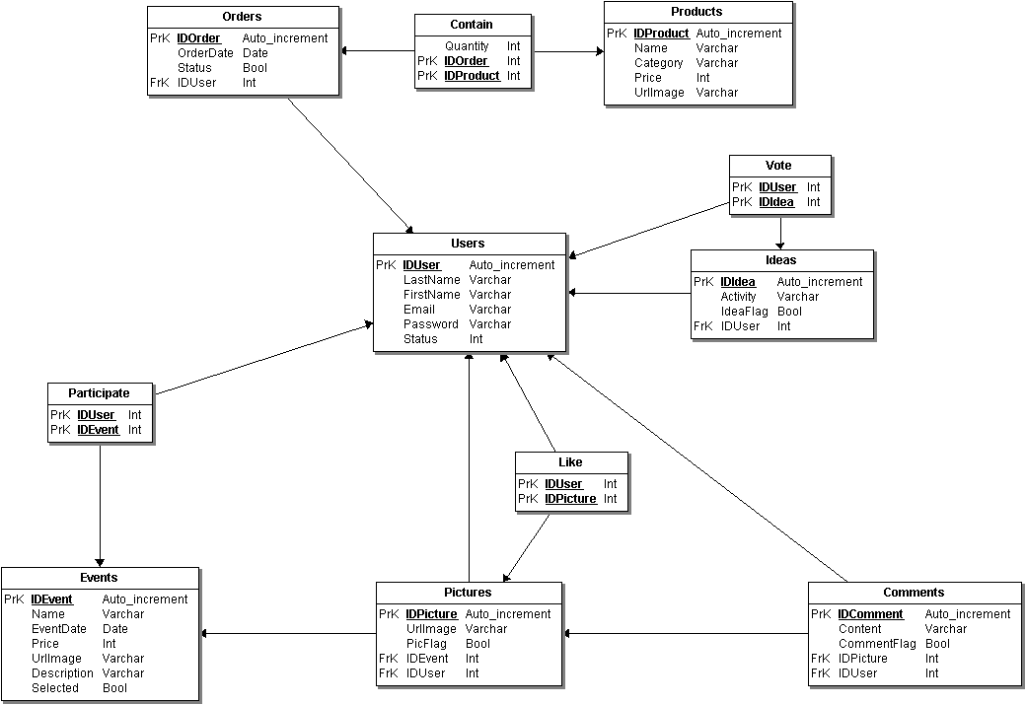
Introduction
Conception
Production
Synthesis
Bata-Base - MLD

Slide 12

Introduction
Conception
Production
Synthesis
Mock-up

Slide 13
Production

Slide 14


Introduction
Conception
Production
Synthesis
Website

Slide 15
Synthesis

Slide 16








Introduction
Conception
Production
Synthesis
GROUP REVIEW

Slide 17
Introduction
Conception
Production
Synthèse
Conclusion
Réutilisabilité du travail sur l’architecture et de certaines configurations.
Prise de conscience sur l’importance de la sécurité.
Responsabilisation sur le projet.
Montée en compétences de toute l’équipe.

Slide 18

Thank you for your attention

