Slide 1

WEB
Project
Exia A2
Groupe 3

Slide 2




Table of Contents
Introduction
Conception
Production
Synthesis

Slide 3
Introduction

Slide 4




Introduction
Conception
Production
Synthesis
Goals of the project :
Develop a website that propose two services :
Students board events managements
Online sales shop
Differentiation of accounts types : Students, CESI Staff and BDE members

Slide 5
Introduction
Conception
Production
Synthesis
Context of the project:
Create a website for CESI’s BDE.
Manage events promotion and an online sales shop.
Create separated roles for students, employees and BDE members with different accesses and rights

Slide 6
Introduction
Conception
Production
Synthesis
Team presentation
MOYON
Matthis
CHÉRAUD
Florentin
PASQUET
Vincent
VINCENT
Amaury

Slide 7




Introduction
Conception
Production
Synthesis
Division of labor
Vincent Pasquet : Front end programmer
Florentin Chéraud : Front end programmer
Amaury Vincent : Back end programmer
Matthis Moyon: Project Manager

Slide 8
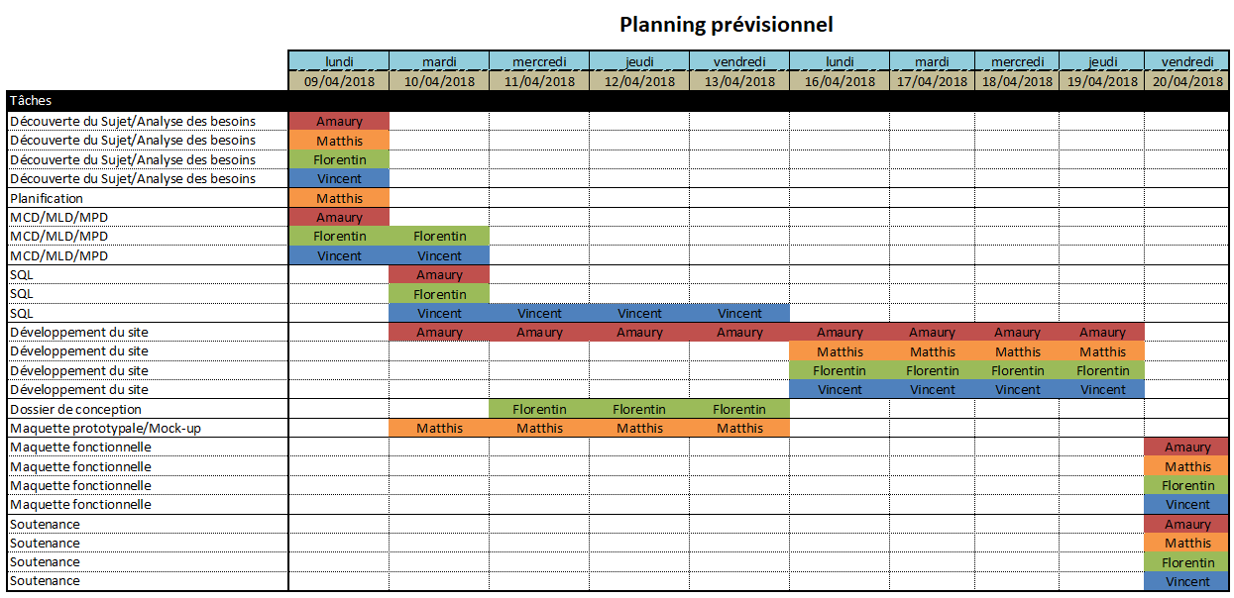
Introduction
Conception
Production
Synthesis
Planning

Slide 9
Conception

Slide 10


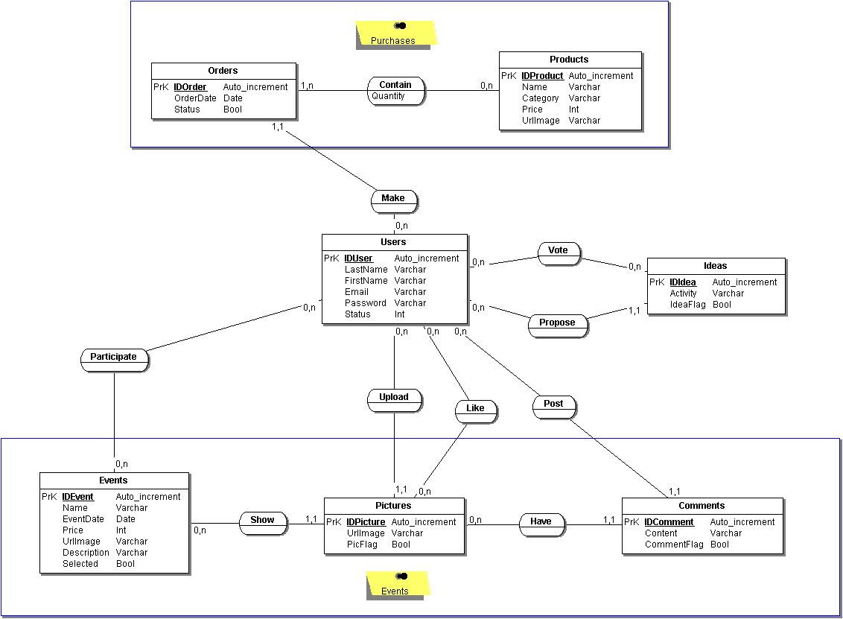
Introduction
Conception
Production
Synthesis
Bata-Base - MCD

Slide 11
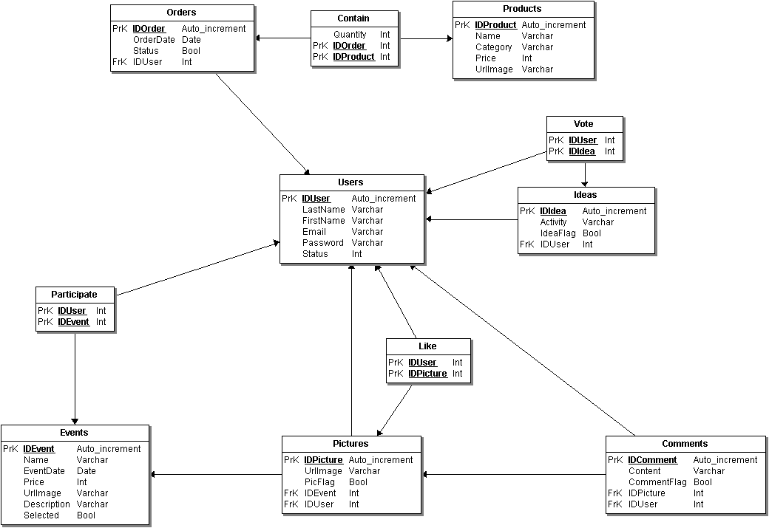
Introduction
Conception
Production
Synthesis
Bata-Base - MLD

Slide 12

Introduction
Conception
Production
Synthesis
Mock-up

Slide 13
Production

Slide 14


Introduction
Conception
Production
Synthesis
Website

Slide 15
Synthesis

Slide 16








Introduction
Conception
Production
Synthesis
GROUP REVIEW

Slide 17
Introduction
Conception
Production
Synthèse
Conclusion
Importance of conception
Imbricated different languages
Work together in parallel
Notes:
We realized the importance of conception
We learned to use imbricated different languages on a single project
We trained ourselves to parallelize the work of everyone

Slide 18

Thank you for your attention

