Slide 1
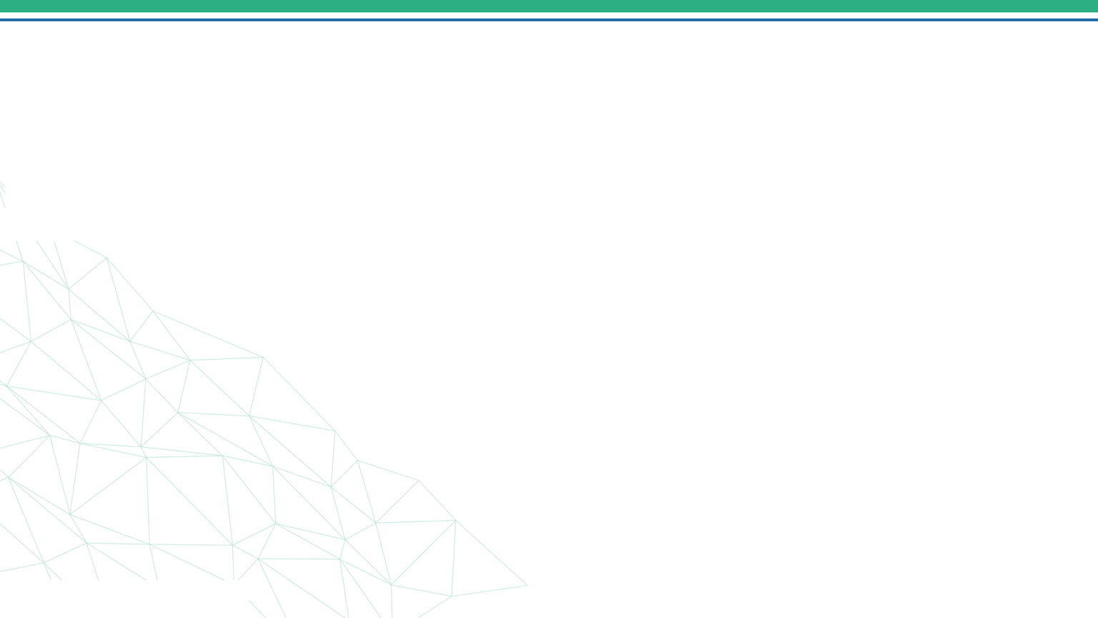






DEPI FINAL PROJECT
Form
Teaching Materials Generator
6 AI agents
One form. A complete lesson package.
Presenter's Name: Ghosoon Amr Samy
Team: TeachWise
PDF by email
Date: 31 October 2026
31 October 2026
1
Notes:
Speaker: Ghosoon Amr Samy. Cover. One sentence: a teacher fills in one form and receives a complete, differentiated teaching package as a PDF by email.

Slide 2



Project Idea
The problem
Proposed solution
Unique value proposition
Teachers spend hours preparing handouts, activities, quizzes and notes for one lesson
One class mixes beginner, intermediate and advanced learners
Dyslexia-friendly materials take extra time and expertise
One web form with 11 fields
Six AI agents write 12 sections (A to L), one after another
An automatic check confirms all 12 sections are present
One PDF is made and emailed to the teacher in about a minute
Three levels plus a dyslexia-friendly version in one package
Built-in checks: an automatic completeness check, then the teacher's review
Complete: objectives to quiz, answer key and teacher guidance
Never invents curriculum standards: it states its assumptions
One form in, one checked and differentiated PDF out
31 October 2026
2
Notes:
Speaker: Ghosoon Amr Samy. Problem: preparing differentiated materials, including dyslexia support, takes teachers hours. Solution: one form, six AI agents, an automatic completeness check, then one PDF by email. What makes it stand out: differentiated levels and a dyslexia-friendly version in the same package, never invented curriculum standards, and built-in checks: the workflow checks that all 12 sections exist, and the teacher then reviews the content.

Slide 3
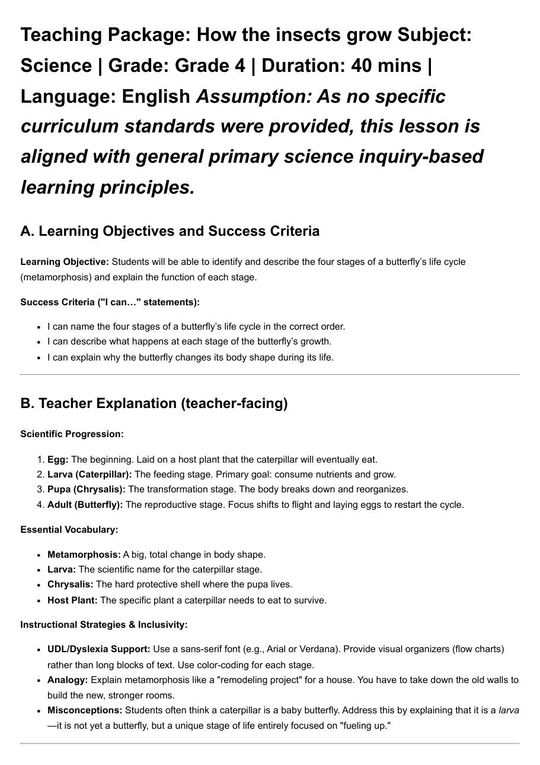

Project Wireframe
1
Teacher form
2
Email delivery
3
Generated PDF
Teaching Materials Generator
Teaching package: How the insects grow
Enter a topic once and get a full resource package by email
Your complete teaching package is attached.
Subject *
Grade Level *
Teaching package (PDF)
Lesson Topic *
Learning Objective *
or, if a section is missing:
Lesson Duration *
Language *
Teaching package incomplete
Email *
+ 4 optional fields
A section is missing. Please run the form again.
Submit
Sent by the n8n Gmail node
1 Open the form
2 Fill 7 required fields
3 Submit
4 Automatic check of 12 sections
5 Receive the PDF by email
6 Teacher reviews it
Usability: no login or setup, plain-language labels, a clear notice if something is missing, and a sans-serif, well-spaced PDF.
31 October 2026
3
Notes:
Speaker: Esraa Ahmed Helmy. Our project has no traditional app screens, so the wireframe shows the three interfaces the teacher sees: the form, the email (success, or an incomplete notice from the automatic check), and the generated PDF (a real page from our Grade 4 insects run). The journey strip shows the five steps from opening the form to receiving the PDF. Focus on usability: nothing to install, seven required fields, a readable PDF.

Slide 4



End Users + Features
End user
Main need
Key features that solve it
Saves preparation time and receives a complete package
One form with 11 fields
12-section package, from objectives to teacher guidance
Automatic check of all 12 sections, then the PDF in about 1 minute
Class teacher
Primary school
Supports mixed levels and learners with dyslexia
Beginner, Intermediate and Advanced versions
Dyslexia-friendly version with word bank and sentence starters
Accessibility guidance and scaffolding options
Inclusive / support teacher
Mixed levels, dyslexia
Materials at their level that are easy to read
Student handout and practice exercises
Discussion questions and visual-content prompts
Quiz with a teacher answer key
Students
Indirect users
31 October 2026
4
Notes:
Speaker: Doaa Hafez Abbas. Three end users. The class teacher wants to save time. The inclusive or support teacher needs differentiated and dyslexia-friendly material. Students are indirect users who receive the handouts, exercises and quiz. Each row shows which features solve that person's problem. Remind the audience that teachers must verify facts and answers.

Slide 5



Data Structure
Form submission
Agent outputs
package
Completeness check
html and page
PDF file
Email
JSON item with 11 fields (7 required, 4 optional), including the Email
6 text fields named output, one per agent (sections A to L)
One Markdown string: a title line plus the 6 outputs
If node: true only if headings A to L are all in the package
Markdown to HTML, then a styled page (Arial, 14 px)
Binary file returned by the html2pdf.app API
Gmail to the form's address: the PDF, or an incomplete notice
Database architecture
Entities and relationships
Data flow
No custom database. Non-relational: data travels as JSON items between nodes and is held in memory during a run.
1 submission leads to 6 agent outputs, 1 package, 1 true/false check, 1 PDF and 1 email. Every agent reads the same 10 teacher inputs by field name.
Collected by the web form, processed by the agents and checked automatically, then accessed as a PDF by email. If the check fails, an incomplete notice is sent instead. No CSV dataset was used.
31 October 2026
5
Notes:
Speaker: Mariam Kotb Mohamed. There is no database: the workflow is stateless and data moves between nodes as JSON items. The chain on top is the real data path: form submission, six agent outputs, one merged package, the automatic completeness check (a true or false result), HTML, a PDF file and the email. We did not use a CSV dataset, so no data-balance discussion applies.

Slide 6



Programming Languages + Frameworks
Languages
Frameworks and tools
Supporting technologies
JavaScript: n8n expressions and the section check (If node)
Markdown: the agents write in it
HTML and CSS: page styling for the PDF
JSON: data between nodes
Prompts in natural language (zero-, one- and few-shot)
n8n: workflow automation, hosted on a server
n8n AI Agent nodes (LangChain-based)
Form Trigger, Edit Fields, If, Markdown and HTTP Request nodes
Google Cloud OAuth for Gmail
Google Gemini API (gemini-3.1-flash-lite)
html2pdf.app API: HTML to PDF
Gmail API (OAuth2): email delivery
Ollama (local llama): first version
GitHub: code and documentation
First version: local Ollama model (10 to 20 minutes). Final version: Google Gemini in the cloud (about 1 minute).
31 October 2026
6
Notes:
Speaker: Esraa Ahmed Helmy. The project is mostly low-code: n8n connects the pieces, with small JavaScript expressions for text handling and for the completeness check. Content is Markdown and HTML with CSS. Supporting services are the Gemini API, the html2pdf.app API and the Gmail API. We started with a local Ollama model and moved to Gemini to cut each run from 10 to 20 minutes to about 1 minute.

Slide 7
Live Application + Test
true
Form
Core Content
Differen-tiated
Dyslexia
Activities
Quiz & Summary
Visuals
Edit Fields
Check (If)
Markdown
Wrap Page
PDF (API)
Gmail
Google Gemini chat model (one per agent)
false
Email: section missing
Final workflow, drawn from the exported JSON (20 nodes)
Current state
Verification
Testing and QA findings
Working beta in n8n; the workflow is active
Six Gemini agents, automatic check and automatic PDF
About 1 minute per package
Live application: 95c73deb.kube-ops.com
Automatic: the workflow checks that all 12 section headings (A to L) are present
If one is missing, the teacher gets an incomplete notice and submits the form again
By hand: the teacher checks facts, quiz answers and the answer key before class
Limit: the check sees structure, not accuracy
Unit: each node run alone. Integration: full runs from form to inbox
Found: title and subject ran together, a typo and a quiz numbering slip
Next steps: automatic rerun, error alerts and a content review step
31 October 2026
7
Notes:
Speaker: Mariam Kotb Mohamed. The top diagram is our final workflow. The gold node is the automatic completeness check: an If node that tests whether all twelve section headings, A to L, are in the merged package. If yes, the PDF is made and emailed. If not, the teacher receives an email saying a section is missing and asking to submit the form again. The teacher then reviews facts, quiz answers and the answer key by hand, because the automatic check only sees structure, not accuracy. Future work: an automatic rerun, error alerts and a content review step. The live application link on this slide opens our hosted form, so we can demonstrate it live. Tip: replace the drawn diagram with a screenshot of the new n8n canvas.

Slide 8



Deliverables
Required submission
Timeline
Supporting products
Project Description
Final Presentation (PPT)
ZIP file with the source code
Live Application link
Project Documentation
Video demo (2 to 4 minutes)
GitHub link (the original one)
1
26 Sep – 4 Oct
n8n Workflow Documentation (10 pages)
Prompt Library: system message and agent prompts
Final workflow JSON (API key removed)
Sample generated PDFs
Design, prompt strategy and local Ollama workflow
2
5 – 12 Oct
Documentation and Gemini workflow update
3
13 – 20 Oct
Presentation draft and JavaScript verification step
4
21 – 30 Oct
Server deployment; final updates, video, GitHub
5
Sat 31 Oct 2026
Final submission by the Team Leader
31 October 2026
8
Notes:
Speakers: Kholoud Mohamed Ibrahim (documentation) and Amal Abdelrazik Mohamed (GitHub and uploads). The left column is exactly the official submission list: project description, presentation, source code ZIP, live application link, documentation, a 2 to 4 minute video demo and the original GitHub link. The final deadline is Saturday 31/10/2026, submitted by the Team Leader through the form. Timeline: we started on 26 September with the design and prompt strategy and the local Ollama workflow, then wrote the documentation and upgraded the workflow to Gemini, drafted the presentation and added the JavaScript verification step, moved the workflow to a server, and finished the final updates before submitting on 31 October. Before uploading the workflow JSON, remove the html2pdf.app API key from the Convert HTML to PDF node.

Slide 9









Project Team + Roles
Mariam Kotb Mohamed
Esraa Ahmed Helmy
Doaa Hafez Abbas
Automation
Automation
Documentation
Forms, handles and updates the n8n workflow
Forms, handles and updates the n8n workflow
Writes the project and technical documentation
Kholoud Mohamed Ibrahim
Amal Abdelrazik Mohamed
Ghosoon Amr Samy
Automation
GitHub
Presentation
Forms, handles and updates the n8n workflow
Uploads all required files following the official instructions
Designs the presentation and coordinates the speakers
Collaboration methods
WhatsApp group chat
WhatsApp voice calls
Zoom meetings
Daily coordination and quick updates
Quick discussions between meetings
Regular team meetings
31 October 2026
9
Notes:
Speaker: Ghosoon Amr Samy. Six members. Automation: Mariam Kotb Mohamed and Esraa Ahmed Helmy form, handle and update the workflow. Documentation: Doaa Hafez Abbas and Kholoud Mohamed Ibrahim. GitHub: Amal Abdelrazik Mohamed uploads everything the instructions require. Presentation: Ghosoon Amr Samy. We coordinate through a WhatsApp group chat, WhatsApp voice calls and regular Zoom meetings.

Slide 10
Thank you
Questions or feedback?
TeachWise team | Contact information
Mariam Kotb Mohamed
Esraa Ahmed Helmy
mariamkotb01@gmail.com
esraaahmedhelmy78@gmail.com
Doaa Hafez Abbas
Kholoud Mohamed Ibrahim
doaahafez1987@gmail.com
khloudmo.022@gmail.com
Amal Abdelrazik Mohamed
Ghosoon Amr Samy
amal.abdelrazek.h@gmail.com
ghosonmochi@gmail.com
GitHub: github.com/Amal-Abdelrazek/Teaching-Materials-Generator-n8n
31 October 2026
10
Notes:
Speaker: Ghosoon Amr Samy, then every member answers questions in their own area. Close by thanking the audience and inviting questions. Likely questions: why Gemini and not a local model (speed), why six agents (shorter, more accurate answers), how wrong facts are handled (an automatic check for missing sections, then the teacher verifies the content, and the output states its assumptions).

