Slide 1
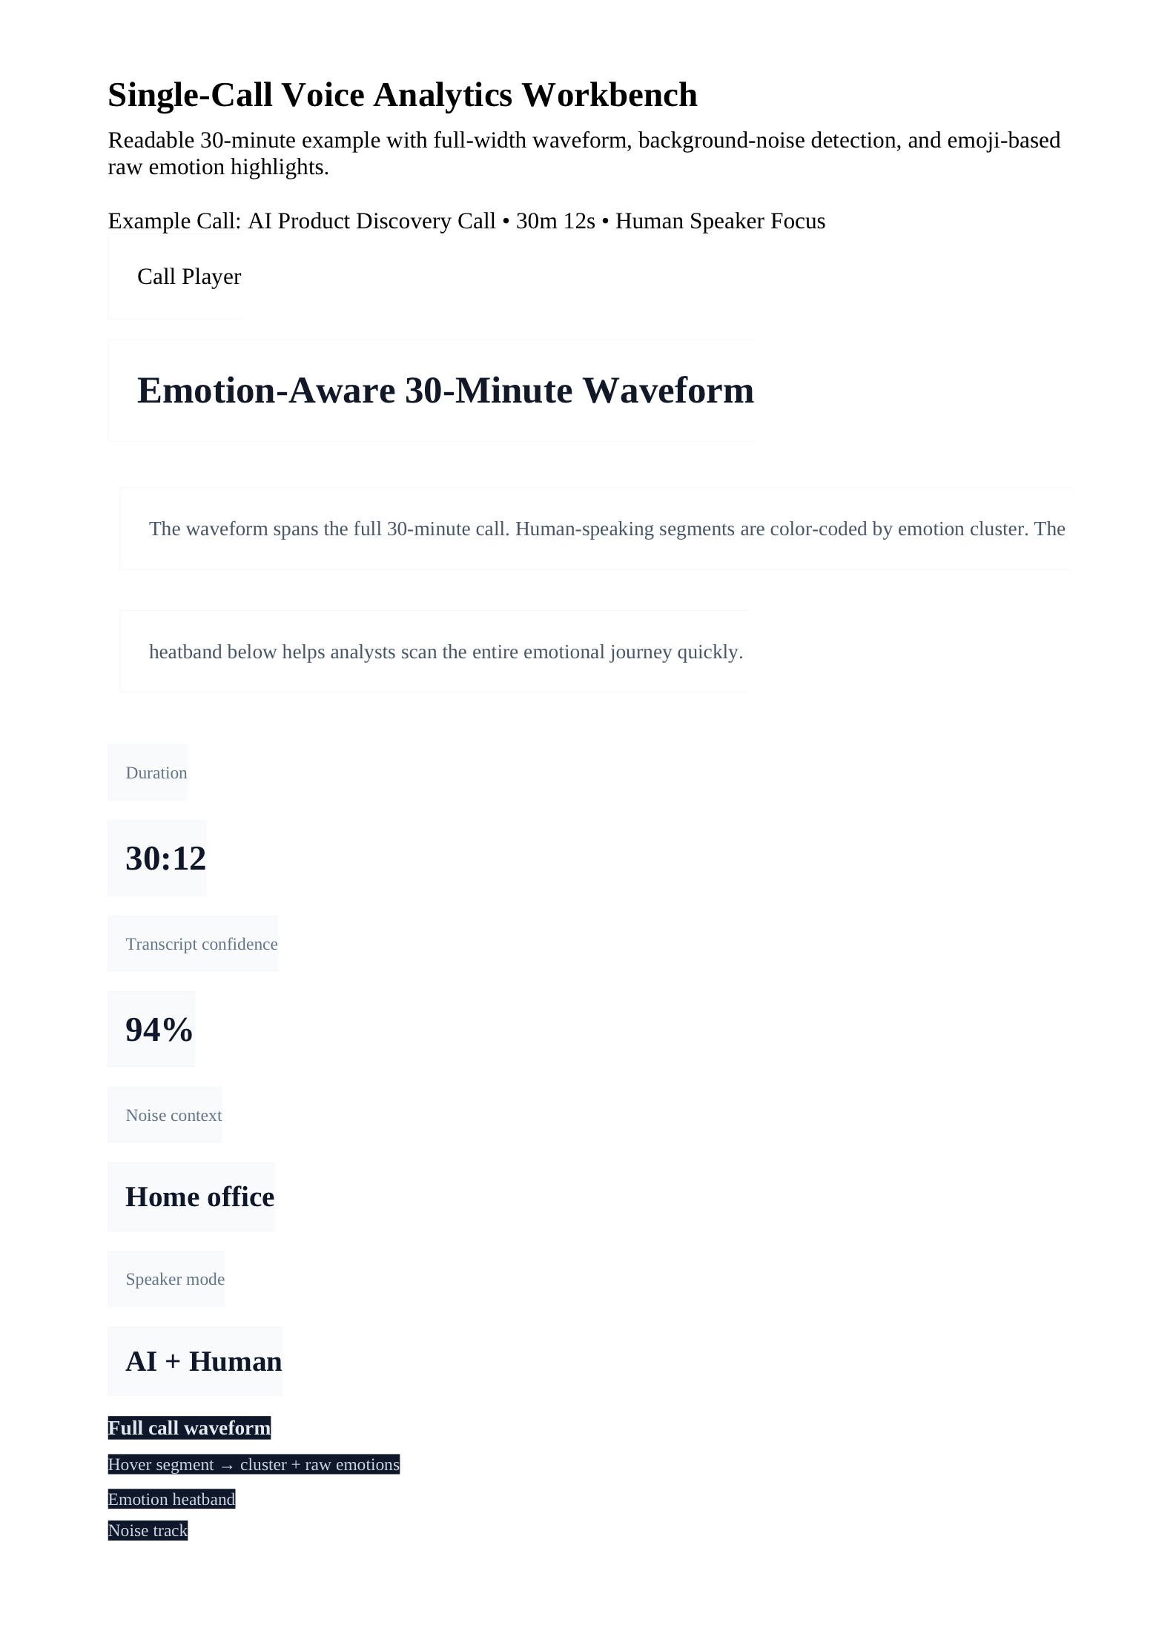
Hackathon demo
Spectrum
Google Analytics for the human side of AI conversations
We turn a 30-minute AI call into emotional, behavioral, and decision-ready insights.
Confidence
Hesitation
Readiness
Friction

Slide 2
PROBLEM
Transcripts tell you what was said. They miss how the human actually felt.
Analysts reviewing AI calls still have to guess where confidence rose, hesitation spiked, or the conversation went off track.
Long calls are slow to review
Emotion and behavior get lost
Teams do not know what to do next
A 30-minute call still means replaying audio, skimming text, and manually hunting for important moments.
Words alone do not show stress, doubt, engagement, pauses, fillers, or recovery after a tense turn.
Without a clear signal, it is hard to decide whether to follow up, coach, escalate, or qualify the call.
The missing layer is human signal: emotion, hesitation, confidence, engagement, and readiness during the AI conversation.

Slide 3
GAP
Why transcripts fail for AI + human call review
A transcript is useful context, but it cannot show timing, emotion, or how the AI changed the human response.
Transcript view
What analysts actually need
"Yeah, I think this would actually help our onboarding team because right now everything is scattered across calls and notes."
Where did hesitation spike?
When did confidence stabilize?
Did the AI reduce friction or create it?
Is the human moving toward a decision?
What should the team do after this call?
You can read the sentence
You cannot see the confidence rise
You cannot see the pause before answering
You cannot see the AI calming effect

Slide 4
SOLUTION
Spectrum is a single-call voice analytics workbench
The product is built around one core question: how did the human sound, behave, and move toward or away from a decision during the AI conversation?
Four job paths in one page
Investigate
Find the key moments and understand what happened.
Score
Measure confidence, hesitation, engagement, and readiness.
Coach
Spot struggle patterns and explain where the human got stuck.
Decide
Recommend follow-up, escalation, qualification, or risk review.

Slide 5
LIVE DEMO
The waveform becomes an analytics surface, not just a player
This is the strongest product moment in the demo because it shows emotion, timing, noise, and key moments on the same 30-minute view.
What to point at live
Full 30-minute waveform for fast scanning
Segment color overlay for emotion clusters
Heatband underneath for clean emotional comparison
Noise track for fan hum, typing, pings, or movement
Emoji raw emotion moments like 😰 😌 💪 😬

Slide 6
WORKFLOW
One call supports four analyst outcomes
Spectrum is not just an emotion viewer. It is a workbench that supports investigation, scoring, coaching, and decisioning from the same session.
Investigate
Score
Coach
Decide
Jump to key moments like hesitation spikes, emotional recovery, or friction peaks.
Generate human-focused metrics like confidence, engagement, hesitation, and readiness.
Explain where the human struggled, what improved mid-call, and where support is needed.
Recommend follow-up, escalation, qualification, or risk flagging based on the call.
Primary lens: evaluate the human. AI stays visible as context for interruptions, talk balance, timing, calming effect, and friction.

Slide 7
Why it matters
Spectrum turns AI conversations into something teams can act on.
30 min
reviewed in seconds
Sales teams can spot readiness. Support teams can catch frustration. AI teams can measure whether the agent builds trust or creates friction.
4 jobs
investigate, score, coach, decide
1 page
human signal + AI context
Spectrum: Google Analytics for the human side of AI conversations

