Slide 1
Out-of-school
Children Analysis
Amal Saber Kassem
March, 5, 2023

Slide 2
Content
Out-of-school reasons and impact.
Conclusion.

Slide 3
Out-of-school
Reasons and Impact

Slide 4
The Analysis Based On The following Factors.
Child labor
Early marriage
Income
Ignorance
basic education Unemployment

Slide 5
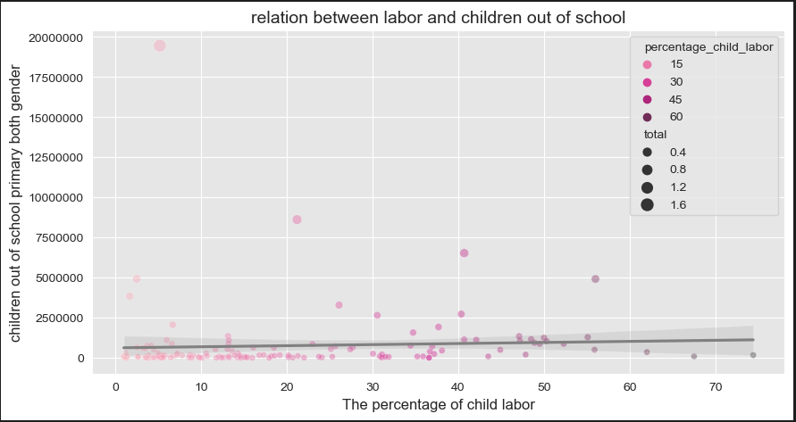
Out-of-school Children impact on Child labor
Positive correlation
Child labor increases positively based
on out-of-school children.

Slide 6
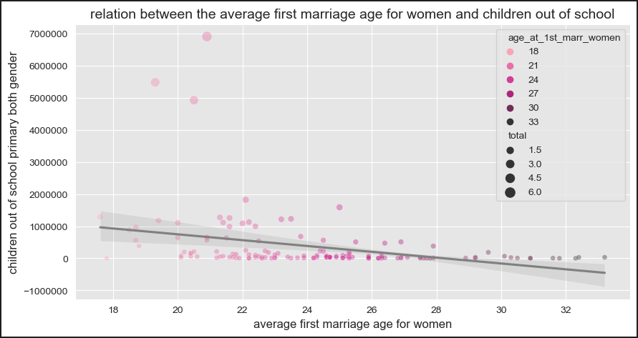
Out-of-school Children impact on early marriage
Negative correlation
early marriage decrease negatively based
on out-of-school children.

Slide 7
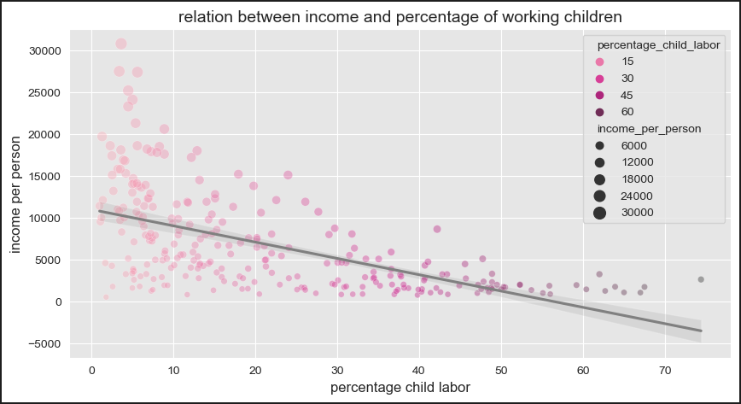
Income impact on child labor
Negative correlation
Child labor decrease negatively
Based on Income.

Slide 8
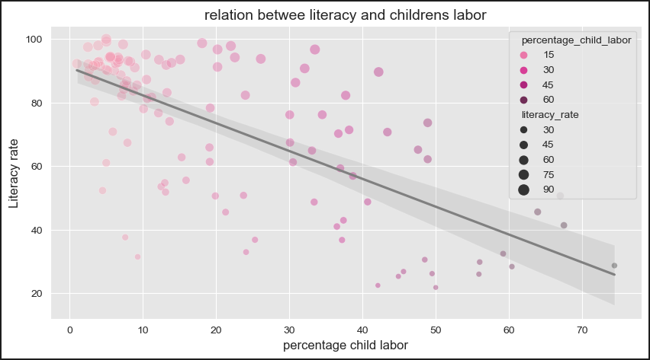
literacy impact on child labor
Negative correlation
child labor decrease negatively
based on literacy.

Slide 9
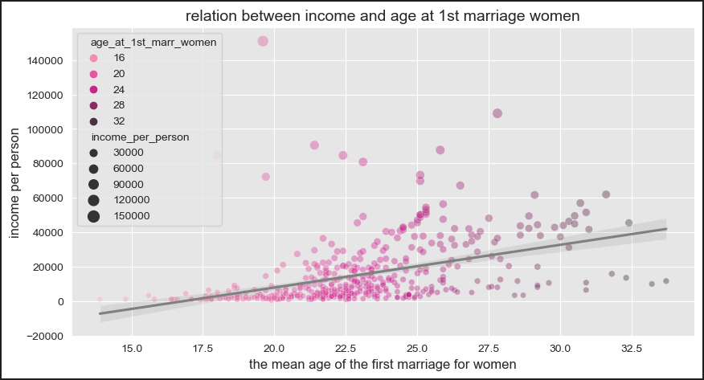
Income impact on early marriage
Positive correlation
Early marriage increases positively
based on income.

Slide 10
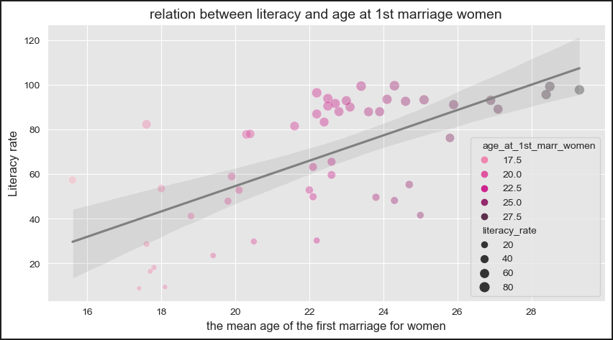
Income impact on early marriage
Positive correlation
Early marriage increases positively
based on literacy.

Slide 11
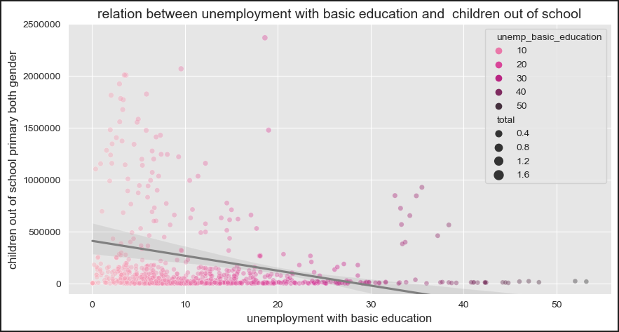

Out-of-school Children impact on unemployment
Negative correlation
Unemployment with basic education decrease negatively
based on Out-of-school Children .

Slide 12
Conclusion
The low income and ignorance cause child labor and
early marriage, That in turn increase unemployed
people with basic education, while income is
decreased and the circuit goes on.

Slide 13


Thanks for reading
Amal Saber
Amal Saber
Out-Of-School project on GitHub

