Slide 1
Machine Learning Algorithm for Heart Disease Data Set

Slide 2
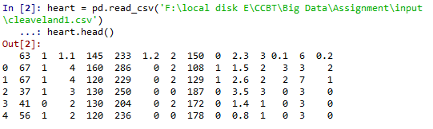
Sample Data Set
Processed Cleveland data

Slide 3
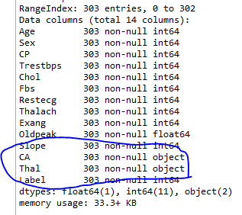
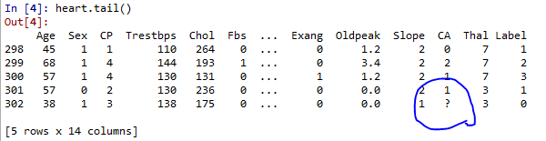
Data Preparation
Fixing CA and Thal columns
CA and Thal is object datatype.
When we check the dataset, we can see few null values as well(?).

Slide 4
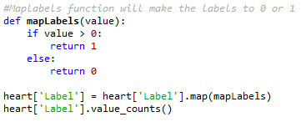
Data Preparation
Fixing Label Field
Label field refers to presence of heart disease in patient.
Its valued from 0 to 4
It can be classified into two values :- 0 and 1
O – Refers to no presence of heart disease
1 – Refers to presence of heart disease.

Slide 5
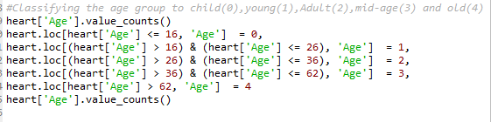
Data Preparation
Age Field
Age data is categorized into five values [0,1,2,3,4]
0 – Child (<16)
1 – Young (between 16 and 26)
2 – Adult (between 27 and 36)
3 – Mid Age (between 37 and 62)
4 – Old (>62)

Slide 6

Data Preprocessing
Preparing data for classification
Separate Label and features from dataframe
Split data into train and test data

Slide 7
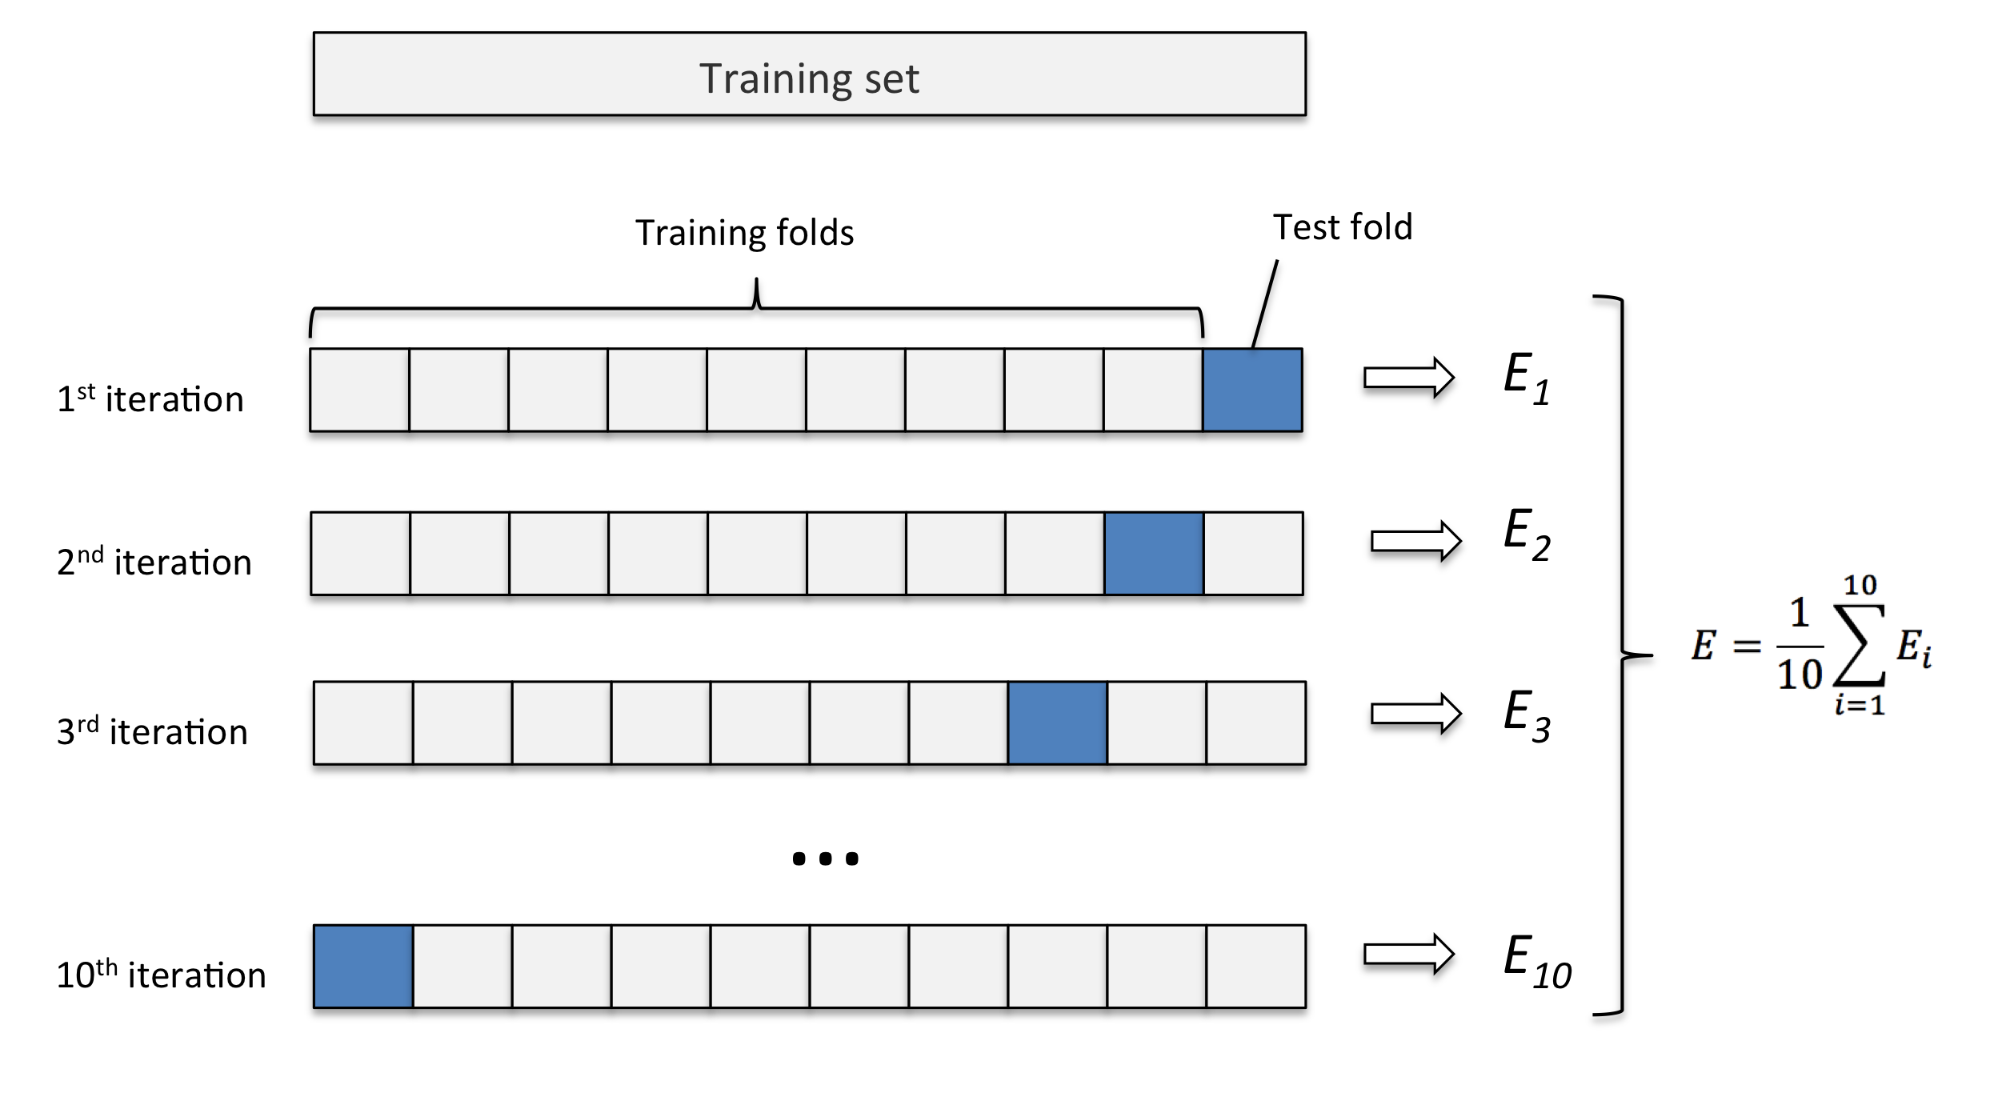
Model Selection
KFold is created to validate our train data and find best test data
Set Kfold to 10

Slide 8
Model Selection
Train the data set with different models.
We have tried the below models :-
- Support Vector Machine (SVM)
- Gradient Boosting Classifier
Decision Tree Classifier
Random Forest
Naïve Bayes

Slide 9
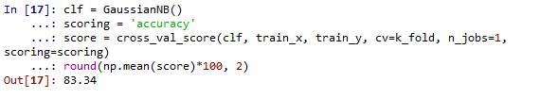
Model Selection
Out of this Naïve Bayes has higher accuracy, so it is selected as our model

Slide 10
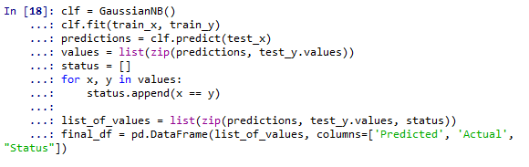
Training Model
Naïve Bayes Classifier Algorithm is used to create the predictions

Slide 11
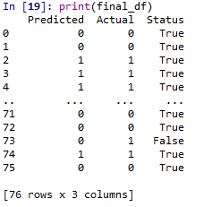
Training Model
Prediction Results
Now our algorithm is able to predict indication of heart disease using the given dataset

