Slide 1
TRUEVOTE
GUIDE :
Ms. ANJU JOHN
Assistant Professor
Dept of Computer Applications
PRESENTED BY:
AMAL SHAJI
ROLL NO: 08
S3 MCA

Slide 2
CONTENTS
ER Diagram
Dataflow Diagram
Use Case Diagram
Class Diagram
Sequence Diagram
System Architecture
Demo Video
References
Introduction
Abstract
Scope & Objectives
Feasibility Study
Problem Definition
Existing System
Proposed System
Literature Review
System Requirements
Modules of Proposed System

Slide 3
INTRODUCTION
TrueVote is a secure online voting system that uses PHP, MySQL, and blockchain technology with Aadhaar and OTP-based authentication to ensure transparency, trust, and tamper-proof elections.

Slide 4
ABSTRACT
TrueVote is a secure and transparent online voting system designed using PHP, MySQL, and Blockchain technology.
It ensures tamper-proof voting by storing each vote as an immutable block on the blockchain.
The system supports roles like admin (to manage elections and candidates) and voters (to cast verified votes).
By combining traditional web technologies with Solidity smart contracts, TrueVote guarantees vote integrity, anonymity, and verifiability.

Slide 5
SCOPE
Provides a secure, transparent, and tamper-proof online voting system using blockchain.
Ensures voter authentication through Aadhaar verification and OTP-based login.
Allows administrators to manage elections, candidates, and results efficiently.
Offers real-time vote recording on blockchain, preventing fraud or manipulation.

Slide 6
OBJECTIVES
To develop a web-based voting platform using PHP and MySQL for backend management.
To integrate Solidity smart contracts for transparent and immutable vote storage.
To implement Aadhaar + OTP-based authentication to prevent fake or duplicate voting.
To provide easy access for voters with a simple and secure user interface.

Slide 7
FEASIBILITY STUDY
Technical Feasibility: The system is built using PHP, MySQL, and Solidity-based Ethereum Smart Contracts, integrated with MetaMask and Web3.js. All technologies are reliable, scalable, and widely supported for secure online voting.
Economic Feasibility: Developed entirely with open-source tools, making it cost-effective. Suitable for academic or institutional use without significant investment.
Operational Feasibility: Offers a secure and user-friendly voting experience. Blockchain ensures transparency and prevents tampering. Suitable for colleges, clubs, and small-scale elections.

Slide 8
PROBLEM DEFINITION
Traditional voting systems are prone to fraud, tampering, and human errors.
Lack of transparency reduces trust in election results.
Weak voter authentication allows fake or duplicate voting.
Managing elections manually is time-consuming and costly.

Slide 9
EXISTING SYSTEM
Traditional voting systems use:
Paper-based ballots or EVMs
Centralized web-based voting with basic login
✅ Pros:
Familiar for users
No need for internet
❌ Cons:
Risk of tampering or rigging
No public transparency or audit trail
Manual counting delays
No proof of integrity after vote is cast

Slide 10
PROPOSED SYSTEM
TrueVote – A blockchain-enhanced web voting platform using PHP & MySQL with custom hashing logic to store votes as secure blocks.
✅ Pros:
Secure and immutable vote records
One vote per person (verified)
Transparent vote history (auditable by public)
Instant vote tally and results
Chain verification to detect tampering
❌ Cons:
Requires basic digital literacy
Internet access needed

Slide 11
LITERATURE REVIEW
SI. NO | Authors / Source | Focus Area | Year
1 | Alzahrani, Bulusu, Shiva (IEEE Access) | A Secure Electronic Voting System Using Blockchain Technology | 2021
2 | P. S. Praveen Kumar et al. (Elsevier) | Blockchain-based e-voting: A review of technologies and implementation models | 2022
3 | Farag, A., Mousa, M., El-Bakry, H. | Secure Online Voting Using Blockchain with Biometric Integration | 2023
4 | Hossain, M. S. et al. (Springer) | Trustworthy e-voting using blockchain: Challenges and future scope | 2024
5 | Singh, A., Kumar, S. (IJCSNS) | Lightweight Blockchain E-Voting System for Educational Institutions | 2025

Slide 12
SYSTEM REQUIREMENTS
Hardware:
Processor: Intel i3 / AMD Ryzen 3 or above
RAM: 4 GB (8 GB recommended)
Storage: 500 MB free for project files + MySQL data
Network: Stable internet connection (for blockchain & email OTP)

Slide 13
Software:
Server Environment: Laragon / XAMPP / WAMP (PHP 8, Apache, MySQL)
Composer: For PHPMailer & dependencies
Node.js + npm: For blockchain tools and Web3.js
Ganache / MetaMask: For local Ethereum blockchain testing
Solidity Compiler (solc or Remix IDE): For compiling and deploying smart contracts

Slide 14
MODULES OF PROPOSED SYSTEM
Admin Module:
Add, update, or delete voter and candidate records
Create and manage elections (set title, date, and status)
Approve or reject voter registrations
Monitor ongoing elections and view voting statistics
View and verify blockchain vote records
Publish final results and declare winners

Slide 15
Voter Module:
Register and log in securely to the system
View available and upcoming elections
Cast vote for a selected candidate
Receive vote confirmation with blockchain reference
Track vote status (once cast, marked as voted)
View election results after voting ends

Slide 16
Blockchain Module (System Logic):
Generate a unique, immutable block for each vote
Link blocks securely using hash and timestamp
Ensure one vote per user per election
Provide verifiable vote history without revealing identity
Prevent tampering or double voting through smart contracts

Slide 17
ER DIAGRAM

Slide 18
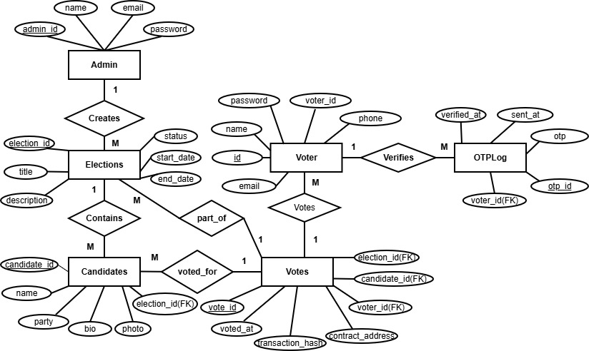

Slide 19
DATAFLOW DIAGRAM

Slide 20
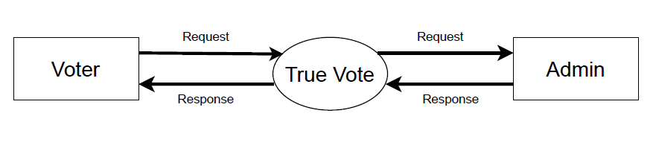
LEVEL 0

Slide 21
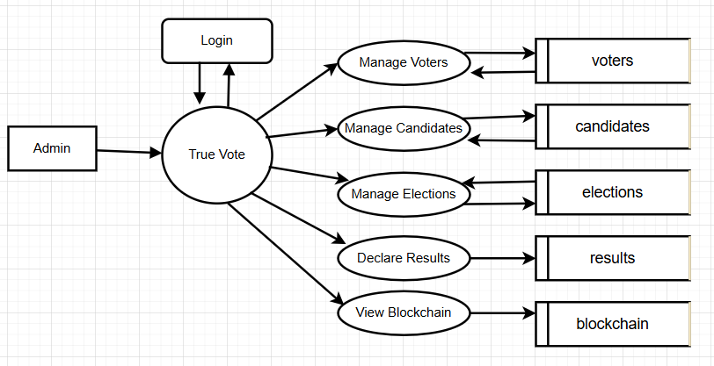
LEVEL 1- ADMIN

Slide 22
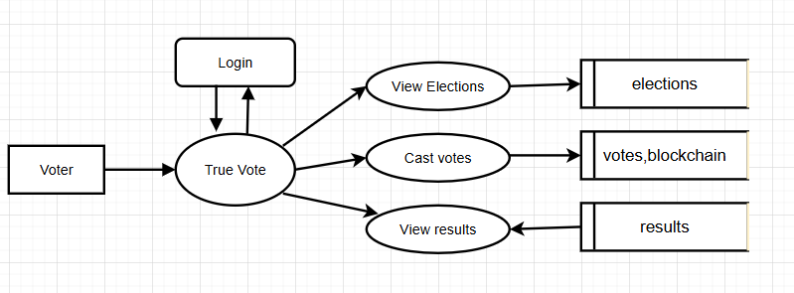
LEVEL 1- VOTER

Slide 23
USE CASE DIAGRAM

Slide 24
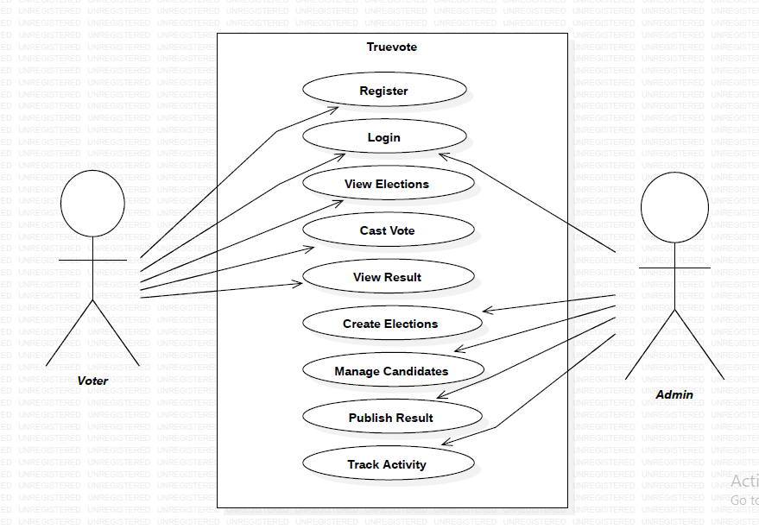

Slide 25
CLASS DIAGRAM

Slide 26
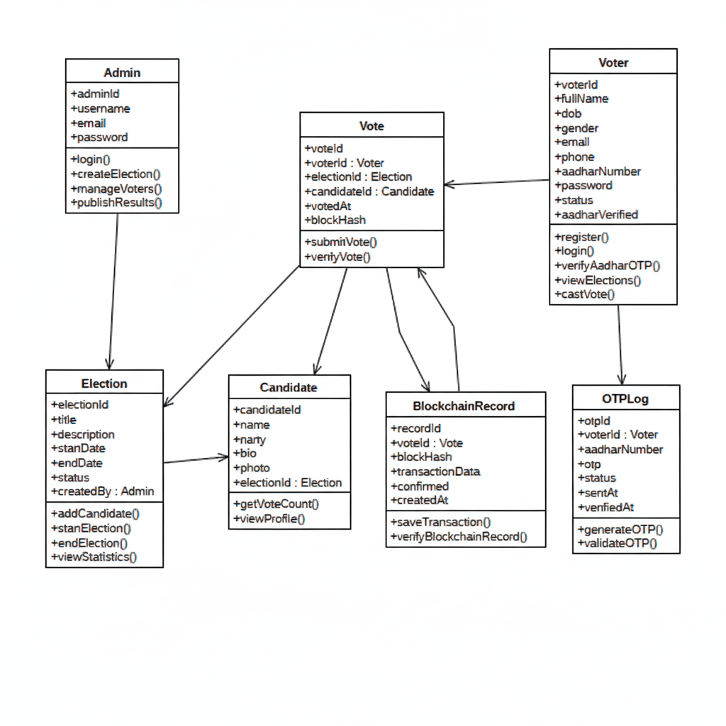

Slide 27
SEQUENCE DIAGRAM

Slide 28
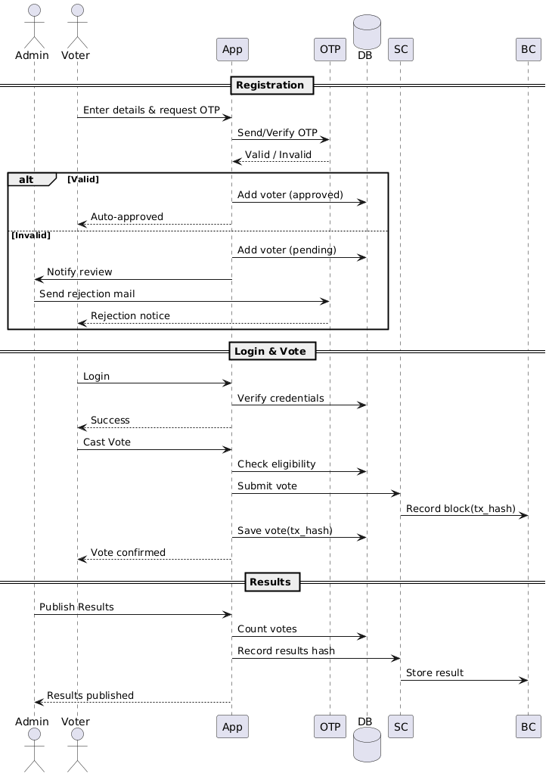

Slide 29
SYSTEM ARCHITECTURE

Slide 30
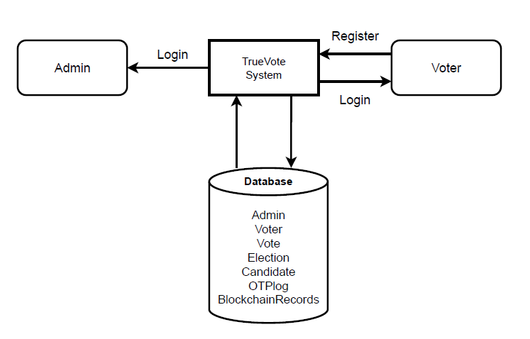

Slide 31
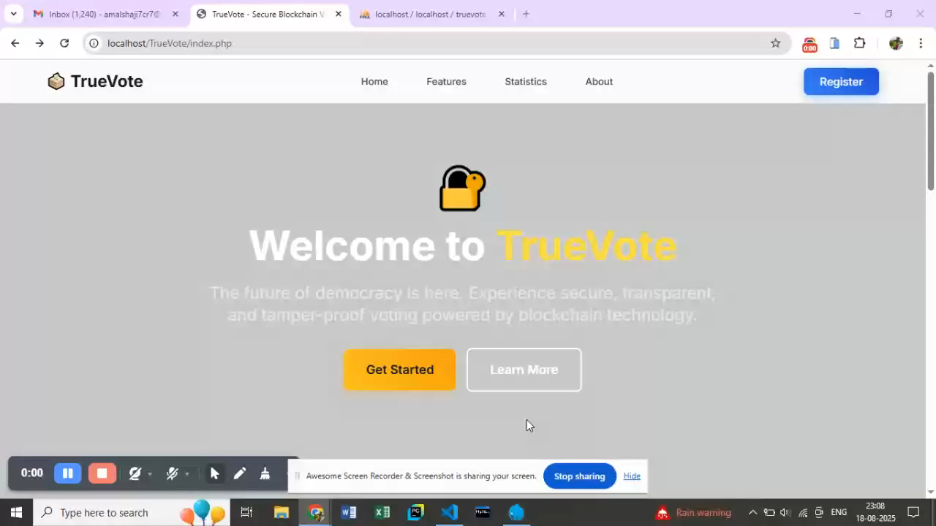
DEMO VIDEO

Slide 32
REFERENCES
Dwivedi, A., & Srivastava, R. (2020). Blockchain-based e-voting system. IJCA. https://www.ijcaonline.org/
Kaur, P., & Singh, M. (2021). Secure online voting using blockchain & OTP. IEEE. ieeexplore.ieee.org
Sharma, V., & Patel, K. (2022). Aadhaar-based voter verification framework. Springer. link.springer.com
Reddy, S., & Thomas, J. (2023). Trust in e-voting through blockchain. Elsevier. sciencedirect.com
Kumar, R., & Nair, S. (2024). OTP-based voter authentication. ACM. dl.acm.org

Slide 33
RESULT ANALYSIS
The system ensures transparent, tamper-proof voting using blockchain.
User authentication (OTP + Voter ID) works reliably and securely.
The interface is user-friendly and suitable for both admin and voters.
Successfully records and tracks each vote on blockchain with a unique transaction hash.

Slide 34
FUTURE SCOPE
Integration with Voter ID and Election Commission APIs for automatic voter verification.
Develop a mobile application version with real-time notifications.
Support multi-language and regional elections.
Enable biometric authentication (fingerprint or facial recognition).
Add real-time blockchain vote tracking dashboards.

Slide 35
CONCLUSION
TrueVote demonstrates how blockchain technology can revolutionize the voting process through digital transformation.
Provides a secure, transparent, and tamper-proof e-voting system.
Builds trust and accountability among voters and administrators.
Reduces manual errors, paperwork, and administrative costs.
Promotes a modern, efficient, and scalable approach to conducting elections.
Paves the way for the future of democratic digital governance.

Slide 36
THANK YOU

