Slide 1

Brazilian
e-commerce Database
BY OLIST
BI mini project
work by : Houda Rabia - Melek Kahloun - Amal Jawahdou

Slide 2

Project
Introduction
Welcome to a comprehensive exploration undertaken with the goal of unraveling insights within the realm of a Brazilian
e-commerce. Our journey involves the strategic integration of powerful tools such as Talend for ETL processes, MySQL for robust data storage, and Power BI for OLAP and visualization..

Slide 3


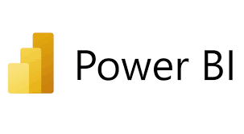
Methodology
Utilizing Talend for Extract, Transform, Load (ETL) processes ensures seamless data integration, cleansing, and transformation. The dataset is then stored in MySQL, a robust database management system, providing a solid foundation for our analytical endeavors. The Power BI tool serves as our lens into the data, enabling On-Line Analytical Processing (OLAP) and visually representing complex relationships, trends, and patterns.

Slide 4

Data Gathering
Our comprehensive data exploration embarks on the utilization of the Brazilian E-Commerce Public Dataset by Olist ,sourced from the Kaggle website. In a meticulous selection process, This amalgamation of datasets seamlessly combines both CSV and JSON formats, presenting a diverse and rich source of information.

Slide 5

Data Extraction : The objective was to obtain relevant information from our dataset by excluding unnecessary columns and including only the essential ones.
01.
ETL Process
Data transformation : it became imperative to optimize certain data for more efficient processing, and Talend played a pivotal role in achieving this objective. Our focus was on manipulating data to ensure a standardized and user-friendly format, creating a unified and usable dataset.
02.
Data loading : our aim was to consolidate the transformed data into a unified format. We adopted two distinct approaches for data storage and accessibility: utilizing .csv files for seamless manipulation within Power BI and implementing SQL storage through MySQL server for robust data warehousing.
03.

Slide 6
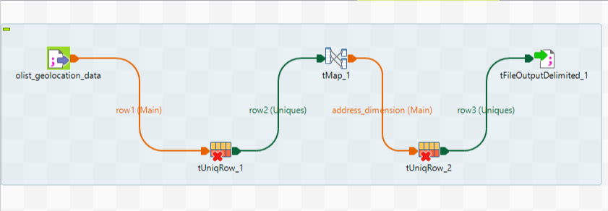
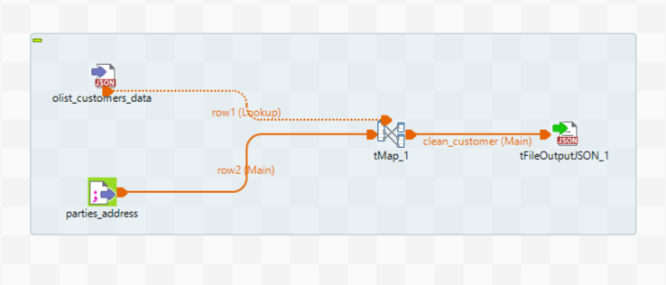
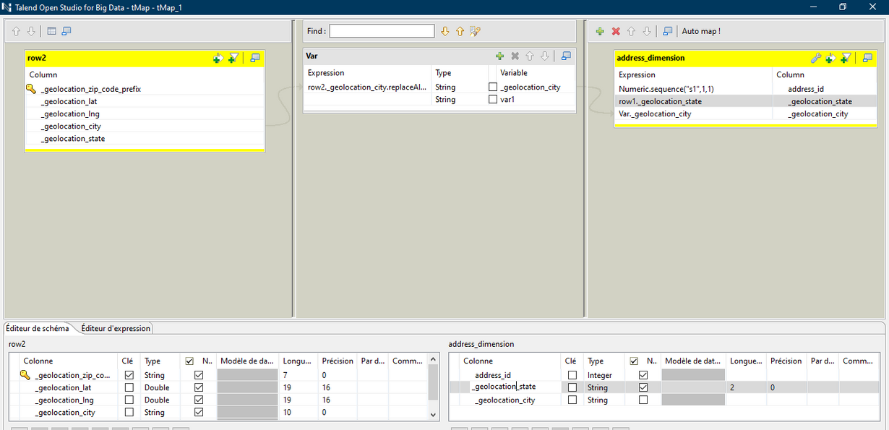
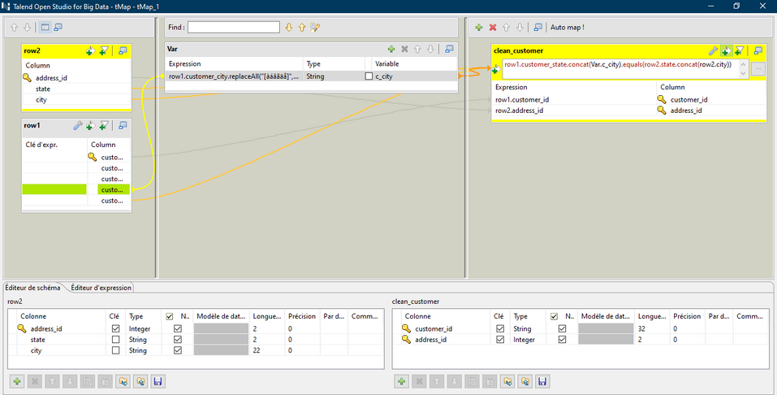
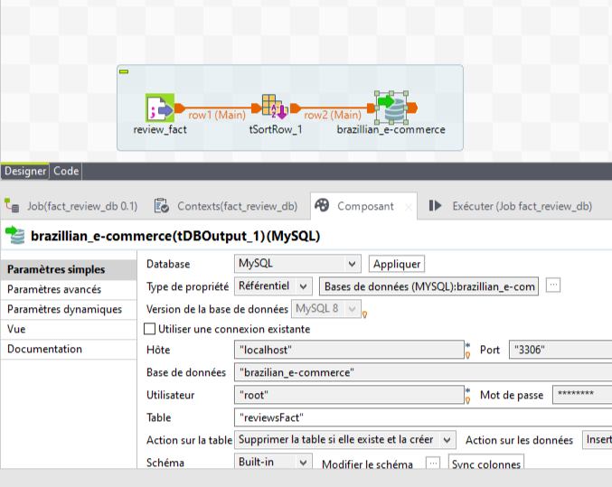
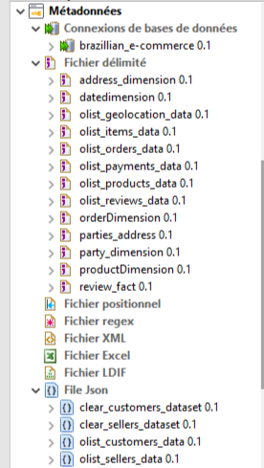

Glence of Talend Work

Slide 7
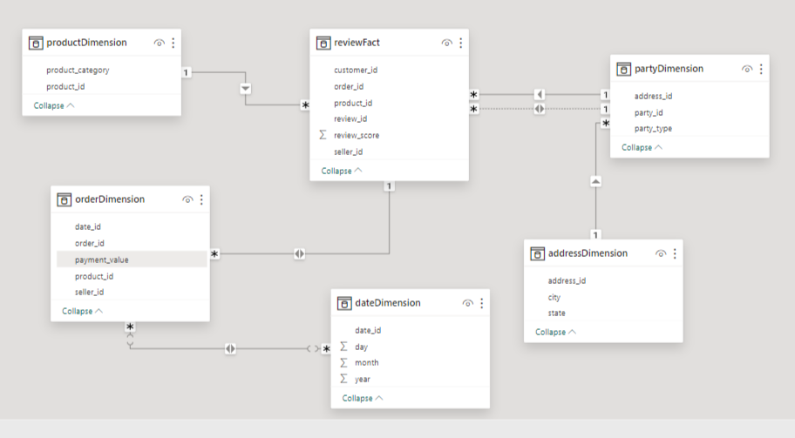
Data Warehouse Model

Slide 8
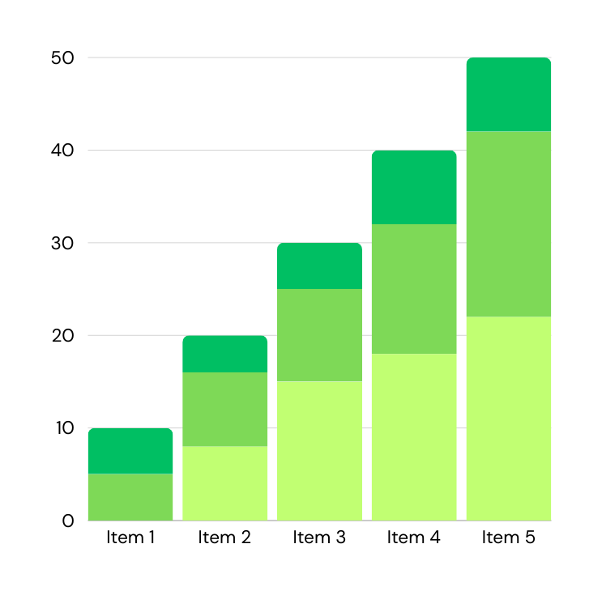
OLAP
Power BI seamlessly connects to a variety of data sources. We linked our data warehouse, hosted on MySQL server, to Power BI, ensuring real-time access to the most up-to-date information. The direct connectivity facilitated smooth data extraction for reporting.
We designed visualizations such as line charts, bar graphs, and geographic maps to convey insights effectively. Users can explore the data dynamically, gaining a comprehensive understanding of the Brazilian e-commerce landscape.

Slide 9
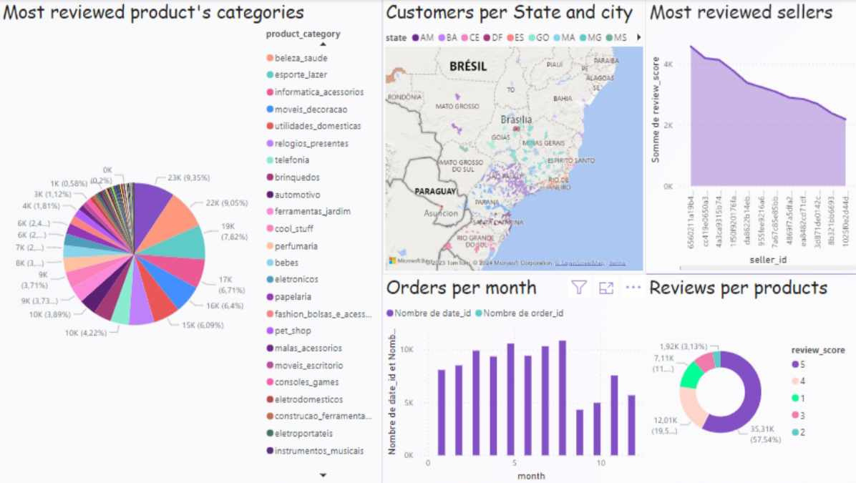

Slide 10

Proposed
Solution
• Focusing more on the high-demand categories to drive sales and revenue growth.
• Entering new states and cities to broaden the market coverage.
• Developing targeted marketing strategies and inventory planning to align with customer order trends, especially during peak months.
• Focusing on promoting the top-performing products.
• Increasing the collaborations with new sellers to expand the market diversity

Slide 11

Our Conclusion
Our small business intelligence has focused on analyzing , describing the data for a Brazilian e-commerce datasets ,with respects to the ratings scores and per consequence interpreting some solutions that may lead to the enhancements of both costumer experience and the enterprise's profits .
Our solution and perspective was only one from many , Then, what will be your perspective to help this organization ?

Slide 12

Thank you!

