Slide 1


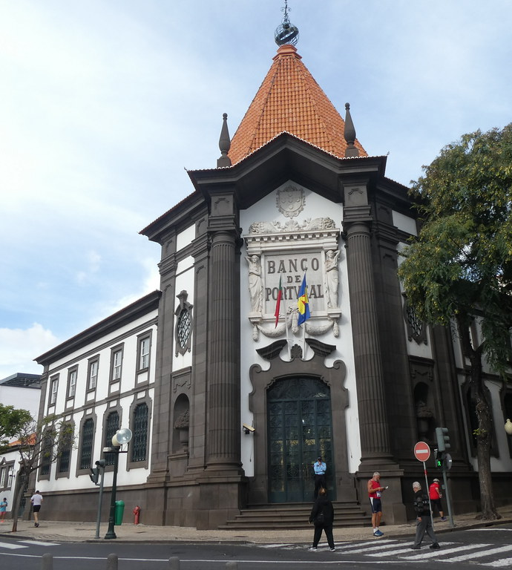
Portuguese Bank
Hind Alamri - Amal Alshrani
This Photo by Unknown Author is licensed under CC BY-NC

Slide 2
Tools :
Python libraries such as sklearn, seaborn.
Django web framework
Sql alchemy
-

Slide 3
Contents :
- Introduction
- EDA and pre-processing .
- build and evaluate the model .
-Prediction of with the model (interactive environment)

Slide 4

Introduction :
The Portuguese Bank has faced significant drop in the revenue. The reason beyond the decline is customers haven’t investigated enough for long term deposit , which motivates the bank to identify the customers might have chance to subscribe for long-term deposit. Then, the marketing campaign will be focused on those customers.
The target :
if the client will subscribe (yes/no) a term deposit (variable y).

Slide 5
EDA
Merging two dataset and store it by SQL (storage )
- Handling with inconsistent data such as (basic.4y, basic.6y, basic.9y) replace it with (basic)
- count most famous jobs of customers , level education
-check the nulls , outliers
pre-processing
- feature engineering by bigging technique .
-Scaling the data
- Dealing with imbalanced data (SMOTE ) .
- Prioritize which are features look promising.>> previous feature looks promising

Slide 6
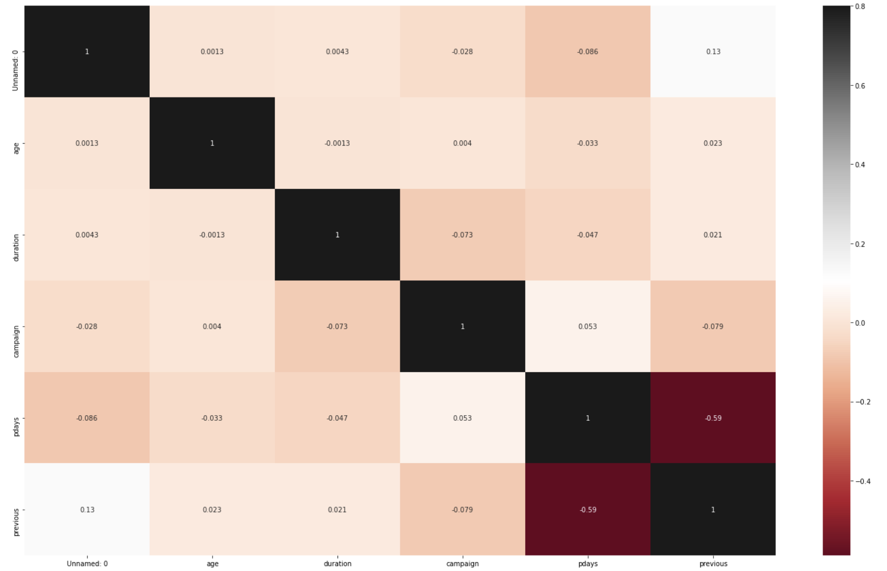
EDA (coorelation)
-

Slide 7
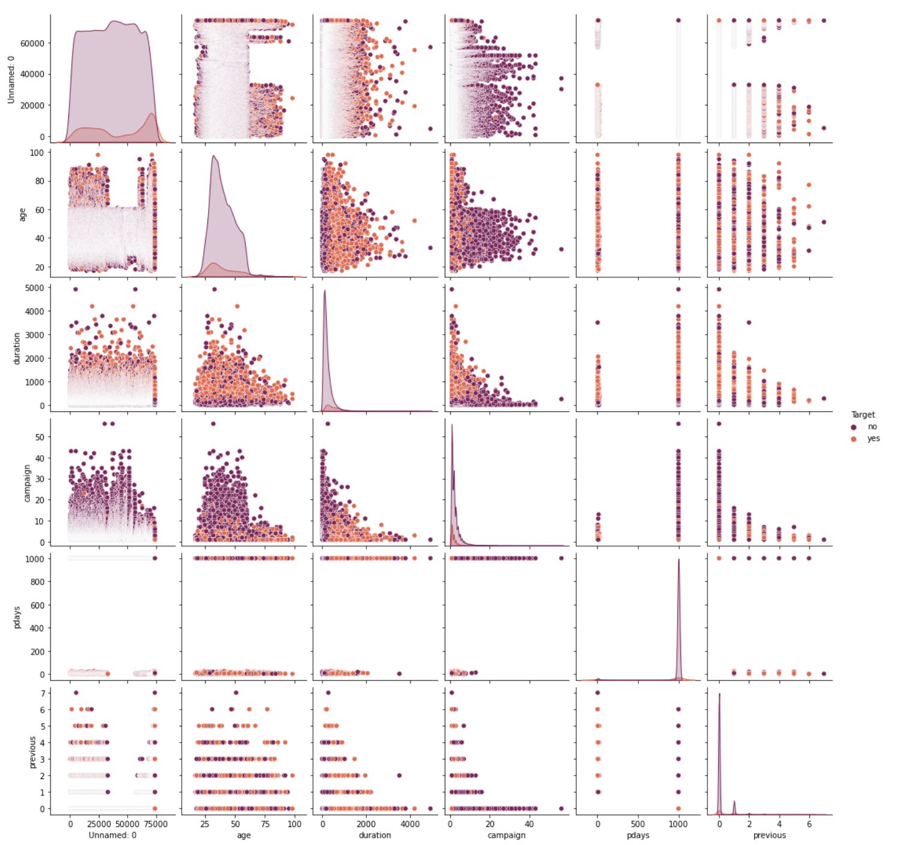
EDA

Slide 8


Feature engineering
Exclude unnecessary features.
1
Convert the Target column from Yes,No to 1,0 .
2
Split the data into 30% test and 70% train
3

Slide 9
Preprocessing data
Scaling Using StandardScaler()
Imbalance Using SMOTE()

Slide 10
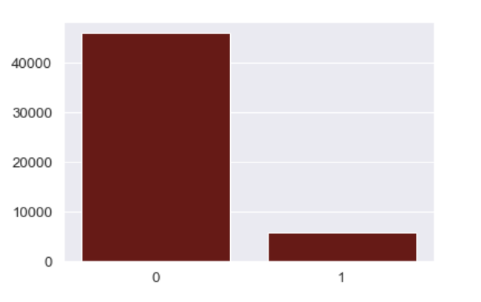

-Preprocessing data
-Preprocessing data

Slide 11
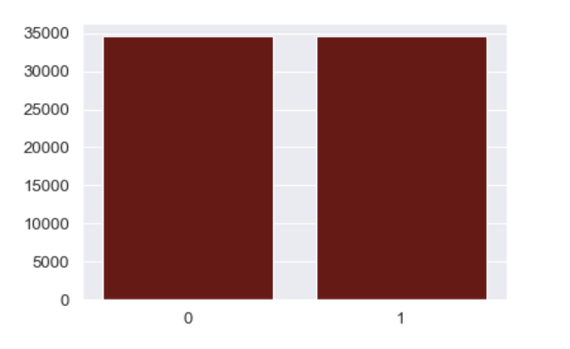
-Preprocessing data
-balanced data

Slide 12
Modeling and evaluation
KNeighbors Classifier
Logistic Regression
Decision Tree Classifier
Random Forest Classifier
Gradient Boosting Classifier

Slide 13
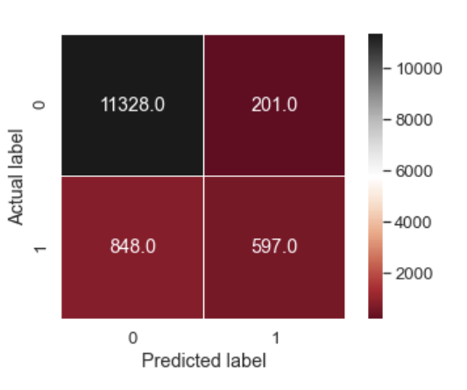
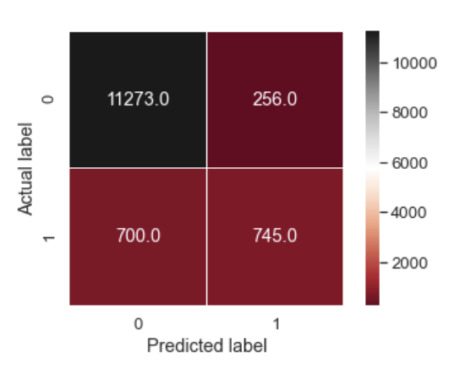
Classifier implementing the k-nearest neighbors vote.

Slide 14
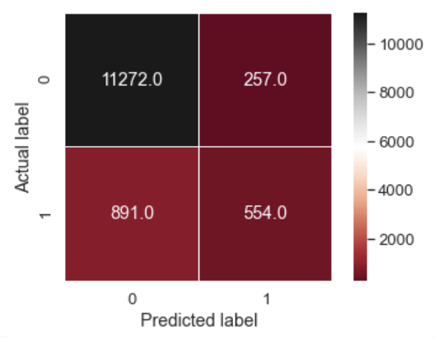
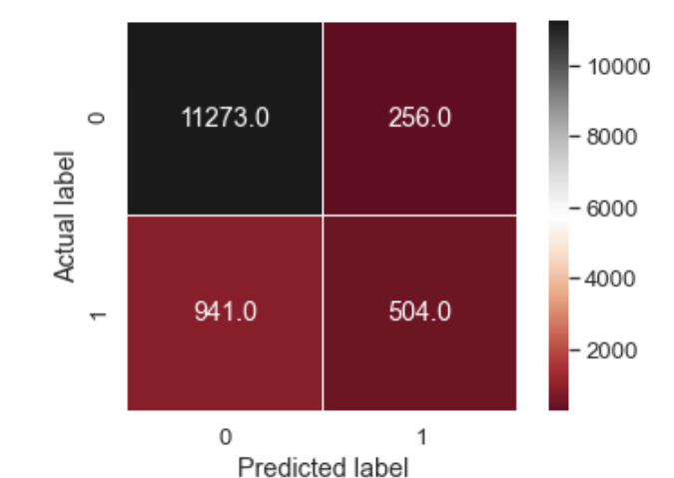
Logistic Regression classifier:

Slide 15
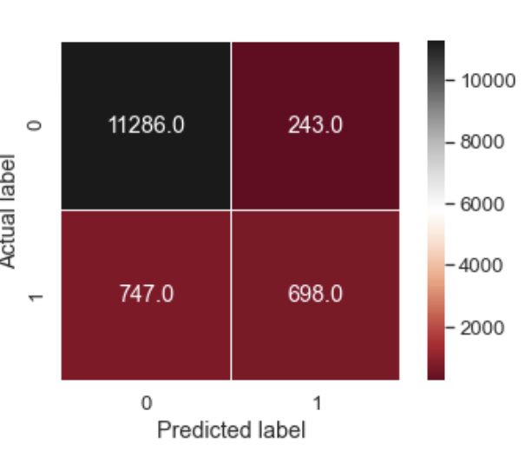
Gradient Boosting for classification:

Slide 16
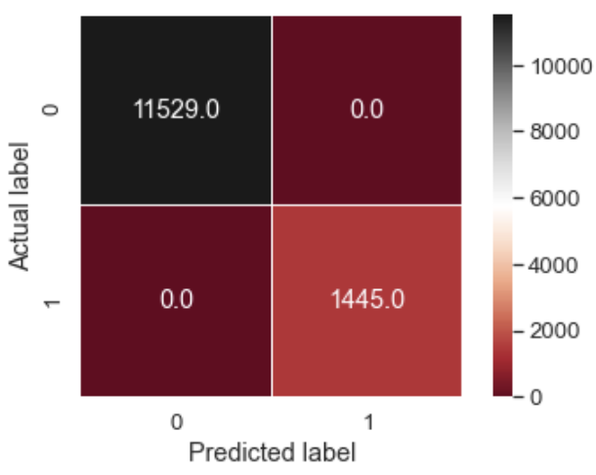
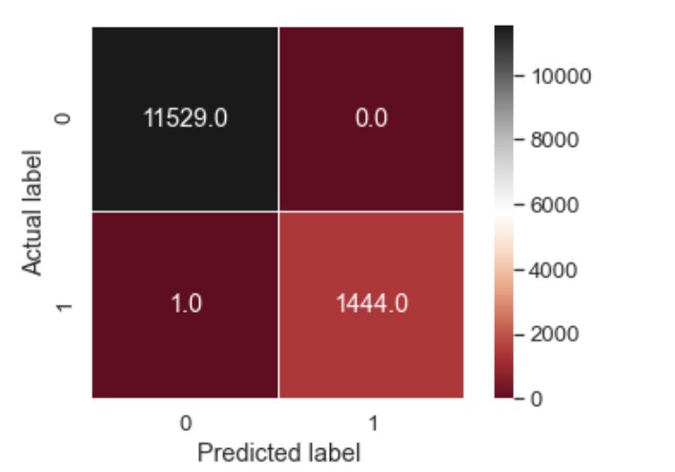
A random forest classifier:

Slide 17
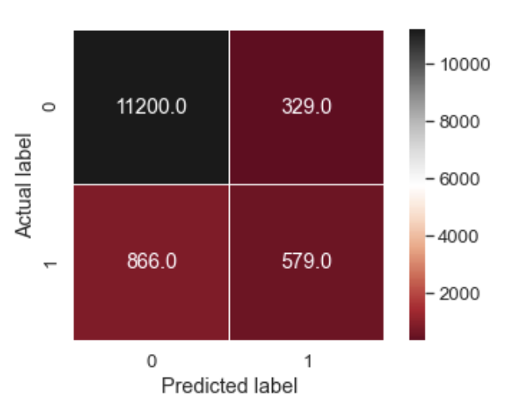
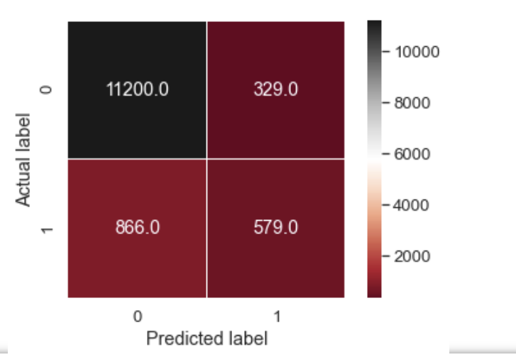
An AdaBoost classifier:

Slide 18
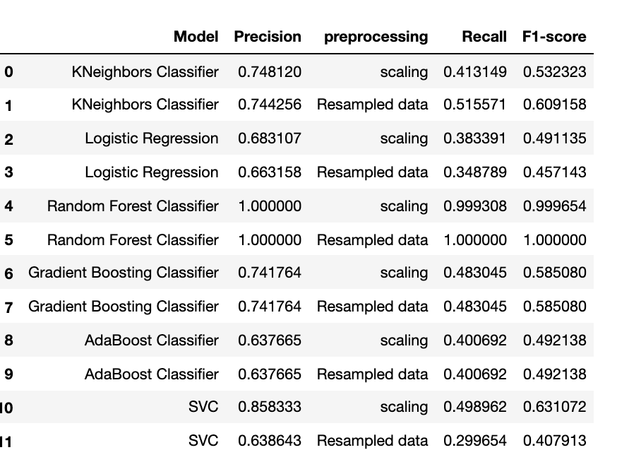
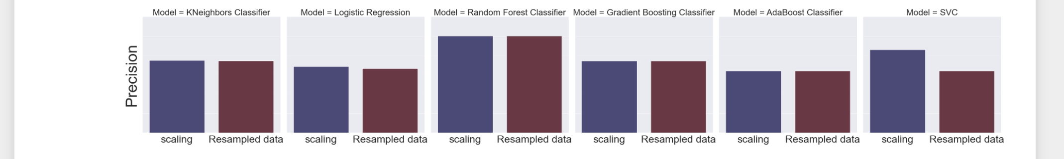
Modles:

Slide 19
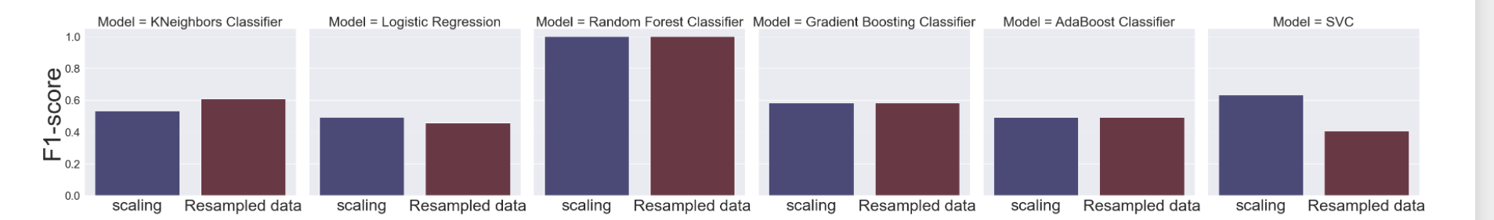
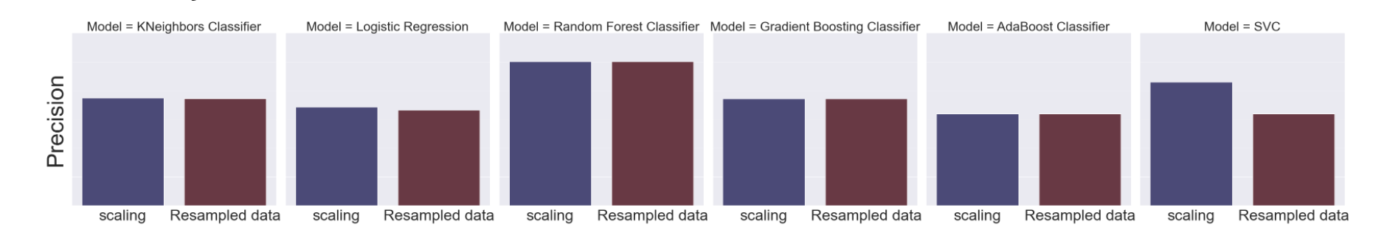
F1-score and precision:
We can see here from graph that Decision Tree Classifier perform well.

Slide 20
Decision Tree Classifier
Random Forest Classifier score: 0.9663

