Slide 1
Chapter 2
A basic overview of statistical tests that are used commonly
Vamsi Balakrishnan

Slide 2
Statistical Tests
Purpose
Major (common) Tests
  Student’s t-Test (paired or independent)
  Wilcoxon Mann-Whitney rank sum test
  Wilcoxon signed rank test
  Contingency tables (Chi-square tests)
  McNemar’s Test
Assumptions
Notes:
The essential purpose of statistics in the real world is to draw conclusions (inferences_ from a population based on measurements or observations on a (small) sample from the population.
We choose what test to perform based off of the assumptions that we can make off of the data such as whether normality can be assumed, or if the samples are taken independent from each other, etc.

Slide 3
Normal Populations
Student’s t-Test
Two types
  Independent
  Paired
Notes:
When attempting to assess hypotheses about two population means where the measurements are assumed to be a sample from a normal distribution, we use a t-test.

Slide 4
Independent Student’s t-Test [equal variance]
H₀: μ₁ = μ₂
H_{A}: <not above>
Assumptions
  Normality
  Equal Variance
  Independent samples
Same standard deviation (and hence variance) is assumed for both sample populations.
“The test statistic is essentially a standardized difference of the two sample means.”
Notes:
The null hypothesis (the one that we want to reject) is that there is no statistical difference between the means of the two samples. This essentially means that the samples are of the same distribution. (N(0,1), for example) and that experimental error probably plays a role in explaining the error.
The one subject in one sample should have no dependence or connection to the subject in the other group. If there is a connection, this test should NOT be used. But, the same standard deviation is assumed for both samples.

Slide 5
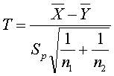
Independent Student’s t-Test (continued) [equal variance]
The Test Statistic (t-statistic)
X and Y are the two populations. The bar above it means sample mean.
The n₁ and n₂ are the sample sizes.
Sp = pooled standard deviation.
Notes:
This is the test statistic and how it is computed. Though it is done by R automatically, this could be a useful review for a certain advanced biostatistics course or other statistics courses where the computer doesn’t play a heavy role.
The pooled standard deviation is explained on the next slide.

Slide 6

Independent Student’s t-Test (continued) [equal variance]
Sp = Pooled Standard deviation
  Purpose
  Computational Formula:
  n₁ and n₂ are the sample sizes, s_{i} are the standard deviations for the population.
Notes:
(covered for the sake of completeness)
It serves to be a good (better) estimate of the REAL standard deviation when considering the standard deviation of the two populations.
It is a weighted average meaning that if one population has a certain standard deviation s1 with a population n1, and another population has s.d. s2 and pop = n2, and n1>>n2 (n1 is much greater than n2), then n1’s s.d. will have much more of an effect on the pooled standard deviation than s2 would. The pooled standard deviation would also be found to be between the two values of s1 and s2.

Slide 7
Independent Student’s t-Test (continued) [equal variance]
Degrees of Freedom
  The possibilities (opportunities) for change – 1 usually. Here though…
  n₁+n₂ -2
Notes:
The confidence interval is a range of plausible values for the difference between the two means.
If 0 is included then there is probably little difference between the two means; it’s bad to cover 0 in the CI.

Slide 8
Independent Student’s t-Test (unequal/difference variances)
Modified t statistic
Welch Test
  Same assumptions as previous test (independence, normality) except, unequal variance
  Same hypotheses are used
  Compare to previous equal var. formula
Used for data of very different sizes (Relative definition)
Notes:
This is the Welch Test. It is used in cases where the samples have unequal variance, but the other conditions for the t-test are met.
Formula is nearly the same as the equal variance formula (next slide), though the degrees of freedom one is more complex. This is of little concern though since we would compute that value through R programming if needed.

Slide 9
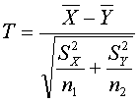

Independent Student’s t-Test (unequal/difference variances)
(continued)
Welch Statistic
Degrees of Freedom

Slide 10
Paired Student’s t-Test
“paired t-test I used to compare the means of two populations” when the data is paired:
  Before-and-after
  Same individual is observed twice
Null Hypothesis
  H₀ = 0
  H_{a} = <not above>
Notes:
This test has no regard for if the two populations have the same or different variances. Furthermore it is used specifically when the population observed is either tested twice in some manner, or not independent in an obvious way, or one is considering before-and-after (same subject, altered/different circumstances).

Slide 11

Paired Student’s t-Test
(continued)
Confidence Intervals
  “plausible range of values for the difference between two means”
    CI includes 0.
n-1 degrees of freedom.
Test statistic:
Notes:
Pg 27 for how to formulate the interval.

Slide 12
Summary (t-tests)
Equal Variance
Unpaired t-test
Unpaired
Unequal Variance
Welch Test
T-test
Paired
Paired subjects
(variance may or may not differ)
Paired t-Test

Slide 13
Non-Parametric
No distribution
Paired vs. Unpaired
Types:
  Wilcoxon Mann-Whitney Rank Sum Test
  Wilcoxon signed rank test
Notes:
Non-parametric means that we don’t assume that the data has come from any specific type of distribution (hence, not necessarily normal).
Multiple Types

Slide 14
Wilcoxon Mann-Whitney Rank Sum Test
T-statistic applied to the ranks, not data
Intended for not-normal (non-parametric), but independent
Hypothesis
  H₀ – “the two populations being compared have identical distributions”
  H_{A} – “populations differ in location i.e. (median)”

Slide 15
Wilcoxon Mann-Whitney Rank Sum Test
(continued, example)
Fastest - T H H H H H T T T T T H – Slowest
Consider a race between 6 Hares and 6 Tortoisses.
From the perspective of the Toirtoises, there is one that beats 6 hares, but the second, third, fourth, and fifth beat only one hair. The U value in this case = 6+1+1+1+1+1 = 11.
WMW Rank Sum Test – solely concerns the relative positions/value, not the exact ones.

Slide 16
Paired Wilcoxin Test
Two-sample version of the previous test except that the individuals may be measured twice or before-and-after measurements may be considered.

Slide 17
Paired Wilcoxin Test
(continued)
Computing the U-statistic is very easy.
This test should only be done on data that has the same number of measurements.
Create a third column
  If the difference between the “before” – “after” is positive, then put a + sign.
  If the difference is “negative” put a negative sign.
  Add up all of these signs, the resulting positive or negative value is the statistic.
Consider n_{s/r.} n_{s/r =} X_{a}X_{b} possible – number of pairs of Xa-Xb=0 pairs.
  n_{s/r} > 10: sampling dist is close to normal

Slide 18
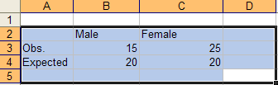
Contingency Tables
Categorical variables
Cross-classification
Set up table

Slide 19
Contingency Tables
(Continued)
Independence or Association
In this case:
  Were the group of males and females statistically likely?

Slide 20
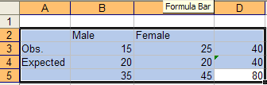
The X² Test
Perform in this case
Take row totals

Slide 21

The X² Test
(Continued)
[(15-20)^2/20] + [(25-20)^2/20)] = 2.5 = X²
Degrees of freedom = n-1 = 2-1 = 1

Slide 22
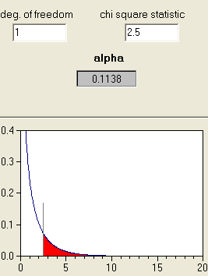
The X² Test
(Continued)
.1138 > α
Fail to reject null

Slide 23
McNemar’s Test
Categorical data from paired observations
“…cases matched with controls on variables such as sex, age, and so on, or observations made on the same subjects on two occasions (cf. paired t-test).”
Hypothesis
  H₀: populations do not differ

Slide 24
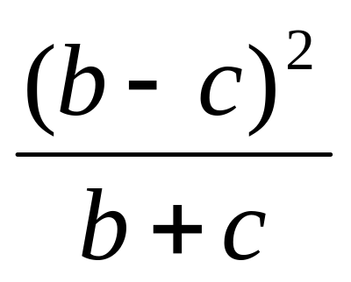

McNemar’s Test
(continued)
H₀ would hold if
  a + b = a +c and c + d = d + b
X² =

Slide 25
Overall Summary of Tests
Equal Variance
Unpaired t-test
Unequal Variance
Welch (modified t-) test
Independent
t-test (perhaps)
Quantitative
Paired
Variance doesn’t matter
Paired t-test
data
Ordinal or Nominal
X² Test
Pearson X² Test
Independent
Paired
McNemar’s X² Test
Notes:
Nominal – value doesn’t matter
Unpaired → equal or unequal → equal = unpaired, unqeual var = Welch
Paired → variance doesn’t matter → paired t

