Slide 1
██████╗ ███████╗ ███████╗ ████████╗ ██╗ ██╗ ██████╗ ██╗ ██╗ ███████╗ ███╗ ██╗ ██╔══██╗ ██╔════╝ ██╔════╝ ╚══██╔══╝ ██║ ██║ ██╔═══██╗ ██║ ██║ ██╔════╝ ████╗ ██║ ██████ █████╗ █████╗ ██║ ███████║ ██║ ██║ ██║ ██║ █████╗ ██╔██╗ ██║ ██╔══██╗ ██╔══╝ ██╔══╝ ██║ ██╔══██║ ██║ ██║ ╚██╗ ██╔╝ ██╔══╝ ██║╚██╗██║ ██████╔╝ ███████╗ ███████╗ ██║ ██║ ██║ ╚██████╔╝ ╚████╔╝ ███████╗ ██║ ╚████║ ╚═════╝ ╚══════╝ ╚══════╝ ╚═╝ ╚═╝ ╚═╝ ╚═════╝ ╚═══╝ ╚══════╝ ╚═╝ ╚═══╝
INNOVATIVE SIGN LANGUAGE TRANSLATION USING MACHINE LEARNING
Guide : Asst. Prof. Nikhil Dharman M.K
Members:-
Aadel Aboobacker (1)
Abhijith N (2)
Amal P K (8)
Safdar Shahir (44)

Slide 2
More than 30 million people around the globe have speech impairments and must rely on sign language, which poses a language barrier when seeking to communicate with non-sign language users
But learning sign language is a tedious and time taking process
At this age of technology, it is quintessential to make these people feel part of the society by helping them communicate smoothly.
The Problem or Challenge

Slide 3
ABSTRACT
Muteness/mutism or the inability to speak is considered to be a true disability .One of the ways in which they can communicate is using sign language
Sign languages are full-fledged natural languages with their own grammar and
Lexicon.
Under this project, we are dedicated to find means to effectively deal with this communication issue using Deep Learning algorithms to train the path captured using mobile Camera. This dataset is thenceforth utilized to analyse the gestures and output the word.
The output of our project includes three potential products including a mobile application, an application program interface and a sign language learning platform. The project aims at taking the basic step in bridging the communication gap between normal people, deaf and dumb people using sign language.

Slide 4

Product.(The solution)
We would present a robust and efficient method of sign language detection. 1. A mobile application that performs real time sign language translation. 2. An application program interface that supports translation on any application.(future scope) 3. A sign language teaching platform. (future scope)

Slide 5



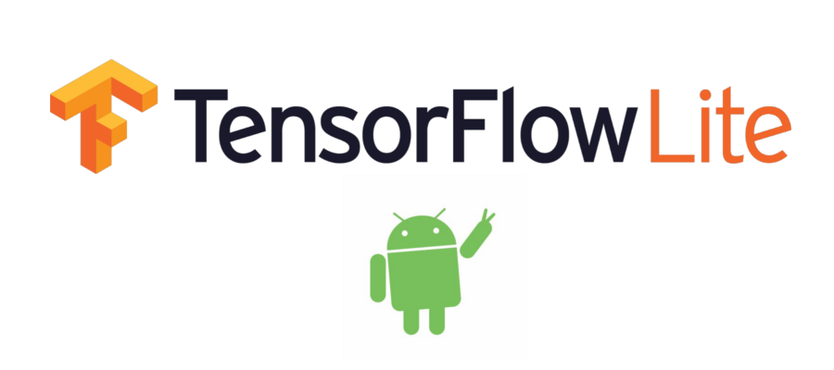
SOFTWARE REQUIREMENTS
Android Studio
OPENCV Libraries
TensorFlow Lite
Visual Studio Code

Slide 6
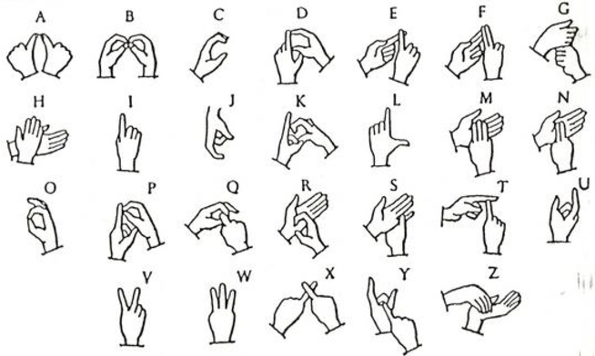
INDIAN SIGN LANGUAGE
ISL is the predominant sign language in South Asia, used by at least several hundred
thousand deaf signers.
Gestures can be identified as a meaningful body motion which can involve hands,
head, body in order to convey a meaningful information or to interact with the environment,
these gestures can be static, dynamic or both.
Sign language is often represented using both hands and in some special occasions
using single hands .The figure shows double-handed patterns.

Slide 7
VISION BASED RECOGNITION
Vision based Approach uses the mobile camera as our input device. Vision based analysis, is based on the way human beings perceive information about their surroundings, yet it is probably the most difficult to implement in a satisfactory way.
The image is captured using a camera then extract some feature and those features are used as input in a classification algorithm for classification.
There are mainly 4 steps say Image acquisition ,Pre-processing ,Feature Extraction ,Classification.
Image acquisition
Pre-processing
Feature Extraction
Classification

Slide 8
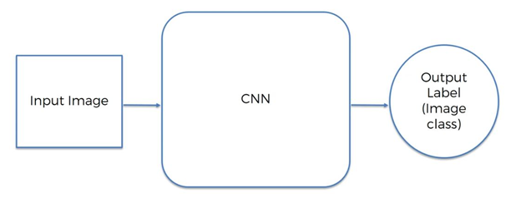
CONVOLUTIONAL NEURAL
NETWORK(CNN)
Neural networks, as its name suggests, is a machine learning technique which is modelled after the brain structure. It comprises of a network of learning units called neurons. These neurons learn how to convert input signals ( i.e. Image of a sign/gesture) into corresponding output signals (e.g. the label “hello”), forming the basis of automated recognition.
CNNs have repetitive blocks of neurons that are applied across space for Images.
For images, these blocks of neurons can be interpreted as 2D convolutional kernels, repeatedly applied over each patch of the image.
The CNN can be thought of 5 steps mainly
Convolution
Pooling /Subsampling
Activation
Full connectedness

Slide 9
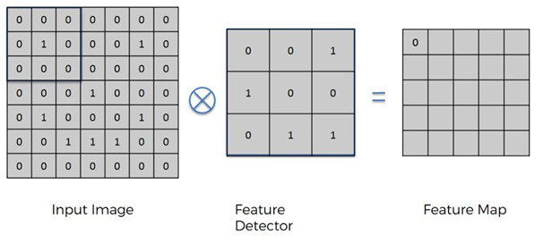
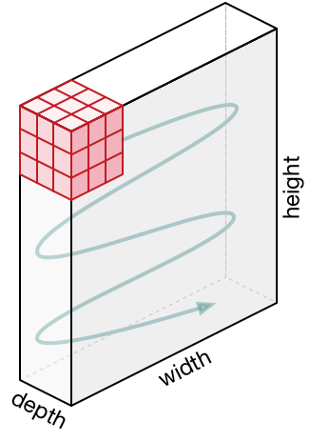
1.Convolution
The first layers that receive an input signal are called convolution filters .Convolution is a process where the network tries to label the input signal by referring to what it has learned in the past.
Convolution preserves the spatial relationships between pixels by learning image features using Small Square of input data .It is a mathematical operation that takes two inputs such as image matrix and a filter or kernel. Convolution of an image with different filters can perform operations such as edge detection, blur and sharpen by applying filters.
CNN terminology, the 3×3 matrix is called a ‘filter’ or ‘kernel’ or ‘feature detector’ and the matrix formed by sliding the filter over the image and computing the dot product is called the ‘Activation Map’ or the ‘Feature Map’. It is important to note that filters act as feature detectors from the original input image.

Slide 10
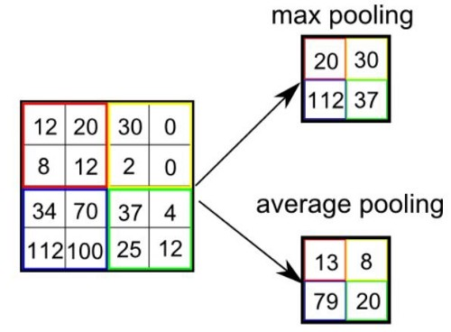
2.Pooling/Subsampling
Similar to the Convolutional Layer, the Pooling layer is responsible for reducing the spatial size of the Convolved Feature. This is to decrease the computational power required to process the data through dimensionality reduction.
Pooling layer operates on each feature map independently.
There are two types of Pooling: Max Pooling and Average Pooling. Max Pooling returns the maximum value from the portion of the image covered by the Kernel. On the other hand, Average Pooling returns the average of all the values from the portion of the image covered by the Kernel.
Max Pooling also performs as a Noise Suppressant. It discards the noisy activations altogether and also performs de-noising along with dimensionality reduction.

Slide 11
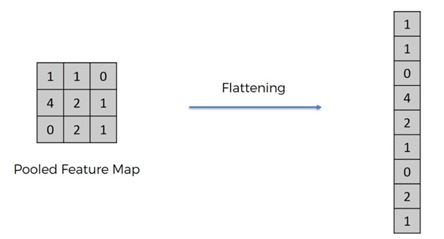
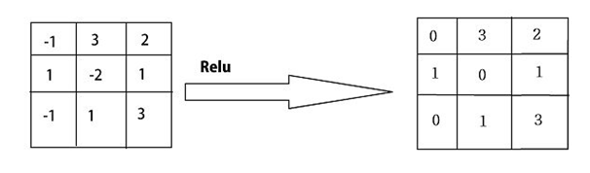
3.Flattening
Flattening is the process of converting al the resultant 2-dimensional arrays into a single long continuous linear vector .We flatten the output of the convolutional layers to create a single long feature vector.
So Flattening is become the input of Artificial Neural Network which is used for the backpropagation Method .
ReLu Layer
An additional operation called ReLU has been used after every Convolution operation. ReLU stands for the Rectified Linear Unit and is a non-linear operation. ReLU is an element-wise operation (applied per pixel) and replaces all negative pixel values in the feature map by zero.

Slide 12
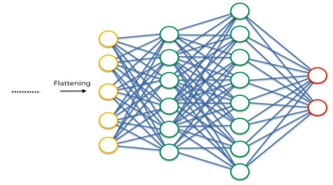
4.Full Connectedness
The Fully Connected layer is a traditional Multi-Layer Perceptron that uses a SoftMax activation function in the output layer (other classifiers like SVM can also be used). The term “Fully Connected” implies that every neuron in the previous layer is connected to every neuron on the next layer.
The output from the convolutional and pooling layers represent high-level features of the input image. The purpose of the Fully Connected layer is to use these features for classifying the input image into various classes based on the training dataset.
The sum of output probabilities from the Fully Connected Layer is 1. This is ensured by using the Softmax as the activation function in the output layer of the Fully Connected Layer. The Softmax function takes a vector of arbitrary real-valued scores and squashes it to a vector of values between zero and one that sums to one.

Slide 13

Putting it all together
As discussed above the convolution + Pooling layers act as Features extractor from the input image while a fully connected layer acts as the classifier.

Slide 14
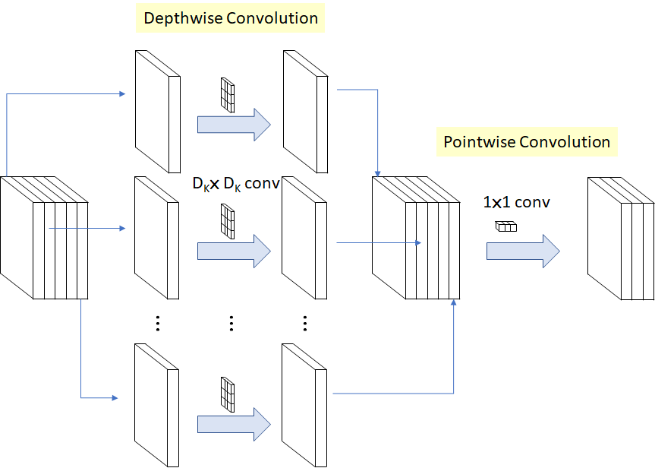
MobileNet Model
MobileNets are small, low-latency, low-power models parameterized to meet the resource constraints of a variety of use cases. They can be built upon for classification, detection, embeddings and segmentation similar to how other popular large scale models, such as Inception, are used. MobileNets can be run efficiently on mobile devices with TensorFlow Lite.
The MobileNets model is based on depth wise separable
convolutions which is a form of factorized convolutions
which factorize a standard convolution into a depth wise
convolution and a 1×1 convolution called a pointwise
convolution.
Depth wise convolution is the channel-wise DK x DK spatial
Convolution.
MobileNet uses 3 × 3 depth wise separable convolutions
which uses between 8 to 9 times less computation than standard
convolutions at only a small reduction in accuracy.

Slide 15
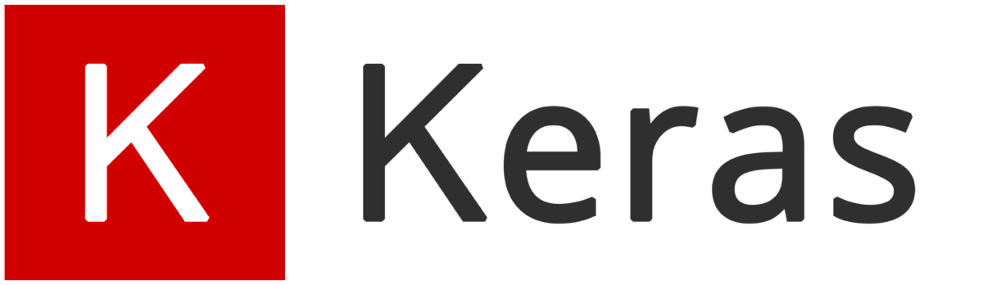
Keras is a high-level API to build and train deep learning models. It is used for fast prototyping, advanced research, and production, with three key advantages:
User-Friendly
Modular and Composable
Easy to extend
Keras is an open-source neural-network library written in Python which is capable of running on top of TensorFlow. Keras has support for convolutional and recurrent neural networks It supports other common utility layers like dropout, batch normalization, and pooling .Keras allows users to productize deep models on smartphones (iOS and Android), on the web, or on the Java Virtual Machine.

Slide 16

DATA COLLECTION
Data collection is done with a python program. Using this program we can generate binary thresholded frames.
In each frame the background will be subtracted and the hand part be in white and the background will be in black colour.
Using this we collected almost 2000 images for each alphabets A to Z and 10 other sign words.

Slide 17
Continue..
We can go through the main functions of the program
import cv2
import imutils
import numpy as np
from sklearn.metrics import pairwise
In this part we import needful packages
cv2 -> library of python used in computer vision problems
imutils -> series of convenience functions to make basic image processing.
numpy -> general purpose array processing package.
Sklearn.metrics -> pairwise is used to find the distance matrix.

Slide 18
BACKGROUND SUBSTRACTION
def run_avg(image, accumWeight):
This function is used to find the running average over the background . Using this function the background of the frames are stored and this function helps to find the moving part in the frame.
def segment(image, threshold=30):
This function is used to segment the region of hand in the image and also binary inversion of the image
cv2.absdiff(bg.astype("uint8"), image)
It uses the previously stored background value(bg) to find the difference between the image and bg.

Slide 19
BINARY THRESHOLDING
cv2.threshold(diff, threshold, 255, cv2.THRESH_BINARY)[1]
Using this threshold function we can do the binary inversion of the background.
(cnts, _) = cv2.findContours(thresholded.copy(),
cv2.RETR_EXTERNAL, cv2.CHAIN_APPROX_SIMPLE)
The cv2.findContours() is used to find the curves and shapes. And using this we get no of shapes in the thresholded frame.
segmented = max(cnts, key=cv2.contourArea)
Using MAX function we find the shape with maximum contourarea .The return of segment function is (thresholded, segmented)

Slide 20
EXTRACTING FRAMES
if __name__ == "__main__":
In the main function we use cv2 functions such as
camera= cv2,videoCapture(0) to connect camera to take video using the web cam.
(grabbed, frame) = camera.read() to read the images from the web cam.
cv2.flip() to flip the frame for avoid the mirror effect of camera
cv2.cvtColor() to convert color to gray
cv2.imwrite() to write the frame to a directory

Slide 21
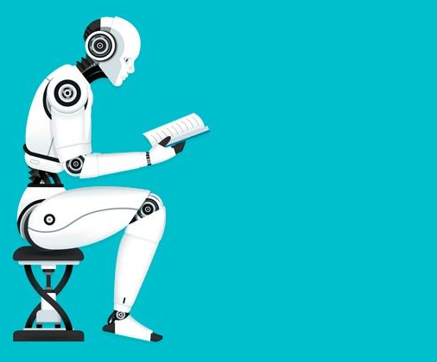
TRAINING MODEL
After dataset collecting ,pre processing ,and labelling the dataset all are completed ,it will given to the model as input using TensorFlow.
The feature extraction process and creating labelled models are done by TensorFlow.
We use Transfer learning which is a ML technique where a model trained on one task is repurposed on a second related task.
This will increase the efficiency of the model.
We use the pre trained model MobileNetV2.

Slide 22
//CODE SECTION//
import tensorflow as tf
import os
import numpy as np
import matplotlib.pyplot as plt
This import libraries that we need TensorFlow ,numpy ,matplotlib ,os.
TRAIN DATA GENERATOR
The data is fed to the model in batch wise .Each batch contains pre-defined number of images to overcome memory overflow.
IMAGE_SIZE =96 BATCH_SIZE=64
datagen = tf.keras.preprocessing.image.ImageDataGenerator( validation_split=0.2, )
This will create a data generator with batch size=64 and validation split as 20%.

Slide 23
Continue..
Using this data generator we generate a train-generator and Validation data generator which will be used for transfer learning of MobileNet for training and validation.
train_generator = datagen.flow_from_directory( base_dir, target_size=(IMAGE_SIZE,IMAGE_SIZE), batch_size = BATCH_SIZE, subset = 'training’, )
val_generator = datagen.flow_from_directory( base_dir, target_size =(IMAGE_SIZE,IMAGE_SIZE), batch_size = BATCH_SIZE, subset = 'validation', )

Slide 24
MODEL BUILDING
model = tf.keras.Sequential([
base_model,
tf.keras.layers.Conv2D(32, 3, activation='relu’),
tf.keras.layers.Dropout(0.2),
tf.keras.layers.GlobalAveragePooling2D(),
tf.keras.layers.Dense(36, activation='softmax') ])
In this the Base model used is MobileNetV2.

Slide 25
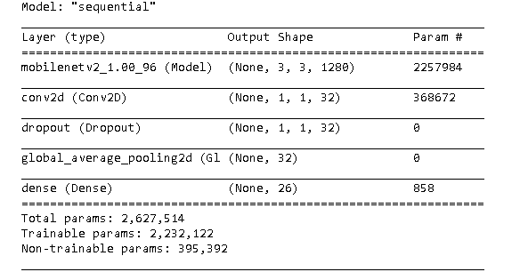
MODEL SUMMARY

Slide 26
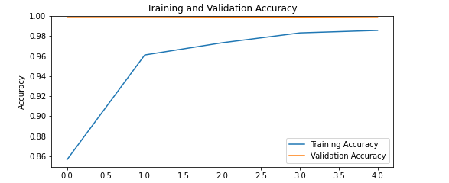
TRAINING AND VALIDATION ACCURACY GRAPH

Slide 27
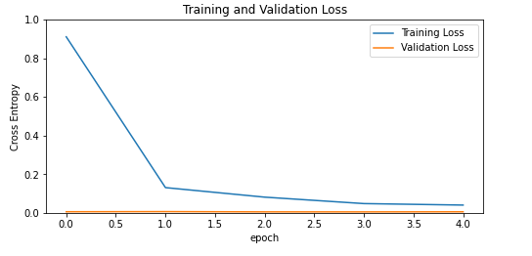
TRAINING AND VALIDATION LOSS

Slide 28
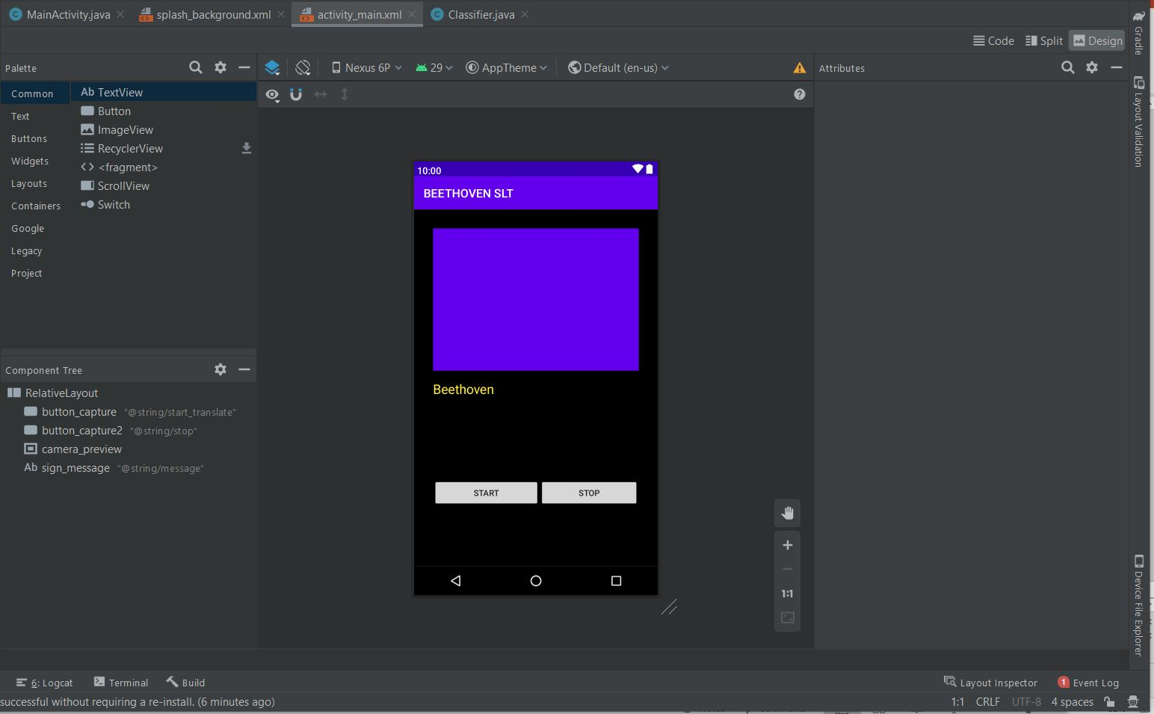
THE USER INTERFACE
The UI is built using Android Studio in Java.

Slide 29

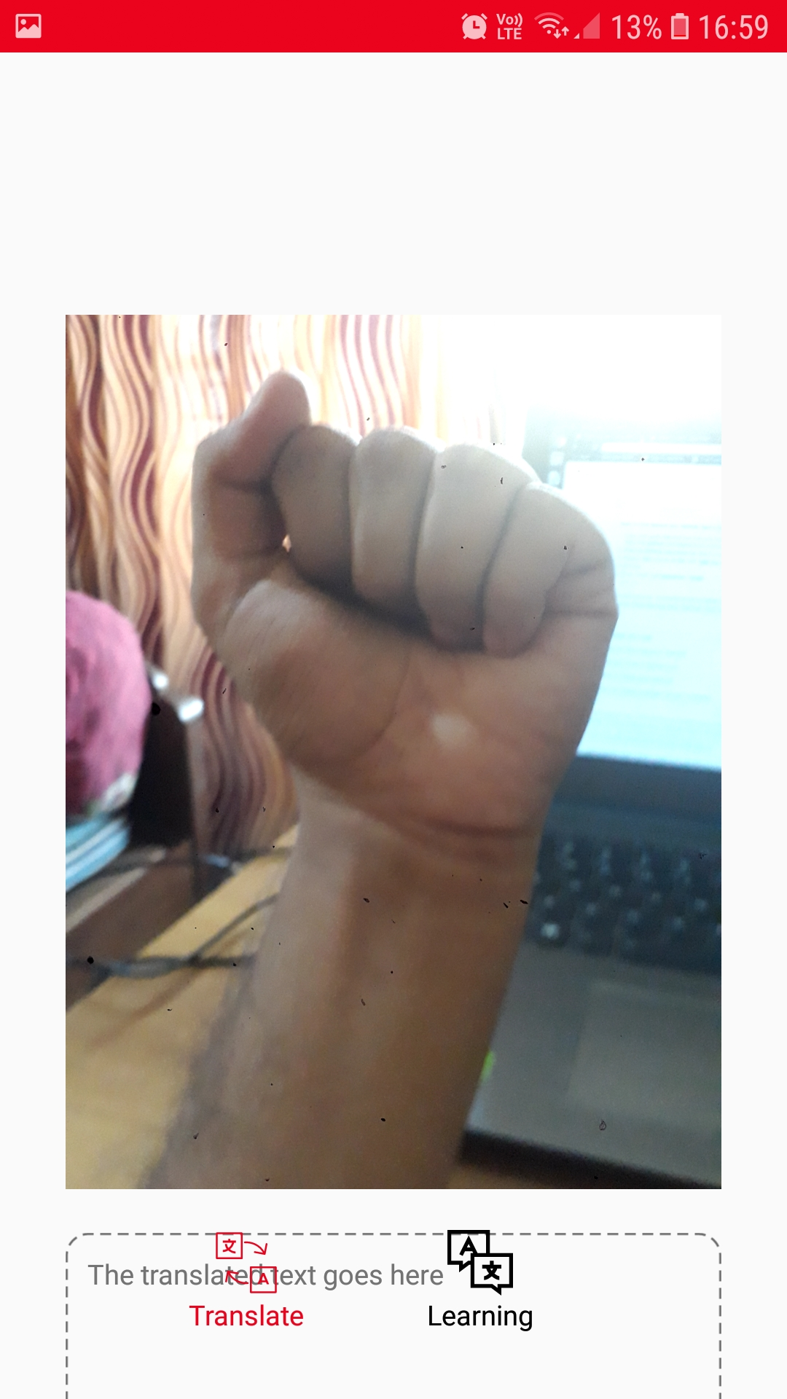
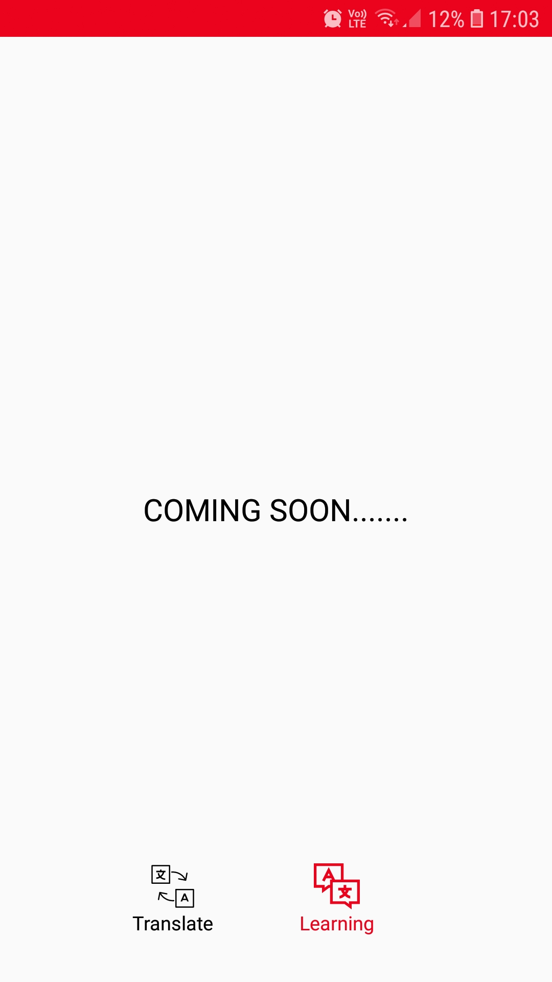
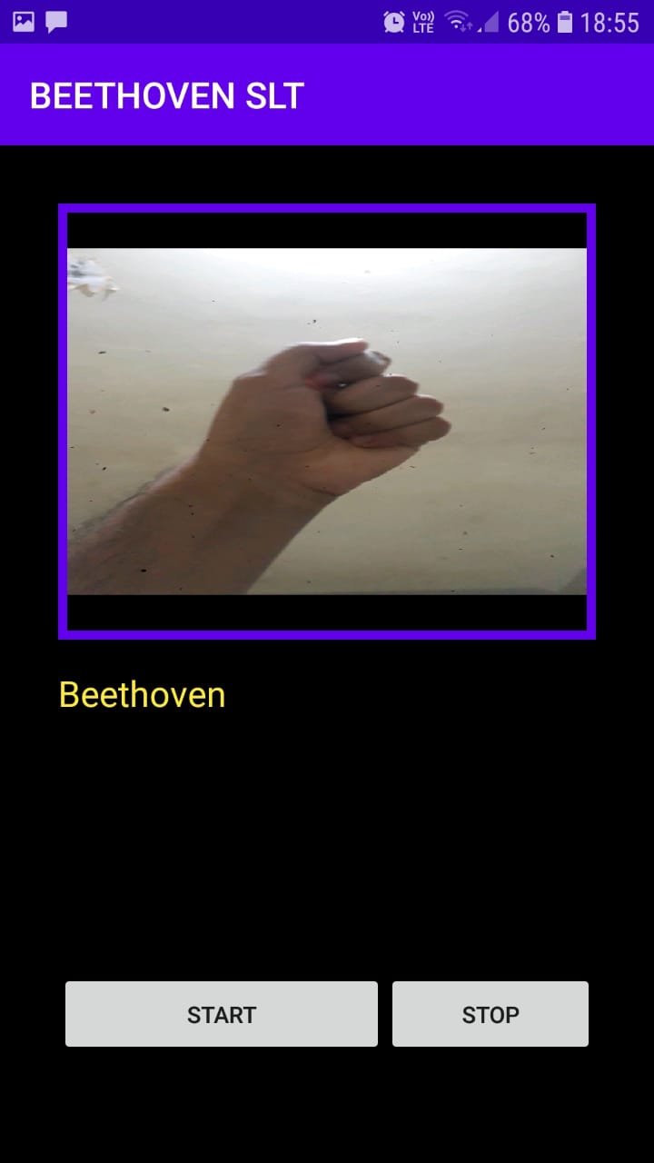
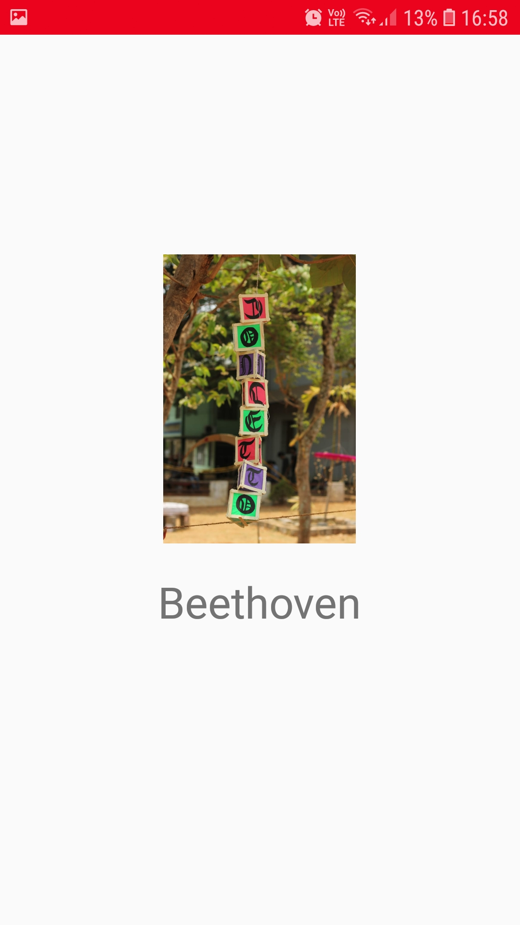
THE USER INTERFACE
Page 0 : Splash Screen
Page 1 : Translate
Page 2 : Learn

Slide 30
CONCLUSION
Machine learning based real time sign language translation system
Probabilities of each category is set using MobileNets CNN
If a sign surpasses probability of 0.8, it is identified as correct gesture
The final product built till now includes an android application that can translate sign language to English text.

Slide 31
FUTURE SCOPE
Sentence level sign language with non-manual feature recognition including facial expression.
Sign language learning platform that includes interactive sessions with peers
Learn through sign language like any other learning platform
Real time sign language translating api that supports video conferencingn applications like google meet, duo, zoom etc.

