Slide 1
Skill Requirements
By
Amal Ragh

Slide 2
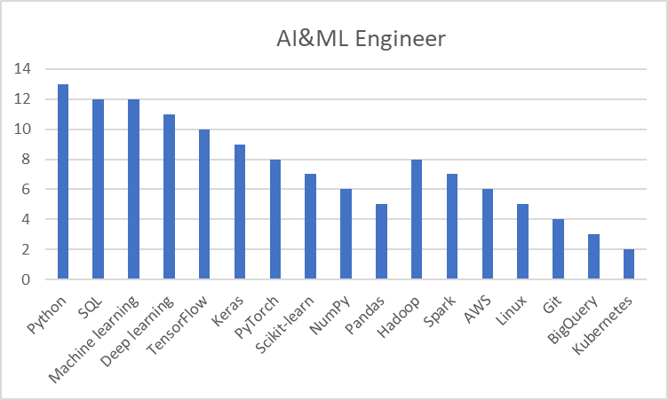

Slide 3
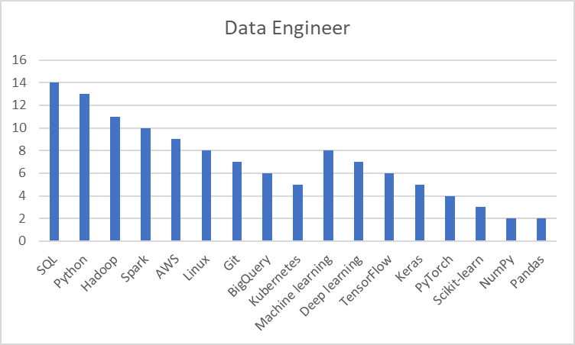

Slide 4
