Slide 1
Luxury Housing Sales Analysis

Slide 2
Problem Statement
Build a complete real estate analytics solution.
Steps to be followed:
Data cleaning and preprocessing using Python.
Load refined dataset into SQL database.
Connect SQL to Power BI for visualization.
Goal : Real-world enterprise-level pipeline for decision-making.

Slide 3
Introduction
Data Source: Housing dataset
Python:
Handle missing values and finding duplicates, outliers
Feature engineering (amenity score, buyer sentiment)
SQL Database:
Structured storage, scalable queries
Power BI:
Dashboards for sales, pricing ,buyer analysis
Interactive visualization

Slide 4
Technical Architecture
Python Layer
→ Data Cleaning and Preprocessing
SQL Layer
→ Connection & Storage
Power BI Layer
→ Visualization & Report Generation.
Flow:
Data set → ETL → SQL → Power BI → Insights

Slide 5
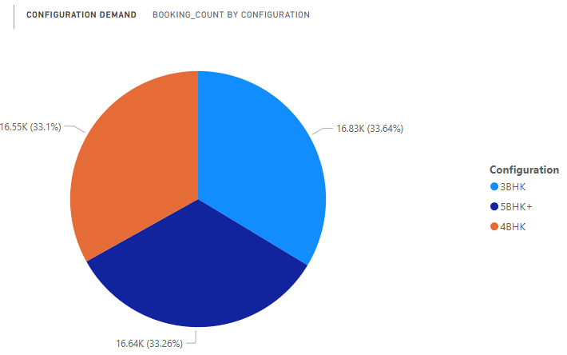
Configuration Demand

Slide 6
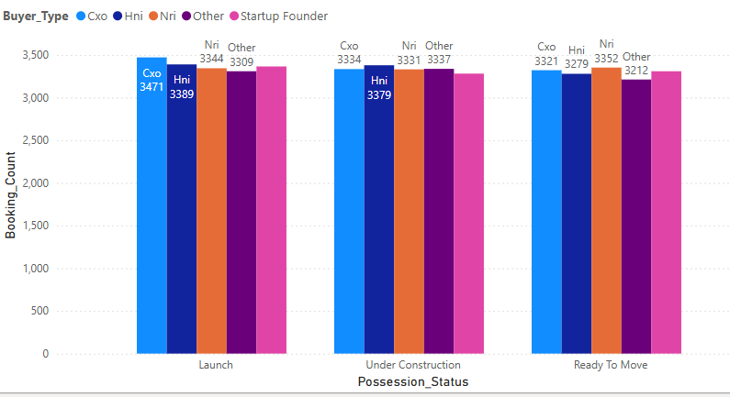
Possession Status Analysis

Slide 7
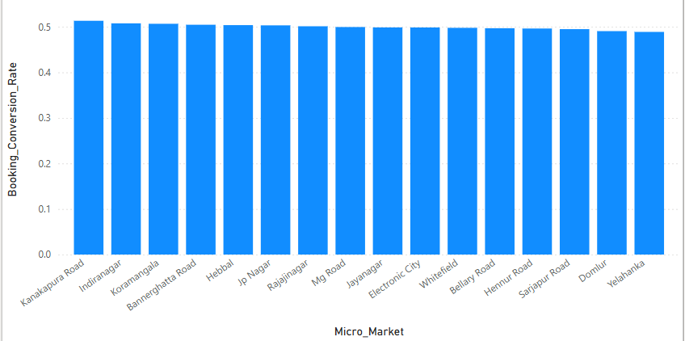
Booking Conversion

Slide 8
RESULTS
Faster and accurate market intelligence
Better sales funnel optimization
Data-driven pricing strategies
Enhanced buyer understanding
Strategic investment decisions with quarterly tracking

Slide 9
Conclusion
End-to-end analytics pipeline provides scalable and real-world solution.
Helps real estate firms gain competitive advantage.
Enables data-driven decision-making in luxury housing sector.

Slide 10
Thank you

