Slide 1


Department of Artificial Intelligence and Data Science
PREDICTING E-SIGNING LIKELIHOOD
Dr.P.Indira Priya,Prof
Akshayaa S (231801007) Amala Encilin T (231801009) AI&DS-’A’

Slide 2
Problem Statement
Efficient loan processing relies on applicants completing the E-Signing step. This project aims to predict the likelihood of E-Signing based on financial history, interaction patterns, and loan details. Accurate predictions will help financial institutions improve follow-up, increase loan conversion rates, and enhance customer experience.

Slide 3
Objectives
The aim is to build a predictive model to assess the likelihood of applicant completing the E-signing step based on the historical data, including the financial history, interaction patterns and the loan details.
Analyse the factors which are most significantly impact the probability of the E-signing step such as financial metrics, customer interaction behaviors, or loan characteristics.
Leverage prediction insights to enable proactive, targeted follow-up with applicants less likely to E-Sign, boosting engagement and conversion rates.
By facilitating timely and personalized interactions based on E-Signing likelihood, improve the customer experience, making the loan application process smoother and more customer-centric.

Slide 4
Abstract
This project builds a predictive model to forecast electronic signature (e-signed) tendencies in financial data using machine learning.
A dataset with customer financial and personal account features is preprocessed by Handling missing values and scaling for optimal model performance.
A Random Forest Classifier is used for classification, chosen for its effectiveness in handling varied features and producing high accuracy. Data visualization through a correlation heatmap helps identify relationships between features, guiding feature selection. Continuous target values are converted to binary where needed to ensure compatibility with the classification model.
An end-to-end machine learning project for financial services, enhancing onboarding, fraud prevention, and customer engagement.

Slide 5
Introduction
Efficient loan processing relies heavily on the E-Signing step, where applicants electronically sign the loan agreement to proceed. However, many applicants abandon this step, leading to delays, lost opportunities, and inefficiencies in follow-up processes, ultimately impacting conversion rates and customer satisfaction.
This project aims to create a predictive model that forecasts the likelihood of applicants completing the E-Signing step by analyzing historical data such as financial history, interaction patterns, and loan details. The model's predictions will enable financial institutions to better target follow-up efforts, improving conversion rates and enhancing the customer experience.

Slide 6
Overview of the Project
This project focuses on leveraging historical data from loan applicants to predict the likelihood of completing the E-Signing step in the loan process by incorporate various factors.
By identifying which factors are most influential in determining E-Signing completion, the project aims to provide actionable insights for financial institutions.
With accurate predictions, institutions can proactively engage applicants who are less likely to complete the E-Signing step, reducing drop-offs and enhancing engagement strategies
This project seeks to enhance customer satisfaction by providing a personalized loan experience, streamlining processing and strengthen customer relationships.

Slide 7
Existing System
The existing systems for predicting the likelihood of E-Signing completion in loan processing typically rely on traditional methods such as rule-based systems, manual intervention, and basic data analysis, but their predictive capabilities are limited in terms of accuracy and automation.
The overview of some of the common approaches used these days are:
1. Rule-Based System: decision-making framework that uses a set of predefined rules or criteria.
2. Basic Data Analytics:Basic analytics tools are used to analyze historical data to understand applicant behavior and detect patterns related to E-Signing completion

Slide 8
Drawback of Existing System
As it works on the Rule-Based System are static and lack the ability to dynamically adapt or predict beyond predefined rules, making them less effective in accurately forecasting E-Signing completion.
The manual monitoring and follow-up is time-consuming, resource-intensive, and reactive rather than proactive, often resulting in missed opportunities to engage applicants before they abandon the process.
The Basic Data Analytics often fail to provide a robust, predictive model that can accurately forecast which applicants are likely to complete the E-Signing step.
The Basic Machine Learning Models often require large volumes of high-quality data, and without proper training or continuous refinement, they can be prone to errors or fail to capture more nuanced customer behaviors.

Slide 9
Proposed System
The proposed system aims to predict whether a loan applicant will complete E-Signing , leveraging machine learning algorithms to improve loan conversion rates, enhance customer experience, and streamline follow-ups through a real-time, user-friendly interface.
Here, we collect the Financial Data, Demographic Data, Loan Specifics, E-Signing Outcome and preprocess these data by handling missing data, encoding the categorical variables, normalization and class balancing.
Algorithm Choice: 1. Decision Trees 2.Random Forests. Training the Models:1.hyperparameter Tuning 2.Cross-Validation
Model Evaluation: Finding the 1.Accuracy 2.Precision 3.Recall 4.F1-Score 5.Confusion Matrix and thus make the evaluation.

Slide 10
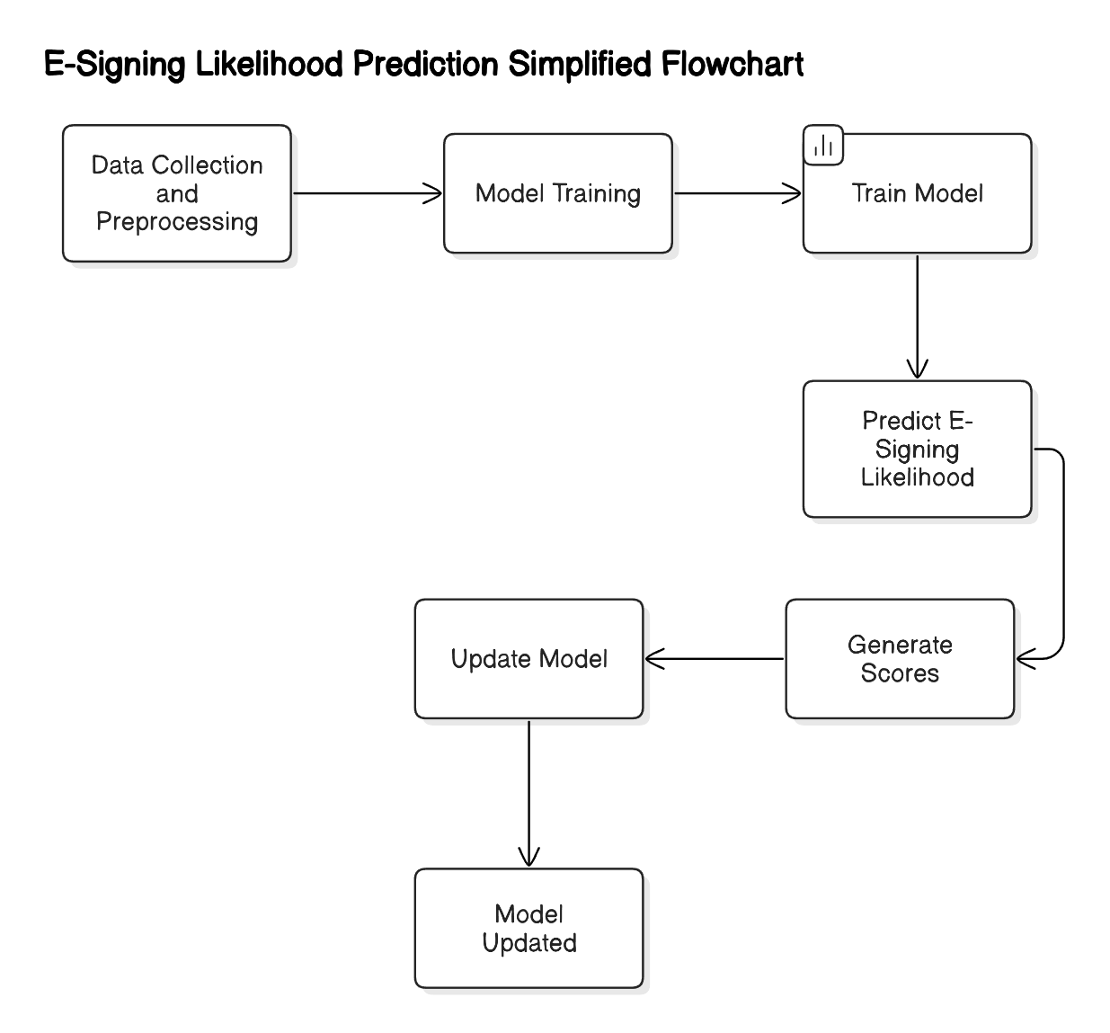
System Architecture
1. Gather and prepare data for training by cleaning and transforming it into a usable format. 2. Train a predictive model on historical data to classify applicants based on their likelihood of E-Signing. Evaluate the model using metrics like precision-recall.
3. Deploy the model and Use it for real-time or batch predictions, generating scores for each applicant's E-Signing likelihood.
4. Continuously monitor model performance and update with new data to improve accuracy, ensuring the model adapts to evolving customer behaviors.

Slide 11
Modules
This project aims to predict the likelihood of applicants completing the E-Signing step in the loan process through a series of modules. These include Data Collection and Preprocessing, Feature Engineering, Model Development and Training, Model Evaluation, Deployment and Prediction, and Monitoring and Feedback.
Each module plays a vital role in gathering, analyzing, and using data to improve loan conversion rates and enhance customer experience, creating an efficient end-to-end solution for loan processing and engagement.
There are 2 modules involved in the proposed system
1. Data Collection and Preprocessing
2. Model Development, Training and Evaluation

Slide 12
Module 1-Data Collection And Preprocessing
We collect the data through the csv file (P39-Financial-Data.csv)
We now preprocess data by 1. Removing the unnecessary columns by dropping the columns 2.Check for missing values and handle them by simply filling it with NaNs with mean. 3.Now we plot the heatmap and select the most relevant features for further processes.
Separate features(X) and target(Y).
Now, Check if the target is being continuous and binarize it if necessary .
Finally, Scale the features, ensuring that no single feature dominates the learning process

Slide 13
Module 2-Model Development, Training and Evaluation
After all the stages of preprocessing is done.
Model training : Random Forest Classifier is the algorithm used here
1. Random Forest is an ensemble learning algorithm that builds multiple decision trees during training and combines their predictions. PROGRAM:
rf_clf = RandomForestClassifier(random_state=0, n_estimators=100, criterion="entropy")
1. random_state=0: This ensures reproducibility
2. `n_estimators=100` specifies that the Random Forest will consist of 100 decision trees, which strikes a balance between model accuracy and computational efficiency.

Slide 14
Module 2-Model Development, Training and Evaluation
3. criterion="entropy": This defines the function to measure the quality of a split in each tree. helping the trees to split in the most informative way. PROGRAM:
rf_clf.fit(X_full_scaled, y_full)
This trains the Random Forest model, The model learns the relationship between the features and the target by iterating through the data and adjusting the parameters of each tree.

Slide 15
Module 2-Model Development, Training and Evaluation
Making Predictions: PROGRAM: predictions = rf_clf.predict(X_full_scaled)
After training the random Forest model ,makes predictions on the datasets . These predictions are stored in the predictions variable.
Creating the final prediction Data Frame:
Program: final_predictions = pd.DataFrame({
'entry_id': entry_ids,
'predicted_e_signed': predictions }) → The data frame that holds the predictions along with the corresponding entry IDs

Slide 16
Conclusion
By predicting applicants’ likelihood of completing the E-Signing step based on financial history, interaction patterns, and loan details, financial institutions can focus follow-up efforts on those less likely to sign, optimizing resources and increasing loan conversion rates by minimizing drop-offs during the process.
The model helps institutions identify factors behind e-signing hesitancy, enabling tailored strategies, such as providing additional support to digitally inexperienced applicants or offering incentives for specific loan types, to enhance completion rates.
Predictive insights from this model help institutions refine onboarding and engagement strategies, improving processing efficiency and customer satisfaction through personalized services that align with individual customer needs.

Slide 17
References.
Abdellatif Aattouf , Said El Kafhali1 and Youssef Saadi . Article on Predicting the e-signing likelihood of loan using machine learning models combining clustering with supervised learning.
Kaggle – dataset on E-signing of loan based on Financial History
E-SIGNING OF A LOAN BASED ON FINANCIAL HISTORY By Prof. Jyoti Patil, Amarnath , Guruprasad , Vikas R Marpalli

Slide 18
Thank You

