Slide 1

Data science laboratory (DSLAB)
Julien Eberle
Swiss Data Science Center
EPFL & ETH Zurich
Data Science Lab – Spring 2018

Slide 2
Start your engines!
Head over to the course webpage
https://dslab2018.github.io/
Configure & Run Oracle VirtualBox
Download, configure & start the DSLab VM
Ubuntu linux
Anaconda (Python 3), git, Docker, Spark / pySpark, pyCharm
{username: student, password: student}
Open a terminal
Notes:
Todays need:
- git
- docker

Slide 3
Solutions to Week #2
https://github.com/dslab2018/dslab2018.github.io#week-3---07032018---module-1---python-for-data-scientists-34
Any questions?

Slide 4

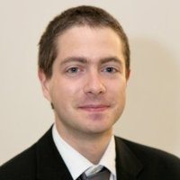
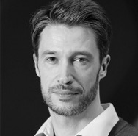
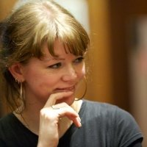
Today’s lab week #3 Git Docker Kaggle
Week 3
Week 4
Weeks 1 & 2

Slide 5
Tools for collaboration
Share code
Versioning: git (mercurial, svn,…)
Service on the cloud: gitlab (github, bitbucket,…)
Share data
As input dataset: depends on the domain (https://www.nature.com/sdata/policies/repositories)
As working dataset: git LFS (git –annex, shared drive, …)
As output dataset: Zenodo, or other that gives you a DOI
Share tasks, progress
Data science as software development: Issue tracking, Milestones, Kanban board, Todo-lists
Share results
Make the report part of your code (or use Jupyter notebooks)
Productize models, algorithms: micro-services with Docker, libraries (pipy)

Slide 6
Git
Linus Torvald, 2005
Basic commands: clone, status, add, rm, commit, pull, push
Useful commands: merge, stash, checkout, branch, diff, tag
Advanced commands: cherry-pick, rebase, log, remote, init, revert, reset
Commits represents snapshots of the state of the repository, expressed as a diff from the previous one, they form a tree (+ merges).
Gitflow: good practice for branching
.gitignore (https://www.gitignore.io/)
Notes:
Interactive tutorials for beginners : https://try.github.io
Git aliases ???
Gitflow workflow: https://www.atlassian.com/git/tutorials/comparing-workflows/gitflow-workflow
Complete git book: https://git-scm.com/book/en/v2

Slide 7
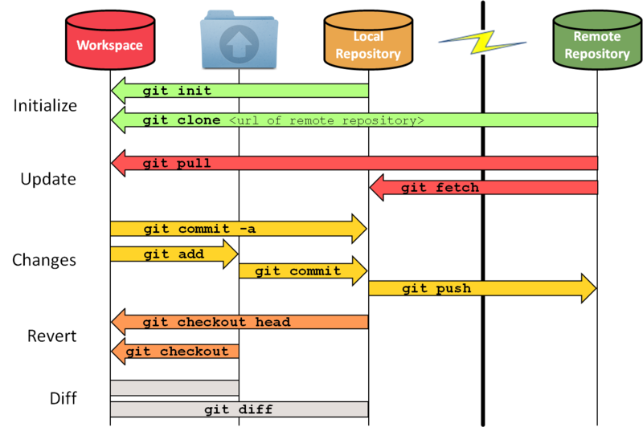
Git
Staging area
Source: https://github.com/fer/dotfiles/wiki/git

Slide 8
Git LFS
Extension for Large File Storage (alternative: git-annex )
Quick setup:
install the package
git lfs install
git lfs track “*.zip”
All files matching regexp in .gitattribute are replaced by pointer-files on remote
Tracked files are then uploaded separately to an object store during push
Pull retrieves the objects
Notes:
https://git-lfs.github.com/

Slide 9
Containerization
Why:
resource isolation
lightweight
portable
extendable
scalable
enabling reproducibility (self contained)

Slide 10
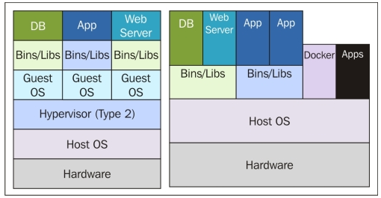
Virtualization
Layer abstracting the hardware resources
Can sit on top of an OS (Virtualbox, VMWare, Qemu)...
… or on a thin hypervisor layer (vSphere, Xen, Hyper-V)
Virtual machines are running their own OS and kernel
Source: https://jaxenter.com/containerization-vs-virtualization-docker-introduction-120562.html

Slide 11
Containerization
Share host OS resources and kernel
chroot, BSD Jails, LXC, Docker
Isolates:
processes
network
file-system
memory/CPU availability
Communication with the outside world:
mounting volumes
network services
stdin/stdout

Slide 12
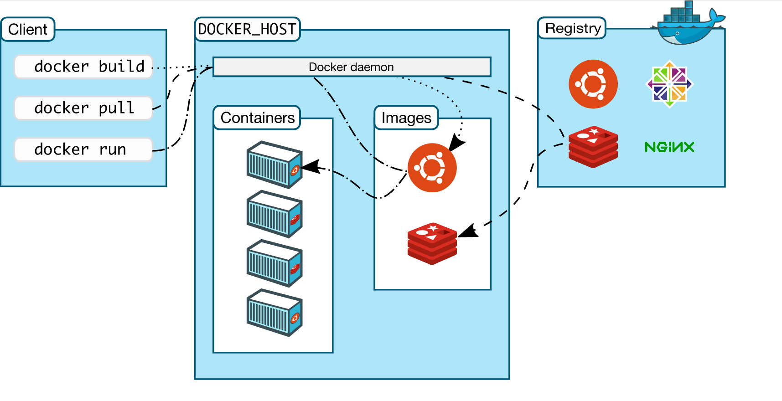
Docker
Source: https://docs.docker.com/engine/docker-overview/#docker-architecture

Slide 13
Docker
Source: https://docs.docker.com/engine/docker-overview/#docker-architecture

Slide 14
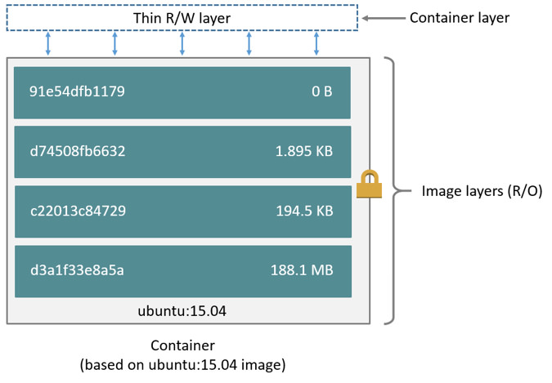
Union file system
aufs, overlayfs, overlay2, btrfs
layered filesystems that are merged
some can be read-only (e.g. cd-rom)

Slide 15
Dockerfile
FROM debian:stable
Base image, have a look at https://hub.docker.com/explore/
USER root
Set the user for the following commands
RUN apt-get update && apt-get install -y --force-yes apache2
Run arbitrary shell commands, each line add a overlay layer!
EXPOSE 80 443
Defines the network ports that will be exposed
COPY website.conf /etc/apache2/site-enabled/
Put a copy of a local file into the docker image, it also add a new layer.
VOLUME ["/var/www", "/var/log/apache2"]
Specifies mountpoint for external volumes
ENTRYPOINT ["/usr/sbin/apache2ctl", "-D", "FOREGROUND"]
The command that is run when container starts
Notes:
https://docs.docker.com/develop/develop-images/dockerfile_best-practices/

Slide 16
Docker image vs. Docker container
Docker image:
a stack of read-only layers
packaged and tagged (downloadable from a registry)
docker pull / docker build
docker images
Docker container
instance of a docker image with a writable layer (volume)
has an id and a name
docker run / docker create
docker ps -a

Slide 17
Managing containers
docker run / docker attach / docker exec -ti
for attaching stdin/stdout to a new/runnning container
docker start / docker stop
for starting/stopping existing containers
docker kill / docker rm
for force-quit and cleanup the volume

Slide 18
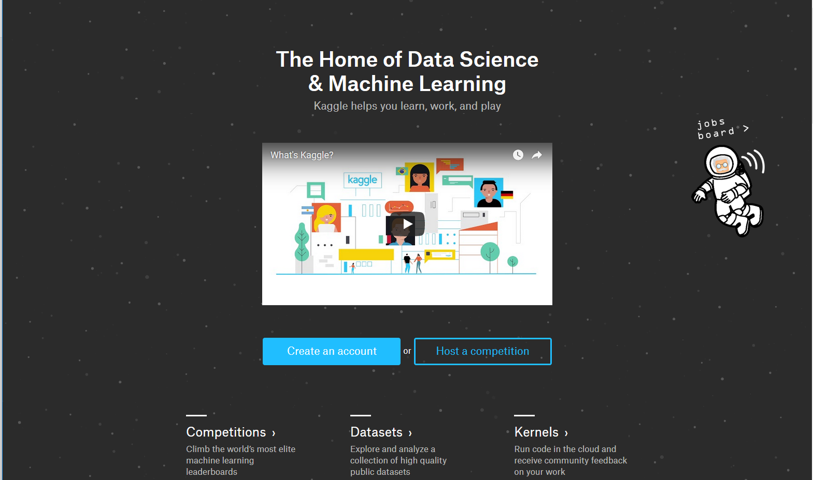
Kaggle
Notes:
https://www.kaggle.com/

Slide 19
This week’s exercises
Get the DSLab Week 3 exercise instructions
Register on https://git-dslab.epfl.ch with your epfl e-mail

