Slide 1

MINI PROJECT
KioMeet
A Secure Video Conferencing & Technical Interview Platform
Aman Verma — 23BCS012
Amrit Kashyap — 23BCS014
Ankit Kashyap — 23BCS017
Mini Project · B.Tech CSE · Mid-Semester Evaluation
B.Tech, Computer Science & Engineering — Shri Mata Vaishno Devi University, Katra

Slide 2
Project at a Glance
▪ Mini Project — B.Tech CSE, mid-semester evaluation, team of 3.
▪ Team: Aman Verma, Amrit Kashyap, Ankit Kashyap.
▪ KioMeet in one line: a secure video-conferencing and technical-interview platform.
▪ Project phases: Requirement Analysis → Design → Implementation → Testing → Demo.
23BCS012 · 23BCS014 · 23BCS017 · KioMeet Mini Project
2

Slide 3
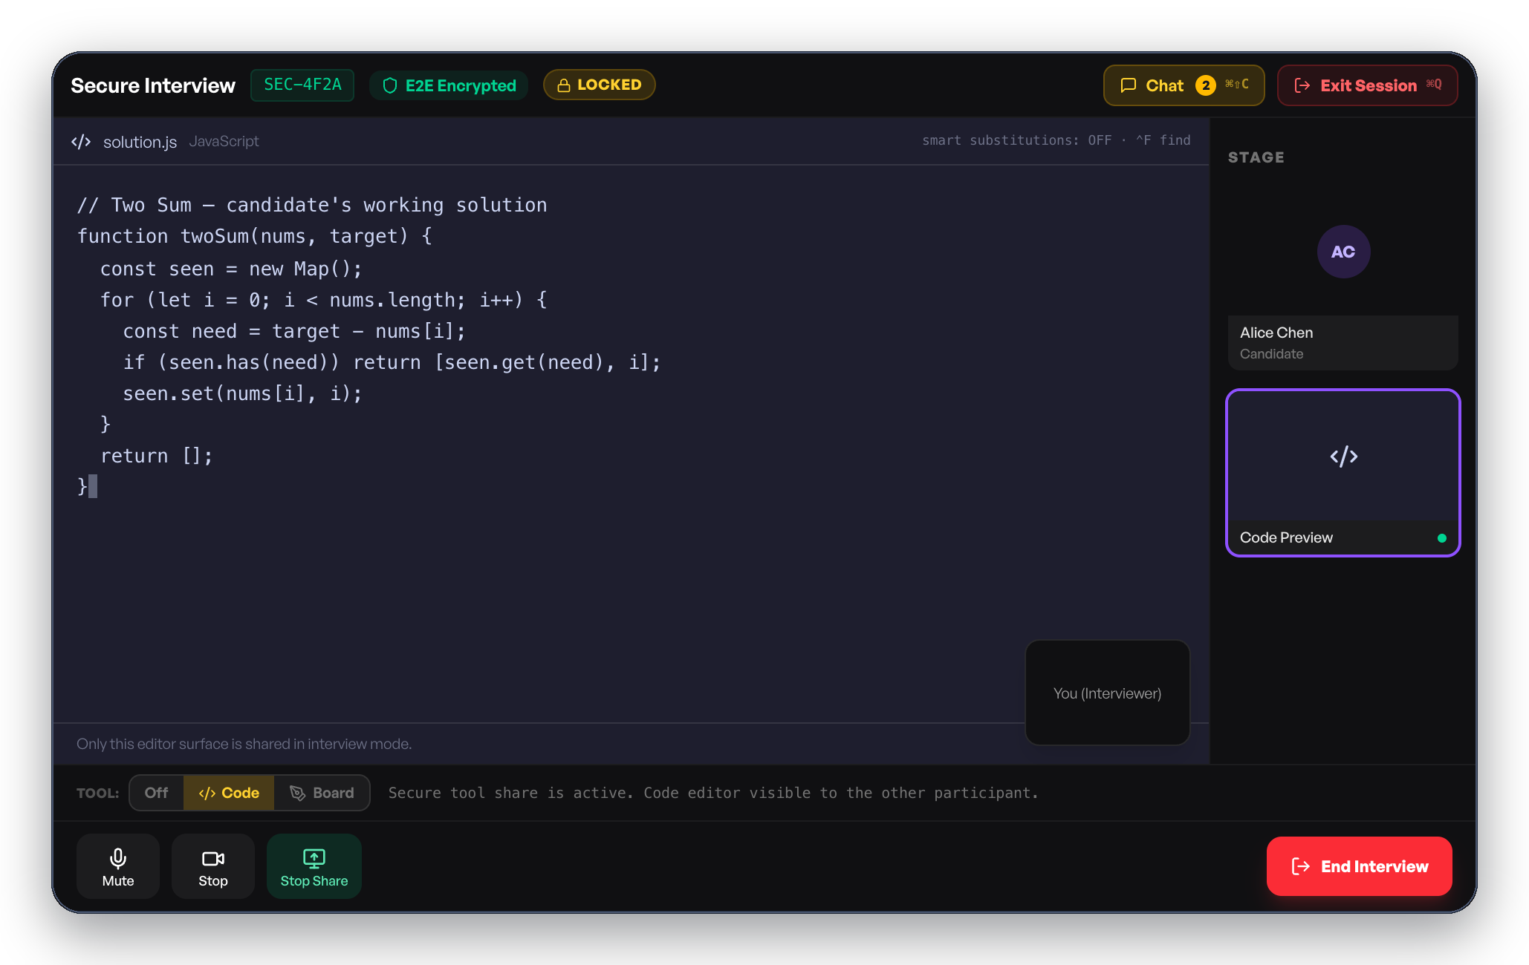
KioMeet — The Project & the Problem
▪ A desktop video-calling app for team meetings and technical interviews (Windows & Mac).
▪ Problem: in a normal screen-share, private windows on the interviewer's screen can accidentally leak to the candidate.
▪ Goal: make sure the candidate only ever sees the one window the interviewer chooses to share — nothing else.
▪ Also in scope: reliable calls, recording, scheduling, and subscription-based features.
Secure interview mode — the candidate sees only the shared code editor, nothing else.
23BCS012 · 23BCS014 · 23BCS017 · KioMeet Mini Project
3

Slide 4
How the System Fits Together
▪ The app has four building blocks:
– The app itself — handles camera, mic, and screen on your computer.
– The video engine — carries live audio/video between participants.
– The server (our area) — logins, meeting links, recordings, subscriptions.
– The databases — store accounts permanently; store live meeting info temporarily.
▪ Our project focuses on the server.
Desktop App
What the user sees and uses
Video Engine
Carries the live call
Server
Our focus — secure sessions, live updates, meetings
Databases
Account data + live meeting data
23BCS012 · 23BCS014 · 23BCS017 · KioMeet Mini Project
4

Slide 5
Team Contributions
Aman Verma — Core Development
– Secure Interview Mode — backend logic that locks a session to one shared window.
– Live Chat, Polls & Q&A — the real-time updates participants see during a call.
– Login & scheduling groundwork.
Amrit Kashyap — Testing & Quality Assurance
– Tested that Secure Interview Mode actually blocks a second shared window once a session is locked.
– Tested that chat messages, poll votes, and Q&A questions reach every participant instantly, with no refresh needed.
– Logged and reported issues found during testing.
Ankit Kashyap — Documentation & Demo Coordination
– Documented how meeting scheduling and team management work, for the project report.
– Prepared the demo environment — test accounts, starting the server — before presentations.
– Reviewed the app's screens for clarity.
23BCS012 · 23BCS014 · 23BCS017 · KioMeet Mini Project
5

Slide 6
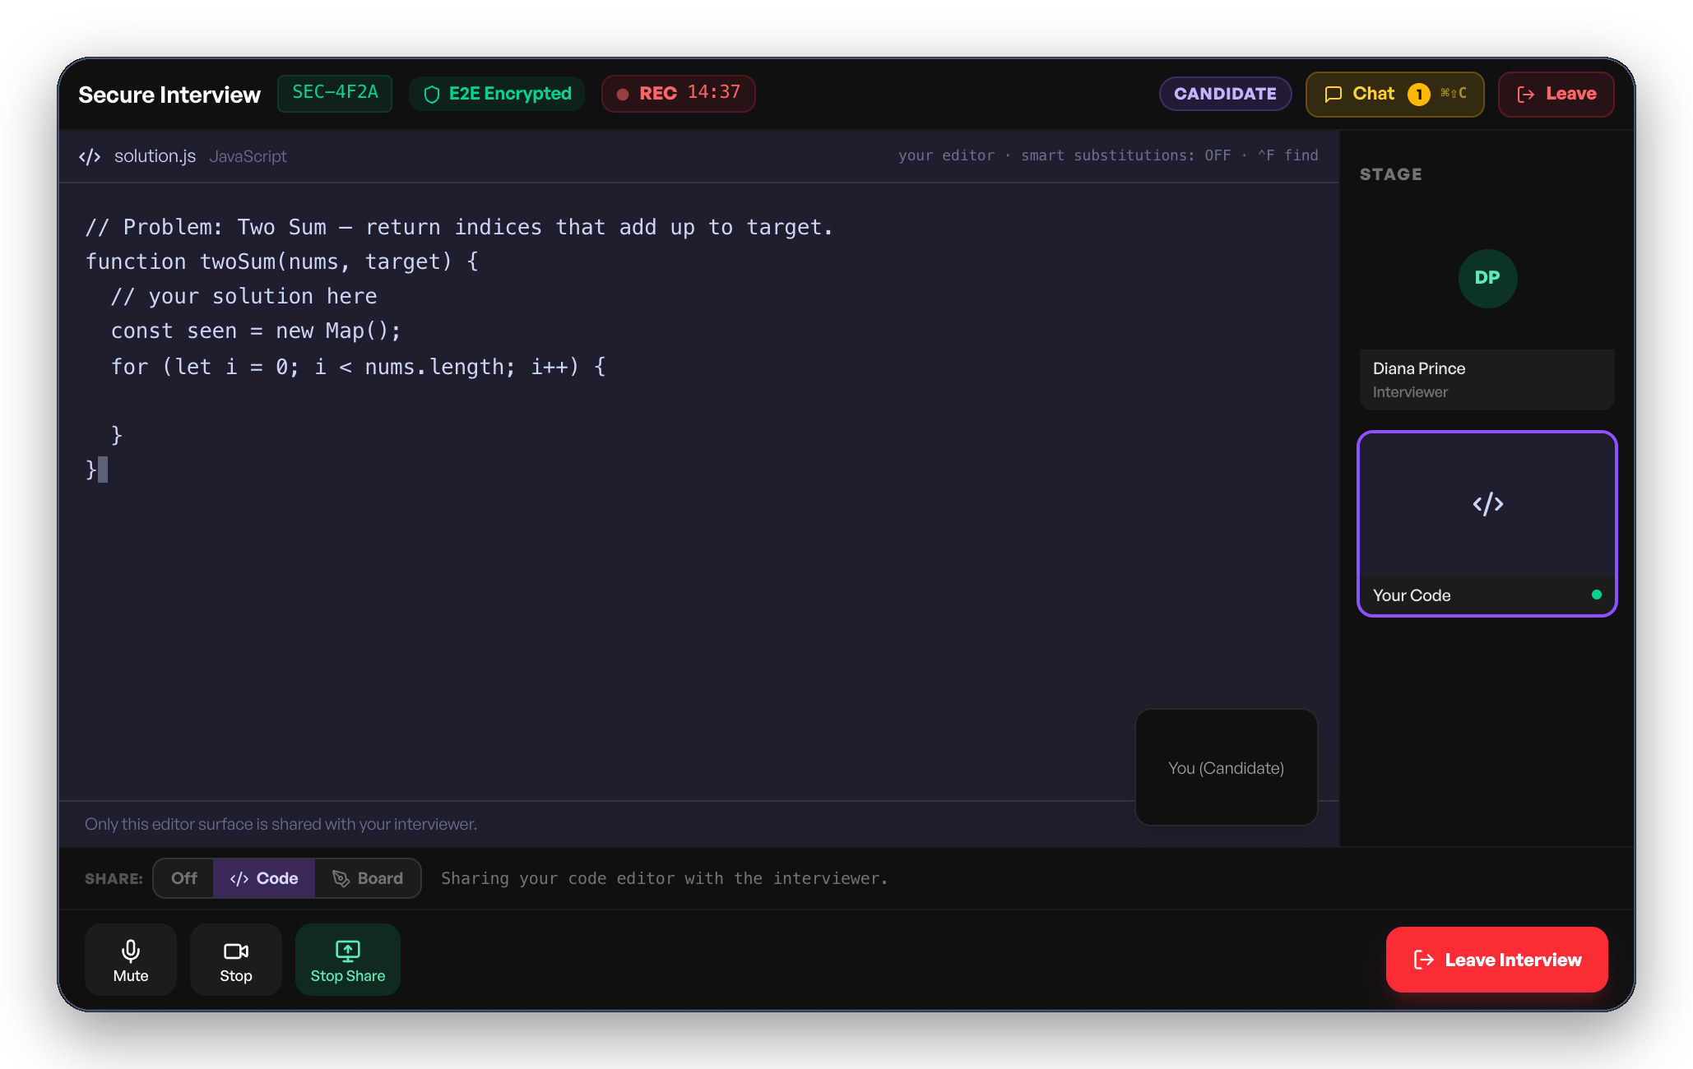
Highlight 1 — Secure Interview Mode
▪ The problem: during a normal screen-share, a candidate could accidentally see private windows on the interviewer's screen.
▪ What was built: the backend creates a locked interview session that allows exactly one shared window — nothing else can be attached to it.
▪ If anyone tries to share a second window, the backend rejects it, so the lock can't be bypassed from either side.
▪ Result: the candidate only ever sees the one code editor the interviewer picked.
Interviewer's view
Candidate's view — same shared window, nothing more
23BCS012 · 23BCS014 · 23BCS017 · KioMeet Mini Project
6

Slide 7
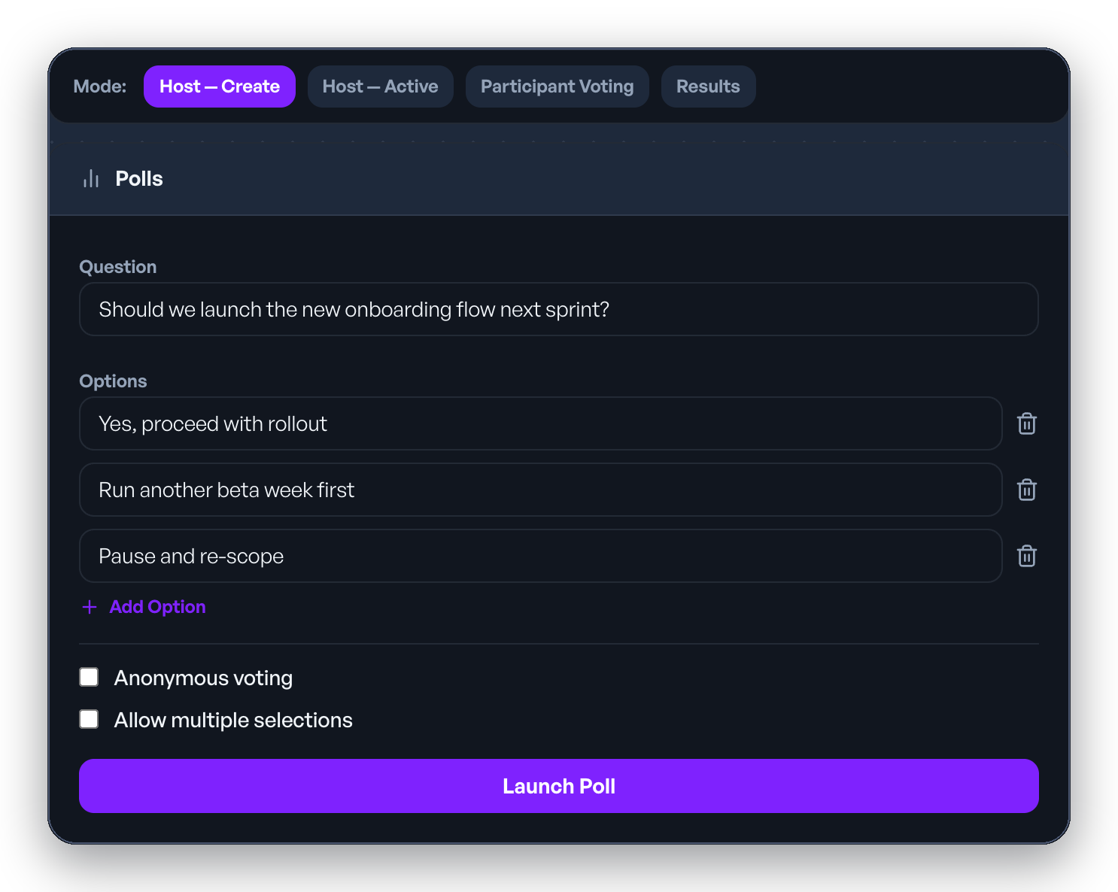
Highlight 2 — Live Chat, Polls & Q&A
▪ During a call, the host can launch a poll or open the Q&A board at any time.
▪ A real-time connection instantly pushes these updates to every participant — no refreshing, no delay.
▪ A chat message, a new poll, or a vote all travel the same way: sent once, delivered to everyone in that meeting immediately.
▪ This keeps everyone in a meeting looking at the same screen at the same time.
Launching a live poll — results update instantly for every participant.
23BCS012 · 23BCS014 · 23BCS017 · KioMeet Mini Project
7

Slide 8
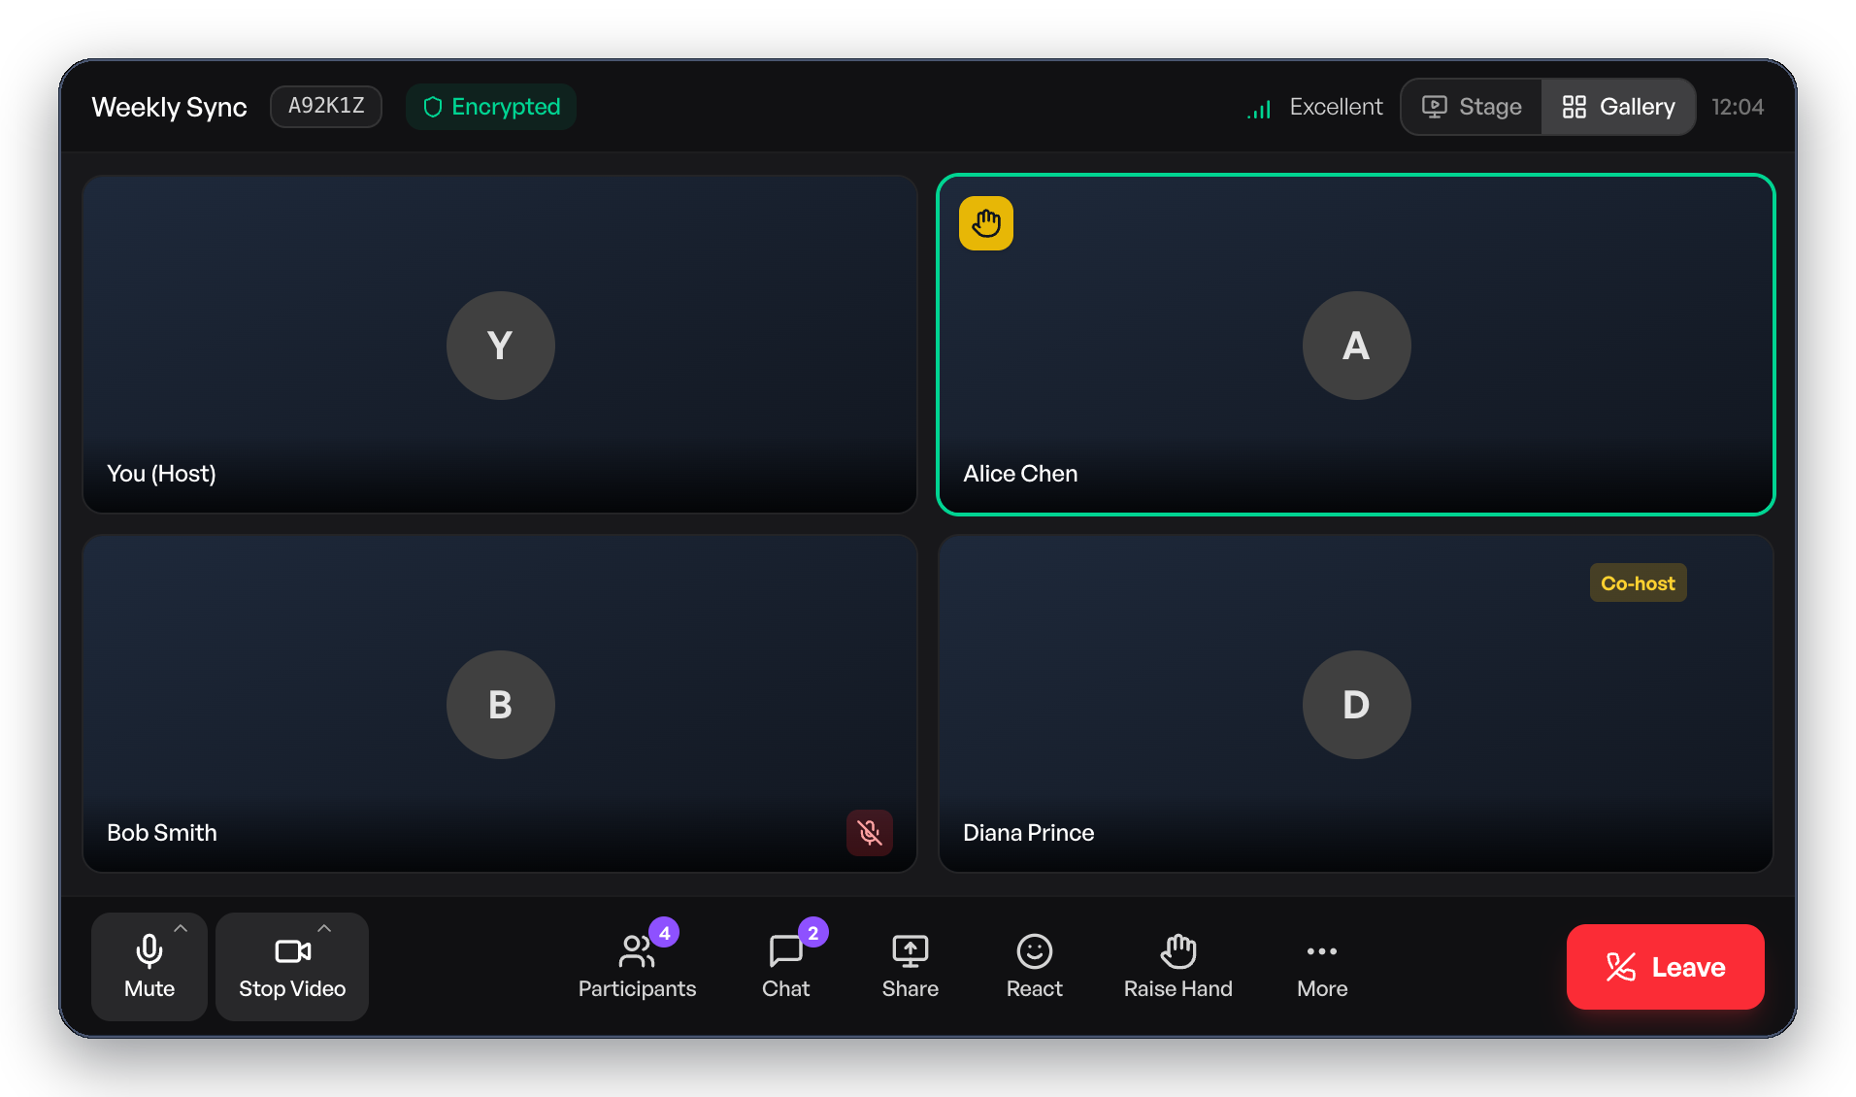
Testing & Results
▪ Testing led by Amrit Kashyap:
▪ Secure Interview Mode: tested that a second shared window is always rejected once a session is locked — no exceptions.
▪ Live Chat/Polls/Q&A: tested that every participant in a room receives updates at the same time, with nothing missed.
▪ End-to-end flow tested: register → log in → create a meeting → join it.
▪ All test results were reviewed by the team ahead of the final demo.
A live call — the end-to-end flow this testing covers.
23BCS012 · 23BCS014 · 23BCS017 · KioMeet Mini Project
8

Slide 9
Conclusion & Future Scope
▪ This mini project gave our team hands-on experience across development, testing, and documentation — building, verifying, and presenting a complete feature end-to-end.
▪ What's next for the project:
– support more cloud storage options for recordings;
– tighten data access rules for extra security;
– add more automated tests that mimic real user behaviour.
Thank you. Questions & discussion welcome.
23BCS012 · 23BCS014 · 23BCS017 · KioMeet Mini Project
9

