Slide 1

INTERNSHIP REPORT
Full Stack Development of KioMeet
A Secure Video Conferencing & Technical Interview Platform
Aman Verma
Entry No. 23BCS012
IndiWebPros · Full Stack Development Track · 12 Jun – 7 Aug 2026
B.Tech, Computer Science & Engineering — Shri Mata Vaishno Devi University, Katra

Slide 2
Internship at a Glance
▪ Host: IndiWebPros — a community-driven tech startup; fully virtual internship.
▪ Supervision: a Program Management Office (PMO) with weekly evaluation sprints.
▪ Track: Full Stack Development.
▪ Duration: 8 weeks (12 June – 7 August 2026).
▪ Capstone: production backend modules for KioMeet, a live cross-platform product.
Aman Verma · 23BCS012 · KioMeet Internship
2

Slide 3
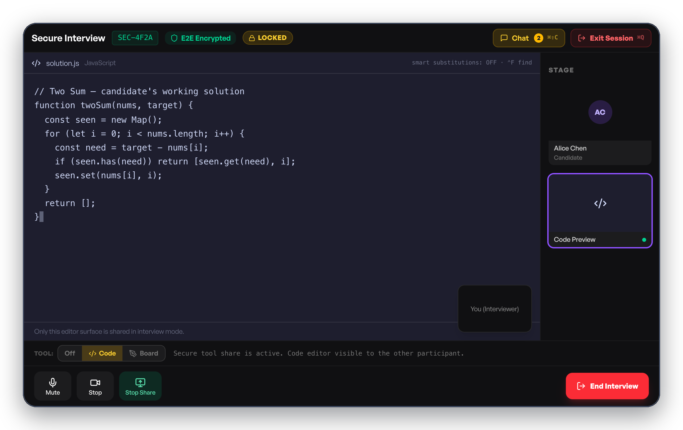
KioMeet — The Project & the Problem
▪ A desktop video-calling app for team meetings and technical interviews (Windows & Mac).
▪ Problem: in a normal screen-share, private windows on the interviewer's screen can accidentally leak to the candidate.
▪ Goal: make sure the candidate only ever sees the one window the interviewer chooses to share — nothing else.
▪ Also needed: reliable calls, recording, scheduling, and subscription-based features.
Secure interview mode — the candidate sees only the shared code editor, nothing else.
Aman Verma · 23BCS012 · KioMeet Internship
3

Slide 4
How the System Fits Together
▪ The app has four building blocks:
– The app itself — handles camera, mic, and screen on your computer.
– The video engine — carries live audio/video between participants.
– The server (my area) — logins, meeting links, recordings, subscriptions.
– The databases — store accounts permanently; store live meeting info temporarily.
▪ My internship work was entirely on the server.
Desktop App
What the user sees and uses
Video Engine
Carries the live call
Server
My focus — secure sessions, live updates, meetings
Databases
Account data + live meeting data
Aman Verma · 23BCS012 · KioMeet Internship
4

Slide 5
What I Worked On
▪ Secure Interview Mode — the backend logic that locks a session to one shared window.
▪ Live Chat, Polls & Q&A — the real-time updates participants see during a call.
▪ Meeting scheduling — creating meetings and sending calendar invites.
▪ Teams — adding members and assigning roles.
▪ Logins & subscription plans — behind the scenes, so features unlock correctly.
Secure Interview Mode — my first highlight, covered next.
Aman Verma · 23BCS012 · KioMeet Internship
5

Slide 6
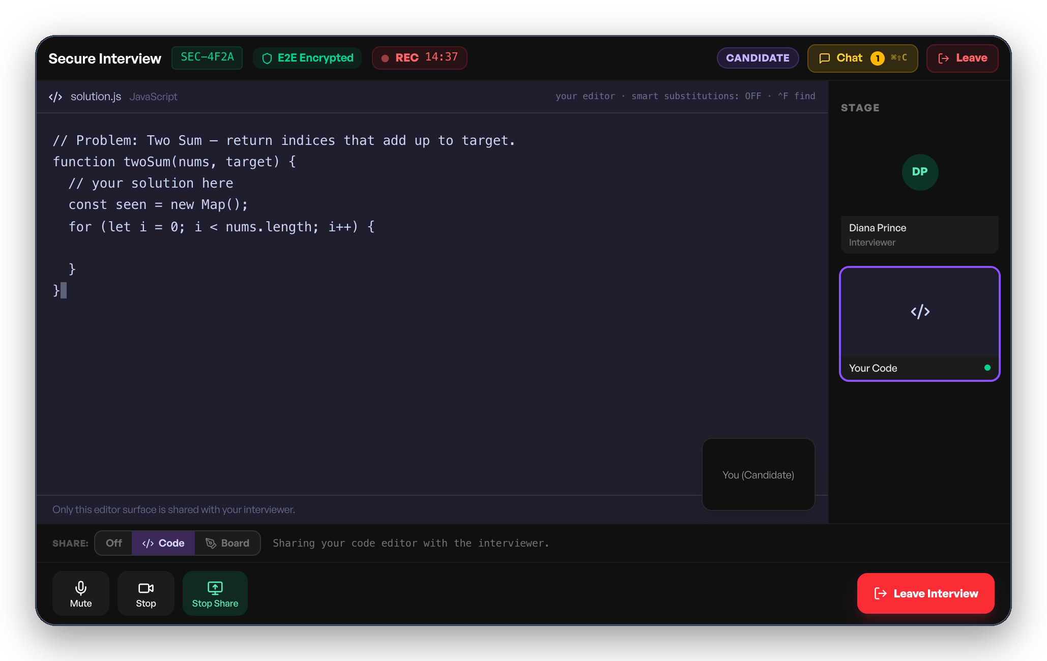
Highlight 1 — Secure Interview Mode
▪ The problem: during a normal screen-share, a candidate could accidentally see private windows on the interviewer's screen.
▪ What I built: the backend creates a locked interview session that allows exactly one shared window — nothing else can be attached to it.
▪ If anyone tries to share a second window, the backend rejects it, so the lock can't be bypassed from either side.
▪ Result: the candidate only ever sees the one code editor the interviewer picked.
Interviewer's view
Candidate's view — same shared window, nothing more
Aman Verma · 23BCS012 · KioMeet Internship
6

Slide 7
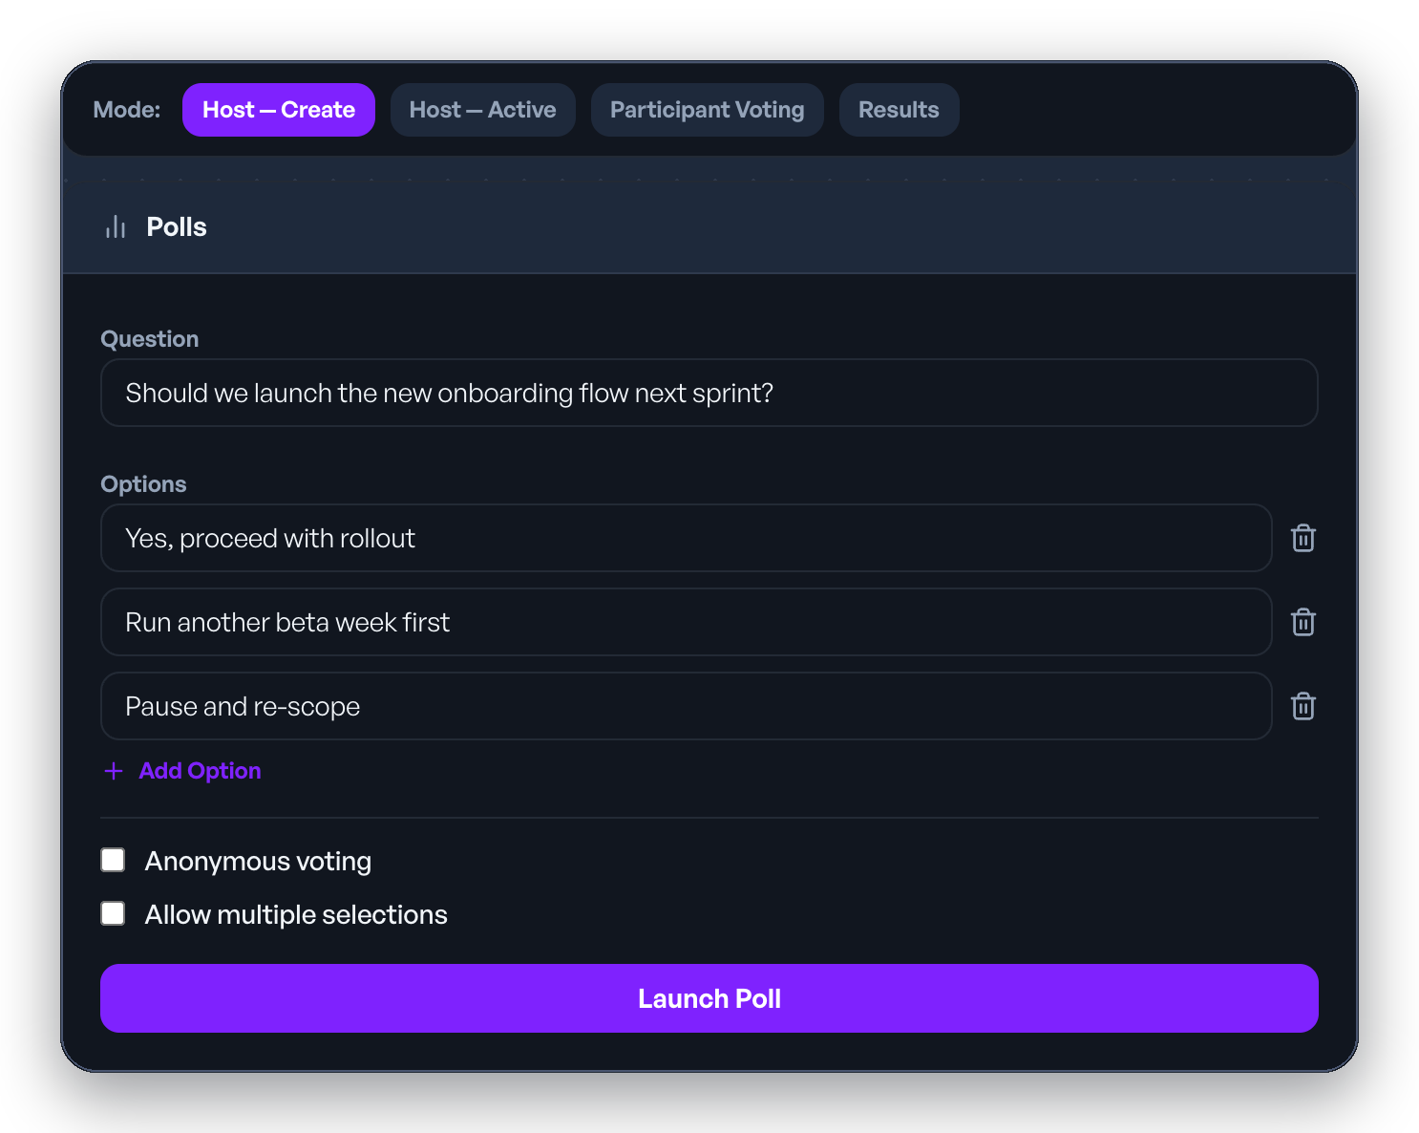
Highlight 2 — Live Chat, Polls & Q&A
▪ During a call, the host can launch a poll or open the Q&A board at any time.
▪ I built the real-time connection that instantly pushes these updates to every participant — no refreshing, no delay.
▪ A chat message, a new poll, or a vote all travel the same way: sent once, delivered to everyone in that meeting immediately.
▪ This keeps everyone in a meeting looking at the same screen at the same time.
Launching a live poll — results update instantly for every participant.
Aman Verma · 23BCS012 · KioMeet Internship
7

Slide 8
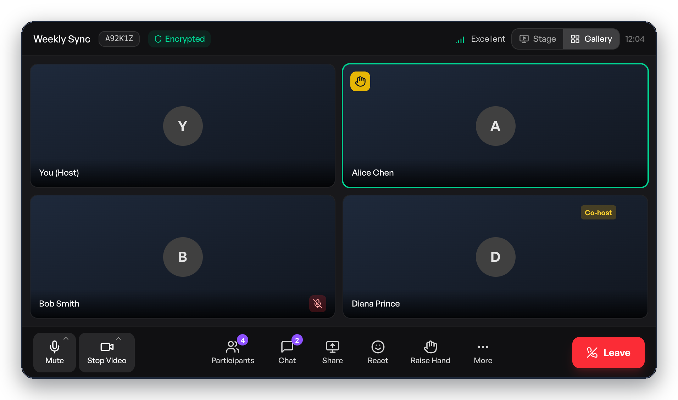
Testing & Results
▪ Secure Interview Mode: tested that a second shared window is always rejected once a session is locked — no exceptions.
▪ Live Chat/Polls/Q&A: tested that every participant in a room receives updates at the same time, with nothing missed.
▪ End-to-end tests run the full real flow: register → log in → create a meeting → join it.
▪ All work was reviewed and approved by the company's engineers before being merged.
A live call — the end-to-end flow this testing covers.
Aman Verma · 23BCS012 · KioMeet Internship
8

Slide 9
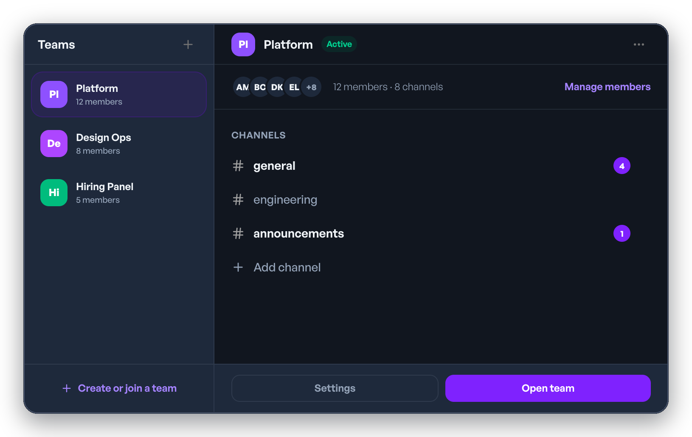
What I Achieved & Learned
▪ Delivered working, tested features that are part of the real product — not a toy exercise.
▪ 8-week journey: onboarding → scheduling → secure interview mode → live chat/polls/Q&A → teams → final demo.
▪ Skills gained:
– Building real-time features that update everyone instantly.
– Designing a security feature that can't be bypassed from the client side.
– Working in a team: code reviews, feedback, deadlines.
Team management — adding members and assigning roles, a feature I built.
Aman Verma · 23BCS012 · KioMeet Internship
9

Slide 10
Conclusion & Future Scope
▪ This internship gave me real, supervised experience building a complete feature from scratch — not just following a tutorial.
▪ What's next for the product:
– support more cloud storage options for recordings;
– tighten data access rules for extra security;
– add more automated tests that mimic real user behaviour.
Thank you. Questions & discussion welcome.
Aman Verma · 23BCS012 · KioMeet Internship
10

