Slide 1

Industrial Training Report
By Aman Chopra
140911358
I&CT Department.

Slide 2
Acknowledgements.
Humble, software development as it should be.
Miss. Jyoti Puri.
Information and Communication Technology Department, MIT, Manipal.

Slide 3
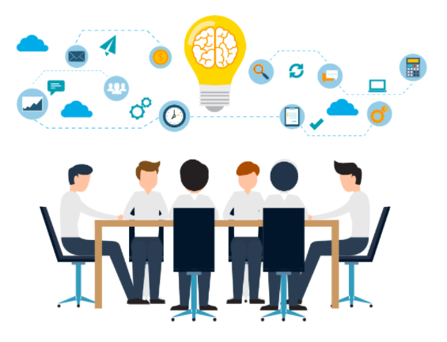
HUMBLE
Humble is a team of talented software developers. We believe in not only building high quality softwares, but solutions that help businesses and delivers value to our customers.
It is said highest comes to humblest. At humble excellence in work and humbleness in attitude is way for us to grow individually and as team.

Slide 4
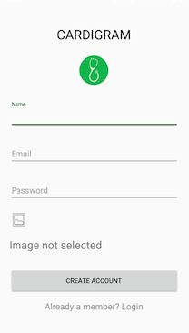
Android application to store and analyze medical data.
Patients personalized medical database.
Real time chat interface.
Book appointments with doctors.
Visual analysis of textual reports.

Slide 5
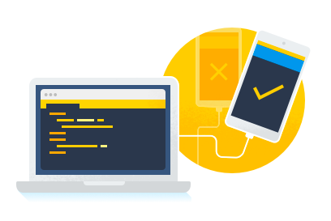
Android Frameworks and Libraries Used
Material Design.
Firebase.
MP Android Charts.
Glide and Picasso.

Slide 6
Material Design
Unified system.
Modular and customizable UI Components.
Simplified Design Workflow.
Layouts, icons, colour tools.

Slide 7
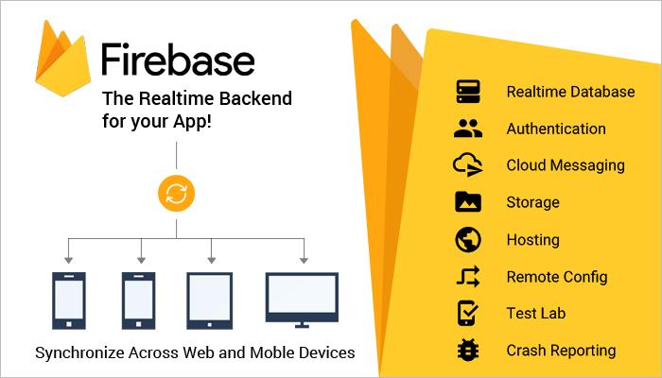
Firebase
Firebase Authentication.
Firebase Real Time Database.
Firebase Storage.
Firebase analytics.

Slide 8
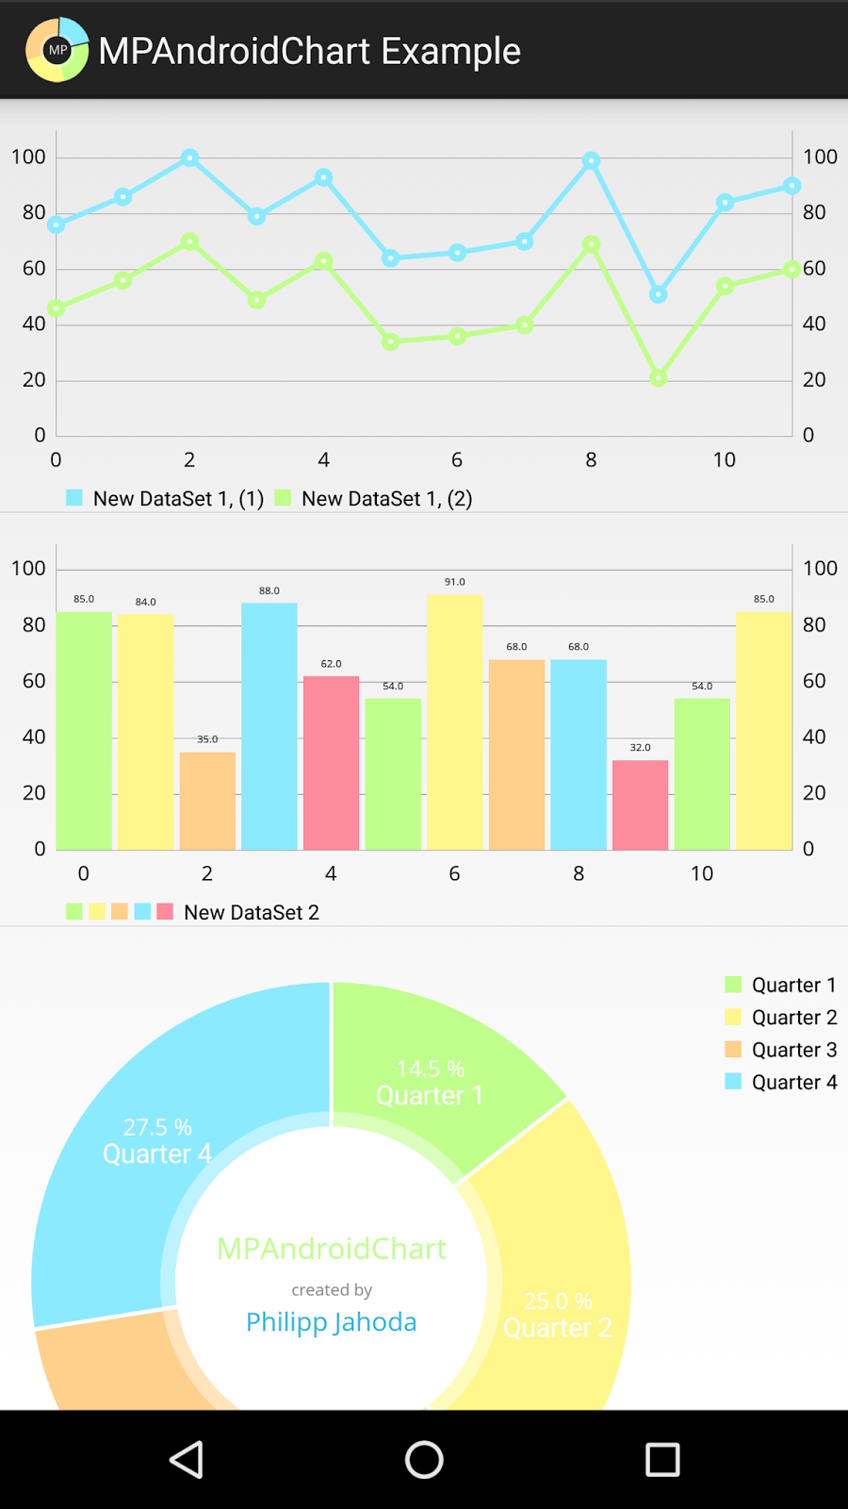
MP Android Charts
Powerful chart library.
Allows cross platform development.
API level 8 and upwards.
Animations with 8 different chart types.

Slide 9
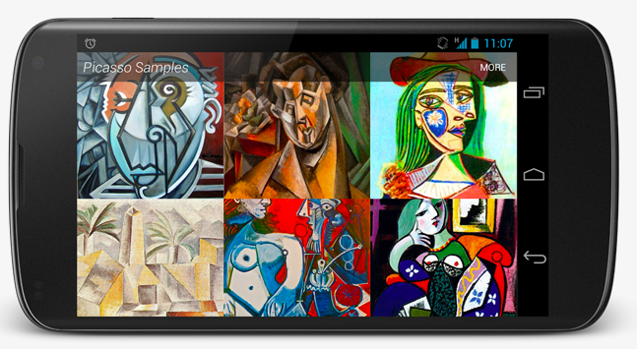
Glide and Picasso
Easy image loading.
Less code is required.
Easy image caching.
Supports fetching, decoding and displaying images.

Slide 10
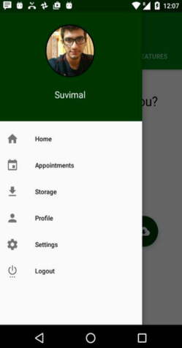
Functionalities of Application
Chats.
Book an appointment.
Save reports.
Generate charts.

Slide 11
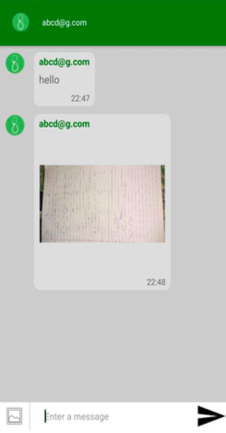
Chats
Group chat functionality.
Fast Image Upload using bitmap compression.
Uses Firebase Real Time Database.

Slide 12
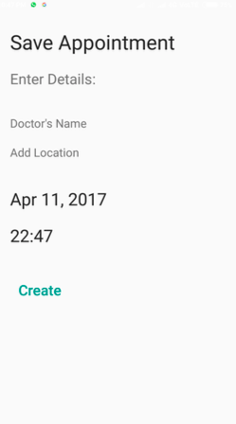
Book an Appointment
Select Doctor, date and time.
Select place using Google Map API.
Appointments are saved in Appointments tab.

Slide 13
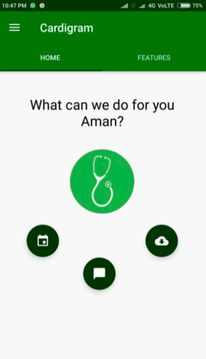
Save reports
Reports and prescriptions can be saved as image files.
Uses glide and picasso for fast rendering.
Uses Firebase Storage to save images.

Slide 14
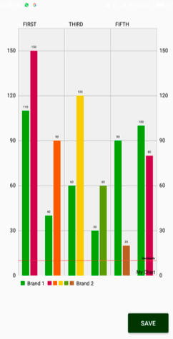
Charts
Animated charts for visual analytics
Uses MP Android chart Library.
Charts can be saved to gallery.

Slide 15
Conclusion
A great learning experience.
Android app development knowledge improved drastically.
Learned importance of collaborating and consensus.
A taste of corporate world.

Slide 16

Thank You

